Slide 1
Fabric Interfaces Architecture – v4
Sean Hefty - Intel Corporation

Slide 2
Overview
Do we have the right type of objects defines?
Do we have the correct object relationships?
Is functionality missing?
Are interfaces associated with the right object?
Do the semantics match well with the apps?
What semantics are missing?

Slide 3
High-Level Architecture
Interfaces
Endpoint
Active
Passive
Event
Queues
Counters
Address Service
Maps
Tables
Domain
Memory Descriptors
Fabric
(Virtual) NIC
Receive
Groups
Topology
Based on object-oriented programming concepts
Derived objects define interfaces

Slide 4
Fabric Object Model
Software objects usable across multiple HW providers
Fabric Interfaces
Boundary of resource sharing
Fabric
Event Queue
Passive Endpoint
Domain
Domain
Event Queue
Endpoint
Event Queue
Endpoint
Event Counter
Address Service
Event Counter
Address Service
Provider abstracts multiple NICs
NIC
NIC
NIC
Physical Fabric

Slide 5
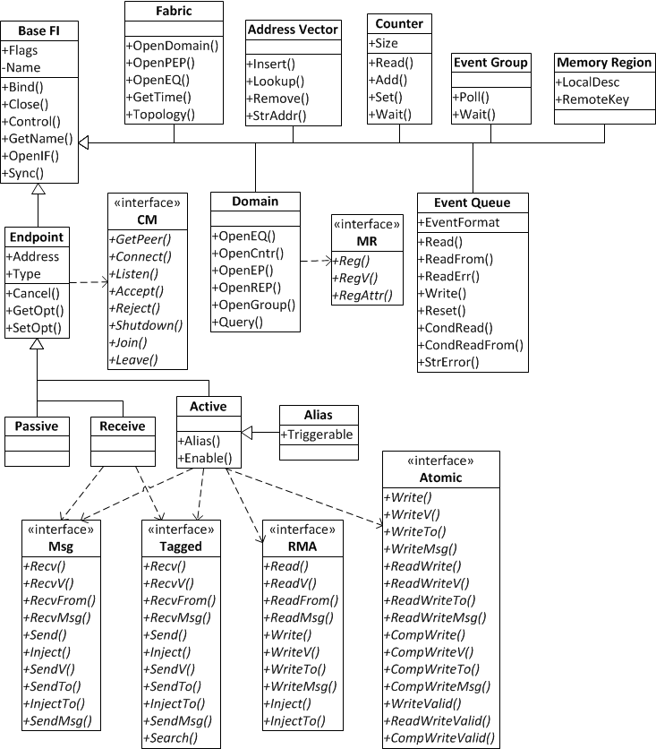
Object / Interface Model
Enlarged on following slides

Slide 6
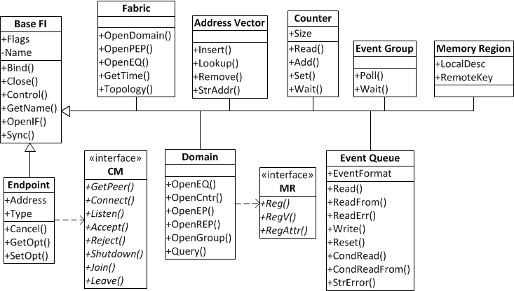

Slide 7
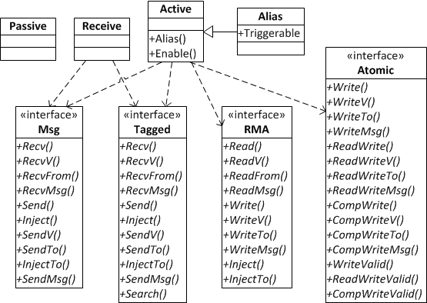
Endpoints

Slide 8
Application Expectations
Progress
Ordering - completions and data delivery
Multi-threading and locking model
Buffering
Compatibility

Slide 9
Progress
Ability of the underlying implementation to complete processing of an asynchronous request
Need to consider ALL asynchronous requests
  Connections, address resolution, data transfers, event processing, completions, etc.
HW/SW mix
All(?) current solutions require significant software components

Slide 10
Progress
Support two progress models
  Automatic and manual
Separate operations as belonging to one of two progress domains
  Data or control
  Report progress model for each domain
SAMPLE | Manual | Automatic
Data | Software | Hardware offload
Control | Software | Kernel services

Slide 11
Automatic Progress
Ideally hardware offload model
  Or standard kernel services / threads for control operations
Once an operation is initiated, it will complete without further user intervention or calls into the API
  True if acting as either an initiator or target
Automatic progress meets manual model by definition

Slide 12
Manual Progress
Implies significant software component
Required to occur when reading or waiting on EQ(s)
  Requirement limited to objects associated with selected EQ(s)
  Not intended to restrict provider implementation
Application can use separate EQs for control and data
App can request automatic progress
  E.g. app wants to wait on native wait object
  Implies provider allocated threading

Slide 13
Ordering
Applies to a single initiator endpoint performing data transfers to one target endpoint over the same data flow
  Data flow may be a conceptual QoS level or path through the network
Separate ordering domains
  Completions, message, data
Fenced ordering may be obtained using fi_sync operation

Slide 14
Completion Ordering
Order in which operation completions are reported relative to their submission
Unordered or ordered
  No application defined requirement for ordered completions
Default: unordered
  Ordering may impose significant software overhead / latency dependent on endpoint type

Slide 15
Message Ordering
Order in which message (transport) headers are processed
  I.e. whether transport message are received in or out of order
Determined by selection of ordering bits
  [Read | Write | Send] After [Read | Write | Send]
  RAR, RAW, RAS, WAR, WAW, WAS, SAR, SAW, SAS
Example:
  fi_order = 0 // unordered
  fi_order = RAR | RAW | RAS | WAW | WAS |
  SAW | SAS // IB/iWarp like ordering

Slide 16
Data Ordering
Delivery order of transport data into target memory between messages
  Ordering per byte-addressable location
  I.e. access to the same byte in memory
Ordering constrained by message ordering rules
  Must at least have message ordering first

Slide 17
Data Ordering
Ordering limited to message order size
  E.g. MTU
  In order data delivery if transfer <= message order size
  WAW, RAW, WAR sizes?
Message order size = 0
  No data ordering
Message order size = -1
  All data ordered

Slide 18
Other Ordering Rules
Ordering to different target endpoints not defined
Per message ordering semantics implemented using different data flows
  Data flows may be less flexible, but easier to optimize for
  Endpoint aliases may be configured to use different data flows

Slide 19
Multi-threading and Locking
Support both thread safe and lockless models
  Compile time and run time support
  Run-time limited to compiled support
Lockless (based on MPI model)
  Single – single-threaded app
  Funneled – only 1 thread calls into interfaces
  Serialized – only 1 thread at a time calls into interfaces
Thread safe
  Multiple – multi-threaded app, with no restrictions

Slide 20
Buffering
Support both application and network buffering
  Zero-copy for high-performance
  Network buffering for ease of use
    Buffering in local memory or NIC
  In some case, buffered transfers may be higher-performing (e.g. “inline”)
Registration option for local NIC access
  Migration to fabric managed registration
Required registration for remote access
  Specify permissions

Slide 21
Compatibility
Reverse mapping may differ from forward mapping
Verbs + RDMA CM | Fabric Interface
HCA + port | Fabric
PD | Domain
QP + cm_id | Active EP
cm_id | Passive EP
CQ + [comp_channel] | EQ / Counter
comp_channel | EQ Group
cm_channel | EQ
SRQ | Receive EP
MR | MW | MR
AH | AV addr | AV index

Slide 22
Sharable Interfaces
Verbs + RDMA CM | Interface | FI Class
QP | Atomics | Active EP
QP / SRQ | Msg | Active / Receive EP
QP / Tagged-SRQ | Tagged | Active / Receive EP
QP | RMA | Active EP
CQ | EQ | EQ
PD | MR | Domain
PD (+ port) | AV | AV
Proposed new object
AV addr == AH

