Slide 1
Persistent Memory over Fabric (PMoF)
Architecture Overview
NVML Implementation & Use Cases
08/08/17
Chet Douglas – DCG NVMS SW Architecture

Slide 2
RDMA with byte-addressable PM – Problem Statement
HA and HPC Use Cases require writes to remote memory between compute nodes utilizing RDMA to support remote data base log updates, remote data replication, etc
Customers are requesting mechanisms to utilize RDMA with persistent memory NVDIMMs
Current RDMA HW and SW solutions do not take persistent memory in to account and do not have an explicit mechanism for forcing RDMA Writes to remote pmem to be persistent before the write’s completion
In the short term, SW only modifications are possible to make RDMA SW Applications persistent memory aware and to force written data to be persistent (PMoF 1.0 for current platforms)
In the longer term, industry wide enabling through standards organizations is required to have specific vendor agnostic mechanisms for utilizing persistent memory with RDMA, requiring HW and SW changes (future PMoF HW/FW/SW additions for future HW platforms)

Slide 3
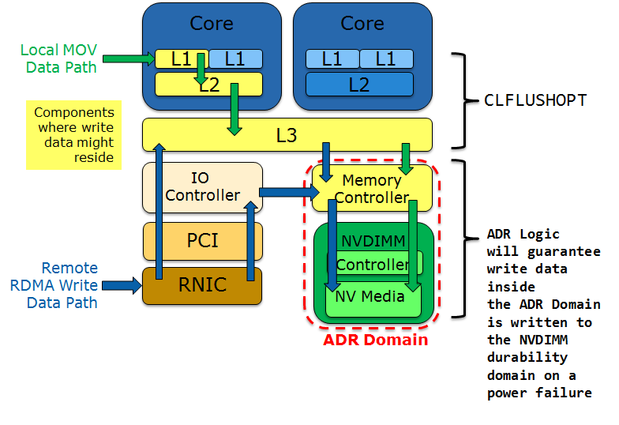
RDMA with byte-addressable PM – Problem Statement
RDMA with PMEM adds additional complexity:
  In order to guarantee written data is durable
  on the target node, CPU caches need to be
  bypassed or flushed to get data in to the ADR
  power fail safe domain
  When writing to PMEM, need a synchronous
  acknowledgement when writes have made it to
  the durability domain but the current RDMA Write
  semantics do not provide such write acknowledgement

Slide 4
PMoF Overview –Overview of DAX Programming Model
Application
DAX
Removes paging IO subsystem & provides direct access to PMEM
SNIA NVM Programming Model
Byte Addressable PMEM Regions surfaced directly to an application through standard Memory Mapped Files
Standard File API utilized to create, open, close, memory map, and synchronize a file
Applications have direct control over load and store from/to the memory mapped file
Applications are responsible for flushing write data in CPU caches in to the persistent memory domain
  clflushopt – cache line flush and invalidate – non temporal, flushes can occur in parallel and require SFENCE after all flushed
  clwb – cache line write back
Standard
File API
PMEM Programming Model
User
Space
open
close
mmap
msync
load
store
movnt
clflushopt
clwb
Persistent Memory Aware File System
MMU
Mappings
DAX
Kernel
Space
Cache Line I/O
AEP NVDIMM
Persistent Region –
App Direct Mode
Apache
Pass

Slide 5
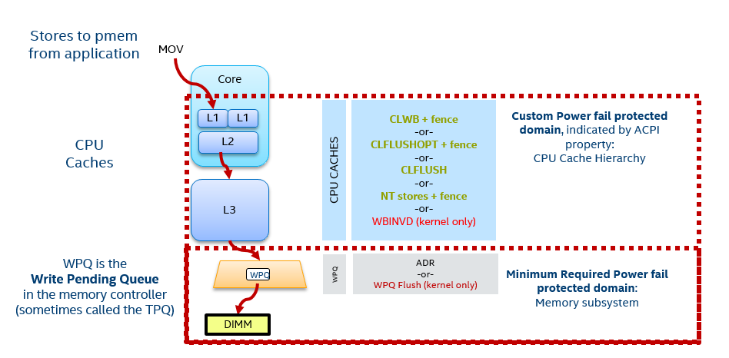
PMoF Overview –Overview of Durability Domain

Slide 6
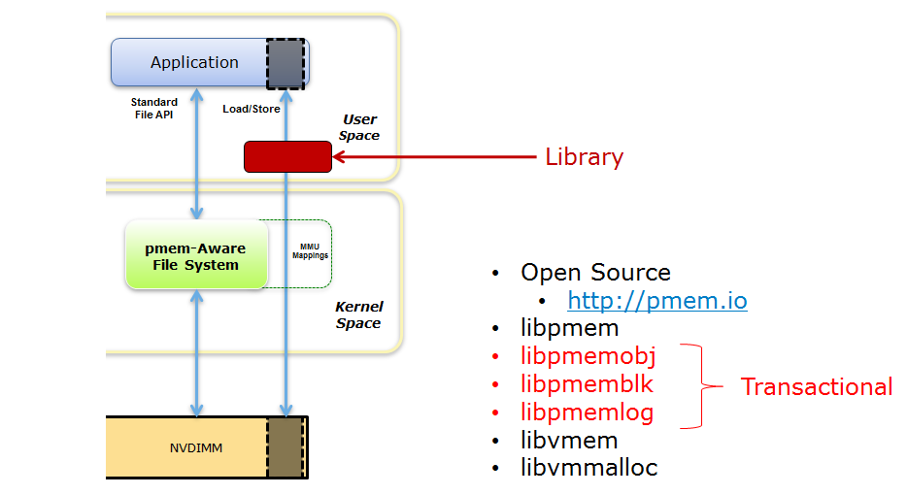
PMoF Overview – NVML Overview
Ring-3 application programming library
Simplifies NVM programming
Provides persistent memory allocation, de-allocation
Persistent power fail safe transactions and ability to undo transactions that fail
Currently available on 64bit Linux via GitHub. See http://pmem.io
NVML is also supported on Windows and is available via GitHub. See http://pmem.io
librpmem – Local node replication library
librpmemd – Remote node replication daemon

Slide 7
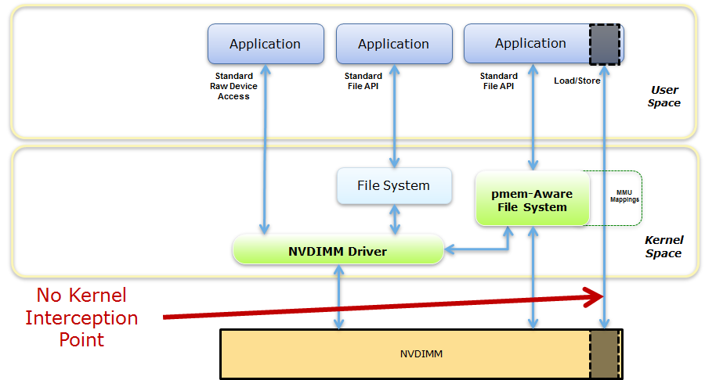
PMoF Overview – NVML Overview
Want to offer HA persistent data replication to local and remote nodes
Since App-Direct memory mapping loads and stores are handled directly by the CPU, there is no way to hook these calls for replication

Slide 8
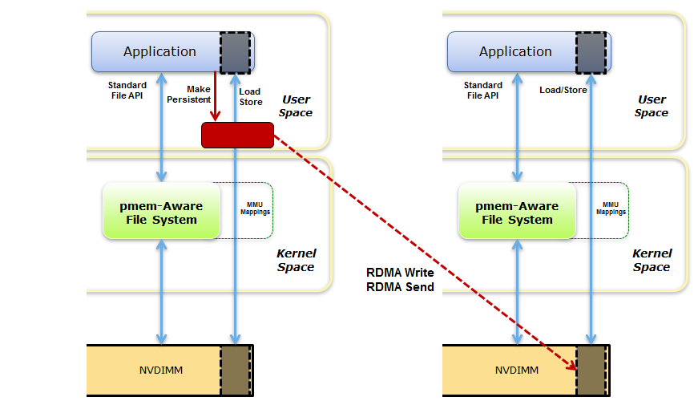
PMoF Overview – NVML PMoF Implementation Overview
Local Node replication:
  Hook local “Make Persistent” call
  Memcopy the data being made persistent in to second local location
  Issue local CLFLUSHOPTs and PCOMMIT for each new buffer
Remote Node replication (this is example of General Server Durability Mechanism):
  Hook “Make Persistent” call
  Issue RDMA Write to push local data to the remote node
  Issue RDMA Send with a list of data to make persistent
  Remote node issues CLFLUSHOPTs and PCOMMIT
NVML local and remote replication support with existing NVML API – NO Application API Changes required for local or remote replication
Local Node
Remote Node
Out-of-band connection setup and resource exchange
librpmemd
librpmem
CPU Flush &
PCommit
Load Store

Slide 9
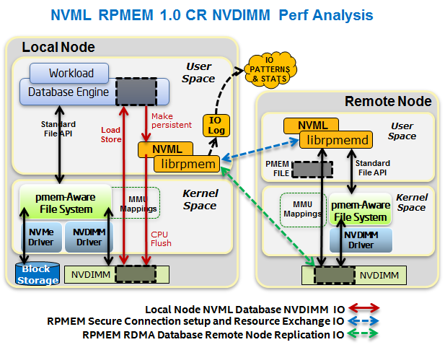
PMoF Overview – NVML PMoF Implementation Overview

Slide 10
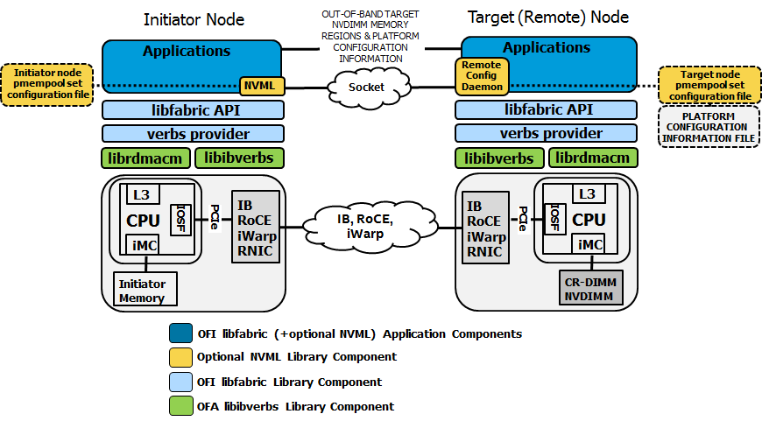
PMoF Overview – Basic Linux PMoF NVML Based Application RDMA Stack
PMoF Fabric Support utilizing libfabric
libfabric API – Common Ring3 Application interface for Ethernet (IB, RoCE, iWARP) RNICs and Omnipath
HCAs
verbs provider – libfabrics RoCE, IB and iWarp provider interface to libibverbs

Slide 11
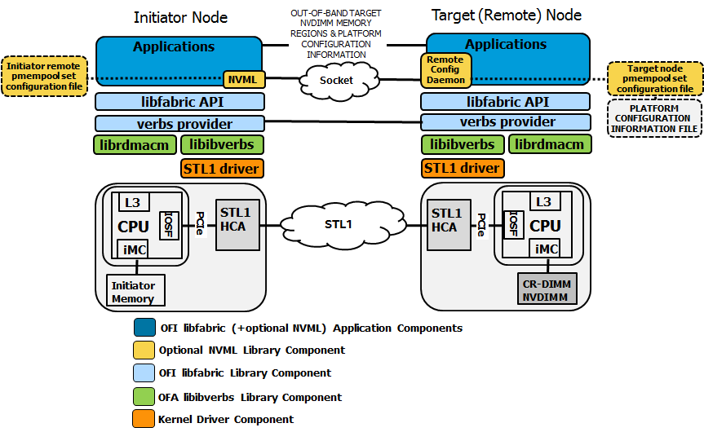
PMoF Overview – Basic Linux PMoF NVML Based Application RDMA Stack w Omnipath
PMoF Omnipath Support utilizing libfabric
Initial PMoF implementation utilizes kernel IO path for Omnipath support of RDMA
Future implementations will provide a native PMoF Omnipath solution that does not utilize the kernel path or RDMA Verbs

Slide 12
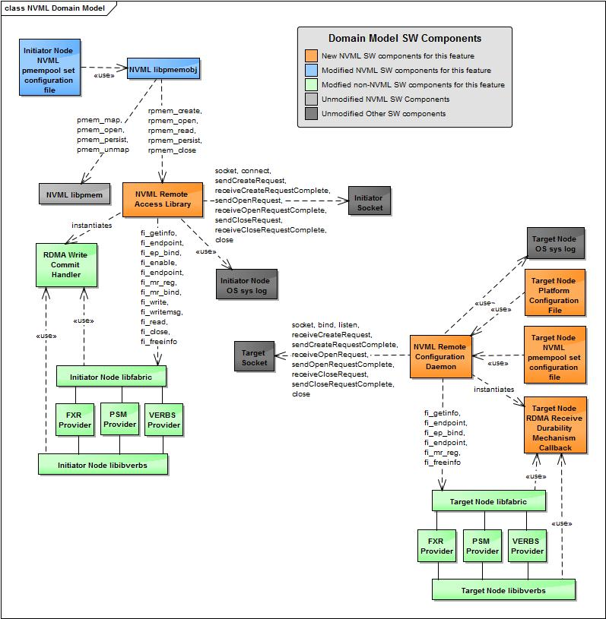
PMoF Overview
– NVML PMoF Implementation Details
PMoF NVML Architecture:
Utilizes libfabric and libibverbs OFA libraries
Utilizes SSL for out-of-band secure socket connection
  Setup remote files based on platform configuration file
  Exchange RKEYs
  Exchange remote node HW configuration

Slide 13
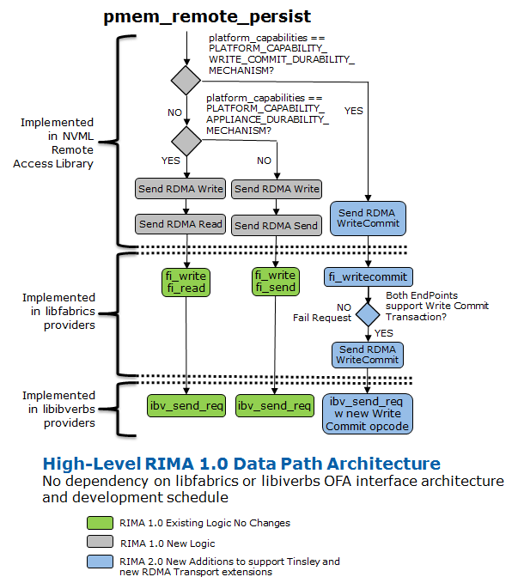
PMoF Overview
– NVML PMoF Implementation Details
Typical NVML Replication Sequence:
  Local node Application:
  Stores a number of cache lines
  Local node Application:
  Calls pmem_persist
  Local node NVML: CLFLUSHOPT(s) / SFENCE
  Local node NVML:
  Calls pmem_remote_persist
  Local node NVML:
  RDMA Write to target node
  RDMA Read 4B to target node Wait for RDMA Read completion Return execution to Application

Slide 14
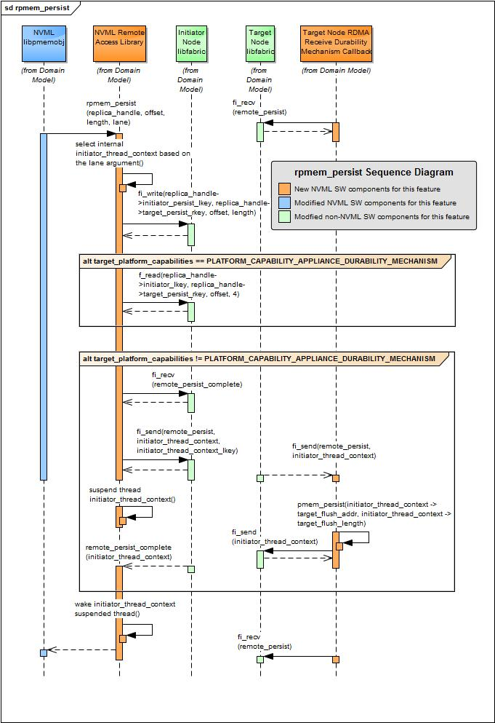
PMoF Overview
– NVML PMoF Implementation Details

Slide 15
PMoF – The Solution - Storage Mode Use Cases compared with existing remote replication storage use cases
APP
APP
DRAM
DRAM
DRAM
DRAM
TCP/IP stack
TCP/IP stack
Storage stack
Storage stack
PCIe
PCIe
PCIe
PCIe
PCIe
PCIe
NIC
NIC
NVMe
RNIC
RNIC
NVMe
SSD
SSD
Client Node
Server Node
Client Node
Server Node
TCP/IP based replication to SSD
RDMA based replication to SSD
APP
APP
DRAM
DRAM
DRAM
NVMe xlat
Storage stack
NVDIMM
PCIe
PCIe
PCIe
PCIe
PCIe
RNIC
RNIC
NVMe
RNIC
RNIC
SSD
Client Node
Server Node
Client Node
Server Node
NVMEoF RDMA based replication to SSD
PMoF RDMA based replication to NVDIMM

Slide 16
PMoF – The Solution - Storage Mode Use Cases compared with existing remote replication storage use cases
NVMeoF
+ 3DXP NVMe SSD + SPDK

Slide 17
PMoF – PMoF 1.0 – “General Purpose Method” – Real HW & SW
Target Memory Controller
PMoF 1.0 for current platforms
General Purpose Method
-Utilizes DDIO on Target System to place incoming RDMA Write data in to LLC
-RDMA Send with list of cache lines to flush
-Target SW Interrupted and CPU issues CLFLUSHOPT or each cache line written followed by SFENCE
-Target SW sends RDMA Send back to ack the Initiator SW of completion
Target CPU
LLC Cache
Target SW
Initiator SW
Target RNIC
Initiator RNIC
PMEM
RDMA Write
RDMA Write
Posted Write (DDIO)
Write data to remote PMEM
RDMA Write
RDMA Write
Posted Write (DDIO)
RDMA Send
RDMA Send
Send
CLFLUSHOPT
Force Write Durability
Write
Write
CLFLUSHOPT
Write
Write
RDMA Send
Send
RDMA Send

Slide 18
PMoF – PMoF 1.0 – “General Purpose Method” – Real HW & SW – Latency Performance
Almost 50% worse latency when compared to the Appliance Method due to
increased network messages and need to wake target SW to perform flushes

Slide 19
PMoF – PMoF 1.0 – “General Purpose Method” – Real HW & SW – BW Scalability Performance
At 4K Write no matter how many parallel threads we add, we can no-longer saturate the
network link of 40 GigE
NOTE: When compared to the Appliance Method the scalability is much worse due to
increased network messages and need to wake target SW to perform flushes

Slide 20
PMoF – PMoF 1.0 – “Appliance Method” – Real HW & SW
Target Memory Controller
PMoF 1.0 for current platforms
-Requires no HW changes, no driver changes, no changes to existing RDMA protocol
-Solutions based on upper layer protocol (ULP) SW sequences easily implemented in PMEM aware applications utilizing RDMA including NVML
Appliance Method
-Utilizes Non-Allocating Writes on Target System to bypass LLC
-Small RDMA Read forces Write data ahead to PMEM
Initiator SW
Initiator RNIC
Target RNIC
PMEM
RDMA Write
RDMA Write
Write data to remote PMEM
RDMA Write
Posted Write (Non-Allocating)
RDMA Write
Posted Write (Non-Allocating)
RDMA Read
RDMA Read
Flushing Read
Write
Force Write Durability
Write
Read
Read Data
Read ACK
RDMA Read ACK
RDMA Read ACK

Slide 21
PMoF – PMoF 1.0 – “Appliance Method” – Real HW & SW – Latency Performance
Almost 50% lower latency when compared to the General Purpose Method
due to reduced messages and no need to wake target SW

Slide 22
PMoF – PMoF 1.0 – “Appliance Method” – Real HW & SW – BW Scalability Performance
At 1K Write no matter how many parallel threads we
add, we can no-longer saturate the network link of 40 GigE
NOTE: When compared to the General Purpose Method the scalability
is much improved due to reduced messages and no need to wake target SW

Slide 23
PMoF – PMoF 1.0 - Tail of the Log Use Case
Target Memory Controller
Initiator SW
RNIC
RNIC
RDMA Write
RDMA Write
Tail or the Log Use Case
-Common operation for existing DB
-Flow:
1) SW writes new entry at the end of the log
2) SW updates End of Log pointer
-Step 1 must be replicated before step 2
-Step 1 new entry must reach durability domain before end of the log pointer is changed in step 2
-Only replication of step 2 must be acknowledged
-4 RDMA messages from Initiator to Target
-2 RDMA messages from Target to Initiator
RDMA Read
Posted Write
Replicate new log entry
RDMA Read
Read
RDMA Read ACK
RDMA Read ACK
Read ACK
RDMA Write
RDMA Write
RDMA Read
Posted Write
Replicate End of Log pointer
RDMA Read
Read
RDMA Read ACK
RDMA Read ACK
Read ACK

Slide 24
PMoF – PMoF in the Future - Tail of the Log Use Case – Future Fabric Implementations
Utilize new proposed Flush to force previous writes on the connection to be made durable before the flush is completed
Follow the Flush with a proposed Non-Posted Write operation which is a synchronous write all the way to the media.
Suggested here that the NP Write completion is not waited for but that is ope to debate. Typically the Tail of the Log use case does not need to wait for the NP Write completion.
-3 RDMA messages from Initiator to Target
-1 or optionally 2 RDMA messages from Target to Initiator
Initiator SW
Target Memory Controller
Target
PMEM
RNIC
RNIC
Replicate new log entry
Write
Write
Flush
PCIe Wrt
Flush
Asynch Mem Wrt
NP Write
NP Write
PCIe Flushing Rd
Replicate End of Log pointer
Flushing Rd Rsp
Flush Response
NP PCIe Wrt
Flush Response
Synch Mem Wrt
NP PCIe Write Ack
NP Write Ack
NP Write Ack

Slide 25
PMoF – PMoF in the Future - Tail of the Log Use Case – Future Fabric Implementations
Initiator SW
Target Memory Controller
Target
PMEM
RNIC
RNIC
Combine the Flush and NP Write in to a single Write w Commit instruction to improve transport efficiency
-1 RDMA message from Initiator to Target
-1 RDMA message from Target to Initiator
Write w Commit
Write w Commit
PCIe Wrt
PCIe Flushing Rd
Asynch Mem Wrt
Replicate new log entry
Flushing Rd Rsp
Replicate End of Log pointer
NP PCIe Wrt
Synch Mem Wrt
NP PCIe Write Ack
Write w Commit
Response
Write w Commit
Response

Slide 26
PMoF Overview – NVML PMoF Performance Details
NVML call log for single 64-byte Redis KV INSERT
pmemobj_tx_begin - start transaction
pmemobj_tx_zalloc] - allocate dictionary entry
pmem_persist, offset=4196416, length=64
rpmem_persist, offset=4096, length=32
rpmem_persist, offset=4112, length=8
rpmem_persist, offset=3937464, length=8
rpmem_persist, offset=6312, length=8
rpmem_persist, offset=4112, length=8
pmemobj_tx_zalloc - allocate Key string
6 x rpmem_persist
pmemobj_tx_zalloc] - allocate Value string
6 x rpmem_persist
pmemobj_tx_zalloc] - allocate Redis object
6 x rpmem_persist
pmemobj_tx_commit] - commit object allocation
rpmem_persist, offset=4196456, length=24
rpmem_persist, offset=3931112, length=24
rpmem_persist, offset=3931240, length=24
rpmem_persist, offset=3931368, length=24
rpmem_persist, offset=3931136, length=64
rpmem_persist, offset=3931264, length=64
rpmem_persist, offset=3931392, length=64
rpmem_persist, offset=4196480, length=128
rpmem_persist, offset=6144, length=8
tx_clear_undo_log - clear undo log as part of transaction commit phase
rpmem_persist, offset=6336, length=8
rpmem_persist, offset=6328, length=8
rpmem_persist, offset=6320, length=8
rpmem_persist, offset=6312, length=8
rpmem_persist, offset=6144, length=8
pmemobj_tx_end

Slide 27
PMoF Overview – Proposed libfabric extensions for the future
fi_getinfo
Retrieve information about each fabric endpoint for a given connection
Capabilities expanded to describe byte addressable persistent memory support for each endpoint
int fi_getinfo( int version,
const char *node,
const char *service,
uint64_t flags,
struct fi_info *hints,
struct fi_info **info);
Add the following capability bit to the info flags field to describe additional capabilities of the system
The caller requests specific capabilities to be supported in the info struct and the endpoint SW will update the same info struct with the supported capabilities:
FI_PMEM
  Initiator or target node is capable of supporting byte addressable persistent memory (Pmem)
  Assumes endpoint supports read/write to pmem with optional write flags: FI_COMMIT, FI_IMMED, FI_FENCE
  Endpoints that only support read or write to pmem direction can optional set the FI_READ, FI_READ_REMOTE, or FI_WRITE, FI_WRITE_REMOTE flags with FI_PMEM to report specific direction supported.

Slide 28
PMoF Overview – Proposed libfabric extensions for the future
fi_mr_reg
Register persistent memory data buffer addresses with the fabric controller for a specific protection domain with requested accesses and return the lkey and rkey handles that describe the registered memory
By making these part of opaque rkey, initiator SW is not burdened with understanding these attributes
int fi_mr_reg( struct fid_domain * domain,
const void * buf,
size_t len,
uint64_t access,
uint64_t offset,
uint64_t requested_key,
uint64_t flags,
struct fid_mr ** mr,
void * context);
Add the following bits to the flags field to further describe the attributes of the memory region being registered. The access requested is a combination of OR’ing these new access capabilities with existing flags:
  FI_PMEM – Memory region being registered is byte addressable persistent memory
  FI_UNCACHED - Memory region should not be backed by cache. When data is written to this region, the local cpu caches should be bypassed. Without this flag being present, the write data should be placed in cpu cache as SW will most likely access the data shortly after remote transfer is complete.

Slide 29
PMoF Overview – Proposed libfabric extensions for the future
fi_writemsg Updates
The existing fi_writemsg API is utilized for writing to persistent memory
Proposed that RDMA protocol extensions will implement the write with commit as a new opcode on the fabric
Proposed that RDMA protocol extensions will implement the write with commit with immed as a new opcode on the fabric
static inline ssize_t fi_writemsg( struct fid_ep *ep,
const struct fi_msg_rma *msg,
uint64_t flags)
struct fi_msg_rma {
const struct iovec *msg_iov;
void **desc;
size_t iov_count;
fi_addr_t addr;
const struct fi_rma_iov *rma_iov;
size_t rma_iov_count;
void *context;
uint64_t data;
};

Slide 30
PMoF Overview – Proposed libfabric extensions for the future
fi_writemsg Updates
The following libfabric flags are added for handling writes to persistent memory.
The flags are utilized by the target node endpoint device to precisely control steering of the write data and handling of any device specific completion handling.
Therefore these indicators should be visible in the wire protocol payload and available at the target end point:
FI_COMMIT – Commit to pmem all data within scope of the command.
  Completion to the initiator occurs after all data has been committed to the durable memory domain
  Previous fi_write* messages sent to the same rkey on the same QP will also be committed to durability before the completion is signaled.
    With a non-volatile memory region (memory registered with FI_PMEM), completion indicates all write data in scope has reached durability and is power fail safe. Once durability occurs the Initiator RNIC will insert a Completion WQE on the initiators CQ to notify SW.
    With a memory region that is volatile memory (memory registered without FI_PMEM). The completion indicates all write data in scope has reached the global visibility point
FI_IMMED – Used in conjunction with FI_COMMIT
  Once all write data in scope of the write has reached the pmem durability domain issue a Completion WQE to the target CQ.
  Setting this flag without setting FI_COMMIT is considered an error.
FI_FENCE – Extend the use of this existing flag to cover fencing of writes on the target node.
  When set with FI_COMMIT, the target endpoint will guarantee that previous writes with the same RKEY will be made durable before executing this fenced write to the same RKEY.

Slide 31
PMoF Overview – Proposed libfabric extensions for the future
fi_writemsg ordering and completion semantics with PMEM
Here are the basic rules for using the fi_write* API with persistent memory:
All existing libfabric fi_write* API can be utilized to write data to PMEM by supplying an RKEY whose memory region was registered with FI_PMEM set
fi_write, fi_writev, fi_writedata, fi_inject_write and fi_inject_writedata API that do not take a flag argument cannot request data to be committed to the persistent memory durable domain
For fi_writemsg (with FI_COMMIT set) to properly commit other write data previously sent via fi_write* API methods, all of the commands must utilize the same QP for all command submittals and must utilize the same RKEY.
There is no write data ordering guarantee for any sequence of fi_write* or fi_writemsg commands sent to different QPs or different RKEYs.
The ordering of write data associated with fi_writemsg (with FI_COMMIT set) with respect to the ordering of write data for other fi_writemsg (with FI_COMMIT set) requests is indeterminate, even when issued on the same QP and RKEY. It is possible for one to pass the other. SW must utilize the FI_FENCE with FI_COMMIT to avoid this indeterminate ordering on the same RKEY. To control write data placement ordering on the same QP but to different RKEYs, SW can continue to utilize fi_read* or fi_send* API in between fi_writemsg (with FI_COMMIT set) commands.

Slide 32
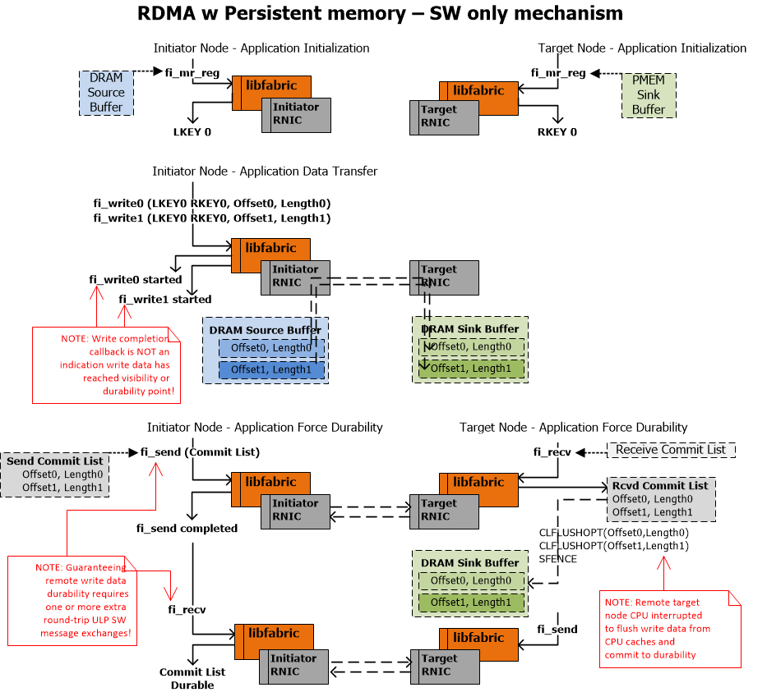
PMoF Overview
– Proposed libfabric extensions
– example sequences
Libfabric pmem write sequence
without proposed extensions

Slide 33
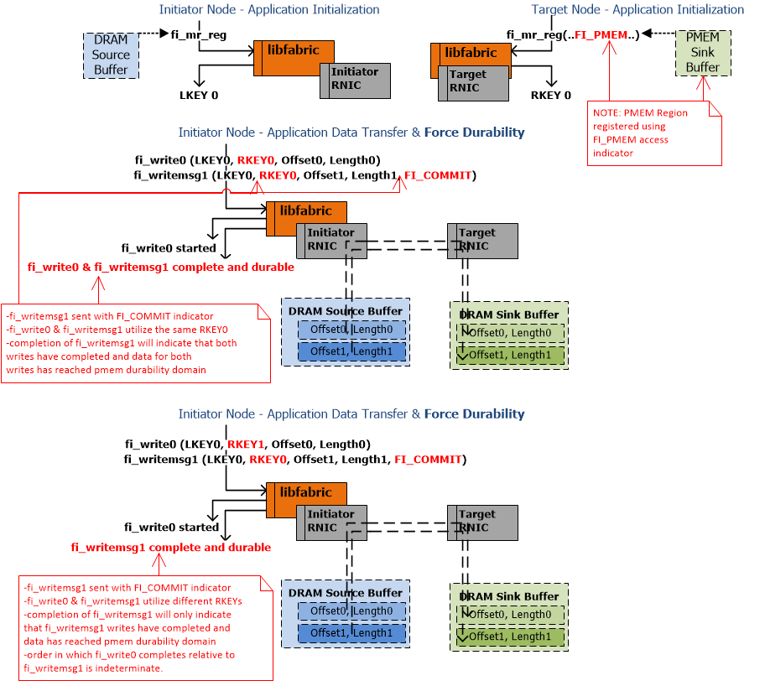
PMoF Overview
– Proposed libfabric extensions
– example sequences
Libfabric pmem write sequence
with proposed extensions

Slide 34
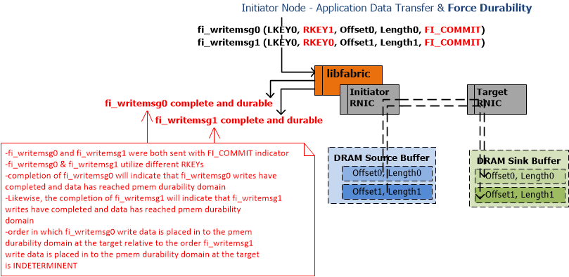
PMoF Overview
– Proposed libfabric extensions
– example sequences
Libfabric pmem write sequence
with proposed extensions

Slide 35
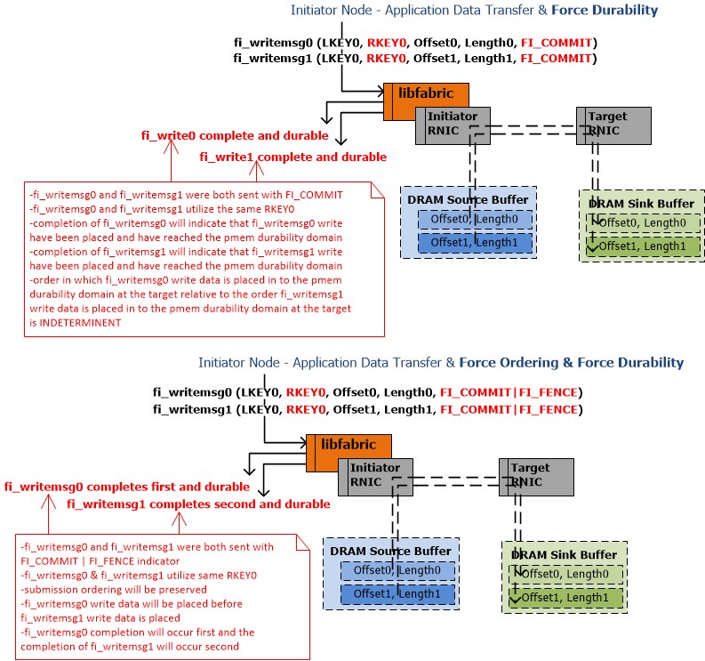
PMoF Overview
– Proposed libfabric extensions
– example sequences
Libfabric pmem write sequence
with proposed extensions

