Slide 1
Persistent Memory over Fabrics
Rob Davis, Mellanox Technologies
Chet Douglas, Intel
Paul Grun, Cray, Inc
Tom Talpey, Microsoft

Slide 2
Agenda
The Promise of Persistent Memory over Fabrics
Driving new application models
How to Get There
An Emerging Ecosystem
Encouraging Innovation
Describing an API
API Implementations
Flush/commit is the way to go
But how to optimize these operations?

Slide 3
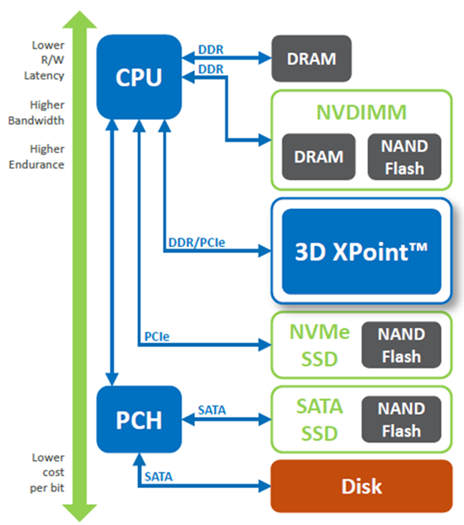
Persistent Memory (PM)
Persistent Memory (PM) Benefits
Considerably faster than NAND Flash
Performance accessible via PCIe or DDR interfaces
Lower cost/bit than DRAM
Significantly denser than DRAM
PM
Leading Edge PM Technologies

Slide 4
PM Needs High Availability (HA)
 | PM | NAND
Read Latency | ~100ns | ~20,000ns
Write Latency | ~500ns | ~50,000ns

Slide 5
Applications Enabled by PM
Compute Disaggregation
Scale out file/object systems
In-Memory Database
Machine learning
Hyperconverged Infrastructure

Slide 6
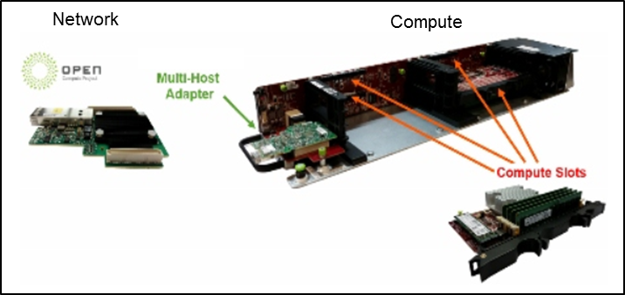
Compute Disaggregation

Slide 7
Core Requirements for Networked PM
PM is really fast
Needs ultra low-latency networking
PM has very high bandwidth
Needs ultra efficient, transport offload, high bandwidth networks
Remote accesses must not add significant latency
PM networking requires:
Predictability, Fairness, Very Low Packet Loss
 | PM | NAND
Read Latency | ~100ns | ~20,000ns
Write Latency | ~500ns | ~50,000ns

Slide 8
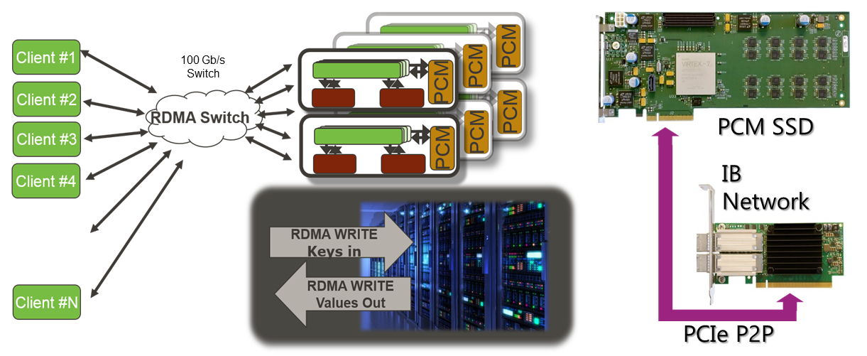
We Can Get There
HGST live demo at FMS 2015
PM based Key-Value store over 100Gb/s fabric
Key-Value Store fetch from non-volatile memory in 5usec

Slide 9
How to get there – the PM Ecosystem
Memory
Storage
object, file, block…
SNIA, OSVs. Language writers, App developers, middleware providers
APIs
libfabric, Verbs, NVMF, ND, NDK
IBTA, OpenFabrics Alliance, NVMe Inc,
Linux, Windows…
Today’s Focus
provider
provider
…
provider
network
H/W
network
H/W
network
H/W
IETF, IBTA, OS drivers, N/W Vendors…
…
Persistent Memory Media,
Form Factors
Vendors, JEDEC…
Notes:
This slide needs to convey the overlap between OFIWG as a developer of an API and (OFA+IBTA) as a developer of the verbs API.

Slide 10
No one argues with this…
Persistent memory changes the way that applications store, access, communicate and share information
local mem
remote PM
remote storage
latency
pS
uS
mS
Data Access, Data Sharing…
Data Storage
What happens when apps can access shared information at near-memory speeds?
How will apps evolve to take advantage of pools of global, shared, PM?
What happens when apps evolve in the ways that they access, share and consume data?
What should network architects do to prepare?
Notes:
Persistent memory is (or soon will) change the landscape. We in the networking community are preparing for the ground shift.

Slide 11
Focus on memory operations
Storage
- object, file, block
- storage class mem
Memory
- persistent memory
Think about accessing PM using memory paradigms, as opposed to storage paradigms…
…even if the data at the far end is stored as a memory mapped file.
storage client
user or kernel app
POSIX I/F
load/store, memcopy…
file system
virtual switch
DIMM
DIMM
NVDIMM
NVDIMM
NVM
devices
(SSDs…)
provider
NIC
remote storage class memory, persistent memory
Notes:
Taxonomy – let’s be clear on the different access methods. For this talk today, we’re not talking about NVMe/F – we’re talking about PM

Slide 12
Simultaneous Equations to Solve
user app, middleware, languages…
Let consumers drive the requirements
Consumer of network services
Define the functions to be exported upward
Fabric Independent
API
Provider
Provider
Provider
…
Implement APIs for the fabrics of interest
Different Providers for different fabrics
H/W device
H/W device
H/W device

Slide 13
Representative Use Cases
app
app
app
app
global shared memory service
NVDIMM
NVDIMM
NVDIMM
app
app
Replication
High Availability use case
Shared PM
Remote Access, Storage use cases
Notes:
We don’t yet know much about how PM is going to be deployed, but these two use cases are a good start

Slide 14
How they work
store,
store,
store,
commit
store,
store,
store,
flush
mem ctrl,
library
High Availability Use Case
user
Local
NVDIMM
write,
write,
write,
commit
Remote
NVDIMM
completion
user
user
Remote Shared Memory Use Case
put
get
Remote
NVDIMM
completion
notice
Notes:
Remote memory use case. Remote persistent memory appears as a fabric-attached service which is shared by number of clients.

Slide 15
Shared PM - A Closer Look
user
user
put
put
put
commit
get
Remote
NVDIMM
valid
node
cntlr
persistent
notice
API Requirement: Distinguish between data which is globally valid, and data which has been made persistent
Notes:
Remote memory use case. Remote persistent memory appears as a fabric-attached service which is shared by number of clients.

Slide 16
The Beginnings of a List of API Reqmts
user
user
user
Applications Requirements – a starting point
Ability to force flushes of local caches to remote persistent memory
Perform non-cached writes to remote to persistent memory
Identify the persistence characteristics of a remote memory device
Distinguish between data which is globally valid and data which is remotely persistent
Notes:
Remote memory use case. Remote persistent memory appears as a fabric-attached service which is shared by number of clients.

Slide 17
Basic API Features (example)
Consumer
provider, fabric adapter
provider, fabric adapter
persistence domain
PUT w/ Commit
Plenty of work to be done to define the semantics of the API
Lots more to figure out how to implement the semantics over a given wire
Write
ack
completion
Commit
Commit
Completion
completion
API
Magic Happens
Notes:
From those two use cases, there are some things we already know we’re going to need to do.

Slide 18
Fabric Implementations
consumer
provider, fabric adapter
provider,
fabric adapter
remote
mem subsystem
remote
pmem
PUT
Write
Utilize FLUSH to force previous writes on the connection to be made durable before the flush is completed
PUT w/ Commit
PCIe Wrt
Flush
Asynch Mem Wrt
NP Write
PCIe Flushing Rd
Flushing Rd Rsp
Flush Response
NP PCIe Wrt
Completion
Synch Mem Wrt
NP PCIe Write Rsp
API
fabric
specific
platform
specific

Slide 19
Alternate Fabric Implementation
consumer
provider, fabric adapter
provider,
fabric adapter
remote
mem subsystem
remote
pmem
An alternative approach:
combine the FLUSH and following WRITE into a WRITE w/ COMMIT
PUT
Write
PUT w/ Commit
PCIe Wrt
Write w/ Commit
Asynch Mem Wrt
PCIe Flushing Rd
Flushing Rd Rsp
NP PCIe Wrt
Synch Mem Wrt
NP PCIe Write Rsp
Flush Response
Completion
API
fabric
specific
platform
specific

Slide 20
Fabric Implementations
Challenge to the industry is to extend the existing fabric protocols to provide:
Efficient, low overhead PMEM semantics
Simple provider fabric adapter implementation
Flexible, extensible across common fabric types

Slide 21
Q & A, Discussion
Rob Davis, Mellanox Technologies
Chet Douglas, Intel
Paul Grun, Cray, Inc
Tom Talpey, Microsoft

Slide 22
Thanks!

