Slide 1
Application Access to Persistent Memory – The State of the Nation(s)!
Stephen Bates, Paul Grun, Tom Talpey, Doug Voigt
Microsemi, Cray, Microsoft, HPE

Slide 2
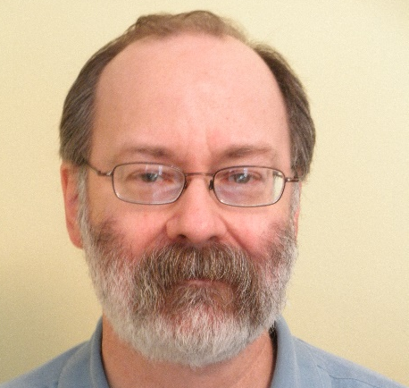
The Suspects
Stephen Bates Microsemi
Paul Grun Cray
Tom Talpey Microsoft
Doug Voigt HPE
Notes:
Paul to add this

Slide 3
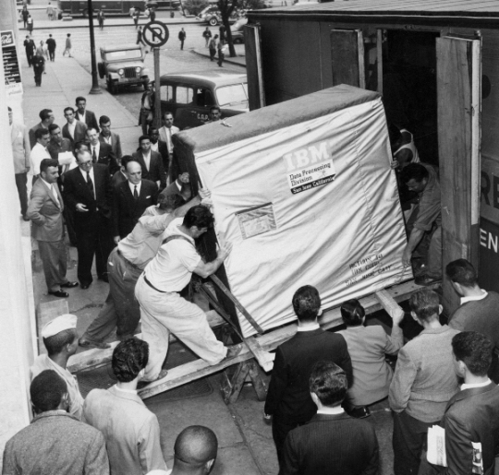
We’ve Come a Long Way, Baby!
Notes:
We’ve come a long way baby! Can give ourselves a slap on the back.
Leased at 3200 a month (28000 in today’s money)
About 5MB
7bit characters!!
1200 rpm
Seek ~600ms
http://www.snopes.com/photos/technology/storage.asp

Slide 4
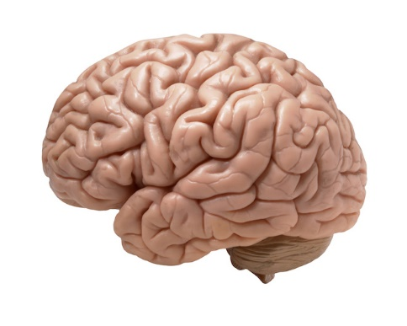
Persistent Memory (PM)
Low Latency
Memory Semantics
Storage Features
Notes:
We want three things from PMEM.
Low latency access
memory sematic access
Storage features – persistence, DI, RAID, replacement in field etc.
If you don’t need low latency then don’t bother with PMEM (a mmap’ed SSD will do the job just fine). Maybe mention sub10us though we can cover that later.
For storage features touch on RAID, replacement of FRUs and data-integrity

Slide 5
Taxonomy
NVM – Non-Volatile Memory. All types, including those that are not byte-addressable
PM – Persistent Memory. Sometimes PMEM is used but we use PM in this talk
NVMe – NVM Express. A block protocol to run over PCIe, RDMA or Fibre Channel. A SATA/SAS replacement.
NVMP – NVM Programming Model. Application-visible NVM behavior
NVMf – NVMe over Fabrics. NVMe extended over fabrics

Slide 6
Low Latency
 | Latency | Relative
L1 Cache Read | 0.5ns | 1
L2 Cache Read | 7ns | 14
DRAM Read | 100ns | 200
The PM Opportunity
NVMe DRAM SSD Read | 10us | 20,000
NVMe NAND SSD Read | 150us | 300,000
SAS HDD | 500us | 1,000,000
NVMe SSDs are (relatively) high latency!
PM provides persistence at memory-like speeds and semantics
Notes:
Mention NVMe is adding memory semantics
Mention that PMEM is all about persistence near (in time) to the processor. Nobody should store data in PMEM unless that plan to process it.

Slide 7
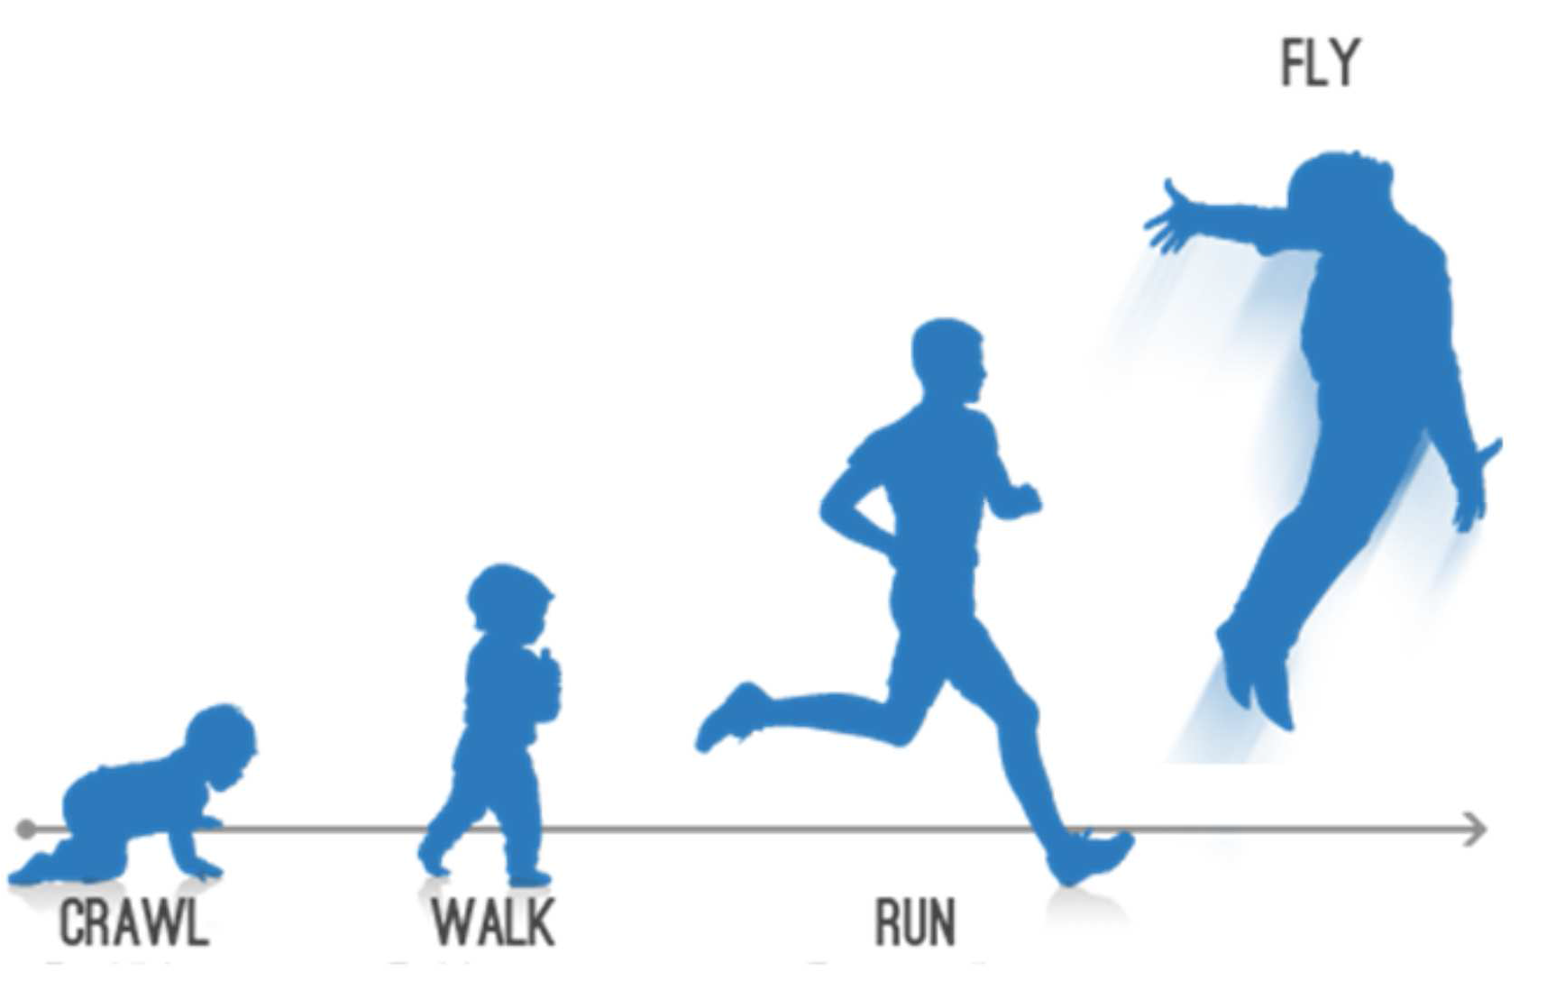
Where Are We?

Slide 8
What is Needed?
Media &
Form-Factors
Protocols & Inter- connect
Apps
OS Support
Libraries & Toolchain
Notes:
The PMEM Jigsaw
Progress being made on each of the pieces
All the outer pieces need to be in place to deliver on the last (middle) piece

Slide 9
Lots of Moving Parts
User space apps
Kernel space apps
Communications middleware
Apps
Consumers
APIs
Libraries & Toolchain
Protocols &
Interconnect
Infrastructure
Drivers
Communications
Infrastructure
Protocols &
Interconnect
OS Support
Non-volatile Media,
Form Factors
Media &
Form-Factors
Media,
Form Factors
Notes:
It is a complex problem, with lots of moving parts

Slide 10
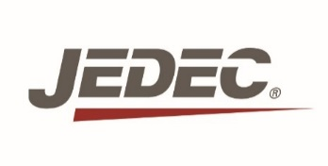
Where does PM sit? (Answer – anywhere it wants to)
PM
NAND
CPU
DDR
NAND
PM
Fabric
DRAM
PCIe
NAND
PM
Notes:
And to add to the complexity, we have to deal with both NAND and PM devices that can be sited anywhere.
Also mention that CPU vendors are the ones who decide what comes out of their processors.
Mention other interfaces including: NVLINK, CAPI, RAPID-IO
Under ‘fabrics’, we are describing the organizations that play a significant role in influencing the fabric implementation, not just the purveyors of the hardware.

Slide 11
Rationalizing the Problem Space
Memory
byte-addressable
Storage
object, file, block…
NVM consumers
SNIA, OSVs …
APIs
OFI, Verbs, NVMF, ND, NDK
OpenFabrics Alliance, NVMe Inc,
Linux,
Windows…
network
I/O bus
memory bus
IETF, IBTA, PCIe SIG, OS drivers…
Non-volatile Media,
Form Factors
Vendors, JEDEC…
11
Notes:
Managing complexity is what engineers do best, usually by partitioning large, sticky problems into small, manageable chunks.
ND, NDK are Windows APIs for driving fabric devices, similar to verbs

Slide 12
Start with Consumers of NVM Services
Apps
storage client
user app
POSIX read or write
load/store, memcopy…
file system
virtual switch
DIMM
DIMM
NVDIMM
NVDIMM
NVM
devices
(SSDs…)
provider
NIC
Remote NVM device (storage, memory)
Notes:
It begins by understanding who the consumers are, and what they need.
Consumers are characterized by, among other things, the way that the NVM device is accessed.
Is it accessed using some sort of block-based I/O protocol?
Is it accessed using memory semantics?
Not all NVM devices are created equal; some don’t have the latency characteristics needed to respond well as remote memory

Slide 13
Application View
Apps
SNIA NVMP
Describe application visible behaviors
APIs align with OSs
User
PM Aware Apps
File APIs
Ld/St
PM data structure libraries
PM File System Actions
Map – expose PM directly to applications
Optimized Flush – make data persistent
Kernel
PM Aware File Systems
MMU
Mapp
ings
Middleware features
e.g. RAID
PM Device

Slide 14
Possible Stack for NVM Access
kernel application
user app
user app
kernel application
VFS / Block Layer
byte access
byte access
VFS / Block I/O / Network FS / LNET
SCSI
NVMe
ulp
SRP, iSER, NVMe/F, NFSoRDMA, SMB Direct, LNET/LND,…
iSCSI
APIs
libfabric
kfabric
sockets
provider
provider
kverbs
PCIe
mem bus
PCIe
HBA
SSD
NVDIMM
SSD
fabric-specific device
NIC, RNIC
HCA
NIC
local I/O
local
byte
addressable
remote
byte
addressable
remote I/O
Notes:
Key point: NVM services are exported to the consumer via a series of APIs. The API, in turn, defines the features that are available to the consumer.
There are several organizations involved in developing network APIs for NVM, which are by-and-large harmonious.

Slide 15
Optimizing Fabrics for NVM
Add persistence semantics to RDMA protocols
Register persistent memory regions
Completion semantics to ensure persistence, consistency
Client control of persistence
Solve the “write-hole” problem
Lots of Initiatives underway!
I/O bus
mem bus
NVM
device(s)
storage client
user app
NVM client
NVM server
NIC
NIC
Can we make this work for NVDIMMs? NVMe SSDs with CMBs?
Notes:
Clearly there is lots of work to do here

Slide 16
Simple Math
NVMe
+ RDMA
-------
AWESOME
PM
+ RDMA
--------
AWESOME²

Slide 17
…continuing down the stack
NVM
consumers
Memory
byte-addressable
Storage
-object, file, block…
APIs
-OFI, Verbs, NVMe/F…
network
I/O bus
memory bus
Non-volatile Media,
Form Factors

Slide 18
NVMe over Fabrics – Present an NVMe block device to a client over RDMA or Fibre Channel
NVMe Controller Memory Buffers – Standardize (persistent) PCIe memory on NVMe devices. NVDIMM-N on PCIe bus?
LightNVM – A low-level SSD interface that is more aligned to the underlying media (NAND)
Notes:
Updates and current topics in the NVMe Standards body

Slide 19
Media
Category | Vendors | Comments
DRAM Drop-In | Everspin Micron Toshiba/SK Hynix | DRAM like latency Super-Cap Replacement Not for bulk storage Memory Interface
Storage Class Memory | Micron-Intel SanDisk Toshiba Crossbar Nantero | Faster than NAND, Cheaper/Slower than DRAM Byte Addressable Block and Memory Interfaces
NAND | Micron Toshiba SanDisk SK Hynix Samsung | Lowest cost Slow (for NVM) Not byte addressable cheap and plentiful Block Interface
PM
NVM
NOT PM

Slide 20
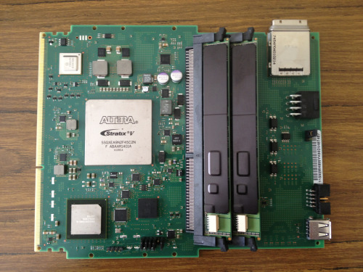
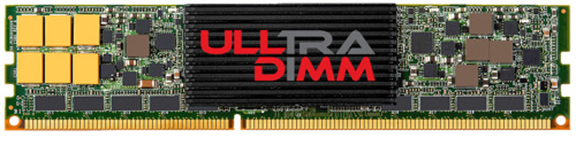
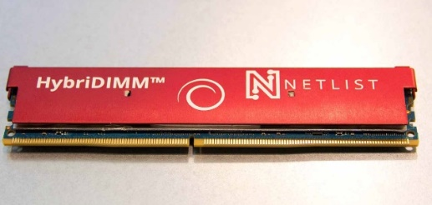
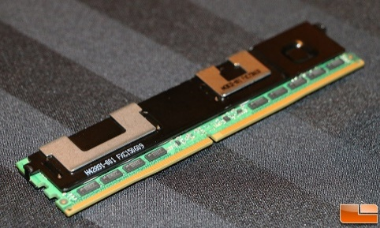
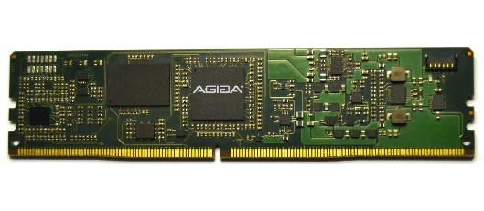
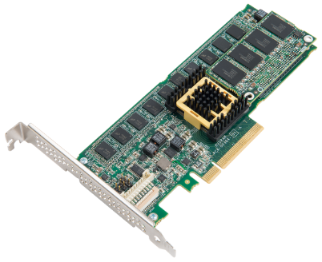
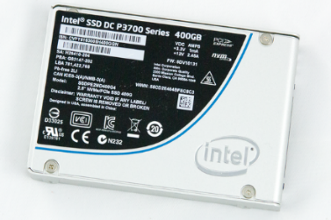
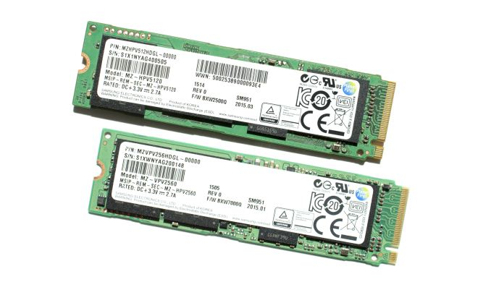
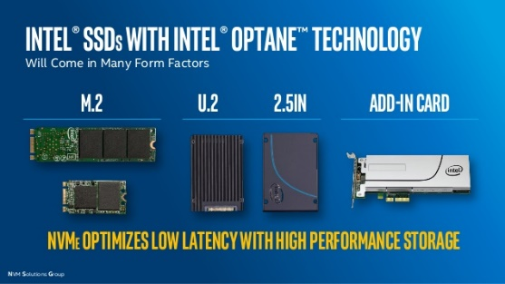
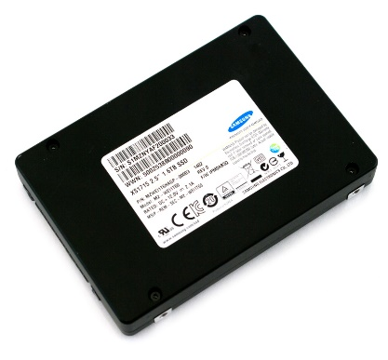
PM Form Factors
NVDIMM-N
NVDIMM-P
Not-NAND NVMe
NAND NVMe

Slide 21
PM Form Factors
Form-Factor | Media | Latency | Memory Semantics | Storage Features
NVDIMM-N | DRAM/ MRAM
NVDIMM-P | NAND/ PM
Non-NAND NVMe | DRAM/ PM
NAND NVMe | NAND
Form factors impact Features
(No DMA engines on a DIMM!)
Notes:
NVDIMM-P user slower media than NVDIMM-N but less overhead than NVMe.
NVDIMM-P may present memory semantics to the CPU/OS but underneath it may be using block media (NAND).
NVDIMM-N stores data as cachelines. Impossible to get good ECC and DI out of that. Also no DMA engines in a DIMM form factor.

Slide 22
PM Scenarios
PM region as a block device (a la persistent ram disk).
Filesystems support: direct access to the memory (e.g DAX), PM aware FS (e.g. m1fs).
You can put your files, databases etc. on top.
Remember we are crawling right now!
Soon: Shared persistent memory
Notes:
Note that right now this is only x86_64.
Mention that I have PMEM performance data for NVMDIMM-N in my other talk.

Slide 23
Libraries and Toolchains
EASY
HARD
int main(int argc, char *argv)
{
printf(“Hello, PMEM World!\n”);
return 0;
}
section .text
global _start
_start:
mov edx,len
mov ecx,msg
mov ebx,1
mov eax,4
int 0x80
mov eax,1
int 0x80
section .data
msg db 'Hello, PMEM World!',0xa
len equ $ - msg
Vs
Make it easy for applications to utilize PM, regardless of OS and ARCH!
Notes:
Which would the user prefer to write.
Slide showing how hard it is to code without glibc and discussing nvml.
Library support that is portable across OS and ARCH. NVML is a start.
Bindings for all common languages.
Compiler, assembler and linker support in the most popular toolchains.

Slide 24
Call to Arms
Notes:
Lots done, lots still to do
Not quite a Sisyphean task but there is a lot of work to be done

Slide 25
Call to Arms
Libraries and Toolchains: NVML for non-x86, integration into glibc/gcc etc.
Media & Form Factors: Production PM, appropriate PM form factors.
Protocols and Interconnect: Enhancements to NVMe and RDMA, PM over Fabrics, standardization of memory channels.
OS Support: ISA updates, DAX devices, Other OS, new OSes?

Slide 26
Conclusions
We are almost walking! Help out if you can
If you want sub 10us access to persistent data then PM may be for you
The CPU vendors have a lot of say in the interconnect but some open options exist too
Toolchains, libraries and OSes are adapting
New applications will complete the jigsaw and lead to revenue

