Slide 1
NVM Programming Model

Slide 2
Emerging Persistent Memory Technologies
Phase change memory
    Heat changes memory cells between crystalline and amorphous states
Spin torque memory/MRAM
    Magnetic layers within memory cells are aligned or juxtaposed
Resistive RAM
    Ion concentrations are migrated within memory cells to change resistance
All of these can have latencies close enough to DRAM
to allow them to be accessed like DRAM.

Slide 3
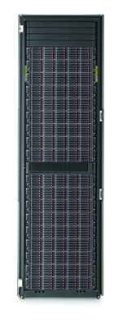
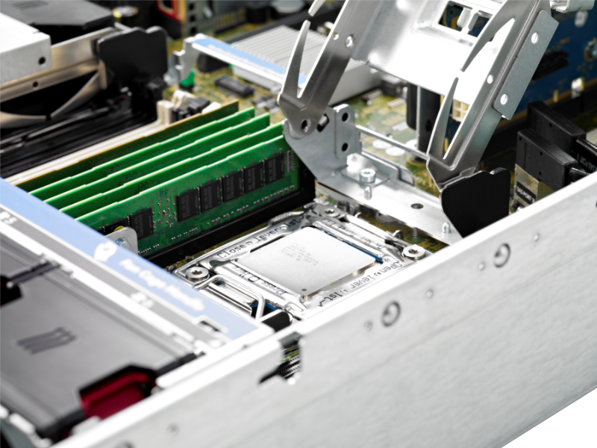
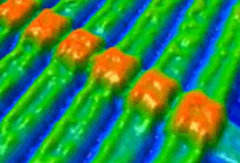
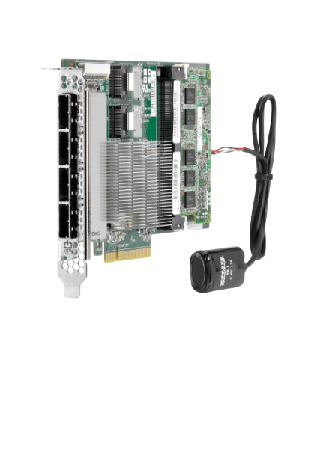
Persistent Memory Vision
PM Brings Storage
Fast Like
Memory
PM
Durable
Like Storage
To Memory Slots
Make Data Durable Without Doing IO!

Slide 4
Application View of IO Elimination
Non-Blocking
NUMA
Software overheads are being driven to keep pace with devices
NUMA latencies up to 200 nS have historically been tolerated
Anything above 2-3 uS will probably need to context switch
Latencies below these thresholds cause disruption

Slide 5
SNIA NVM Programming Model Version 1
Approved by SNIA in December
    Downloadable by anyone
Expose new features of block and file to applications
    Atomicity capability and granularity
    Thin provisioning management
Use of memory mapped files for persistent memory
    Existing abstraction that can act as a bridge to higher value from persistent memory
    Limits the scope of re-invention from an application point of view
    Open source implementations already available for incremental innovation (e.g. PMFS)
Programming Model, not API
    Describes behaviors in terms of actions
    Facilitates discovery of capabilities using attributes
    Usage illustrated as Use Cases
    Implementations map actions and attributes to API elements

Slide 6
Conventional Block and File Modes
BLOCK mode describes extensions:
Atomic write features
Granularities (length, alignment)
Thin Provisioning Management
FILE mode describes extensions:
Discovery and use of atomic write features
The discovery of granularities (length, alignment characteristics)
Memory Mapping in NVM.FILE mode uses volatile pages and writes them to disk or SSD
Notes:
Note the statement at the bottom about memory mapping in NVM.FILE; next slide mentions the difference with PM

Slide 7
Persistent Memory Modes
NVM.PM.VOLUME mode provides a software abstraction to OS components for Persistent Memory (PM) hardware:
list of physical address ranges for each PM volume
Thin provisioning management
NVM.PM.FILE mode describes the behavior for applications accessing persistent memory including:
mapping PM files (or subsets of files) to virtual memory addresses
syncing portions of PM files to the persistence domain
Memory Mapping in NVM.PM.FILE mode enables direct access to persistent memory using CPU instructions

Slide 8
What's next for NVM programming?
Beyond version 1, three work items are under investigation
Software hints
      Application usage , access patterns
      Optimization based on discovered device attributes
      Present hints emerging in standards (SCSI, NVMe) to applications
Atomic transactional behavior
      Add atomicity and recovery to programming model
      Not addressed by current sync semantics
Remote access
      Disaggregated memory
      RDMA direct to NVM
      High availability, clustering, capacity expansion use cases

Slide 9
RDMA Challenge
Use case:
      RDMA writing to persistent memory
      within a memory mapped file
      built on NVM.PM.FILE from version 1 programming model
How can the initiator of the RDMA efficiently learn when data is persistent at the remote side?
      Sync semantics for remote access
      Flushing processor queues on the remote end

Slide 10
Discussion

