Slide 1
ZeroMQ-ofi sketch
Kayla Seager

Slide 2
Purpose of discussion
  Explore requirements of ZeroMQ (“sockets library”)
      ZeroMQ: widely used in AI/enterprise
  Identify Mismatches between ZeroMQ and Libfabric
    Focus on a commonly used subset of ZMQ API
  Brainstorm Libfabric improvements

Slide 3

Zeromq
“Asynchronous sockets library with load balancing”

Slide 4
What is ZeroMQ?
Socket-like interface but builds features on top of it…
  Multiple Connections per socket
  Async communication model: fire and forget
  Background CM: listen/accept
  Message-based (vs stream)
  Some built-in load balancing (defined by socket type)

Slide 5
ZMQ Objects & Mapping to OFI
ZMQ CTX
FI_DOMAIN
ZMQ
Socket fd
ZMQ
Socket fd
FI_EP
Connection fd
Connection fd
Connection fd
Connection fd
Notes:
Ctx: only zeromq object that can be safely shared between threads

Slide 6
Example Code
1) void *context = zmq_ctx()
Server:
  2) void *rep_sock =
  zmq_socket(context, ZMQ_REP)
  3) zmq_bind(rep_sock, “tcp://*:4040”)
  4) zmq_recv(rep_sock, buffer, 6, flag)
Client:
  2) void *req_sock =
  zmq_socket(context, ZMQ_REQ)
  3) zmq_connect(req_sock, “tcp://localhost:4040”)
  4) zmq_send(req_sock, “hello”, 6, flag)

Slide 7
Example Code: What’s missing?
Server:
  4 zmq_recv(rep_sock, buffer, 6, flag)
Client:
  zmq_send(req_sock, “hello”, 6, flag)
No destination address provided!
One socket <--> multiple connections
how does it pick the connection?

Slide 8
Example Code:
Server:
  zmq_socket(context, ZMQ_REP)
Client:
  zmq_socket(context, ZMQ_REQ)
Socket type determines connection selection
  Learning curve…

Slide 9
Socket types/Message Patterns
Definition: how and when to use connections
Example:
  Request-Reply: (ZMQ_REQ/ZMQ_REP) Load balancing
    Dealer/Router
  Pub-Sub: broadcast to all connections
  Exclusive Pair: only one connection
Different sockets with the right type can connect to each other
Notes:
Only going to talk about REQ/REP/DEALER/ROUTER

Slide 10
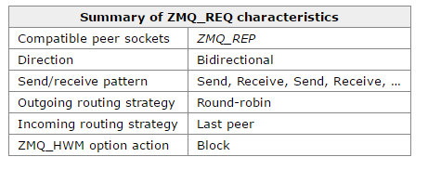
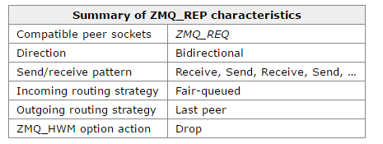
REQ/REP: synchronous Send/Recv
Requires a single REQ and REP socket
Synchronous send/recv
  Will wait for recv from socket it sent to
Round Robin load balancing
1
SockAREP
Wait for SockA recv
Sock
REQ
REQ.send(msg1)
REQ.send(msg2)
SockBREP
2
Notes:
REQ knows exactly which pipe to expect the reply from
Last peer = last person I communicated with since its sync you know who that is =)

Slide 11
Round Robin Send
send one message to each destination in round robin order
send msg1
send msg2
send msg3
1
2
3
dest1
dest2
dest3
dest1
dest2
dest3
dest1
dest2
dest3

Slide 12
Fair Queue Recv
Read one message from each destination in round robin order
Recv(msg1, dest1)
Recv(msg2, dest2)
Recv(msg3, dest3)
1
2
3
MsgQ
Dest1
MsgQ
Dest2
MsgQ
Dest3

Slide 13
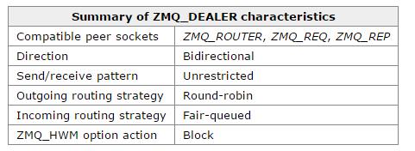
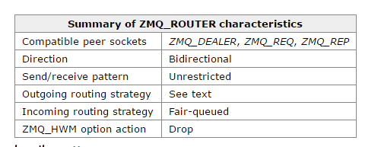
Dealer/Router
Aynchronous (REP/REQ)
Round Robin load balancing
  send and receive!
Router: uses ID for connections

Slide 14
Special case: Router and IDs
Wait you can set the Destination? (on Router Send only)
Dealer/Client: (connection to Router)
Can “address” your connection via ID’s
can set ID (else ZMQ will set one for you)
Router and ID management:
Specify Send via connection ID
  Expects first “message” to be ID
  uses it for connection look-up
Receive
  Round robins connections
  Chosen connection: look-up which ID,
    First receive is ID, then message

Slide 15
Special case: Router and IDs
Client: set ID
zmq_setsockopt( client_sock, ZMQ_IDENTITY, ClientA_ID…)
zmq_connect( client_sock, Router_address )
3) zmq_recv(msg_for_ClientA)
4) zmq_send(msg_for_Router)
Router Server:
1) zmq_send(ClientA_ID, MORE)
2) zmq_send(msg_for_ClientA)
5) zmq_recv(ClientA_ID)
6) zmq_recv(msg_for_Router)
ID is only used at Router Socket layer
– not transmitted

Slide 16
ZMQ Architecture: Single Socket
User’s ZMQ socket_fd
Front End:
Message Pattern Protocol implementation
Front end
  ZMQ_REP/REQ…
  Put/recv message on/from queue
  Signal backend
Back end
  “fi_send/fi_recv”
  Put/recv message on/from queue
  Signal front end
  CM polling
Message Queue
Message Queue
“Pipes” created per connection
Control messaging
Back End:
Transport/CM
Poll(fds..)
network

Slide 17
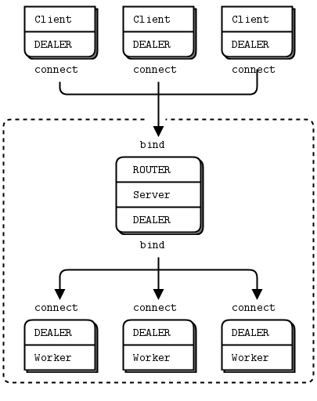
Overall ZMQ goal: build systems
Make asynchronous sockets “easy”
ZMQ sockets are “lego blocks” for messaging systems
Not constrained to any particular system -can do broker or brokerless
Notes:
Not constrained to any one message system (like other MQ systems)

Slide 18
Case Study: MXNet-Pslite Model:
AI Framework
ZMQ API usage
  Router/Dealer socket type
  Msg API (send/recv)
  MORE flag
Dealer Dealer Dealer
Dealer Dealer Dealer
Dealer Dealer Dealer
process 1
process 2
process 3
Router
Router
Router
bind
bind
bind
connect
connect
connect
Dealer Dealer Dealer
Node 4
Router
Notes:
Focusing on this API set
Essentially ps-lite is devising their own ID-connection scheme and overlaying that on the dealer sockets to determine who to send to

Slide 19
ZeroMQ – OFI mismatches

Slide 20
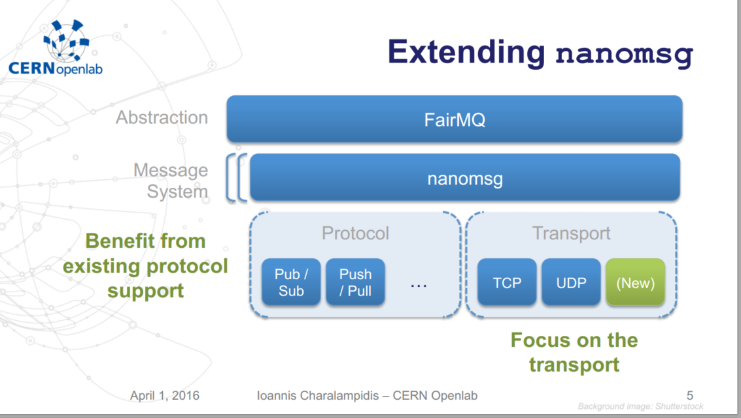
Related Work note
Alice – FairMQ - Nanomsg
Nanomsg:
  refactored ZeroMQ
    Pluggable transports
Nanomsg-Libfabric (usNIC target)
  PR for true Zero-Copy support
  Can’t reuse existing FD based solns

Slide 21
ZMQ Architecture
User’s ZMQ socket_fd
Front End:
Message Pattern Protocol implementation
Not a great fit for Libfabric
We already have async communication…
  Asynchronous progress
  Message queues
  Are we only missing the message patterns? no….
Message Queue
Message Queue
“Pipes” created per connection
Control messaging
Back End:
Transport/CM
Poll(fds..)
network

Slide 22
ZMQ Semantic mismatches for Libfabric
Multi-connection “endpoints”
Dynamic Process management
Buffered receive
Peer-to-peer flow control
Shared memory solution

Slide 23
Multi-connection “endpoints”
One endpoint: multiple connect oriented connections?
mapping to connectionless FI_EP_RDM
or
single connection FI_EP_MSG?
  It is multi-connection per socket…

Slide 24
2. Dynamic Process management
Back End:
Transport/CM
Poll(fds..)
network

Slide 25
CM Problem statement 1
Need Server/Client name Exchange
  Can’t solely use ZMQ “CM” calls
  Need to be able to go from a bind->send
Creating and destroying connections at any time
Can’t have CM send/recv interfere with messaging
    Need a dedicated separate CM channel
    Can’t have a recv(any) interfering with the routing/scheduling algorithm
Notes:
Must resolved remote connection before send w/o recv help
Need to queue incoming receives

Slide 26
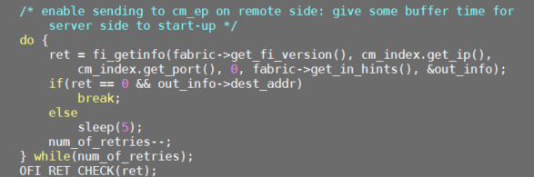
CM Problem statement 2
  Utility CM:
  -need timeout if client tries to resolve server address before server is started

Slide 27
3. Buffered receive
ZMQ Buffering Requirement
-forces buffer to come from transport
Zmq_msg_t msg
create_buffer()

Slide 28
ZMQ Buffering Requirement
ZMQ_MSG_API
  Requires usage of zmq_msg_t (internal to transport buffer)
    User responsible for create/destroy
MORE flag
  send/recv API has “MORE” flag capability
    Multiple send/recv treat as send/recv single message
Notes:
MORE = multi-sends/recv = 1 message

Slide 29

ZMQ Buffer: ZMQ_MSG API
zmq_msg_t: buffer “handle”
  Asks ZMQ to provide buffer
      But user decides on lifetime of ptr (malloc/free)
Example: Send

Slide 30
ZMQ Buffer: ZMQ_MSG API
Example: Recv
  Void * context = Zmq_ctx()
  Void * rep_sock = Zmq_socket(context, ZMQ_REP)
  Zmq_bind(rep_sock, “tcp://*:4040”)
  Zmq_msg_t msg
  Zmq_msg_init(msg)
  Zmq_msg_recv(&rep_sock, msg, flag) ,
Asked ZMQ to buffer without knowing size

Slide 31
ZMQ Buffer: MORE flag cont.
Transport implications: multi-msg as “one message”
  must have local completion of segments
    Must buffer “iovec” segments
  User API: Parts are sent separately and received separately
  Must receive all or none of the message parts
buf1
buf2
buf3
Zmq_recv(buf1, MORE)
Zmq_recv(buf2, MORE)
Zmq_recv(buf3, 0)
Notes:
-even in msg case they can free buffer
Main point: atomic send/recv but also local completion = must buffer chunks on send AND recv

Slide 32
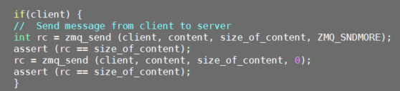
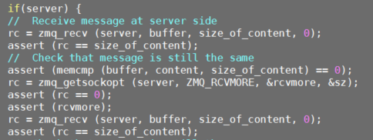
ZMQ Buffer: MORE flag
treat as single fi_send
ZMQ tells user if there is more to receive

Slide 33
ZMQ Buffer: Summary
Need buffering for zmq_msg_t handle
receive side: user won’t provide
    Length
    Buffer
Libfabric Options
  FI_PEEK helps, but no buffer support
  Buffered send/recv iovec?
  “buffered” recv?

Slide 34
4. Peer-to-peer flow control
Implementing Router/Dealer socket type:
->Requirement comes out of load balancing support
1
2
3
MsgQ
Dest1
MsgQ
Dest2
MsgQ
Dest3

Slide 35
Router Requirements: ID & FQ
ID management
  Create ID’s for sockets (sockopt)
  Map to connections
Send/Recv
  Send:
    ID lookup
  Receive:
    Fair queuing
    Return ID
Notes:
add one connection at a time

Slide 36
Router Requirements: flow control
  Loop over active connections in Round Robin fashion
  If queue is either empty or full (unused or overused), deactivate
      Atomic swap into deactivated index
        reactivated by backend
      High water mark: relies on TCP flow control
        (full queue)
Logical End of active connections
Round Robin:
Message in queue?
Connection1
MsgQ
Connection2
MsgQ
Connection3
MsgQ
Connection4
MsgQ
Notes:
Tracks HWM, Send side: if a pipe hits high water mark swap to deactives it (relies on TCP flow control)
If a recv queue gets full need to back off sender
Recv: reactivate sender if back at lwm

Slide 37
5. shared memory solution:
Extent of ZeroMQ transport support
Unicast (can do all protocols)
Multicast (only PUB/SUB)
TCP
IPC
(inter-process communication)
TIPC
Cluster IPC with socket interface
INPROC
Inter-thread communication
EPGM
PGM
NORM
Engines
Stream Engine
Shared Memory
EPGM?
PGM
Norm Engine

Slide 38
Summary ZMQ mismatches for Libfabric
Multi-connection “endpoints”
Dynamic Process management
Buffered receive
Peer-to-peer flow control
Shared memory solution

Slide 39
Thank you!
Notes:
Feedback: RabbitMQ etc same requirements? How wide are these requirements? How often flow control? Why do Apps do X?

Slide 40
Case Study: AI Framework MXNet-Pslite Model:
Per process resources
  N x Dealer sockets
    Send only
  1 Router socket
    Recv only
Dealers connect to one Router
  Dedicated connection
Router receive
  Fair queuing all incoming recvs
Dealer Dealer Dealer
Dealer Dealer Dealer
Dealer Dealer Dealer
process 1
process 2
process 3
Router
Router
Router
bind
bind
bind
connect
connect
connect
Dealer Dealer Dealer
Node 4
Router
Notes:
Essentially ps-lite is devising their own ID-connection scheme and overlaying that on the dealer sockets to determine who to send to

Slide 41
How does it compare to other MQ systems?
  Pro:
  Brokerless
  higher throughput/latency
  More flexible in message model options
    Messaging library
  Con:
  Static routing (always RR)
  Learning curve
    Harder to build complex systems

