Slide 1


Slide 2
Sean Hefty
THE LATEST ON OPENFABRICS INTERFACES (OFI):
THE NEW SCALABLE FABRIC SW LAYER FOR SUPERCOMPUTERS
OpenFabrics Interfaces Working Group Co-Chair
Intel
November 2016

Slide 3
OFIWG: develop … interfaces aligned with … application needs
Open Source
Application-Centric
Expand open source community
  Inclusive development effort
  App and HW developers
Software interfaces aligned with application requirements
  Careful analysis of requirement
libfabric
Implementation Agnostic
Scalable
Optimized SW path to HW
  Minimize cache/memory footprint
  Reduce instruction count
  Minimize memory accesses
Good impedance match with multiple fabric hardware
  InfiniBand*, iWarp, RoCE, Ethernet, UDP offload, Intel®, Cray*, IBM*, others
3
* Other names and brands may be claimed as the property of others

Slide 4


OFI APPLICATION REQUIREMENTS
Give us a high-level interface!
Give us a low-level interface!
MPI developers
OFI strives to meet both requirements

Slide 5
OFI SOFTWARE DEVELOPMENT STRATEGIES
One Size Does Not Fit All
Application
Application
Application
App uses OFI features
OFI
OFI
App optimizes based on supported features
Provider
Common optimization for all apps/providers
OFI
Provider optimizes for OFI features
Provider
Provider
Provider supports low-level features only
Fabric Services

Slide 6
OFI DEVELOPMENT STATUS
Application
App uses OFI features
App optimizes based on supported features
Few apps
Many apps
libfabric
OFI-provider gap
Common optimization for all apps/providers
Provider
Provider’s choice
Provider optimizes for OFI features
Provider supports low-level features only
Fabric Services
6

Slide 7
OFI LIBFABRIC COMMUNITY
Because of the OFI-provider gap, not all apps work with all providers
Intel® MPI Library
MPICH Netmod/CH4
Open MPI
MTL/BTL
Open MPI
SHMEM
GASNet
*
Sandia SHMEM
Clang UPC
rsocket
ES-API
libfabric Enabled Middleware
libfabric
Control Services
Communication Services
Completion Services
Data Transfer Services
Discovery
Connection Management
Event Queues
Message Queue
RMA
fi_info
Address Vectors
Event Counters
Tag Matching
Atomics
Sockets
TCP, UDP
Verbs
*
®
*
*
*
*
Cisco usNIC
Intel
OPA PSM
Cray
GNI
Mellanox MXM
IBM Blue Gene
A3Cube RONNIE
supported
* Other names and brands may be claimed as the property of others
experimental

Slide 8

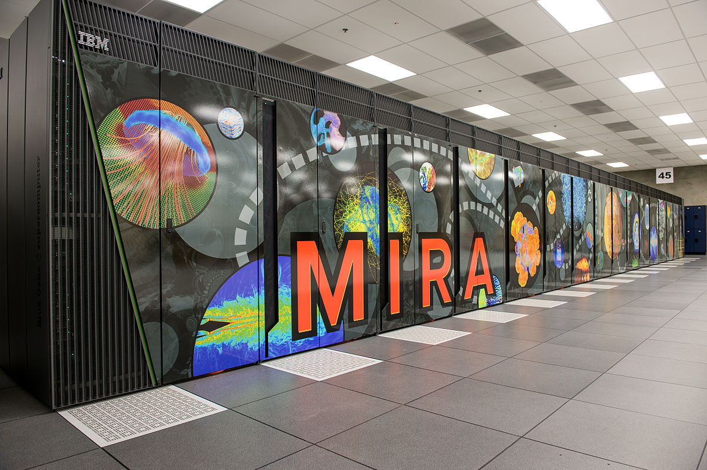
LIBFABRIC SCALABILITY
Blue Gene / Q
Developed to evaluate the Aurora software stack at scale and assist applications in the transition from Mira to Aurora
By Courtesy Argonne* National Laboratory, CC BY 2.0, https://commons.wikimedia.org/w/index.php?curid=24653857
Native provider implementation that directly uses the Blue Gene/Q hardware and network interfaces for communication
* Other names and brands may be claimed as the property of others

Slide 9
LIBFABRIC SCALABILITY
Blue Gene / Q
PAMI and libfabric performance
Completely subjective software stack comparison
IBM* MPICH / PAMI
  IBM XL C compiler for BG, v12.1
  Optimized for single-threaded latency
  …/comm/xl.legacy.ndebug/bin/mpicc
  v1r2m2
MPICH / CH4 / libfabric
  gcc 4.4.7
  global locks, inline, direct, etc.
  Provider not optimized for performance
MPICH
MPICH
PAMID
CH4 OFI
PAMI
vs
libfabric
BG/Q Provider
hardware
32 nodes on ALCF Vesta machine

Slide 10
Blue Gene / Q
OSU* MPI Performance Tests v5.0
LIBFABRIC SCALABILITY
MPI scale out testing:
- cpi – 1M ranks,
- ISx benchmark – 0.5M ranks
Tests document performance of components on a particular test, in specific systems. Differences in hardware, software, or configuration will affect actual performance. Consult other sources of information to evaluate performance as you consider your purchase. For more complete information about performance and benchmark results, visit http://www.intel.com/performance.
* Other names and brands may be claimed as the property of others

Slide 11

LIBFABRIC SCALABILITY
CRAY XC40
SHMEM
Evaluate libfabric SHMEM performance on high-performance interconnect
Computing Sciences
Lawrence Berkeley National Laboratory
Provider implementation that uses the Cray* uGNI hardware and network interface for communication
* Other names and brands may be claimed as the property of others

Slide 12
LIBFABRIC SCALABILITY
CRAY XC40
SHMEM
1630 nodes on Cray* XC40 (Cori)
Cray* SHMEM
  Cray* Aries, Dragonfly* topology
  CLE (Cray* Linux*), SLURM*
  DMAPP
    Designed for PGAS
    Optimized for small messages
Sandia* OpenSHMEM / libfabric
  uGNI
    Designed for MPI and PGAS
    Optimized for large messages
https://www.nersc.gov/users/computational-systems/cori/configuration
Cray SHMEM
Open SHMEM
OFI
libfabric
DMAPP
vs
uGNI
Aries Interconnect
* Other names and brands may be claimed as the property of others

Slide 13
CRAY XC40
LIBFABRIC SCALABILITY
SHMEM
Blocking Get/Put B/W
Put – up to 61% improvement
Get – within 2%
Tests document performance of components on a particular test, in specific systems. Differences in hardware, software, or configuration will affect actual performance. Consult other sources of information to evaluate performance as you consider your purchase. For more complete information about performance and benchmark results, visit http://www.intel.com/performance.
* Other names and brands may be claimed as the property of others

Slide 14
CRAY XC40
LIBFABRIC SCALABILITY
SHMEM
NAS ISx (Integer Sort)
weak scaling
GUPS Scaling
slight improvement
(lower is better)
Improved scalability
XPMEM
Tests document performance of components on a particular test, in specific systems. Differences in hardware, software, or configuration will affect actual performance. Consult other sources of information to evaluate performance as you consider your purchase. For more complete information about performance and benchmark results, visit http://www.intel.com/performance.
* Other names and brands may be claimed as the property of others

Slide 15
ADDRESSING THE OFI-PROVIDER GAP
libfabric API
Libfabric Framework
Utility Provider
Interface ‘extensions’ – for consistency
Provider Services
Logging
Environment variables
Assist in provider development
Components
templates, lists, rbtree, hash table, free pool, ring buffer, stack, …
Enhance core provider
Base Class Implementations
fabric, domain, EQ, wait sets, AV, CQ, … SHM primitives
Core Provider

Slide 16
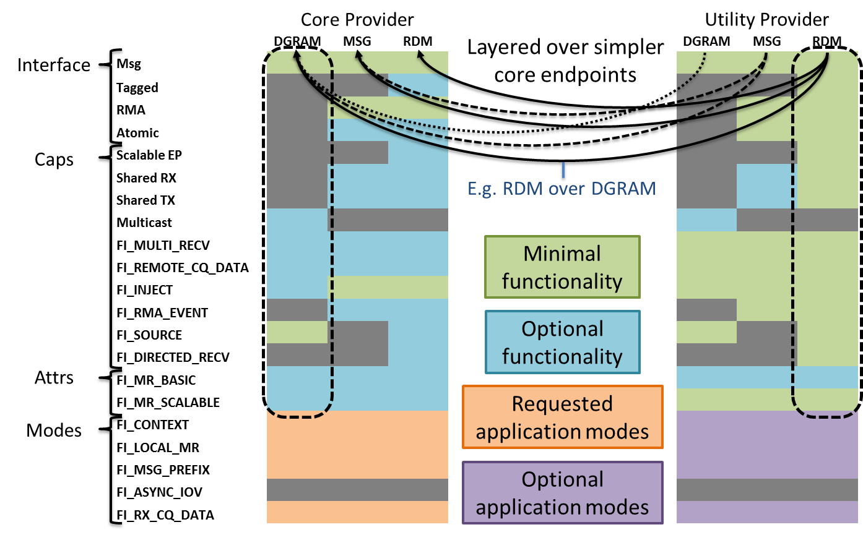
UTILITY PROVIDER
Performance is a primary objective

Slide 17




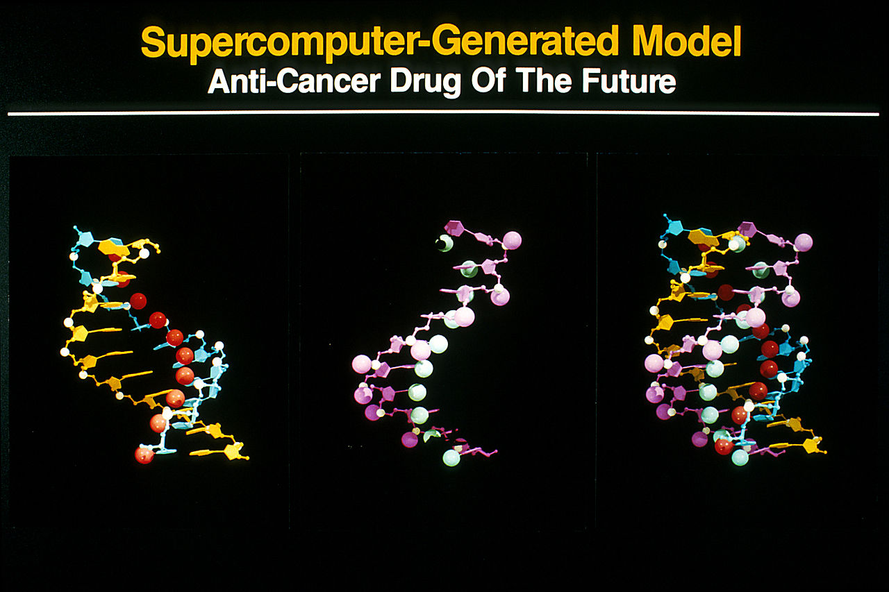


MOVING FORWARD
Sockets – TCP/UDP
NetworkDirect
Analyze requests to expand OFI community
Beyond Linux*
Enterprise, Cloud, Storage (NVM)
Beyond HPC
Stronger engagement with these communities
* Other names and brands may be claimed as the property of others

Slide 18
TARGET SCHEDULE
2016
Q2
Q3
Q4
2017
Q2
Q3
Q4
RDM over DGRAM Util
RDM over MSG Util
Utility provider is ongoing
Shared Memory
New Core Providers
Driven by implementation feedback
Improve error handling, flow control
Better support for non-traditional fabrics
Optimize completion handling
Address deferred features
Traditional and non-traditional RDMA providers
ABI 1.1

Slide 19

SUMMARY
OFI is so good
OFIWG development model working well
Interest in OFI and libfabric is high
Growing community
Significant effort being made to simplify the lives of developers
  Applications and providers

Slide 20
LEGAL DISCLAIMER & OPTIMIZATION NOTICE
No license (express or implied, by estoppel or otherwise) to any intellectual property rights is granted by this document. Intel disclaims all express and implied warranties, including without limitation, the implied warranties of merchantability, fitness for a particular purpose, and non-infringement, as well as any warranty arising from course of performance, course of dealing, or usage in trade. This document contains information on products, services and/or processes in development. All information provided here is subject to change without notice. Contact your Intel representative to obtain the latest forecast, schedule, specifications and roadmaps. The products and services described may contain defects or errors known as errata which may cause deviations from published specifications. Current characterized errata are available on request.
Software and workloads used in performance tests may have been optimized for performance only on Intel microprocessors. Performance tests, such as SYSmark and MobileMark, are measured using specific computer systems, components, software, operations and functions. Any change to any of those factors may cause the results to vary. You should consult other information and performance tests to assist you in fully evaluating your contemplated purchases, including the performance of that product when combined with other products.
Copyright © 2016, Intel Corporation. All rights reserved. Intel, Pentium, Xeon, Xeon Phi, Core, VTune, Cilk, and the Intel logo are trademarks of Intel Corporation in the U.S. and other countries.
*Other names and brands may be claimed as the property of others
Optimization Notice
Intel’s compilers may or may not optimize to the same degree for non-Intel microprocessors for optimizations that are not unique to Intel microprocessors. These optimizations include SSE2, SSE3, and SSSE3 instruction sets and other optimizations. Intel does not guarantee the availability, functionality, or effectiveness of any optimization on microprocessors not manufactured by Intel. Microprocessor-dependent optimizations in this product are intended for use with Intel microprocessors. Certain optimizations not specific to Intel microarchitecture are reserved for Intel microprocessors. Please refer to the applicable product User and Reference Guides for more information regarding the specific instruction sets covered by this notice. Notice revision #20110804

Slide 21

Thank you for your time!
Sean Hefty
sean.hefty@intel.com
www.intel.com/hpcdevcon

