Slide 1
OpenFabrics Interfaces BoF SC15
Paul Grun – Cray
Sean Hefty – Intel
Frank Yang - NetApp

Slide 2
Who’s here?

Slide 3
Consumers of Network Services
distributed computing
data storage, data access
data analysis
Provider
of Network Services
A network

Slide 4
Useful things to know
OFA Monterey Workshop
April 4 – 8, Monterey CA
www.openfabrics.org
OpenFabrics Interfaces
Working groups (2) meet on Tuesdays
ofiwg@lists.openfabrics.org
ofiwg-mpi@lists.openfabrics.org

Slide 5
Possible Topics
Brief intro to the OFI project
Where we are, how we got here
Libfabric
Mapping consumers to OFI
Extending libfabric
DS/DA – Storage
Storage use cases
NVM
Testing

Slide 6
Brief Intro to OFI

Slide 7
OFI Project Concept
distributed computing
data storage, data access
data analysis

Slide 8
OFI Project Concept
distributed computing
data storage, data access
data analysis
Consumer focus
“Transport independent”
Performance, Extensibility, Exascale

Slide 9
OFI Project Concept
distributed computing
data storage, data access
data analysis
API
Framework
…
Provider
Provider
Provider

Slide 10
OFI – OFIWG
UPC
Chapel
PGAS
distributed computing
data storage, data access
data analysis
SHMEM
MPI
libfabric
libfabric
…
Provider
Provider
Provider
Initial emphasis was on defining libfabric for distributed computing

Slide 11
OFI – Data Storage, Data Access
UPC
Chapel
PGAS
byte addressable
byte addressable
distributed computing
user mode I/O
kernel mode I/O
data analysis
SHMEM
object
block
file
MPI
object
libfabric
libfabric
kfabric
…
Provider
Provider
Provider
Extend libfabric for User Mode I/O
Define kfabric for Kernel Mode I/O

Slide 12
OFI is the name for an umbrella project to develop APIs that are
a) transport independent
b) entirely responsive to the needs of network consumers
c) extensible

Slide 13
OFI is the name for an umbrella project to develop APIs that are
a) transport independent
b) entirely responsive to the needs of network consumers
c) extensible
Two Active Working Groups
OFI WG (‘ofee wig’) – distributed computing
- Developing the libfabric API for distributed computing
Initial release is complete
Looking at extensions for added features – more on this shortly
DS/DA – data storage, data access
Possible extensions to libfabric for user mode I/O
- Defining kernel modules for I/O
- Planning a discussion with Linux kernel maintainers ‘soon’

Slide 14
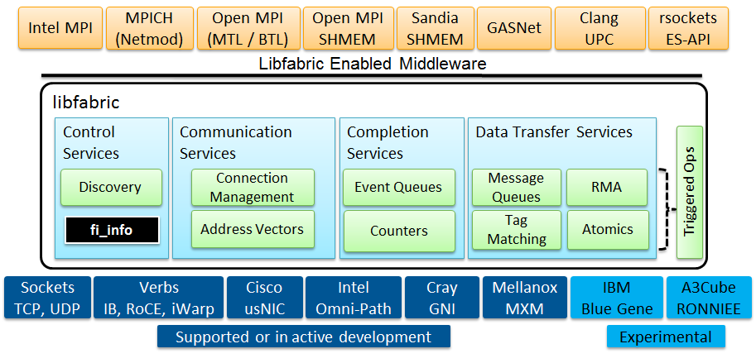
Architecture

Slide 15
Kfabric Overview (speculative)
KFI API
KFI API
KFI Providers
Verbs Provider
Sockets Provider
New Providers**
kernel Verbs
Kernel Sockets
Device Drivers
InfiniBand
iWarp
RoCE
NIC
New Devices**
Red = new kernel components, ** = e.g. NVM

Slide 16
Mapping Consumers to OFI

Slide 17
Consumer Perspectives
UPC runtime
Nenad Vukicevic, Gary XXX, Intrepid Technology, Inc.
MPICH
Ken Raffenetti, Argonne National Lab
SHMEM
Sean Hefty, Intel Corp.
OpenMPI
Dave Goodell, Cisco
Java wrapper for libfabric
Howard Pritchard, LANL

Slide 18
Libfabric Extensions

Slide 19
Current libfabric status
Several features were deferred post libfabric release 1.0
Application enabling has identified newly desired features with the current interfaces
Provider enabling has identified potential implementation inefficiencies
Summary: there is a need to extend the API

Slide 20
Expanded iovec support
Expand iovec support to include other data formats (issue 32)
Proposal to add strided iov support
FI_IOSV – IO strided vector flag
struct fi_iosv { struct iovec iov; offset_t stride; size_t count; };
May not require new FI version

Slide 21
Domain Events
Mechanism for domain events (issue 244)
Needs further discussion
Identify specific events and how they map to OFI objects
Likely requires new ‘registration’ interface and event structures
Event structures do not require bumping FI version
Registration mechanism may, unless an existing call is re-used (e.g. fi_control)
Use of fi_control can be wrapped by a static inline to provide a cleaner interface to the app

Slide 22
Provider Specific AV Data
Ability to insert provider specific data into AVs that is exchanged OOB (issue 298)
Retrieve data from on AV and insert it into a remote peer
Proposal in github issue needs refinement
Get/set data AV routines
Common header for provider data
Likely needs new AV interfaces and structures

Slide 23
Configuration File Support
Support for parameter configuration file(s) (derived from issue 487)
Proposal discussed in PR 1411
Still under discussion
Trending to creation of single config/ini file
Expands existing provider environment variable infrastructure
May need updated param data structures

Slide 24
Multicast Support
Define multicast support (issue 1001)
Needs further discussion and design analysis
Avoid negative performance interaction between multicast and unicast traffic

Slide 25
Atomic Data Sizes
Define size of atomic floating point data types (issue 1124)
Floating point
Need to settle on a solution
Likely needs new atomic interfaces or data types

Slide 26
Relax CQ Flag Support
Relax support for completion flags (issue 1142)
Provider driven
One of several CQ related requests
May need to expand CQ initialization

Slide 27
Chained Operations
Marking end of linked operations (issue 1218)
Proposal in github issue needs consensus
New interfaces to mark start and end of chain
Likely needs new endpoint interfaces

Slide 28
Buffered Receive Restrictions
Buffered receive restrictions (issue 1240)
Proposal to expand buffered receive attributes
Need application analysis of proposals
Likely adds new fields to attribute structures

Slide 29
Report Optimal CQ Attributes
Report optimal CQ attributes (issue 1255)
One of several CQ requests
Need to develop and analyze proposal
May require changing CQ initialization

Slide 30
Framework Expansions
Additional framework support for provider initialization (issue 1275)
Proposal to extend provider structure
Identify other candidates for new provider entry points (fi_getinfo2?)s

Slide 31
FI_ASYNC_IOV Limits
FI_ASYNC_IOV limits (issue 1393)
Determine need for min/max limits for async IOVs
Likely needs new fields added to attributes
Coordinate with strided IOV support

Slide 32
Restrict EP and CQ Bindings
Limiting which EPs may be associated with a CQ or counter (derived from issue 1394)
One of several CQ requests
Associated with optimal CQ use
Driven from the provider side
Analyze application impact

Slide 33
CQ Reports Source Address
Provide mechanism for receiver to learn source address (issue 1399)
Handle cases where sender is NOT is associated AV
One of several CQ requests
Prepare proposal for discussion
App enables CQ support
For unmatched sources, report data as CQ ‘error’ (EADDRNOTAVAIL)
May not require new FI version

Slide 34
Data Storage / Data Access

Slide 35
Current DS/DA activities
Currently collecting requirements
Scope
Local and Remote I/O
Kernel and User mode
Major focus on NVM

Slide 36
Motivation for NVM
NVM is seen as an important emerging technology of great importance to the consumers of OFS
It is sufficiently unlike existing memory models to warrant a discussion of an API to access it
It will have a significant enough impact on how storage is architected, deployed, and accessed to warrant a discussion of NVM for storage, and an API to access it
Both ‘Data Storage’ and ‘Data Access’ are therefore potentially impacted by the emergence of NVM
Hence, the initial look at NVM is being taken by the DS/DA subgroup
A broader discussion with the main OFI WG is anticipated

Slide 37
Local use cases (typical)
I/O
memory
NV DIMM
NV DIMM
NV DIMM
NV
DIMM
DIMM
DIMM
DIMM
NV
DIMM
MC
MC
fs
block access* via e.g. NVMe
SSD
*f/s storage today is block storage, but in the future it may be some other access paradigm, e.g. byte level, object I/O

Slide 38
Remote I/O access (typical)
shared remote access I/O device
CPU
NV DIMM
NV DIMM
NV DIMM
NV
DIMM
CPU
NIC
NIC
SSD
SSD
SSD
I/O device exports a byte or block interface

Slide 39
Useful things to know (again)
OFA Monterey Workshop
April 4 – 8, Monterey CA
www.openfabrics.org – see the blog on the homepage
OpenFabrics Interfaces
Working groups (2) meet on Tuesdays
ofiwg@lists.openfabrics.org
ofiwg-mpi@lists.openfabrics.org

