Slide 1
Advancing open fabrics interfaces
Sean Hefty, OFIWG Co-Chair
Intel Corporation
March, 2017

Slide 2
Moving libfabric forward
Apps
Users
Providers
Enhancements
Deferred and new features
API adjustments
Developer feedback
Performance optimizations
Provider implementation
Many features require migration to API 1.5
Existing apps work unmodified

Slide 3
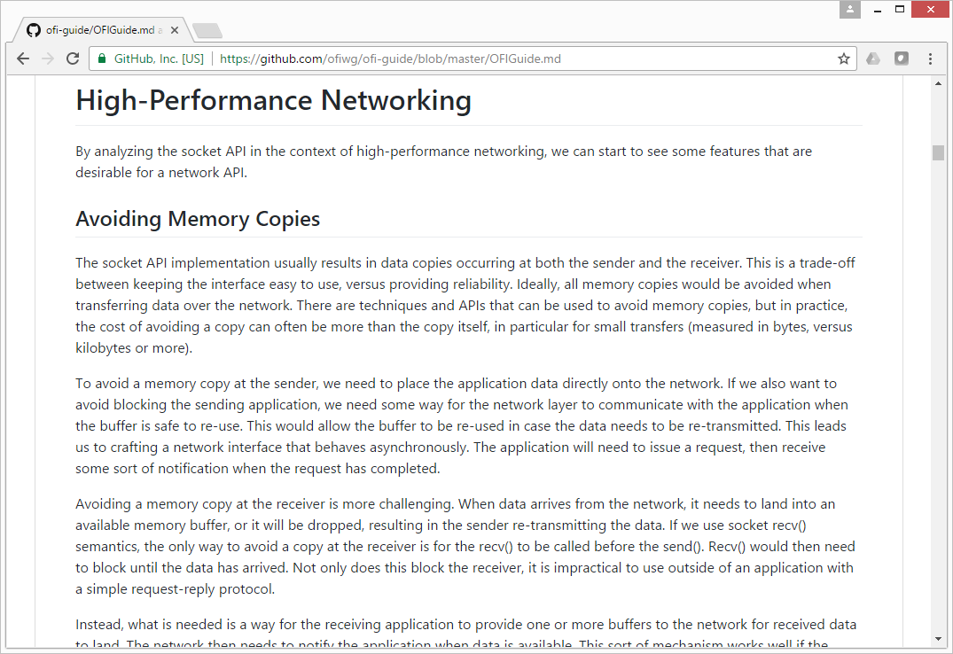
OFI Developer guide
New!
What a novel concept!
Broad coverage of libfabric
Design motivations, architecture, usage guidance
Assumes minimal background
Reviews sockets API for context
Analyzes HPC requirements and their impact on an API
Memory copies, network buffering, asynchronous operations, interrupts, direct HW access, ...
Lower the barrier to adoption
Many concepts are generic

Slide 4
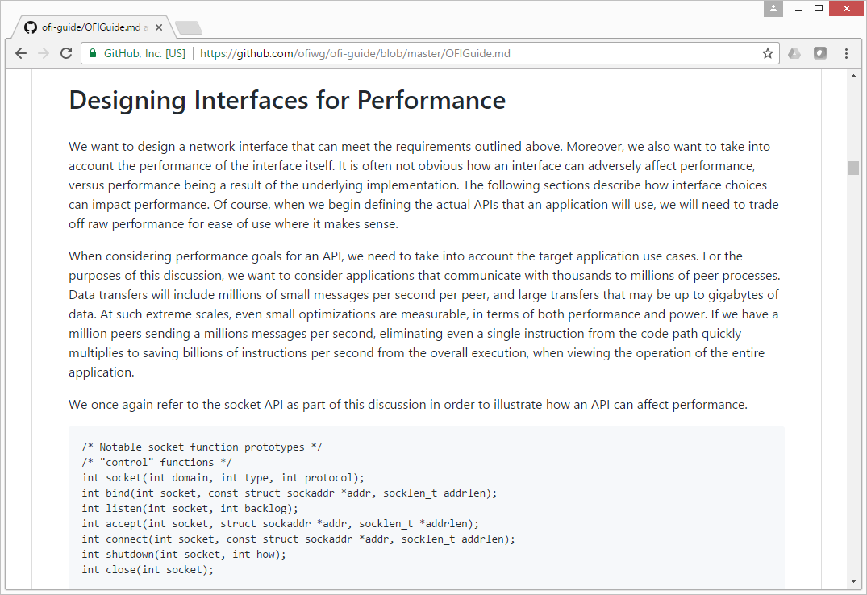
OFI Developer guide
New!
Owl read this later
Examines API trade-offs
Call setup, branches, memory footprint, …
Defines communication primitives
Command queues, memory buffers, completion notification, progress models, data and message ordering, …
Then it goes into detail about OFI
https://github.com/ofiwg/ofi-guide

Slide 5
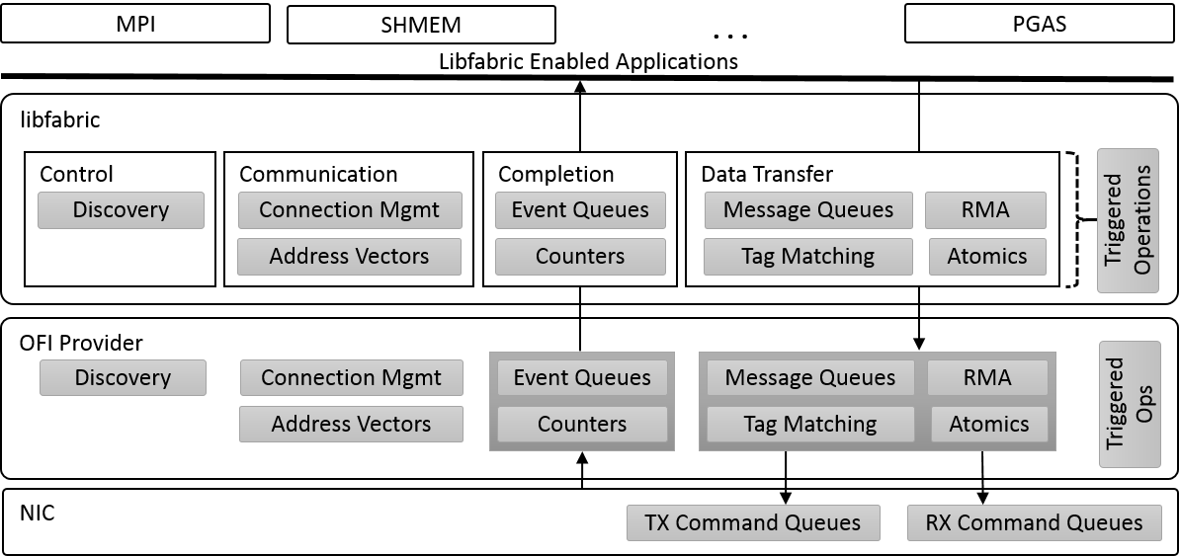
architecture
Old!
Capabilities
Modes

Slide 6
Authorization keys
Job Keys
Isolate traffic between virtual sets of peers
Associated with endpoints and memory regions
Only endpoints with the same key may communicate
Memory regions are only accessible through endpoints with matching keys

Slide 7
Multicast
At Long Last
Datagram endpoint capability
New fi_join call to connect to group
Supports send-only joins
Returns fabric address (fi_addr_t) for group
Uses existing data transfer APIs
Only message queue interface currently defined
Multicast sends require use of FI_MULTICAST flag
Distinguish between unicast and multicast address
Received messages also marked with FI_MULTICAST

Slide 8
New endpoint types
Beyond HPC
Apps/middleware designed around socket semantics
Synchronous completions
No completion queue
Application owns buffers
Enterprise / Cloud
sockets
rsockets
ZeroMQ
…
nanomsg
libfabric
OFI Provider
CM
EQ
EP:SOCK_STREAM
fd
AV
EP:SOCK_DGRAM
fd
Enable provider specific optimizations
RMA, circular receive buffers
Minimize data copies, use offload
Associated with file descriptor
Support for select/poll

Slide 9
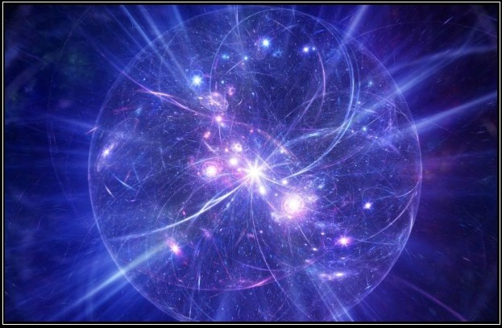
Expanding ATOMICs
Free: 100% More
RMA key (not address) identifies the buffer
0001
RMA Key
(RMA) Atomic
11__
Tagged Atomic
Message Tag
100_
FI_TAGGED op flag
- Replace key with tag
fi_atomic_query()
- Domain level call
- Also reports datatype size

Slide 10
Deferred work queues
Experimental
Conceptual model only
Generalizes triggered operations
work request
Allows (theoretical) associations between any domain level object
Definition is limited
work queue
cq
mem
Conceptual domain level work queue
ep
Primitives to develop and evaluate collective APIs
e.g. directed acyclic graphs
3
5
7
counter

Slide 11
optimizing completions
Reducing Overhead
rx/tx operation
completion
FI_RESTRICTED_COMP
Only similar endpoints will share CQs / counters
Eliminates post-processing
FI_NOTIFY_FLAGS_ONLY
- Drops operation flag
- Retains notification flags:
Remote CQ data
Multi-recv buffer freed
Avoids op save/restore
cq
New mode bits
transmit
receive

Slide 12
Completion Data
App Request
Multi-Threading
Reporting errors
Provider specific data reported for debugging
Data is opaque to application
Storage managed by provider
Report maximum size of error data
Application provides buffer
Improves multi-threaded completion processing
cq
error data
address
FI_SOURCE_ERR capability
- Validate source address against local AV
- Report raw fabric address if not found
EADDRNOTAVAIL completion error
Pushes ‘connect’ address exchange to provider
receive

Slide 13
Feature Grab bag
Feedback
?
New attributes
Communication scope
Fabric: api version
Domain: counter limits,
memory region iov limits
Local: within the local node
Shared memory, most NICs
Remote: with external nodes
Any NIC
Evading more refined definitions
String based addressing
FI_ADDR_STR address format
Generic string format for any address
Application does not need to interpret
Well-known format for sockaddr
Pass directly to fi_getinfo() or AV insertion

Slide 14
Provider updates
Simplify Development
Endpoints
DGRAM
MSG
RDM
☑☑☑
✓ …
✓ …
✓ …
✓ …
✓ …
Exported X Core EP type
Capabilities
Provider: “udp;ofi-rxd”
OFI
ofi-rxd
ofi-rxm
ofi-mxr
Utility Providers
☑
◻
◻
✗ …
✗ …
✗ …
✗ …
✓ …
◻◻
☑
✓ …
✓ …
✓ …
✓ …
✓ …
◻
☑
◻
✗ …
✗ …
✓ …
✓ …
✓ …
◻◻
☑
✓ …
✓ …
✓ …
✓ …
✓ …
◻
◻
☑
✗ …
✓ …
✗ …
✓ …
✓ …
◻
☑
◻
✗ …
✗ …
✓ …
✓ …
✓ …
OFI
☑☑☑
✓ …
✓ …
✓ …
✓ …
✓ …
☑
◻
◻
✗ …
✗ …
✗ …
✗ …
✓ …
◻◻
☑
✗ …
✗ …
✗ …
✓ …
✓ …
◻ ☑
☑
✗ …
✗ …
✓ …
✓ …
✓ …
◻◻
☑
✗ …
✗ …
✓ …
✓ …
✓ …
◻◻
☑
✗ …
✗ …
✓ …
✓ …
✓ …
◻◻
☑
✗ …
✓ …
✓ …
✓ …
✓ …
◻◻
☑
✗ …
✗ …
✓ …
✓ …
✓ …
◻◻
☑
✗ …
✗ …
✗ …
✓ …
✓ …
®
®
*
*
*
Sockets
(TCP)
UDP
Cisco usNIC
Verbs
Intel
OPA PSM
Intel
OPA PSM2
Cray
GNI
IBM Blue Gene
Mellanox Mlx
*
New
Core Providers
* Other names and brands may be claimed as the property of others
Notes:
Utility must be layered over core. Well-known prefix name. Only slight differences in internal handling.

Slide 15
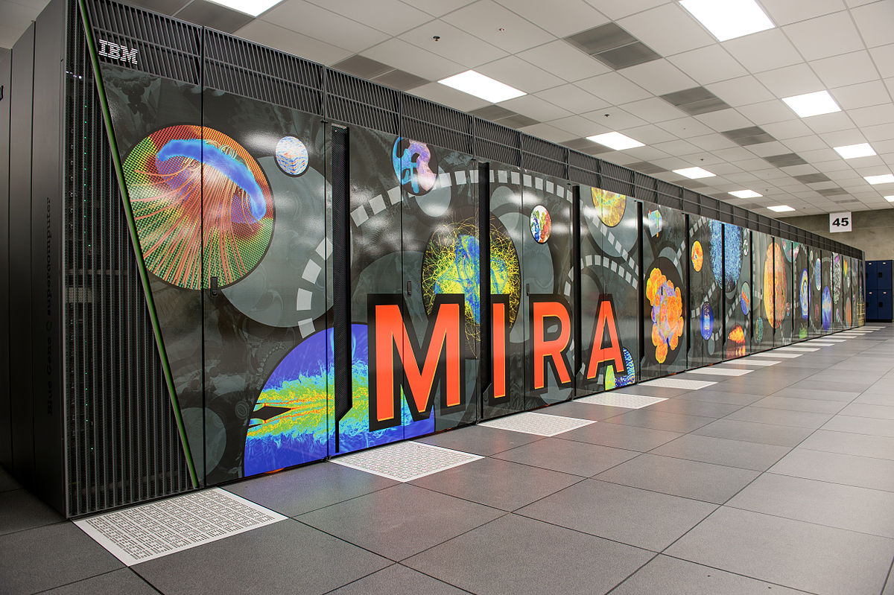
Memory registration
Exposing the Pain
FI_MR_BASIC
Traditional RDMA fabrics
FI_MR_SCALABLE
Application driven capability
FI_MR_NEITHER
What other fabrics support

Slide 16
MR Mode bits
Exposing the Pain
Redefine domain attribute mr_mode
enum → integer flags
Divide FI_MR_BASIC into specific restrictions
FI_MR_SCALABLE implied if mr_mode = 0
FI_MR_BASIC, FI_MR_SCALABLE kept for compatibility
Behavior dependent on selected API version

Slide 17
‘Basic’ MR Mode bits
Exposing the Pain
FI_MR_VIRT_ADDR
Target offset is virtual address
0001
virtual address: 0x8000
1001
RMA
1001 @ 0x8100
0010
✗
1010
FI_MR_ALLOCATED
Backed by physical pages
0011
✗
1100
FI_MR_LOCAL
Locally accessed buffers must be registered
FI_MR_PROV_KEY
Provider sets key

Slide 18
Raw Memory Regions
It’s only a flesh wound
FI_MR_RAW
More generic version of ‘basic’ registration
Provider selects base address
0001
base address: ?
10011001
RMA
raw key @ base + offset
> 64-bit keys
0010
fi_mr_raw_attr()
Retrieve MR attributes
10101010
0011
11001100
fi_mr_map_raw()
Peer sets up MR

Slide 19
non-omnipotent providers
Annoying itch
FI_MR_MMU_NOTIFY
App notifies provider when physical pages backing MR change
I.e. almost scalable, but NIC not linked into MMU
Only those addresses accessed need to be backed
RMA event
5
6
8
8
8
FI_MR_RMA_EVENT
App indicates if MR will be used with RMA event counting
MRs must be enabled after resource binding

Slide 20
Looking Back
Apps
Users
Providers
Balance application needs, developer requests, and provider capabilities
New features for expanding use cases
Developer assistance
Sensible performance optimizations

Slide 21
THANK YOU
Sean Hefty, OFIWG Co-Chair
Intel

