Slide 1
developing to the openfabrics interfaces libfabric
Sean Hefty, OFIWG Co-Chair
Intel Corporation
August, 2017

Slide 2
overview
Design Guidelines – 10 minutes
Architecture – 10 minutes
API Bootstrap – 10 minutes
GASNet Usage – 30 minutes
MPICH Usage – 30 minutes
Lightning fast introduction
Implementation highlights
The original code has been modified to fit this screen

Slide 3
overview
Tutorial covers libfabric version 1.5 (unless noted)
ABI version 1.1
Minor changes from v1.0.x – 1.4.x (ABI 1.0)
Developer guide, source code, man pages, test programs, and presentations available at:
www.libfabric.org

Slide 4
Acknowledgements
Sung Choi
Paul Grun, Cray
Howard Pritchard, Los Alamos National Lab
Bob Russell, University of New Hampshire
Jeff Squyres, Cisco
Sayantan Sur, Intel
The entire ofiwg communitee

Slide 5
design guidelines
Charter: develop interfaces aligned with user needs

Slide 6
User-centric interfaces will help foster fabric innovation and accelerate their adoption
Open Source
User-Centric
Inclusive development effort
App and HW developers
Software interfaces aligned with user requirements
Careful requirement analysis
libfabric
Implementation Agnostic
Scalable
Optimized SW path to HW
Minimize cache and memory footprint
Reduce instruction count
Minimize memory accesses
Good impedance match with multiple fabric hardware
InfiniBand, iWarp, RoCE, raw Ethernet, UDP offload, Omni-Path, GNI, BGQ, …

Slide 7
OFI user Requirements
Give us a high-level interface!
Give us a low-level interface!
MPI developers
OFI strives to meet both requirements
Middleware is primary user
Looking for input on expanding beyond HPC

Slide 8
OFI Software Development strategies
One Size Does Not Fit All
User
User
User
Linux, FreeBSD, OS X, Windows
Client uses OFI features
OFI
OFI
Client optimizes based on supported features
Provider
Common optimization for all apps/providers
OFI
Provider optimizes for OFI features
Provider
Provider
TCP and UDP development support
Provider supports low-level features only
Fabric Services

Slide 9
architecture

Slide 10
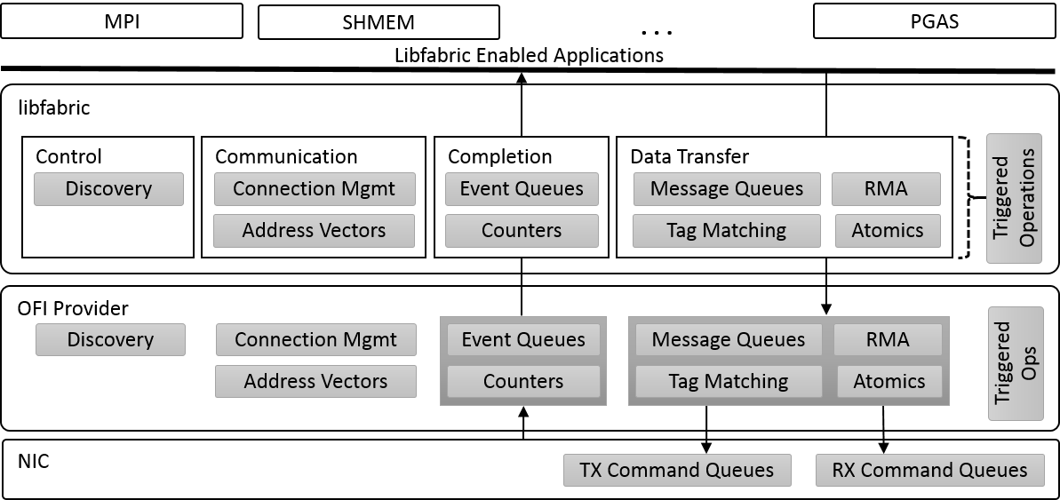
architecture
Capabilities
Modes

Slide 11
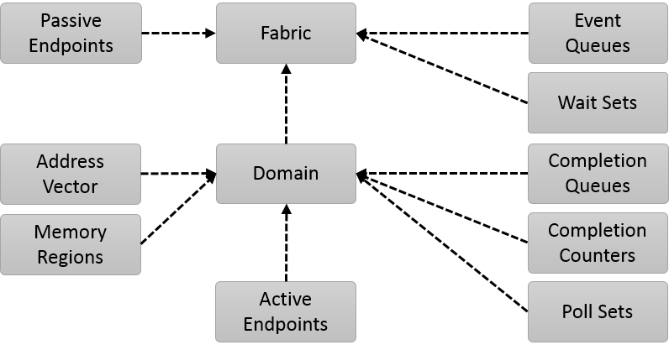
Object-Model
OFI only defines semantic requirements
Listener
Network
Share wait objects (fd’s)
Peer address table
NIC
RDMA buffers
Command queues
Manage multiple CQs and counters
example mappings

Slide 12
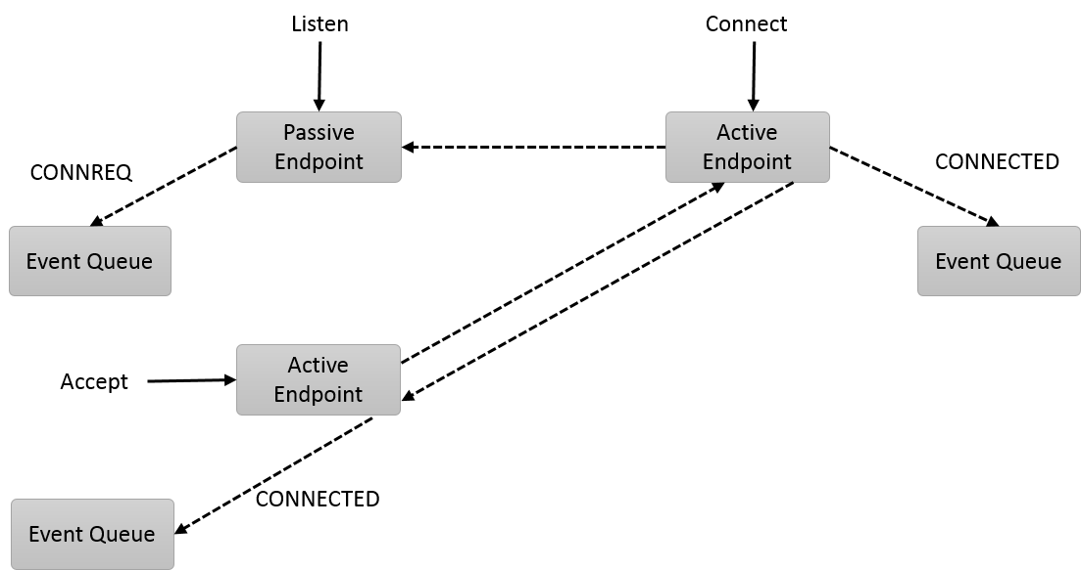
Endpoint Types
Connected
Unconnected

Slide 13
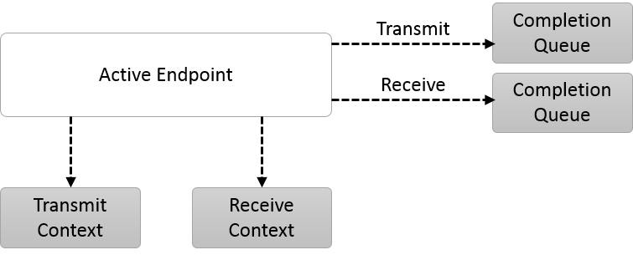
Endpoint Contexts
Default
Tx/Rx command ‘queues’
Tx/Rx completions may go to the same or different CQs
Shared Contexts
Share underlying command queues
Scalable Endpoints
Targets multi-thread access to hardware

Slide 14
Address vectors
Converts portable addressing (e.g. hostname or sockaddr) to fabric specific address
example mappings
User Address
IP:Port
10.0.0.1:7000
10.0.0.1:7001
10.0.0.2:7000
10.0.0.3:7003
…
Address Vector (Table)
fi_addr | Fabric Address
0 | 100:3:50
1 | 100:3:51
2 | 101:3:83
3 | 102:3:64
… | …
Address Vector (Map)
fi_addr
100003050
100003051
101003083
102003064
…
Possible to share AV between processes
Addresses are referenced by an index
- No application storage required
- O(n) memory in provider
- Lookup required on transfers
OFI returns 64-bit value for address
- n x 8 bytes application memory
- No provider storage required
- Direct addressing possible

Slide 15
data transfer types
Maintain message boundaries, FIFO
msg 3
msg 2
msg 1
msg 3
msg 2
msg 1
MSG
tag 3
tag 2
tag 1
tag 2
tag 1
tag 3
TAGGED
Messages carry user ‘tag’ or id
Receiver selects which tag goes with each buffer

Slide 16
data transfer types
Uses ‘MSG’ APIs but different endpoint capabilities
Send to or receive from multicast group
dgram
Multicast MSG
dgram
dgram
dgram
data 1
dgram
data 3
data 2
data 1
data 2
MSG Stream
data 3
Synchronous completion semantics (application always owns buffer)
Data sent and received as ‘stream’
(no message boundaries)

Slide 17
data transfer types
write 3
write 2
write 1
write 1
RDMA semantics
Direct reads or writes of remote memory from user perspective
RMA
write 3
write 2
f(x,y)
g()
f()
f(x,y)
y
y
f(x,y)
ATOMIC
f(x,y)
Specify operation to perform on selected datatype
x
g(x,y)
g(x,y)
g(x,y)
Format of data at target is known to fabric services
x
x

Slide 18
API Bootstrap

Slide 19
fi_getinfo
API semantics needed, and provider requirements for using them
struct fi_info *fi_allocinfo(void);
int fi_getinfo(
uint32_t version,
const char *node,
const char *service,
uint64_t flags,
struct fi_info *hints,
struct fi_info **info);
void fi_freeinfo(
struct fi_info *info);
struct fi_info {
struct fi_info *next;
uint64_t caps;
uint64_t mode;
uint32_t addr_format;
size_t src_addrlen;
size_t dest_addrlen;
void *src_addr;
void *dest_addr;
fid_t handle;
struct fi_tx_attr *tx_attr;
struct fi_rx_attr *rx_attr;
struct fi_ep_attr *ep_attr;
struct fi_domain_attr *domain_attr;
struct fi_fabric_attr *fabric_attr;
};
~getaddrinfo
API version
app needs
Detailed object attributes

Slide 20
capability and mode bits
Capabilities
Modes
Desired services requested by app
Primary – app must request to use
E.g. FI_MSG, FI_RMA, FI_TAGGED, FI_ATOMIC
Secondary – provider can indicate availability
E.g. FI_SOURCE, FI_MULTI_RECV
Requirements placed on the app
Improves performance when implemented by application
App indicates which modes it supports
Provider clears modes not needed
Sample:
FI_CONTEXT, FI_LOCAL_MR

Slide 21
attributes
Already opened resource (if available)
How resources are allocated among threads for lockless access
struct fi_fabric_attr {
struct fid_fabric *fabric;
char *name;
char *prov_name;
uint32_t prov_version;
uint32_t api_version;
};
struct fi_domain_attr {
struct fid_domain *domain;
char *name;
enum fi_threading threading;
enum fi_progress control_progress;
enum fi_progress data_progress;
enum fi_resource_mgmt resource_mgmt;
enum fi_av_type av_type;
int mr_mode;
/* provider limits – fields omitted */
...
uint64_t caps;
uint64_t mode;
uint8_t *auth_key;
...
};
Provider details
Can also use env var to filter
Do app threads drive transfers
Secure communication (job key)
Provider protect against queue overruns

Slide 22
attributes
struct fi_ep_attr {
enum fi_ep_type type;
uint32_t protocol;
uint32_t protocol_version;
size_t max_msg_size;
size_t msg_prefix_size;
size_t max_order_raw_size;
size_t max_order_war_size;
size_t max_order_waw_size;
uint64_t mem_tag_format;
size_t tx_ctx_cnt;
size_t rx_ctx_cnt;
size_t auth_key_size;
uint8_t *auth_key;
};
Indicates interoperability
Order of data placement between two messages
Default, shared, or scalable

Slide 23
attributes
struct fi_tx_attr {
uint64_t caps;
uint64_t mode;
uint64_t op_flags;
uint64_t msg_order;
uint64_t comp_order;
size_t inject_size;
size_t size;
size_t iov_limit;
size_t rma_iov_limit;
};
struct fi_rx_attr {
uint64_t caps;
uint64_t mode;
uint64_t op_flags;
uint64_t msg_order;
uint64_t comp_order;
size_t total_buffered_recv;
size_t size;
size_t iov_limit;
};
Can messages be sent and received out of order
Are completions reported in order
“Fast” message size

Slide 24
GASNET usage

Slide 25
GASNET at a glance
Networking API to enable PGAS languages
Language-independent
Interface intended as a compilation target
Based on active messages
UPC, UPC++, Co-Array Fortran, Legion, Chapel
Some of these have native ports to OFI

Slide 26
ofi objects
struct fid_fabric* gasnetc_ofi_fabricfd;
struct fid_domain* gasnetc_ofi_domainfd;
struct fid_av* gasnetc_ofi_avfd;
struct fid_cq* gasnetc_ofi_tx_cqfd;
struct fid_ep* gasnetc_ofi_rdma_epfd;
struct fid_mr* gasnetc_ofi_rdma_mrfd;
struct fid_ep* gasnetc_ofi_request_epfd;
struct fid_ep* gasnetc_ofi_reply_epfd;
struct fid_cq* gasnetc_ofi_request_cqfd;
struct fid_cq* gasnetc_ofi_reply_cqfd;
Get/put traffic on own endpoint
Separated active message request-reply traffic

Slide 27
Initialization
hints = fi_allocinfo();
hints->caps = FI_RMA | FI_MSG | FI_MULTI_RECV;
hints->mode = FI_CONTEXT;
hints->addr_format = FI_FORMAT_UNSPEC;
hints->tx_attr->op_flags = FI_DELIVERY_COMPLETE | FI_COMPLETION;
hints->rx_attr->op_flags = FI_MULTI_RECV | FI_COMPLETION;
hints->ep_attr->type = FI_EP_RDM;
hints->domain_attr->threading = FI_THREAD_SAFE;
hints->domain_attr->control_progress = FI_PROGRESS_MANUAL;
hints->domain_attr->resource_mgmt = FI_RM_ENABLED;
hints->domain_attr->av_type = FI_AV_TABLE;
ret = fi_getinfo(OFI_CONDUIT_VERSION, NULL, NULL, 0ULL, hints, &info);
if (!strcmp(info->fabric_attr->prov_name, "psm") || ...) {
...
Use a single buffer to receive multiple messages
Generate completions by default
Need thread safety for most providers
Checks to enable provider specific optimizations

Slide 28
address Exchange
av_attr.type = FI_AV_TABLE;
av_attr.size = gasneti_nodes * NUM_OFI_ENDPOINTS;
fi_av_open(gasnetc_ofi_domainfd, &av_attr, &gasnetc_ofi_avfd, NULL);
fi_ep_bind(gasnetc_ofi_rdma_epfd, &gasnetc_ofi_avfd->fid, 0);
...
fi_getname(&gasnetc_ofi_rdma_epfd->fid, NULL, &rdmanamelen);
...
size_t total_len = reqnamelen + repnamelen + rdmanamelen;
on_node_addresses = gasneti_malloc(total_len);
char* alladdrs = gasneti_malloc(gasneti_nodes * total_len);
fi_getname(&gasnetc_ofi_rdma_epfd->fid, on_node_addresses, &rdmanamelen);
...
gasneti_bootstrapExchange(on_node_addresses, total_len, alladdrs);
fi_av_insert(gasnetc_ofi_avfd, alladdrs, gasneti_nodes * NUM_OFI_ENDPOINTS,
NULL, 0ULL, NULL);
3 EPs per node
Bind all local EPs to same AV
Get each EP address
Allocate buffer to store addresses from all nodes
All to all address exchange

Slide 29
multi-recv buffers
buff_size = gasneti_getenv_int_withdefault(... 1024 * 1024 ...);
region_start = gasneti_malloc_aligned(... buff_size * num);
metadata_array = gasneti_malloc(meta_size * num);
for(i = 0; i < num; i++) {
metadata = metadata_array + i;
setup_recv_msg(metadata, i)
setup_metadata(metadata, i);
fi_recvmsg((i % 2 == 0) ?
gasnetc_ofi_request_epfd :
gasnetc_ofi_reply_epfd,
&metadata->am_buff_msg, FI_MULTI_RECV);
}
Use a small (~4) pool of large (~1MB) buffers to receive messages
Metadata tracks the status of each large buffer
Post receive buffers to request-reply active message endpoint handlers

Slide 30
multi-recv buffers metadata
Setup and save descriptor used to (re-)post receive buffer
setup_recv_msg(metadata, i)
metadata->iov.iov_base = region_start + buff_size * i;
metadata->iov.iov_len = buff_size;
metadata->am_buff_msg.msg_iov = &metadata->iov;
metadata->am_buff_msg.iov_count = 1;
metadata->am_buff_msg.addr = FI_ADDR_UNSPEC;
metadata->am_buff_msg.desc = NULL;
metadata->am_buff_msg.context = &metadata->am_buff_ctxt.ctxt;
metadata->am_buff_msg.data = 0;
setup_metadata(metadata, i);
metadata->am_buff_ctxt.index = i;
metadata->am_buff_ctxt.final_cntr = 0;
metadata->am_buff_ctxt.event_cntr = 0;
gasnetc_paratomic_set(&metadata->am_buff_ctxt.consumed_cntr, 0, 0);
metadata->am_buff_ctxt.metadata = metadata;
FI_CONTEXT requires we give the provider some storage space for their context
Reference counting used to track when messages received into the buffer are being processed

Slide 31
receiving message handling
Process request or reply message
void gasnetc_ofi_am_recv_poll(
struct fid_ep *ep, struct fid_cq *cq)
{
struct fi_cq_data_entry re;
if (TRYLOCK(lock_p) == EBUSY)
return;
ret = fi_cq_read(cq, &re, 1);
if (ret == -FI_EAGAIN) {
UNLOCK(lock_p);
return;
}
gasnetc_ofi_ctxt_t *header = re.op_context;
header->event_cntr++;
if (re.flags & FI_MULTI_RECV)
header->final_cntr = header->event_cntr;
UNLOCK(lock_p);
if (re.flags & FI_RECV)
gasnetc_ofi_handle_am(re.buf,
is_request, re.len, re.data);
if (++header->consumed_cntr ==
header->final_cntr) {
metadata = header->metadata;
LOCK(&gasnetc_ofi_locks.am_rx);
fi_recvmsg(ep, &metadata->am_buff_msg,
FI_MULTI_RECV);
UNLOCK(&gasnetc_ofi_locks.am_rx);
}
}
Check CQ for a completion
Repost receive buffer once all callbacks complete
1 event per message
FI_MULTI_RECV flag indicates buffer has been released

Slide 32
Nonblocking put mapping
General outline of gasnet_put_nb flow
Optimized for lowest latency
gasnete_put_nb(gasnet_node_t node, void *dest,
void *src, size_t nbytes...)
{
if (nbytes <= max_buffered_send) {
use_inject(...)
} else if (nbytes <= gasnetc_ofi_bbuf_threshold) {
use_bounce_buffer(...)
} else {
put_and_wait(...)
}
}
‘Inject’ feature allows immediate re-use of buffer
Copy into bounce buffer
Must wait for completion

Slide 33
Nonblocking put mapping
FI_INJECT – buffer is re-usable after call returns, but still generate a completion
use_inject
fi_writemsg(gasnetc_ofi_rdma_epfd, &msg,
FI_INJECT | FI_DELIVERY_COMPLETE);
pending_rdma++;
put_and_wait
fi_write(gasnetc_ofi_rdma_epfd, src, nbytes,
NULL, GET_RDMA_DEST(node),
GET_REMOTEADDR(node, dest), 0, ctxt_ptr);
pending_rdma++;
while (pending_rdma)
GASNETC_OFI_POLL_EVERYTHING();
use_bounce_buffer
get_bounce_buf(nbytes, bbuf, bbuf_ctxt);
memcpy(bbuf, src, nbytes);
fi_write(gasnetc_ofi_rdma_epfd, bbuf,
nbytes, NULL, GET_RDMA_DEST(node),
GET_REMOTEADDR(node, dest), 0,
bbuf_ctxt);
pending_rdma++;
Transfer data and wait for the completion to indicate buffer is no longer needed
Copy source buffer into bounce buffer. Source may be reused.

Slide 34
mpiCH usage OFI Ch4 netmod

Slide 35
MPICH at a glance
Reference MPI implementation
MPI standards 1, 2, and 3
High-performance and scalable
Used on most Top 500, including Top 10 supercomputers
Highly portable
Platforms, OS, networks, CPUs…
Base for most vendor MPI derivatives

Slide 36
Select a mapping
Present one possible mapping
Designed for providers with a close semantic match to MPI
MPICH ch4 / OpenMPI MTL
User
User
Client uses OFI features
MPI 2-Sided
OFI
OFI
OFI Building Blocks
FI_TAGGED
Provider
Common optimization for all apps/providers
MPI Progress
MPI-3 RMA
Counters
FI_MSG
Provider optimizes for OFI features
Provider
CQs
FI_RMA
Provider supports low-level features only
MPICH optimizes based on provider features
Fabric Services

Slide 37
Select capabilities and mode bits
Provide the provider context space
hints = fi_allocinfo();
hints->mode = FI_CONTEXT | FI_ASYNC_IOV;
hints->caps |= FI_RMA;
hints->caps |= FI_ATOMICS;
if (do_tagged)
hints->caps |= FI_TAGGED;
if (do_data)
hints->caps |= FI_DIRECTED_RECV;
Request support for tagged messages, RDMA read and write, and atomic operations
The source address is used as part of message matching

Slide 38
specify domain attributes
Specify API version MPI is coded to
fi_version = FI_VERSION(MPIDI_OFI_MAJOR_VERSION,
MPIDI_OFI_MINOR_VERSION);
hints->addr_format = FI_FORMAT_UNSPEC;
hints->domain_attr->threading = FI_THREAD_DOMAIN;
hints->domain_attr->control_progress = FI_PROGRESS_MANUAL;
hints->domain_attr->data_progress = FI_PROGRESS_MANUAL;
hints->domain_attr->resource_mgmt = FI_RM_ENABLED;
hints->domain_attr->av_type = do_av_table ?
FI_AV_TABLE : FI_AV_MAP;
hints->domain_attr->mr_mode = do_mr_scalable ?
FI_MR_SCALABLE : FI_MR_BASIC;
MPI handles all synchronization (lock-free provider)
MPI is capable of driving progress (thread-less provider)
Provider will protect against local and remote queue overruns
Support either address vector format
Support common memory registration modes (ABI v1.0)

Slide 39
specify endpoint attributes
Generate a completion after transfer processed by peer
hints->tx_attr->op_flags = FI_DELIVERY_COMPLETE |
FI_COMPLETION;
hints->tx_attr->msg_order = FI_ORDER_SAS;
hints->tx_attr->comp_order = FI_ORDER_NONE;
hints->rx_attr->op_flags = FI_COMPLETION;
hints->ep_attr->type = FI_EP_RDM;
hints->fabric_attr->prov_name = provname;
fi_getinfo(fi_version, NULL, NULL, 0ULL, hints, &prov);
Sends must be processed in order
Transfers can complete in any order
Reliable-datagram endpoint
Optionally select a provider and away we go

Slide 40
mapping mpi communicators
Communicators are groups of peer processes
MPI_COMM_WORLD – all peers
Referenced by rank (index)
Map logical rank to physical network address
AV Table
Shared AV Map
Communicator A
Communicator B
Communicator A
Communicator B
AV Map
Communicator A
Communicator B
Map Table
fi_addr_t
All options are supported
integer

Slide 41
Opening address vector
char av_name[128];
snprintf(av_name, 127, "FI_NAMED_AV_%d\n", appnum);
av_attr.name = av_name;
av_attr.flags = FI_READ;
av_attr.map_addr = 0;
unsigned do_av_insert = 1;
if (0 == fi_av_open(MPIDI_Global.domain, &av_attr, &MPIDI_Global.av, NULL)) {
do_av_insert = 0;
mapped_table = (fi_addr_t *) av_attr.map_addr;
for (i = 0; i < size; i++)
MPIDI_OFI_AV(&MPIDIU_get_av(0, i)).dest = mapped_table[i];
Try opening a shared (named) AV
Copying fi_addr_t address table

Slide 42
tagged protocol
Selection based on support for FI_DIRECTED_RECV
#ifdef USE_OFI_IMMEDIATE_DATA
/*
* 0123 4567 01234567 01234567 01234567 01234567 01234567 01234567 01234567
* | | |
* ^ | Unused | context id | message tag
* | | | |
* +---- protocol
*/
#else
/*
* 0123 4567 01234567 0123 4567 01234567 0123 4567 01234567 01234567 01234567
* | | |
* ^ | context id | source | message tag
* | | | |
* +---- protocol
*/
Source rank carried in remote QP data
Need source rank for matching

Slide 43
MPI send (tagged messages)
Direct API mapping
MPL_STATIC_INLINE_PREFIX int MPIDI_OFI_send_handler(...)
{
if (is_inject) {
if (do_data)
fi_tinjectdata(ep, buf, len, dest, dest_addr, tag);
else
fi_tinject(ep, buf, len, dest_addr, tag);
} else {
if (do_data)
fi_tsenddata(ep, buf, len, desc, dest, dest_addr, tag, context);
else
fi_tsend(ep, buf, len, desc, dest_addr, tag, context);
}
}
Optimized transfers under certain conditions
No completions
Immediate buffer reuse
Limited transfer size
Base endpoint or tx_tag transmit context
fi_addr_t from mapped_table[ ]
tag format based on protocol
Protocol selection

Slide 44
THANK YOU
Sean Hefty, OFIWG Co-Chair

