Slide 1
RDMA with PMEM
Software mechanisms for enabling access to remote persistent memory
Chet Douglas
Intel Corporation

Slide 2
RDMA with PMEM - Agenda
Problem statement
Platform HW Background
Visibility vs Durability
Local Node Data Durability Considerations
Remote Node Data Durability Consideration
“Appliance Method” for Remote Data Durability
“General Purpose Server Method” for Remote Data Durability
Modeling SW Latencies for Remote Data Durability
Performance Tradeoffs & Durability Mechanism Pros/Cons
Future Considerations
Takeaways

Slide 3
RDMA with PMEM – Problem Statement
Current RDMA HW and SW solutions do not take persistent memory (pmem) in to account and do not have an explicit mechanism for forcing RDMA Writes to remote pmem to be durable (power fail atomic)
HA and HPC pmem Use Cases require writes to remote memory between compute nodes utilizing RDMA to support remote data base log updates, remote data replication, etc
In the short term, SW only modifications are possible to make RDMA SW Applications persistent memory aware and to force written data to be persistent (this slide deck)
In the longer term, industry wide enabling through standards organizations is required to have specific vendor agnostic mechanisms for utilizing persistent memory with RDMA, requiring HW and SW changes (See Tom Talpey’s session)

Slide 4
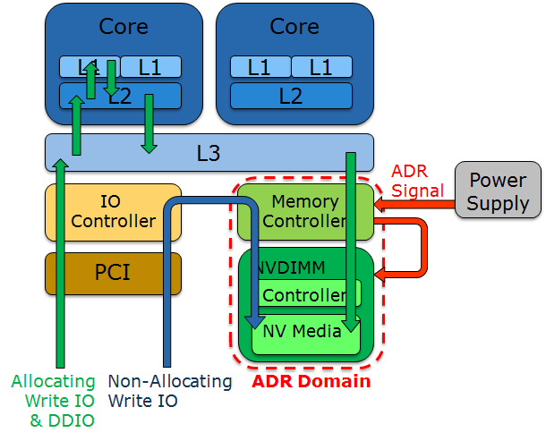
RDMA with PMEM – HW Background
ADR - Asynchronous DRAM Refresh
  Allows NVDIMMs to save DRAM contents to flash on power loss
  ADR Domain – All data inside of the domain is protected by ADR and will make it to pmem before supercap power dies. The integrated memory controller (iMC) is currently inside of the ADR Domain.
IO Controller
  Controls IO flow between PCIe devices
  and Main Memory
  “Allocating write transactions”
    PCI Root Port will utilize write buffers
    backed by cache
    Data buffers naturally aged out of cache
    to main memory
  “Non-Allocating write transactions”
    PCI Root Port Write transactions utilize
    buffers not backed by cache
    Forces write data to move to the iMC
    without cache delay
  Enable/Disable via BIOS setting
DDIO – Data Direct IO
  Allows Bus Mastering PCI & RDMA IO to move data directly in/out of LLC Core Caches
  Allocating Write transactions will utilize DDIO

Slide 5
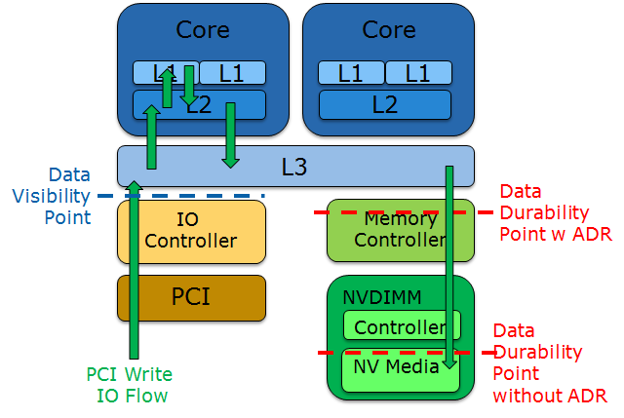
RDMA with PMEM – Visibility vs Durability
Write Data Visibility Point – Once data makes it out of the IO controller, HW makes the data visible to all caches and cores, independent of DRAM or NVDIMM devices
Write Data Durability Point – Typically data is not considered durable until it has been successfully written by the Memory Controller to persistent media

Slide 6
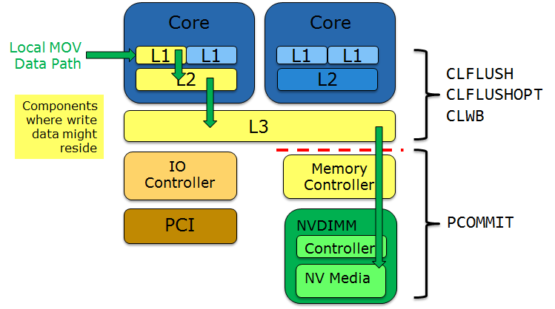
RDMA with PMEM – Local Node Data Durability Considerations
First, Write Data must be flushed from CPU caches to the Memory Controller and optionally invalidated
Second, Write Data in the Memory Controller must be flushed to pmem

Slide 7
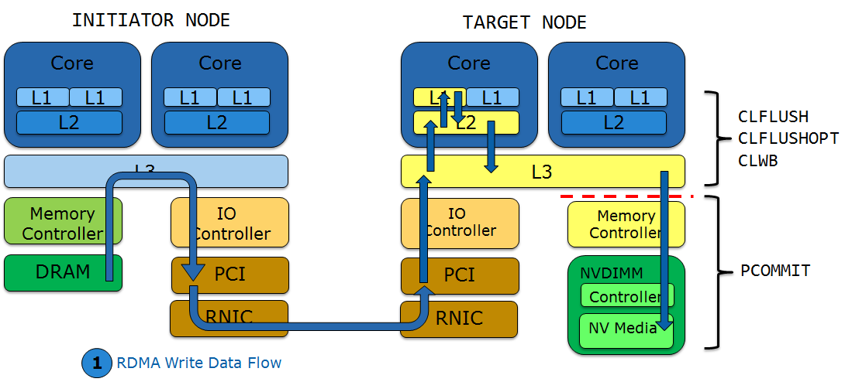
RDMA with PMEM – Remote Node Data Durability
Considerations
Same steps to make write data durable on a local node, must be followed on a remote Target node
Signal to make data durable does not need to come from the Initiator node

Slide 8
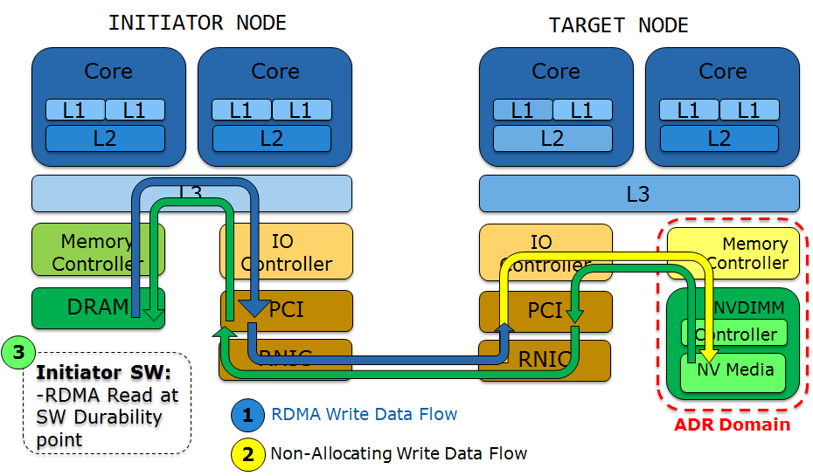
RDMA with PMEM – “Appliance” Durability Mechanism
Use Non-Allocating Writes for the remote Target node RNIC to bypass CPU caches – Target node does not need to issue CLFLUSHOPTs
Follow a number of RDMA Writes with an RDMA Read at the point SW wishes to make data durable – Flushes PCI and Memory Controller pipelines
Utilize ADR
so Target
node does
not need to
issue
PCOMMIT

Slide 9
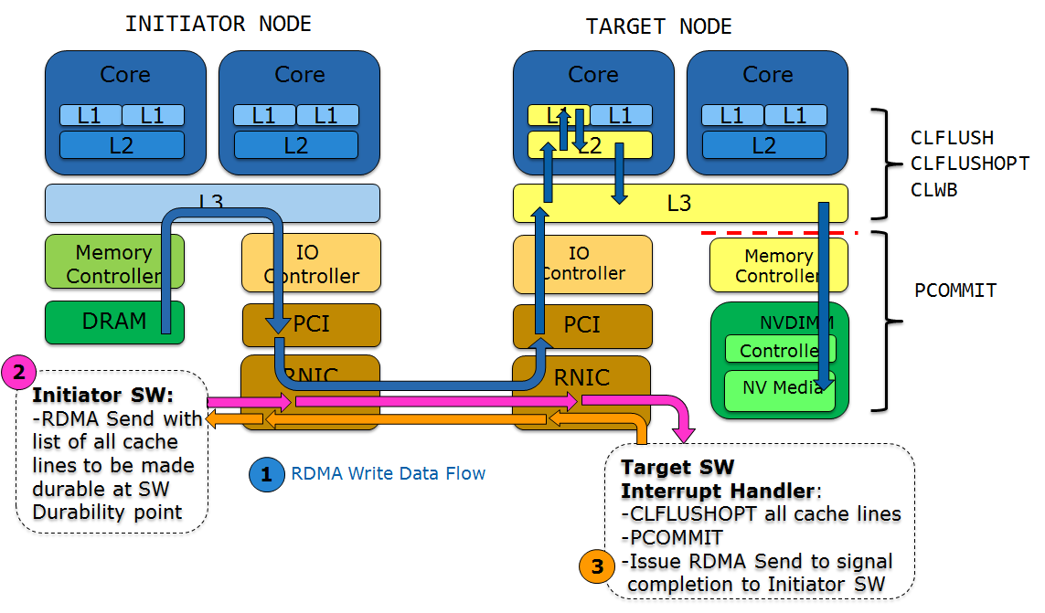
RDMA with PMEM – “General Purpose Server” Durability Mechanism
Use default platform configuration & allocating write flows
Initiator SW issues RDMA Send at SW Durability Point and passes list of cache lines to make durable
Target SW Interrupt Handler is interrupted and issues CLFLUSHOPT for each cache line in the list to push data in to the Memory Controller followed by PCOMMIT to force
write data to pmem
media
Target SW Interrupt
Handler issues
RDMA Send back
to the Initiator SW to
complete the
synchronous
handshake

Slide 10
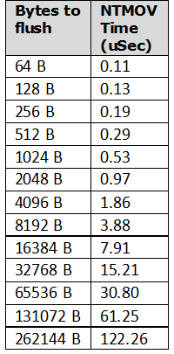
RDMA with PMEM – Modeling SW Latencies for
Remote Durability Mechanisms
CLFLUSHOPT/SFENCE Model
Basic SW latency model for determining the order of magnitude for flushing write data from CPU caches to the Memory Controller and waiting for flushes to complete
Not trying to be cycle accurate for a non-blocking “CLFLUSHOPT” instruction which is not that interesting at this level
For a single cache line flush, use CLFLUSH/SFENCE as a proxy
For multiple cache lines to flush, use full line non-temporal (NT) stores as a proxy
  NT stores flush each cache line but don't have the serializing behavior of CLFLUSH
  _mm_stream_si128() streaming execution time can vary depending on CPU preparation and cache preloading
  Measure time moving the entire data transfer amount so that variance in first cache line move are averaged out

Slide 11
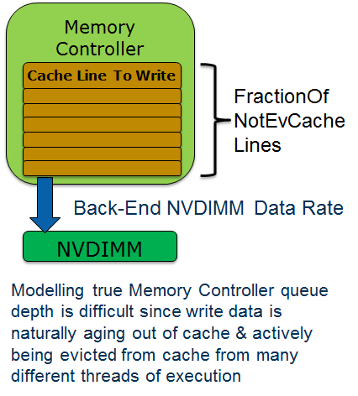
RDMA with PMEM – Modeling SW Latencies for
Remote Durability Mechanisms
PCOMMIT/SFENCE Model
Basic SW latency model for determining the order of magnitude for committing write data from the iMC to pmem
Not trying to be cycle accurate for a non-blocking “PCOMMIT” instruction which is not that interesting at this level
To bound the latency calculation the
calculation can be bounded with a fraction
of cache lines that have not been evicted
by the time SW gets to committing the
write data
  Determine the amount of write data to
  be committed based on
  FractionOfNotEvCacheLines
  Use the backend NVDIMM BW to
  calculate a basic latency based on
  write data not already evicted

Slide 12
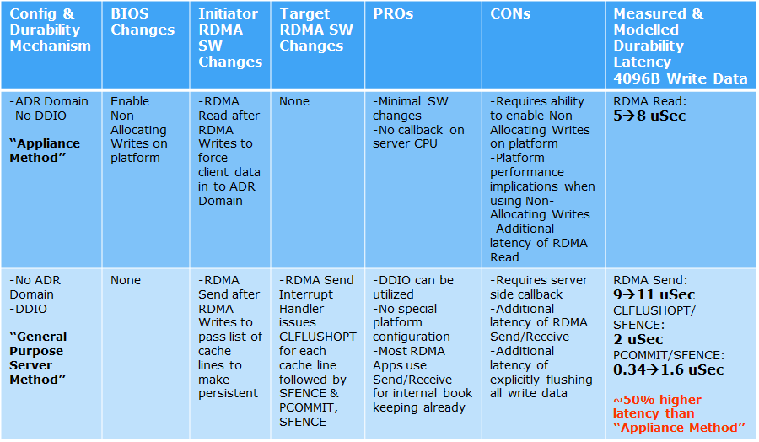
RDMA with PMEM – Performance & Durability
Mechanism Pros/Cons

Slide 13
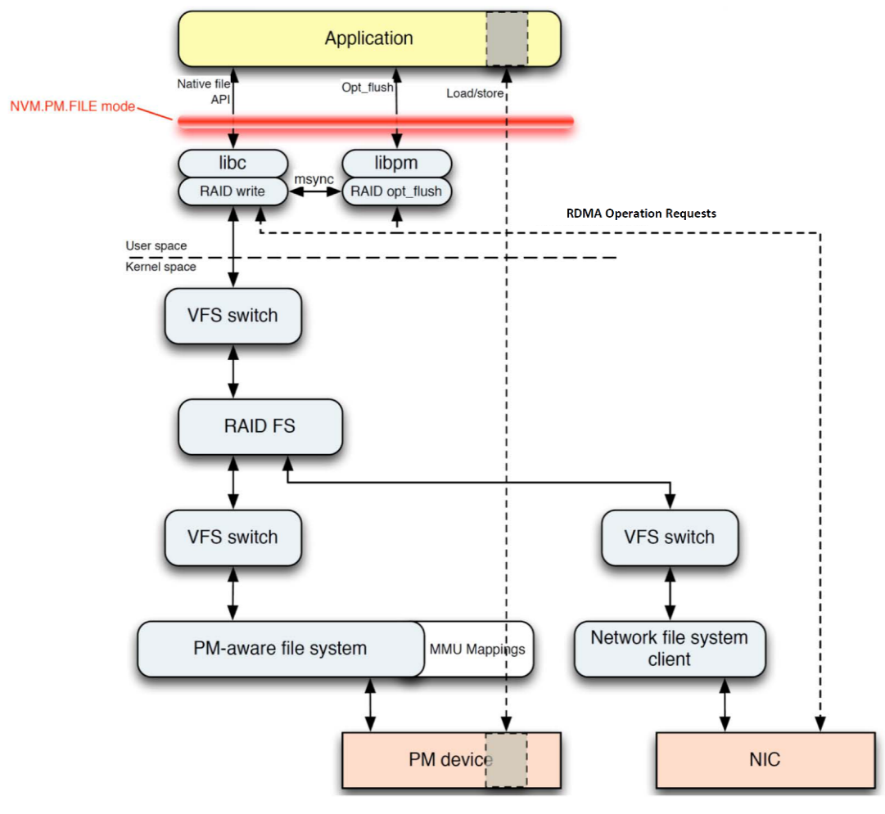
RDMA with PMEM – Future Considerations
SNIA NVM Programming Model
  Extend to address remote access to pmem
SNIA NVM PM Remote Access for High-Availability white paper
  Already contains basic NVM.PM.FILE.OPTIMIZED_FLUSH concepts
  Add Appendix or Extension
    Durability mechanisms described here
    Platform and HW capabilities to detect supported mechanisms
Proposed NVM Programming Model updates
for NVM.PM.FILE.OPTIMIZED_FLUSH from
NVM PM Remote Access for High-Availability

Slide 14
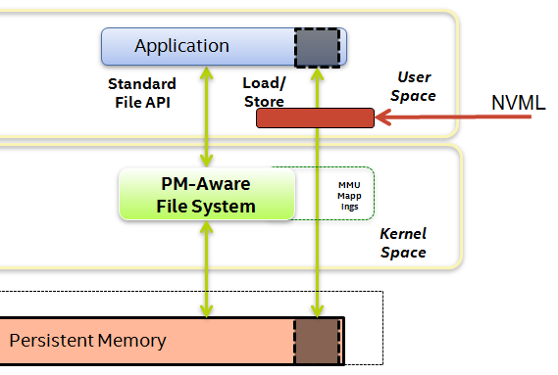
RDMA with PMEM – Key Takeaways
Inserting SW durability points in to existing RDMA based SW is not difficult
Prepare for future fabric protocol, HW (RNIC, CPU, chipset) & SW extensions to make remote persistent memory programming even easier and improve latency
Consider abstracting durability
mechanisms behind a SW
library such as Intel’s NVML,
OFA libfabrics and libibverbs API
Get involved in SNIA NVM
Programming TWG!
Bigger changes coming for
future extensions to RDMA,
PMEM, and data durability
http://www.snia.org/forums/sssi/nvmp

