Slide 1
Storage Interconnect Requirements
Chen Zhao, Frank Yang
NetApp, Inc.

Slide 2
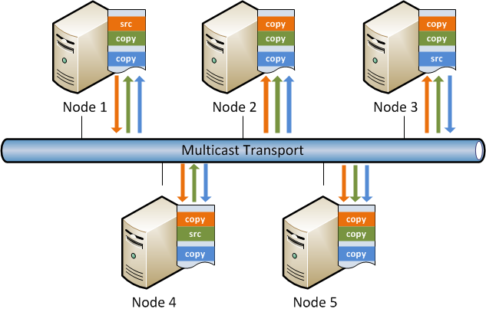
Storage Interconnect Requirements
Multi-destination RMA operation with reliable unconnected transport

Slide 3
Storage Interconnect Requirements
Multi-destination RMA operation
    One single IO operation targets multiple memory locations on multiple remote nodes
    Need reliable multi-destination support in the transport
    Take advantage of multi-destination capabilities of certain hardware
Reliable unconnected transport
    Preferred transport model to support multi-destination RMA operation
    Fencing / in-order delivery support for traffic between the same set of end points

Slide 4
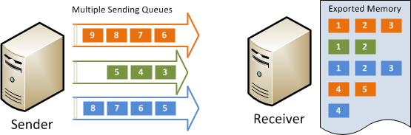
Storage Interconnect Requirements
Single sided RMA operation
    Sender creates multiple queues to access a shared memory exported by receiver
    Receiver only need to export memory for remote access
    No further connection management effort is needed at receiver above the fabric interface

Slide 5
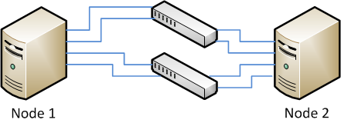
Storage Interconnect Requirements
Transparent multi-path with in-order delivery
    Aggregate multiple port / link / NIC / HCA under a single end point for higher bandwidth
    Transparent path failover for higher resiliency
    In-order delivery / fence support over aggregated multi-path at end point level

Slide 6
Storage Interconnect Requirements
Delivery confirmation and memory write commit
    Options to ensure data commitment to destination memory upon completion
Fast registration and invalidate stag operation
    Interface support of fast memory registration and send with invalidated stag
Ordering support
    Options to configure in-order delivery and read / write fence
Flow control
    Options to configure flow-control at end-point level

Slide 7
Storage Interconnect Requirements
Remote notification support in RMA operations
    In RDMA write / read operations, provide the option of generating a completion event at the remote end
Asynchronous completion notification
    Notification / upcall infrastructure at interface level
Support physically discontiguous memory buffer
    Application should not care about underlying physical contiguity of allocated memory

