Slide 1
Summarizing NVM Usage Models for DS/DA
OFA OpenFabrics Interfaces Project
Data Storage/Data Access subgroup
November 2015

Slide 2
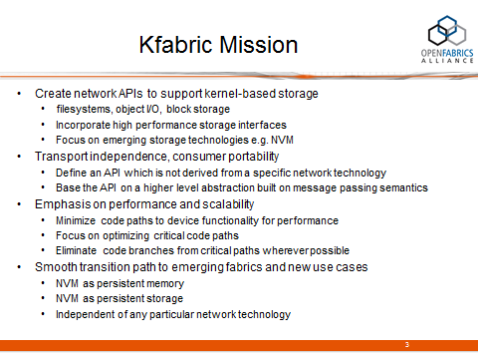
Objective
Objective of this slide deck is to dig down into these two
Notes:
This is an attempt to explain the 3 categories on the previous slide

Slide 3
Motivation
  NVM is an important emerging technology of great importance to OFA members and the consumers of OFS
  It is sufficiently unlike existing memory models to warrant a discussion of an API to access it
  It will have a significant enough impact on how storage is architected, deployed, and accessed to warrant a discussion of NVM for I/O, and an API to access it
  Both ‘Data Storage’ and ‘Data Access’ are therefore potentially impacted by the emergence of NVM
    Hence, the initial look at NVM is being taken by the DS/DA subgroup
    A broader discussion with the main OFI WG is anticipated

Slide 4
Scope
NVM as a target of I/O operations
  out of scope: NVM as a target of memory L/S ops
Accessed either locally or remotely
As a local device
  attached to the I/O bus (e.g. SSD) or
  attached to a memory channel
As a remote device
  attached to a network device

Slide 5
NVM access methods summarized
Case | Access method |  | note
1 | local memory access | access via memory load/store ops | (1)
2 | local byte access | accessed as I/O
3 | local block access | general case of byte access | (2)
4 | remote byte access
5 | remote block access
Case 1 is almost certainly out of scope for DS/DA but is included here for completeness
Block level access, where the target is described by an address and extent, is seen as the general case of byte-addressable memory, where the extent is as small as 1 byte.

Slide 6
Case 1,2,3 – local access models
I/O – byte-addressable or block
memory
NV DIMM
NV DIMM
NV DIMM
NV
DIMM
DIMM
DIMM
DIMM
NV
DIMM
MC
MC
fs
block access* via e.g. NVMe
SSD
*f/s storage today is block storage, but in the future it may be some other access paradigm, e.g. byte level, object I/O

Slide 7
Case 4,5 – remote NVM I/O access
Consumers (clients) of NVM I/O include e.g.
user or kernel file or object storage (Lustre, CEPH…)
block storage consumers (iSER, SRP, NVMef…)
shared remote access I/O device
CPU
client
NV DIMM
NV DIMM
NV DIMM
NV
DIMM
CPU
NIC
NIC
SSD
SSD
SSD
I/O device exports a byte-addressable or block level I/O interface

