Slide 1
Summarizing NVM Usage Models for DS/DA
OFA OpenFabrics Interfaces Project
Data Storage/Data Access subgroup
October 2015

Slide 2
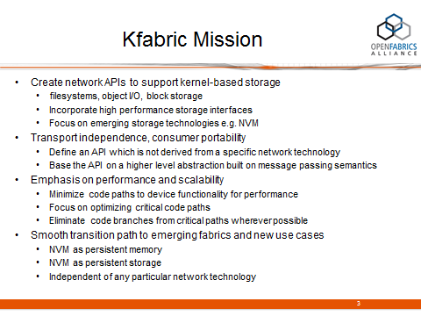
Objective
Objective of this slide deck is to dig down into these two
Notes:
This is an attempt to explain the 3 categories on the previous slide

Slide 3
Motivation
  NVM is seen as an important emerging technology of great importance to OFA members and the consumers of OFS
  It is sufficiently unlike existing memory models to warrant a discussion of an API to access it
  It will have a significant enough impact on how storage is architected, deployed, and accessed to warrant a discussion of NVM for storage, and an API to access it
  Both ‘Data Storage’ and ‘Data Access’ are therefore potentially impacted by the emergence of NVM
    Hence, the initial look at NVM is being taken by the DS/DA subgroup
    A broader discussion with the main OFI WG is anticipated
Notes:
This is an attempt to explain the 3 categories on the previous slide

Slide 4
Scope
NVM as persistent memory
NVM as storage
Local access
Remote access

Slide 5
Use cases summarized
Case
1 | local memory access
2 | local storage
3 | remote byte access
4 | remote block access
5 | remote file access
6 | remote object access
7 | remote memory access
Does this one exist??

Slide 6
Cases 1,2 – typical local use cases
I/O
memory
NV DIMM
NV DIMM
NV DIMM
NV
DIMM
DIMM
DIMM
DIMM
NV
DIMM
MC
MC
fs
block access* via e.g. NVMe
SSD
*f/s storage today is block storage, but in the future it may be some other access paradigm, e.g. byte level, object I/O

Slide 7
Cases 3,4,5,6 – typical remote I/O access
shared remote access I/O device
CPU
client
NV DIMM
NV DIMM
NV DIMM
NV
DIMM
CPU
NIC
NIC
SSD
SSD
SSD
I/O device exports an object, file, block, or byte-addressable interface: LNET, iSER/NVMef/SRP

