Slide 1
Summarizing NVM Usage Models for DS/DA
OFA OpenFabrics Interfaces Project
Data Storage/Data Access subgroup
October 2015

Slide 2
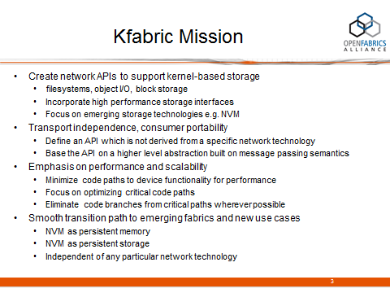
Objective
Objective of this slide deck is to dig down into these two
Notes:
This is an attempt to explain the 3 categories on the previous slide

Slide 3
Motivation
  NVM is seen as an important emerging technology of great importance to OFA members and the consumers of OFS
  It is sufficiently unlike existing memory models to warrant a discussion of an API to access it
  It will have a significant enough impact on how storage is architected, deployed, and accessed to warrant a discussion of NVM for storage, and an API to access it
  Both ‘Data Storage’ and ‘Data Access’ are therefore potentially impacted by the emergence of NVM
    Hence, the initial look at NVM is being taken by the DS/DA subgroup
    A broader discussion with the main OFI WG is anticipated
Notes:
This is an attempt to explain the 3 categories on the previous slide

Slide 4
Scope
NVM as persistent memory
NVM as storage
Local access
Remote access

Slide 5
Use cases summarized
Case
1 | local memory access
2 | local storage
3 | remote block access
4 | remote file access
5 | remote memory access

Slide 6
Case 1, 2 – local access
memory access
CPU
DIMM
DIMM
DIMM
NV
DIMM
MC
fs
Work In Progress
block access via e.g. NVMe
SSD

Slide 7
Case 3 – remote block access
CPU
shared remote access block device
fs
CPU
Work In Progress
NIC
NIC
SSD
SSD
SSD
NVMef
How does NVMef differ from e.g. SRP, if at all?

Slide 8
Case 4 – remote file access
CPU
CPU
client
storage
server
Work In Progress
NVMe?
I/O bus
NIC
NIC
SSD
e.g. LNET

Slide 9
Case 5 – remote memory access
CPU
CPU
client
storage
server
Work In Progress
NVMe?
NIC
NIC
SSD
e.g. LNET

