Slide 1
Local and Remote byte-addressable NVDIMM High-level Use Cases
Chet Douglas – Principal NVDIMM SW Architect - DCG
09-11-15

Slide 2
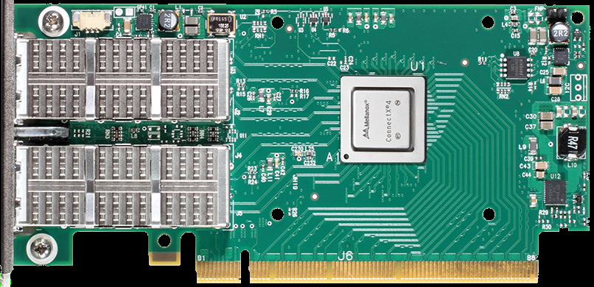
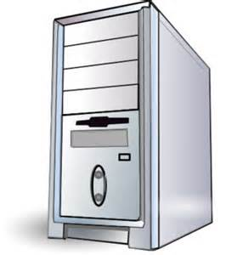
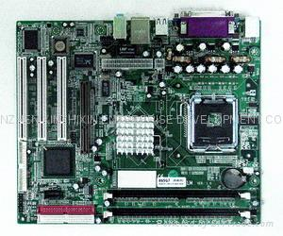

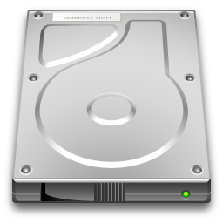
USE CASE – Local NVDIMM – Kernel Access
-Memory Side Cache
-Hierarchical Tiered Memory
Client Workstation
or Enterprise Server
On Package High-Bandwidth Memory
Hierarchical Tiered Memory and Caching
-On-Package High-Bandwidth Memory
caching DDR4 main memory
-DDRT4 Main Memory caching byte-addressable
NVDIMM
-NVDIMM caching SSDs
-Typical OS implementations will require
extensive kernel access
DDR4 Main Memory
Byte addressable,
direct access,
NVDIMM
SSD
Asynchronous Demand On Package High-Bandwidth Memory Cache Requests
Asynchronous Demand On Package High-Bandwidth Memory Cache Completions
Asynchronous Demand DDR4 Main Memory Cache Requests
Asynchronous Demand DDR4 Main Memory Cache Completions
Asynchronous Demand Byte-Addressable NVDIMM Cache Requests (Writes, Flushes, Commits)
Asynchronous Demand Byte-Addressable NVDIMM Cache Completions
Asynchronous Demand SSD Requests
Asynchronous Demand SSD Completions

Slide 3
USE CASE – Local NVDIMM – Kernel Access
-SW RAID – Close “R5 Write Hole”
-SW RAID – Cache for SSD RAID Volumes
SSD RAID Volume
Acceleration Cache
Byte addressable,
direct access,
NVDIMM
SW RAID Use Cases – Kernel Access
-Typically SW RAID products utilize OS Kernel
RAID Storage Drivers and UEFI RAID Pre-Boot
drivers to implement SW RAID functionality.
-Performance acceleration caches or caches to
close vulnerabilities in RAID Data replication,
require shared persistent kernel access
to regions of the NVDIMM by both UEFI
RAID Pre-Boot drivers and OS Kernel RAID
Storage Drivers
SSD RAID-5 Volume
“Write Hole”
Temp Data Store
Byte addressable,
direct access,
NVDIMM
Client Workstation
or Enterprise Server
SSD
SSD
RAID
Volume
Asynchronous Demand SW RAID Acceleration Cache Requests
Asynchronous Demand SW RAID Acceleration Cache Completions
Asynchronous Demand SW RAID Data Vulnerability Cache Requests
Asynchronous Demand SW RAID Data Vulnerability Cache Completions
Asynchronous Demand SW RAID Requests
Asynchronous Demand SW RAID Completions

Slide 4
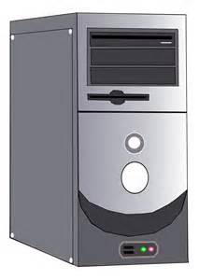



USE CASE – Local & Remote NVDIMM
Public & Private Cloud
-Synchronous (1:1) (active:passive)
-Database Replication
PUBLIC & PRIVATE CLOUD
Active
Server
Node
Active
Server
Node
Database
copies
kept in
lock step
Client
Active
Database
Master
Synchronous
Passive
Database
Slave
Byte addressable,
direct access,
NVDIMM
Byte addressable,
direct access,
NVDIMM
Asynchronous Demand Database Master Updates
Asynchronous Database Replication - RDMA Write
Synchronous Database Replication SNIA Optimized Flush
Synchronous Database Replication SNIA Optimized Flush Completion
Asynchronous Demand Database Reads

Slide 5

USE CASE – Local & Remote NVDIMM
Public & Private Cloud
-Asynchronous (1:1) (active:passive)
-Database Replication
PUBLIC &
PRIVATE
CLOUD
Active
Server
Node
Database copies
updated asynchronously
as logfile updates are
pushed to slave nodes
Database
Master
Logfile
Client
Database
Slave
Logfile
Active
Server
Node
Active
Database
Master
Asynchronous
Passive
Database
Slave
Byte addressable,
direct access,
NVDIMM
Byte addressable,
direct access,
NVDIMM
Asynchronous Demand Database Master Updates
Local Logfile Update due to Database update
Asynchronous Database Logfile Replication - RDMA Write
Synchronous Database Logfile Replication SNIA Optimized Flush
Synchronous Database Logfile Replication SNIA Optimized Flush Completion
Local Database Update due to Logfile update
Asynchronous Demand Database Reads

Slide 6

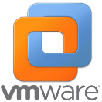



USE CASE – Remote NVDIMM
Public & Private Cloud
-Converged Disaggregated Network Topology
-SW Defined Storage (SDS)
PUBLIC & PRIVATE CLOUD
Storage
Processing
Node
Direct
Attached
NVDIMM
Compute Node
Virtual Clients
(IaaS/PaaS)
Byte addressable,
direct access,
NVDIMM
Compute
Node
Asynchronous Demand SDS Updates
Asynchronous Storage Updates - RDMA Write
Converged Disaggregated
Network Topology → Compute
Nodes and Storage Processing
Nodes are physically separate
nodes
Synchronous Storage Updates SNIA Optimized Flush
Synchronous Storage Updates SNIA Optimized Flush Completion
Asynchronous Demand SDS Reads

Slide 7
USE CASE – Remote NVDIMM
Public & Private Cloud
-Hyper-Converged Network Topology
-SW Defined Storage (SDS)
PUBLIC & PRIVATE CLOUD
Compute
Node
Virtual
Network
Compute Node
Virtual Clients
(IaaS/PaaS)
Virtual
Storage
Processing
Node
Compute Node
Direct Attached
NVDIMM
Asynchronous Demand SDS Updates
Byte addressable,
direct access,
NVDIMM
Asynchronous Storage Updates - RDMA Write
Hyper-Converged Network
Topology → Compute Node
and Storage Processing Node
are in the same physically node
Synchronous Storage Updates SNIA Optimized Flush
Synchronous Storage Updates SNIA Optimized Flush Completion
Asynchronous Demand SDS Reads

Slide 8
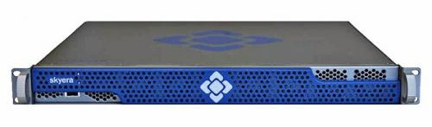
USE CASE – Remote NVDIMM
Enterprise Appliance
Enterprise Server
Storage Processing Node
Network Attached
Enterprise Appliance
Direct Attached
NVDIMM
Storage Attached
Enterprise Appliance
w Internal Network
Fabric Switch & Direct
Attached NVDIMM
Enterprise Server
Compute Node
Byte addressable,
direct access,
NVDIMM
Byte addressable,
direct access,
NVDIMM
Asynchronous Storage Updates
Asynchronous Appliance Updates - RDMA Write
Synchronous Appliance Update SNIA Optimized Flush
Synchronous Appliance Update SNIA Optimized Flush Completion

Slide 9



USE CASE – Remote NVDIMM
HPC – PGAS, SHMEM, MPI, Human Brain Project
-Distributed (1:N) (active:active) Database
Active
Server
Node
IO typically <= 256Bytes, Key/Value pair or pointer updates
Synchronous
Distributed
Database
Active
Server
Node
Byte addressable,
direct access,
NVDIMM
Distributed
Database
Reference
Synchronous
Distributed
Database
Byte addressable,
direct access,
NVDIMM
Active
Server
Node
Client
Synchronous
Distributed
Database
Byte addressable,
direct access,
NVDIMM
Active
Server
Node
Asynchronous Demand Database Updates
Database is distributed
across many nodes all
actively taking part in
Database references
and updates
Asynchronous Database Updates - RDMA Write
Synchronous
Distributed
Database
Asynchronous Database Replication SNIA Optimized Flush
Asynchronous Database Replication SNIA Optimized Flush Completion
Byte addressable,
direct access,
NVDIMM
Asynchronous Demand Parallel Database Reads

Slide 10
USE CASE – Remote NVDIMM
HA & HPC
-Synchronous (1:N) (active:passive)
-Database Replication w Parallel Access
High Availability –
Database
copies
kept in
lock step
Active
Server
Node
Active
Server
Slave
Node
Synchronous
Database
Slave
Client
Active
Server
Slave
Node
Database
Master
Byte addressable,
direct access,
NVDIMM
Synchronous
Database
Slave
High Performance
Computing - Parallel
Database Reads
typically load-balanced
across all Passive Server
Nodes
Active
Server
Slave
Node
Byte addressable,
direct access,
NVDIMM
Byte addressable,
direct access,
NVDIMM
Synchronous
Database
Slave
Asynchronous Demand Database Master Updates
Byte addressable,
direct access,
NVDIMM
Asynchronous Database Updates - RDMA Write
Synchronous Database Replication SNIA Optimized Flush
Synchronous Database Replication SNIA Optimized Flush Completion
Asynchronous Demand Parallel Database Reads - RDMA Read

