Slide 1


OFA/GEN-Z
Memorandum of Understanding
Update

Slide 2


Spokespersons
Paul Grun, OpenFabrics Alliance Chair
Kurtis Bowman, Gen-Z Consortium President

Slide 3
About OpenFabrics Alliance (OFA)
The OFA advances the development of open source software for networking and supports/maintains existing fabric technologies:
Enables the development of software for fabrics
Provides a forum for collaboration, communication and education to support fabric technologies
Promotes fabric technologies, including emerging usages for such technologies
Provides programs to support fabric technology such as training, testing and validation
Facilitates partnerships with related organization and communities

Slide 4
Enabling Software for Fabrics
Advanced Software for Fabrics means high-performance APIs and associated software for current and future HPC, cloud and enterprise data centers.
Target is applications and deployments requiring efficient networking, ultra low latencies, faster storage connectivity, scalable parallel computing, and the cloud
Applies advanced network technologies such as RDMA, RMA
OFA is fabric and vendor agnostic
Current focus areas
  User Mode APIs
    Current focus: OpenFabrics Interfaces (OFI) – libfabric APIs
    Past efforts: Verbs – now wholly supported in the open community via the RDMA subsystem
  Network Management for Composable Networks
    Management of heterogeneous networks using a common management framework

Slide 5
About Gen-Z
Gen-Z is an open-systems fabric-based architecture designed to provide high-speed, low-latency, secure access to data and devices
Gen-Z is a memory-semantic protocol that enables the expansion of executable memory space, as well as device resource sharing so that processing environments can be configured to optimally support application needs.
Server and rack scale interconnectivity allows memory resources to be disaggregated and centralized for pooling of shared resources
Native device interfaces and bridging to processor interfaces enables a Gen-Z fabric to provision memory, GPUs, FPGA accelerators, NICs and storage
​

Slide 6
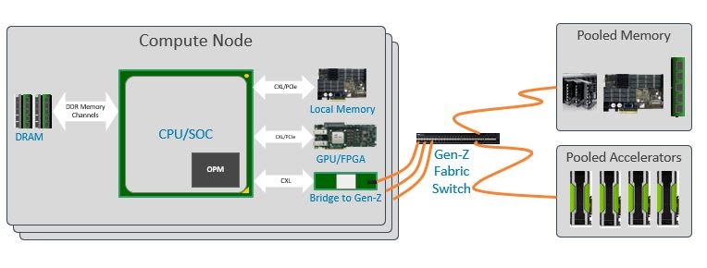
Gen-Z Fabric
Management of a Gen-Z fabric leverages best-in-class fabric management for secure and non-invasive management, dynamic resource provisioning to support rack-scale multi-processing and accelerator environments.
Developed with a focus on accommodating continuous performance increases through the transparent aggregation of next generation devices such as persistent memory, as well as leveraging DRAM through composable memory, and accelerators

Slide 7
Shared Industry Interests
Gen-Z and the OFA share a mutual interest in advancing the state of the art in high performance interconnects:
  Gen-Z is motivated by a requirement to implement memory-like semantics across fabric topologies to support the Gen-Z vision for a distributed memory architecture. Such a data access model implies a requirement for an unusually sophisticated interconnect exhibiting extraordinarily low end-to-end latencies.
  OFA accelerates the development and adoption of new generation fabrics for the benefit of the advanced networks ecosystem, including interconnects such as Gen-Z. At the heart of the OFA’s mission is a reliance on the consumers and providers of network services to define the key characteristics of the interconnect and the mechanisms (APIs) used to access those services.

Slide 8
Memorandum of Understanding (MoU)
Port Gen-Z to OpenFabrics Interfaces (libfabric)
  Create libfabric ‘provider’ for Gen-Z
  Enables easy access to Gen-Z features for any libfabric-enabled application or middleware
  Explore possible enhancements to the libfabric APIs
Create a Solution for Managing Composable Networks
  Composable networks are scalable and based on heterogeneous components
  Begs for a unique approach to fabric management
  The proposal consists of a management framework, an “abstract” (fabric agnostic) fabric manager, and fabric specific plug-ins
  Based on DMTF’s Redfish® standard
  Gen-Z will be the first target, used to drive this development

Slide 9
Thank You

