Slide 1
RoCEv2 Update from the IBTA
#OFADevWorkshop

Slide 2
Introduction – RoCE (v1)
Introduction - The RoCE (v1) Protocol Stack
RDMA Application / ULP
OFA Verbs Interface
OFA* Stack
IB
Transport
Protocol
IB
Transport
Protocol
Network Layer
Network Layer
InfiniBand
Link Layer
Ethernet
Link Layer
InfiniBand
RoCE
Specification
RoCE
InfiniBand
Management
Ethernet
Management

Slide 3
The RoCE(v1) Packet Format
InfiniBand
LRH
(L2 Hdr)
L3 Hdr
BTH+
(L4 Hdr)
IB Payload
ICRC
VCRC
No Changes
Eth L2
Header
L3 Hdr
BTH+
(L4 Hdr)
IB Payload
ICRC
FCS
RoCE

Slide 4
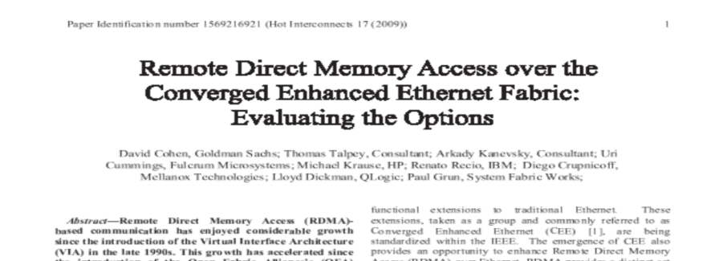
RoCE(v1) Timeline
May 2009 - IBTA forms RoCE WG
July 2009 – RoCE Prototype Available
Aug 2009 – Position paper on RoCE at HOTI
April 2010 - Ratified IBTA Standard
October 2010 – RoCE in upstream Linux

Slide 5
RoCE(v1) and L2-Datacenters
RoCE is a L2 Protocol
(“flat”) L2 Eth Topology
L2 Extensions are Supported
TRILL
Provider Networks (PB, PBB, etc)
Virtualization Overlays
RDMA within an Ethernet L2 Domain
FCoE is similar
Plain L2 or TRILL or PBB or
Virtualization Overlays
L2
L2
L2
L2
RoCE within a Single Rack
Scale up with Single Ethernet L2 Domain
(from endnode perspective)

Slide 6
The Need for (IP) Routable RoCE
A Common Class of L3 Datacenter
Nodes within a Rack share a Ethernet L2 Domain
TOR Device
L2 Switch for intra-rack communication
L3 (IP) Router for inter-rack communication
other topologies also apply
Customer Demand
RDMA Across Racks
i.e. Across IP Subnets
Focus on Data Center Networks
RoCE is Already “close” to being “IP Routable”
RoCE Address in API is IP
RoCE Packet Format / Wire Protocol Includes L3 Header
L2
L2
L2
L2 Domain
L2 Domain
L2 Domain

Slide 7
RoCEv2 – A Straightforward Extension
RDMA Application / ULP
OFA Verbs Interface
Software
OFA* Stack
IB
Transport
Protocol
IB
Transport
Protocol
IB
Transport
Protocol
IB Network Layer
IB Network Layer
UDP
Typically HW
RoCEv2
Specification
IP
InfiniBand
Link Layer
Ethernet
Link Layer
Ethernet
Link Layer
InfiniBand
RoCE
Specification
RoCE
RoCE v2
InfiniBand
Management
Ethernet / IP
Management
Ethernet / IP
Management

Slide 8
RoCEv2 - IP Routable Packet Format
EtherType indicates
that packet is RoCE
(i.e. next header is IB GRH)
Eth L2
Header
EtherType
IB GRH
IB BTH+
(L4 Hdr)
IB Payload
ICRC
FCS
RoCE
Eth L2
Header
EtherType
IP
Header
Port #
RoCEv2
Proto #
UDP
Header
IB BTH+
(L4 Hdr)
IB Payload
ICRC
FCS
EtherType indicates
that packet is IP
(i.e. next header is IP)
UDP dport number Indicates
that next header is IB.BTH
ip.protocol_number
indicates that packet is UDP

Slide 9
RoCEv2 Highlights
Contained Change
Clean L3 Replacement
Strict Layering Preserved
Generated and Consumed Below the Channel Interface (i.e. the “API”)
Transparent to Applications
No Application Software Changes
Current RoCE API is already IP L3 based
Transparent to Underlying Network Infrastructure
Mainstream processing on L2 Ethernet Switches / L3 IP Routers
Additional Benefits of the RoCEv2 Approach (some examples)
Traditional Network Management Tools Apply
ACLs (Metering, Accounting, Firewalling)
IGMP Snooping for optimized Multicast
Network Monitoring Tools

Slide 10
Status Update
IBTA SC Requested Technical Work on RoCEv2 (Nov 2013)
IBTA Invited to give Presentation at November 2013 IETF Meeting
IBTA Starting Definition of IP Routable RoCE
Well Received by the IETF Community
IBTA IBXoE Working Group Re-Activated to Specify RoCEv2
Started Work in December 2013
Initial RoCEv2 Specification Draft
Undergoing IBXoE WG Review
Next Steps

Slide 11
Thank You

