Slide 1
Exploring Improvement to Verbs
Tom Stachura, OFA TAC Co-chair
#OFADevWorkshop

Slide 2
About this session…
I am not a Verbs expert
But that’s ok, b/c YOU (& Nathan) are…
I co-chair the TAC (Technical Advisory Council)
The TAC is responsible for driving OFA direction
I need your help to get through this session
Audience participation is required

Slide 3
Commercial Spot: TAC
TAC = Technical Advisory Council
TAC Charter, the fine print:
  Investigate technology trends
  Review needs of end user markets/apps/technology
  Maintain links to IBTA TWG, Spec bodies, & end users
TAC Charter, my words:
  Find OFA growth vectors
We (a group of smart technologists + me) meet twice a month
I drive the agenda

Slide 4
TAC Outputs & Focus Areas
Key TAC Outputs to-date
  Vetted new ULPs & Proposing OFA synergies
  Analyzed the hi-performance needs of Applications
  OFI WG was incubated in the TAC
Current TAC Exploration Areas:
  Improving Verbs
  Expanding to the Cloud
  Storage Usage models, esp. NVM
Contact tom.l.stachura@intel.com if you are interested

Slide 5
End of Commercial
Key TAC Outputs to-date
  Vetted new ULPs & Proposing OFA synergies
  Analyzed the hi-performance needs of Applications
  OFI WG was incubated in the TAC
Current TAC Exploration Areas:
  Improving Verbs
  Expanding to the Cloud
  Storage Usage models, esp. NVM

Slide 6
The Hurdles with Verbs…
Nathan Hjelm @ LANL provided great feedback:
  RDMA-CM doesn’t scale
    Issues scaling beyond 1500 ranks and 32 CPUs/node. SSA?
  RC mode runs out of queue pair resources
    Good focus here (DCT), but no standardization
  Verbs interfaces don’t map well to MPI semantics
    Supporting multiple MPIs causes code bloat
  Heavy cost of setup & managing memory registration
    More of an issue for PGAS
  Lack of standardization between h/w implementations
    i.e. PSM vs. MXM
  No mapping to “Well-known ports”
    QPn is random – MPI w/ UD wants a specific port & QPn

Slide 7
Verbs Hurdles – A Simplification
Scalability
  RDMA-CM
  QP Resources
Scalability & Usability
  Heavy cost for memory registration
Application Impedance Mismatch
  Not mapping to well to MPI
  Different h/w implementations
  Mapping to “well-known” ports
Any key hurdles we missed?

Slide 8
Verbs Hurdles – We heard it this week…
NASA Pleades, DCT,
OFI WG, MPI API,
SSA
Scalability
  RDMA-CM
  QP Resources
Scalability & Usability
  Heavy cost for memory registration
Application Impedance Mismatch
  Not mapping to well to MPI
  Different h/w implementations
  Mapping to “well-known” ports
OFI WG, MPI API
PGAS API, ODP
OFI WG
MPI API
SMC-R

Slide 9
Verbs Hurdles – Next Steps…
Scalability
  RDMA-CM
  QP Resources
Scalability & Usability
  Heavy cost for memory registration
Application Impedance Match
  Not mapping to well to MPI
  Different h/w implementations
  Mapping to “well-known” ports
Recommended
Focus area
for OFA & IBTA
OFI WG
Focus Area

Slide 10
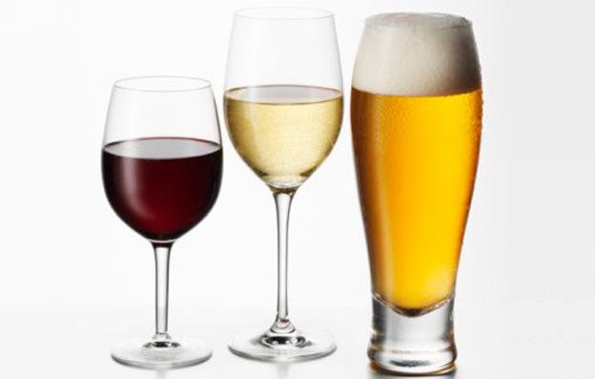
My Only Presentation Picture

Slide 11
Thank You

