Slide 1
Signature Verbs Extension
Richard L. Graham

Slide 2
Data Integrity Field (DIF)
Used to provide data block integrity check capabilities (CRC) for block storage (SCSI)
Proposed by the T10 committee
DIX extends the support to main memory
Motivation:
Data integrity checks are included in:
memory bus
I/O bus (PCI-e)
internal chips
RAID controller within arrays
network packet interfaces
Missing data protection: storage controller
iSCSI can DMA wrong pages from memory and calculate checksum on these pages
Array may receive incorrect data and use it to generate RAID parity blocks
Disks may write to the wrong logical block

Slide 3
What is DIF
The standard specify an additional 8 byte field designated for data integrity/protection for each data block (usually of size 512 bytes but not a must).
GUARD tag (Logical Block Guarding):
16-bit CRC covering the hardware sector
Regardless of sector size
4096 KB sectors appear only to gain momentum in lower end
REFERENCE tag (Misdirected writes):
4 bytes – depend on protection type
For Type 1 protection, REF tag contains lower 32 bits of LBA
For Type 2 protection, REF tag has to match LBA in CDB + N
Wraps at 2TB with 512 byte sectors, 16TB with 4KB
APPLICATION tag (Up for grabs):
2 bytes per sector
Ownership negotiated with target

Slide 4
System Architecture
Host Machine
Initiator with
*DIF Offload Support
DIF Enabled Target
*DIF Offload Support
Target Machine
FC/SATA/SCSI
Memory
IB
Memory
Legacy Initiator
Host Machine
Storage
Data
Meta Data (DIF)
Memory

Slide 5
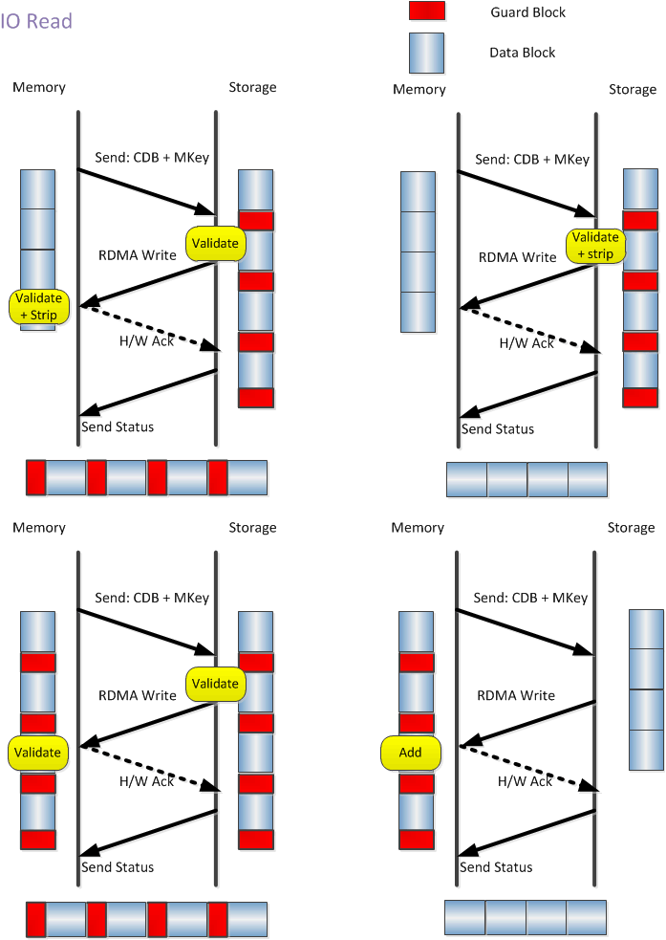
System Architecture

Slide 6
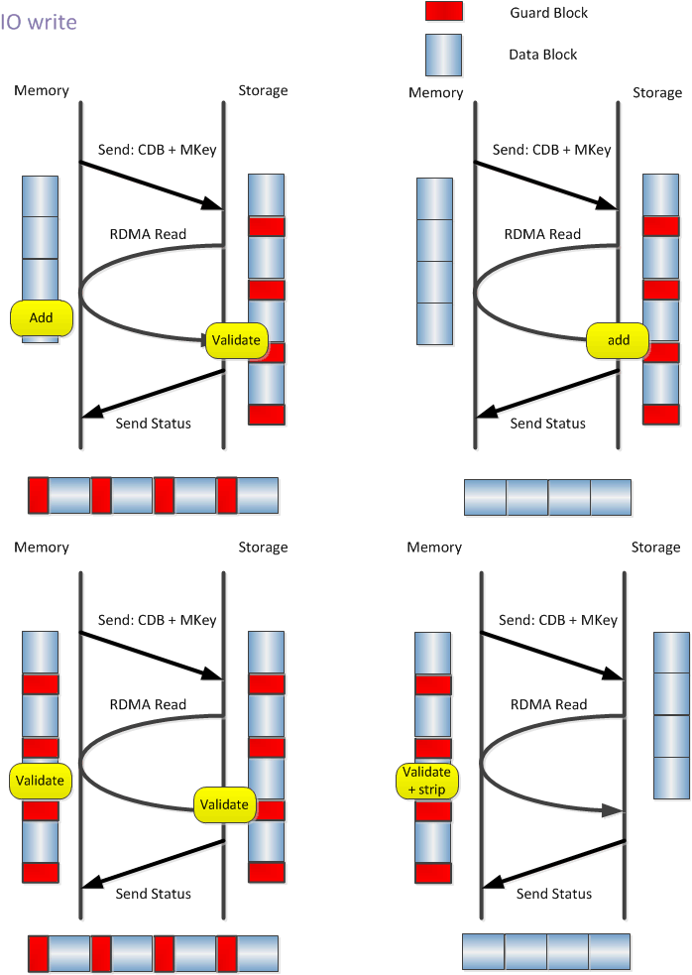
System Architecture

Slide 7
Signature Verbs - Actions
1. Allocate Signature enabled memory regions
mr_init_attr.flags |= IB_MR_SIGNATURE_EN;
sig_mr = ib_create_mr(pd, &mr_init_attr);
2. Set QP as Signature enabled
qp_init_attr.create_flags |= IB_QP_CREATE_SIGNATURE_EN;
sig_qp = ib_create_qp(pd, &qp_init_attr);
3. Register Signature MR (send work request IB_WR_REG_SIG_MR)
sig_wr.opcode = IB_WR_REG_SIG_MR;
sig_wr.sg_list = data_sge; /* Data buffer */
sig_wr.wr.sig_handover.prot = prot_sge; /* protection buffer */
sig_wr.wr.sig_handover.sig_attrs = &sig_attrs; /* signature attributes struct */
sig_wr.wr.sig_handover.sig_mr = pi_ctx->sig_mr; /* Signature enabled MR */
ret = ib_post_send(qp, sig_wr, &bad_wr);
3.5. do RDMA (data-transfer) – Leverage existing verbs support
4. Check Signature status
ret = ib_check_mr_status(sig_mr, IB_MR_CHECK_SIG_STATUS, &mr_status);

Slide 8
Leverage Extended User Mode Memory Registration
Memory Key Creation: Support combining contiguous registered memory regions into a single memory region. H/W treats them as a single contiguous region (and handles the non-contiguous regions)
For a given memory region, supports non-contiguous access to memory, using a regular structure representation – base pointer, element length, stride, repeat count.
Can combine these from multiple different memory keys
Memory descriptors are created by posting WQE’s to fill in the memory key
Supports local and remote non-contiguous memory access
Eliminates the need for some memory copies

Slide 9
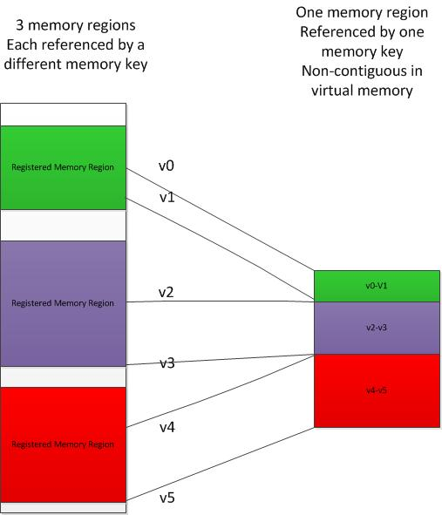
Combining Contiguous Memory Regions

Slide 10
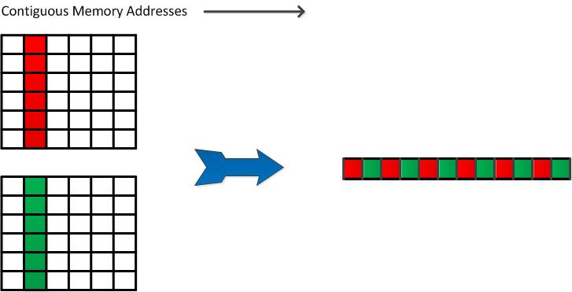
Non-Contiguous Memory Access – Regular Access
Memory
Wire

Slide 11
Non-Contiguous Memory Access – Regular Access
Wire
Memory

Slide 12
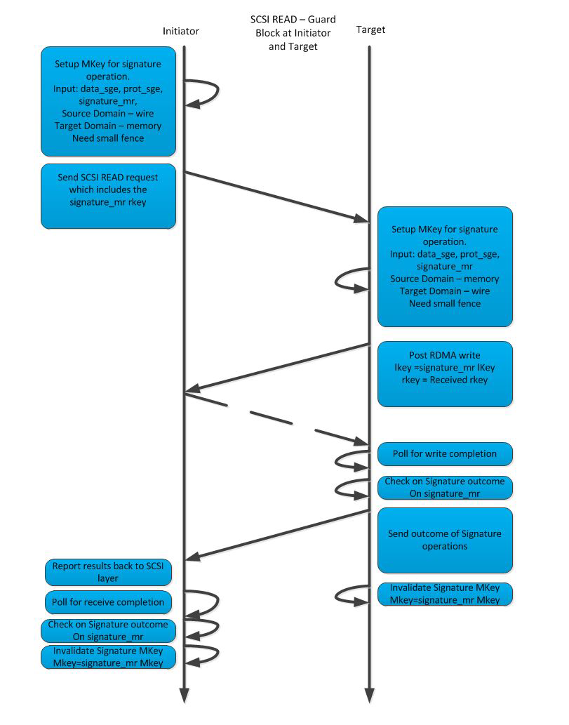
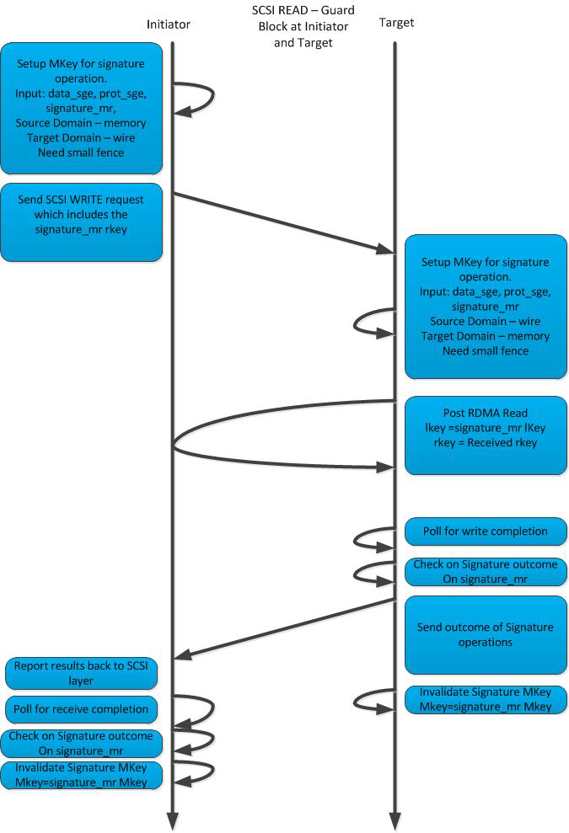
Example in SCSI transport

Slide 13
Thank You

