Slide 1
The future of Unstructured Data Workloads
#OFADevWorkshop
Tasneem Maistry Pivotal

Slide 2
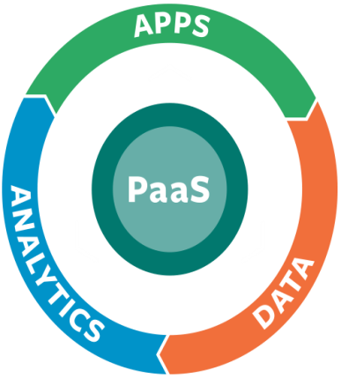
What Matters: Apps. Data. Analytics.
Apps power businesses, and those apps generate data
Analytic insights from that data drive new app functionality, which in-turn drives new data
The faster you can move around that cycle, the faster you learn, innovate & pull away from the competition
Notes:
I want to start out by talking about what matters to enterprises today. Today more than ever, the world is driven by applications.
This diagram represents a cycle of continuous value creation for enterprises; driven by the relationship between Apps, Data, and Analytics.
Software Applications power businesses, and those applications generate data.
Analytic insights from that data drive new app functionality, which in-turn generates new data. The faster you move around this value cycle, the faster you learn, take action, and win.

Slide 3
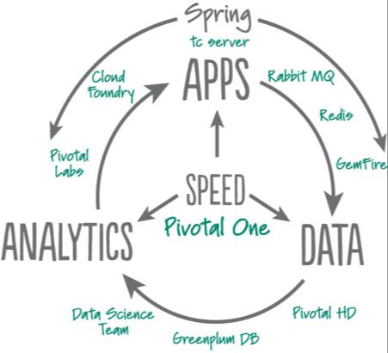
Pivotal’s Opportunity
Uniquely positioned to help enterprises modernize each facet of this cycle today
Comprehensive portfolio of products spanning Apps, Data & Analytics
Converging these technologies into a coherent, next-gen Enterprise PaaS platform

Slide 4
IT Technology Eras
Mainframe
Client-Server
Mobile-Cloud
The exponential increase in business expectations is unsustainable for IT
Millions of Apps
Billions of Users
Exabytes of data
Business Expectations
Ability of IT to Deliver
$ $ $ $ $ $
Steady IT Budgets*
* Source: Gartner, 2013: “Hunting and Harvesting in a Digital World: The 2013 CIO Agenda”
Notes:
Let’s put this in context by looking at the core challenge facing most IT organizations.
Available resources and IT budgets have continued to decline as the industry has transitioned from the mainframe, to the client server, and now to the mobile-cloud era.
Over the last decade, VMware and the adoption of virtualization technology helped IT drive tremendous efficiencies that significantly improved IT’s ability to meet the expectations of the business.
But now in the mobile-cloud era, IT is faced with both opportunities & challenges presented by billions of new mobile consumers, and millions of new applications and services. The business expectations of IT have accelerated exponentially.
Without a fundamental change in “how we do IT” – no one can keep up.

Slide 5
Pivotal Can Help Bridge the Gap
IT Technology Eras
Mainframe
Client-Server
Mobile-Cloud
IT at the Speed of Business
Business Expectations
Ability of IT to Deliver
$ $ $ $ $ $
Steady IT Budgets*
* Source: Gartner, 2013: “Hunting and Harvesting in a Digital World: The 2013 CIO Agenda”
Notes:
We know that innovation is the key to enabling IT to deliver at the speed of business – and we know that liberating resources, and shifting them from maintenance to innovative projects is the only way to get there. Some of our customers are already there. These customers have realized dramatic increases in IT responsiveness, efficiency, and overall IT capacity that have allowed them to keep pace with business needs and deliver a fundamentally different kind of value to the business, to end customers, to employees, and ultimately to shareholders.
Their businesses are changing because their IT is changing.

Slide 6
IT is Constrained by Technology Silos
72% of IT operating budget spent on maintaining old technologies
Modern Silos
Legacy Silos
Notes:
Legacy silos, built around a hardware-centric approach, drain IT resources and prevent IT from serving the business at the speed of business. These hardware-defined approaches have so significantly compromised IT’s ability to serve up applications to the business efficiently that many businesses have opted to pursue options outside of their traditional IT organizations. Meanwhile, these organizations are stuck managing yesterday’s inefficient operational silos, and are unable to free up the resources necessary to invest in innovation that truly impacts strategic value, and ultimately impact the bottom line.
Our goal is to help customers break down legacy silos and provide a common computing platform for all applications, today and tomorrow, based on a highly automated software-defined data center architecture. This includes a common cloud management approach that embraces and provides transparent governance of infrastructure and software-as-a-service components, even those that are outside of traditional IT control.

Slide 7
Liberating Resources Serves Customers
Data isn’t available.
Analysis takes too long.
App dev takes too long.
Industry Average: IT Spend on Innovation
IT Maintenance
30%
Provisioning takes weeks.
Production workloads are managed via email.
* Source: Gartner, 2013: “Hunting and Harvesting in a Digital World: The 2013 CIO Agenda”
Notes:
Gartner estimates that only 30 percent of IT’s budgets today are going into new innovation.
And the reason is that apps are slow, device management consumes too much, provisioning is too slow, infrastructure is too brittle and heavy …all of these reasons bog IT down with the responsibility of maintaining the status quo, instead of innovating for the future.
<click>

Slide 8
Liberating Resources Serves Customers
Any user, any device, any app… automatically.
Apps get rolled out at “the speed of business.”
IT Maintenance
50%
Goal: IT Spend on Innovation
Provisioning a production environment takes minutes.
You can routinely deploy any workload…anywhere.
Source: VMware Journey Benchmark Survey, 4th Wave 2013
Notes:
But our goal is to move our customers to a 50/50 model – 50% on maintenance and 50% on innovation. At this point, IT goes from being a ball and chain to becoming a powerful tool where apps are self-service and rolled out at the speed of business; where IT becomes an asset to accelerate business opportunities for the future.
Through a recent benchmark study with our customers, we know that roughly 1/3 of our customers have already shifted to this 50/50 investment model where they are freeing up resources to increase investments in innovation.
This is our goal. Our commitment to our customers. When our customers can devote 50% of their budgets to innovation we will have progressed significantly in transforming IT into an agile, high performing asset for the business.

Slide 9
Interfaces and Usage Patterns vs. Hosting Solutions
Users and usage
Increased set-up time, but longer usage
More dynamic and autonomous usage patterns
Service Offered
Hosted Processing
Hosted Infrastructure
Application Hosting
PaaS – Hosted Analysis Environments
Shared Scientific Analysis hosts
SOA
High performance file system
Virtual Infrastructures for other organisations
Cloud Federation / Brokering
Virtual Storage
Bare metal
Increasing virtualisation
Notes:
The cloud presents an entirely new set of value propositions for enterprise computing environments, offering myriad benefits including application scalability, improved economies of scale, reduced costs, resource efficiencies and more. Such benefits enable companies' vision of the truly dynamic data center and further a new level of agility and nimbleness that is unfathomable with the traditional silo computing model.

Slide 10
The Need for an Application Centric Layer
Developers can focus on development and not infrastructure plumbing
Separate the concerns of AppDev and Operations
Eliminate the bottleneck of provisioning and deployment processes
PaaS
IaaS
SaaS
Notes:
No need to configure VMs, databases, AppServers, Load-balancers…
Developers can focus on development and not infrastructure plumbing
Separate the concerns of AppDev and Operations
Eliminate the bottleneck of provisioning and deployment processes
Make full use of investments in the “Cloud”

Slide 11
Build your cloud for today and tomorrow
Automated
Virtualization
Cloud
ITaaS Infrastructure
Apps
Workloads
Services
Multi-Service Broker
IaaS
DaaS SaaS
PaaS
STaaS
IT Operations
Cloud Orchestration
Private & Public IaaS
App and Desktop Virtualization
Server Virtualization
Storage, Compute, Network
Manual
Business Impact
IT Only ---------------- Departmental ---------------------------------------------------------- All
Notes:
Think of this as a journey, that builds off your existing investments that you have already done in Server, App and Desktop Virtuzlation.

Slide 12
Why is this relevant and important
Sensitivity analysis of each platform component on the outcomes (QoS, analysis etc)
What does it need .. Logs, users, processing, and processes
What is missing -- processes to capture and collect these
What is missing -- people who can analyze this and come up with learnings
What can AWB provide -- lots, users, processing
NEED VOLUNTEERS TO do research on the cluster

Slide 13
Pivotal Analytics Workbench (AWB)
1000 node cluster
Collaborative project with industry leaders (Mellanox, Intel, Seagate)
Provides mixed mode environment (GPDB, GemXD, PCF, PHD)
Contains entire Hadoop stack
(HDFS, HBASE, PIG, HIVE)

Slide 14
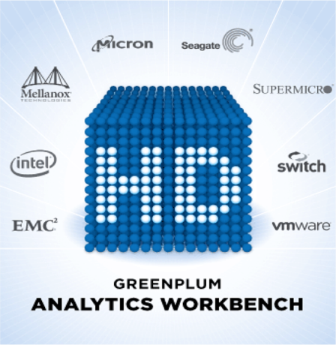
Partners
Intel
Contributed 2,000 6-core CPUs.
Mellanox
Contributed >1,000 network cards and 72 switches.
Micron
Contributed 6,000 8GB DRAM modules.
Seagate
Contributed 12,000 2TB Drives

Slide 15
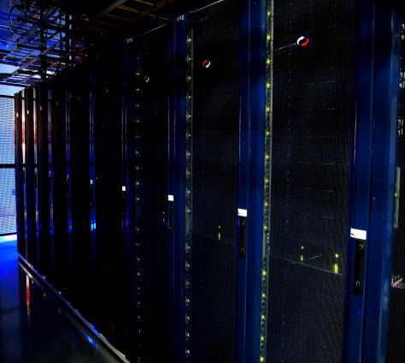
Cluster

Slide 16
Cluster Size
Physical Hosts - More than 1,000 nodes
Processors - Over 24,000 CPU’s
RAM – Over 48TB for memory
Disk capacity – More than 24PB of raw storage.
“Equivalent to nearly half of the entire written works of mankind from the beginning of recorded history”

Slide 17
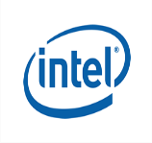
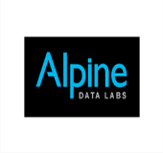
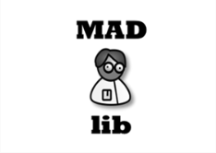
Typical Target Use Cases
Pivotal demonstration
Partner engagements
(Intel, Mellanox, Seagate)
Industry and academia collaboration
(Alpine, Informatica)

Slide 18
Submitting your Proposal
Request invite @ www.analyticsworkbench.com
Project determination made within 2 weeks of submission

Slide 19
Q & A

Slide 20
Thank You

