Slide 1
OFED for Linux
Status and Plans
Authors:
Robert J Woodruff; Rupert Dance
Date: 4/1/2014
#OFADevWorkshop

Slide 2
Agenda
General Goals and Charter
EWG – OFED for Linux status update
  OFED-3.5-x
  OFED-3.12
Process Review and Changes
OFED H/W and S/W validation
OFED Roadmap
Open Discussion Items
How to contribute

Slide 3
EWG General Goals and Charter
The charter of the EWG working group is to provide enterprise ready distributions of the Open Fabrics code for Linux
  Includes providing backports to support several Linux kernel versions and Linux distributions
  Includes comprehensive testing, validation, and hardening of the code
  Includes software packaging, release notes, and software installers to allow for easy installation
  Includes processes for bug tracking and problem resolution
  Provides platform for experimental OFA technologies
  Used for interoperability testing and OFA logo program

Slide 4
EWG – OFED Linux Status Update
Production releases done since last year:
  OFED 3.5-1
  OFED 3.5-2
  OFED 3.12 RC 1
Experimental feature releases done since last year
  OFED-3.5-MIC
  OFED-3.5-1-MIC
  OFED-3.5-2-MIC

Slide 5
OFED 3.5-1
Released in September 2013
Main new features:
  Added support for RHEL EL 6.4

Slide 6
OFED 3.5-2
Released in December 2013
Main new features:
  Added support for SLES 11 SP 3
  Removed packages
  - compat-dapl (older uDAPL 1.0)
  Updated packages: dapl-2.0.39, ibacm-1.0.8, infiniband-diags-1.6.2, infinipath-psm-3.1-4, libcxgb4-1.3.1, libibmad-1.3.10, libibverbs-1.1.7, libmlx4-1.0.5, libmthca-1.0.6, librdmacm-1.0.17.1, mstflint-3.0-0.6, opensm-3.3.16, perftest-2.0-0.58

Slide 7
OFED 3.12 RC 1
Based on kernel.org 3.12 kernel
OSes supported
  RHEL EL 6.4, RHEL EL 6.5
  SLES 11 SP 3
  Kernel.org 3.12
Main new features:
  Mellanox Connect-IB (mlx5) support
  Emulex RoCE NIC (ocrdma) support
  Updated user-space packages
    dapl-2.0.40, ibsim-0.6, infiniband-diags-1.6.4, infinipath-psm-3.2-2_ga8c3e3e_open, libcxgb4-1.3.2, libibmad-1.3.11, libibumad-1.3.9 libipathverbs-1.2.1, libnes-1.1.4, librdmacm-1.0.18, mstflint-3.5.0 opensm-3.3.17, perftest-2.0-0.80.g54c73c6, srptools-1.0.2

Slide 8
OFED 3.5-x MIC
Experimental branch releases to support running OFED on Intel® Xeon Phi ™
  OFED-3.5-MIC (released December 2013)
    For Intel® Xeon Phi™ MPSS 2.1
  OFED-3.5-1 beta (based on OFED-3.5-1)
    Since OFED-3.5-2 was released, OFED-3.5-1 was discontinued to upgrade to OFED-3.5-2 as base.
  OFED-3.5-2 (currently under development)
    Support for Intel® MPSS 3.1.x and later on RHEL EL 6.3,6.4, 6.5 and SLES 11 SP 2 and SLES 11 SP3
    Added support for Mellanox Connect-IB (mlx5)
    Added support for kernel mode Intel® Xeon Phi™ clients, e.g. IPoIB and Lustre from on the Intel® Xeon Phi™
    Performance enhancements for Intel® Truescale HCAs

Slide 9
OFA Process Changes
Starting with OFED-3.5, the code is based on upstream kernel and user-space packages.
  Only fixes accepted upstream are included
  Moved to new compat-rdma method for backports
  MPI no longer included
  Changes were designed to allow better alignment with distro and upstream code base to reduce fragmentation
Companies can provide experimental features based on OFED.
  e.g. OFED-3.5-x-MIC

Slide 10
OFA Process Changes
As a result of new process changes, OFED and Linux distribution releases are now much closer aligned.
  e.g. – Next SLES release (SLE12) will be based on kernel.org 3.12 and upstream user-space packages
  RHEL EL 7 based on 3.10 kernel and upstream user-space packages
Experimental branch release features
  Original process was to allow vendors to make branch releases for new non-upstream experimental features, e.g. OFED-3.5-x-MIC
  However, feedback is that is causing more fragmentation of OFED, not less, which was the original goal of the process changes.

Slide 11
OFA Process Changes
Experimental branch release features (cont.)
  Thus we are modifying the process to allow new experimental features be included in base OFED
  Reduce OFED fragmentation by having a single OFED with both production and experimental code
  Experimental code not enabled by default and clearly marked as a non-upstream feature
  Similar to what kernel.org has for experimental code
  Will start this new process after OFED-3.12

Slide 12
OFED – SW & HW validation
OpenFabrics Interoperability Logo Group (OFILG)
  Purpose: validate OFED functionality, test ULPs and verify interoperability in a heterogeneous environment
  Members: Chelsio, DDN, Emulex, IBM, Intel, Mellanox and NetApp
OFA Cluster at UNH-IOL
  Servers: iWARP 12 hosts, InfiniBand 18 hosts, RoCE 15 hosts
  InfiniBand HW : 12 HCAs, 4 switches, 5 SRP targets, 1 gateway
  iWARP HW: 9 RNICs, 1 switch
  RoCE HW: 6 RCA, 1 switch
OFED versions Tested
  1.5.x, 3.5.x, 3.12
PXE Boot environment available
  RHEL 5.x and 6.x, SLES 11, Ubuntu 10.04 and 12.04
  OFED 1.4.x, 1.5.x, 3.5.x, 3.12
Protocols Tested
  Fabric Init, IPoIB, Link Init, NFSoRDMA, Open MPI, RDMA Utilities, RSockets, SM failover, SRP, uDAPL
  Tests executed – approximately 8,049

Slide 13
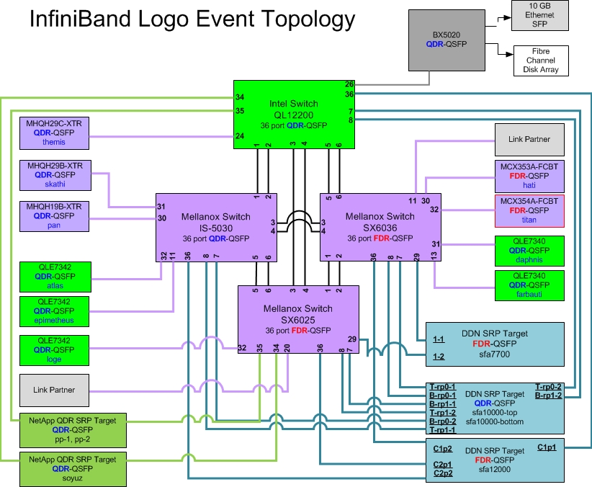
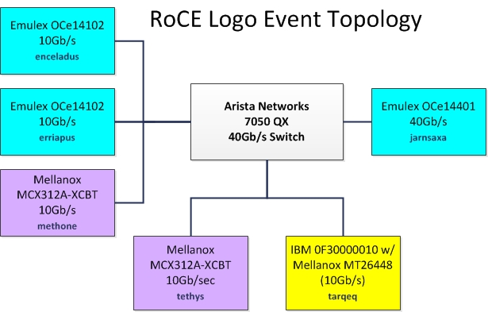
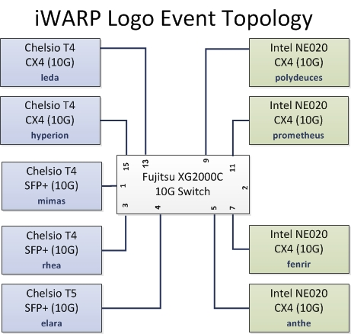
OFED – test topologies

Slide 14
OFED Roadmap.
OFED-3.12-1
  Add Intel® Xeon Phi™ support as an experimental feature
  Add support for new distros, i.e. RHEL EL 7
  Updated user-space packages and cherry picked bug-fixes from later upstream kernel.org
  Release timing depends on RHEL GA release

Slide 15
Open Discussion Items
When should we do the next major OFED release ?
  What kernel should we base it on ? 3.16, 3.17 ?
  What new features are being developed that would drive us to rebase to a new kernel.org kernel ?
    OFIWG libfabric 1.0 release, when will that be ready to include in OFED ?
    Are there other new features being developed that will need never kernel.org kernel support ?

Slide 16
If You Want to Help….
Developing code:
  Including back-ports in Linux
  Reviewing code submitted to Linux kernel/libs
Doing QA and testing
Performance tuning
Sending patches and comments to the mailing lists:
  OFED for Linux: ewg@lists.openfabrics.org
  General Linux development: linux-rdma@vger.kernel.org
  Maintainers and git trees: http://www.openfabrics.org/downloads/MAINTAINERS
Participate in EWG meetings
Opening bugs in Bugzilla (http://bugs.openfabrics.org/)
  When opening a new bug you can choose OpenFabrics Linux

Slide 17
Thank You

