Slide 1
RDMA in Virtualized and Cloud Environments
#OFADevWorkshop
Aaron Blasius, ESXi Product Manager
Bhavesh Davda, Office of CTO
VMware

Slide 2
Takeaways
It is possible to bring the benefits of virtualization to low latency environments
VMware is working on virtualization support for host and guest services over RDMA
Early performance numbers are promising

Slide 3
Virtualization of Latency-Sensitive Applications on ESXi
Historically, virtualization was not suitable for latency-sensitive workloads
vSphere ESXi 5.5 (2013) introduced an “easy button” for running extremely latency-sensitive workloads
  Disables Interrupt Coalescing
  Pins vCPUs to pCPUs
  Pins down VM memory on local NUMA node
  Reduces idle guest (HALT) wake-up latencies in VMM

Slide 4
Host-Level RDMA
Physical RDMA interconnect on ESXi hosts:
  Support for physical RDMA connections on ESXi hosts (RoCE, iWARP, IB)
  OFED RDMA stack in ESXi vmkernel
Use cases:
  vMotion (Live migration of virtual machines between ESXi hosts)
  vSAN (Scale-out clustered storage from direct-attached HDDs and SSDs on ESXi hosts)
  SMP-FT (Lock-step fault tolerance of SMP VMs)
  NFS
  iSCSI

Slide 5



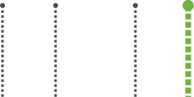


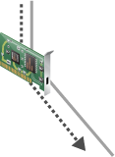
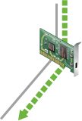
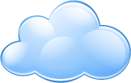


RDMA for hypervisor services
iSCSI
SMP-FT
vSAN
vMotion
TCP/IP
RDMA Verbs
Virtual Switch
10 GigE
10/40 GigE RoCE

Slide 6
Guest-Level RDMA
Proposed paravirtual vRDMA device supports Verbs
  Compatible with all virtualization features like vMotion, snapshots and checkpoints
  Lowest latencies for a pure virtual environment, without relying on pass through direct assignment
Use cases:
  Scale-out databases
  Enterprise distributed applications
  MPI-based HPC applications
  Faster network attached storage
  Big data applications

Slide 7
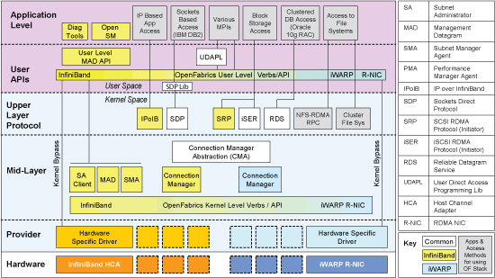

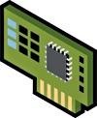
Proposed Paravirtual RDMA HCA (vRDMA) offered to VM
Paravirtualized device exposed to Virtual Machine
  Implements Verbs interface
Device emulated in ESXi hypervisor
  Translates Verbs from Guest to Verbs to ESXi OFED Stack
  Guest physical memory regions mapped to ESXi and passed down to physical RDMA HCA
  Zero-copy DMA directly from/to guest physical memory
  Completions/interrupts proxied by emulation
OFED Stack
Guest OS
vRDMA HCA Device Driver
vRDMA Device Emulation
I/O Stack
ESXi “OFED Stack”
Physical RDMA HCA
Device Driver
Physical RDMA HCA

Slide 8




Data Center Networks – the Trend to Fabrics
WAN/Internet
NORTH / SOUTH
EAST/WEST
WAN/Internet
Increase in East-West traffic due to:
  Virtualization leading to flexible placement of applications within datacenter
  Scale-out applications
  Scale-out hypervisor services
More uniform bandwidth and latencies
  Very Similar to HPC network topologies

Slide 9
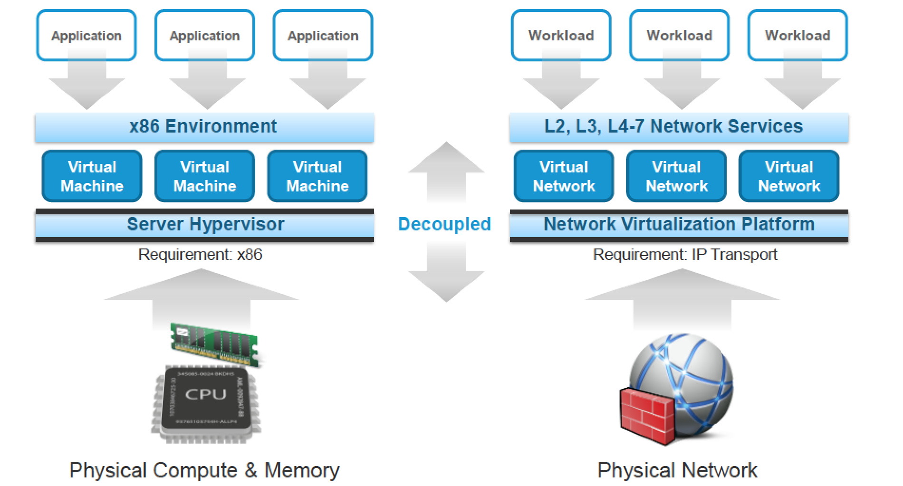
Network Virtualization

Slide 10
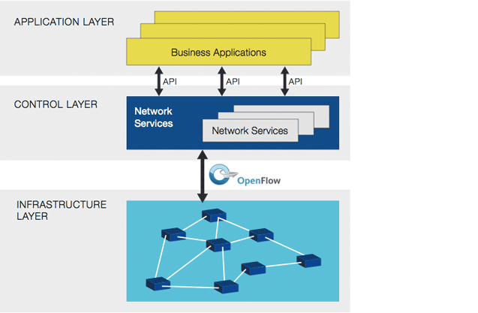
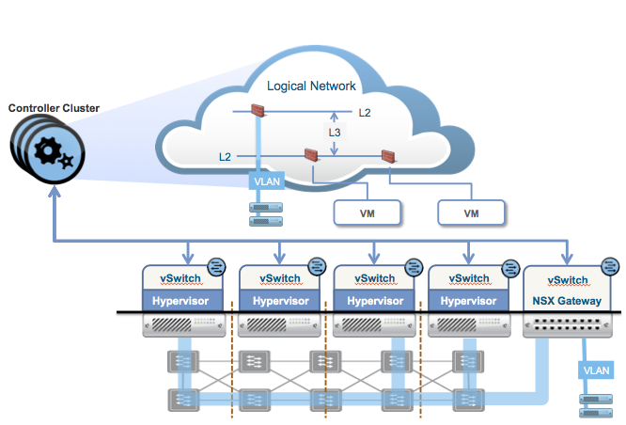
Software Defined Network
Open Networking Foundation’s SDN Architecture
VMware NSX Network Hypervisor Architecture

Slide 11
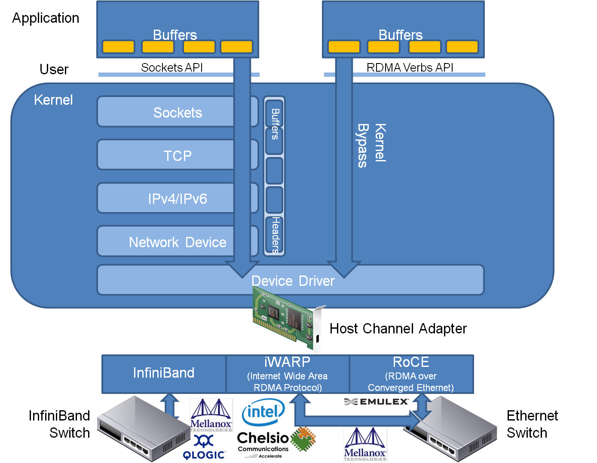
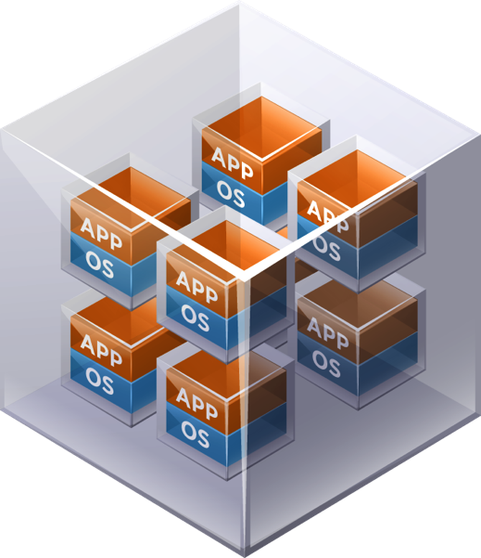
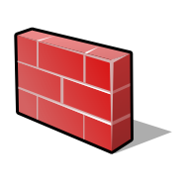
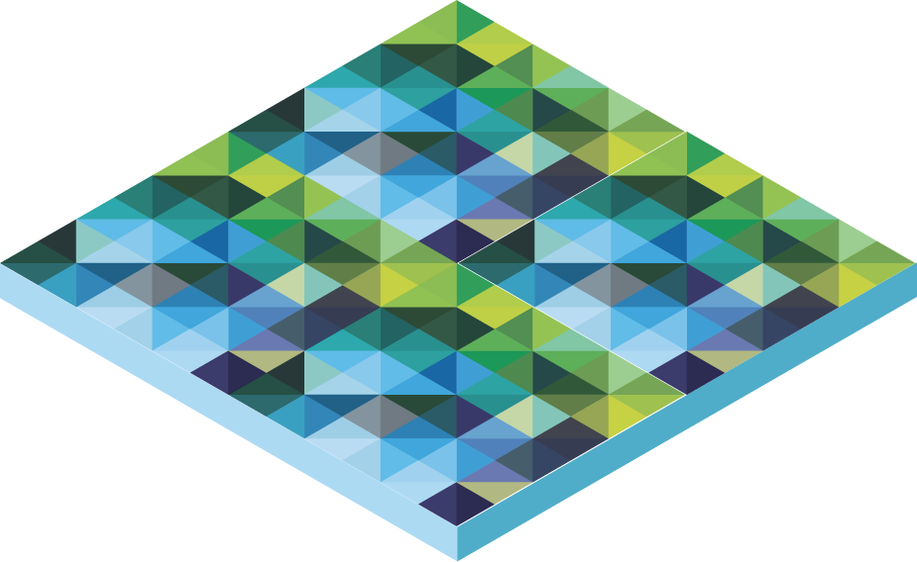
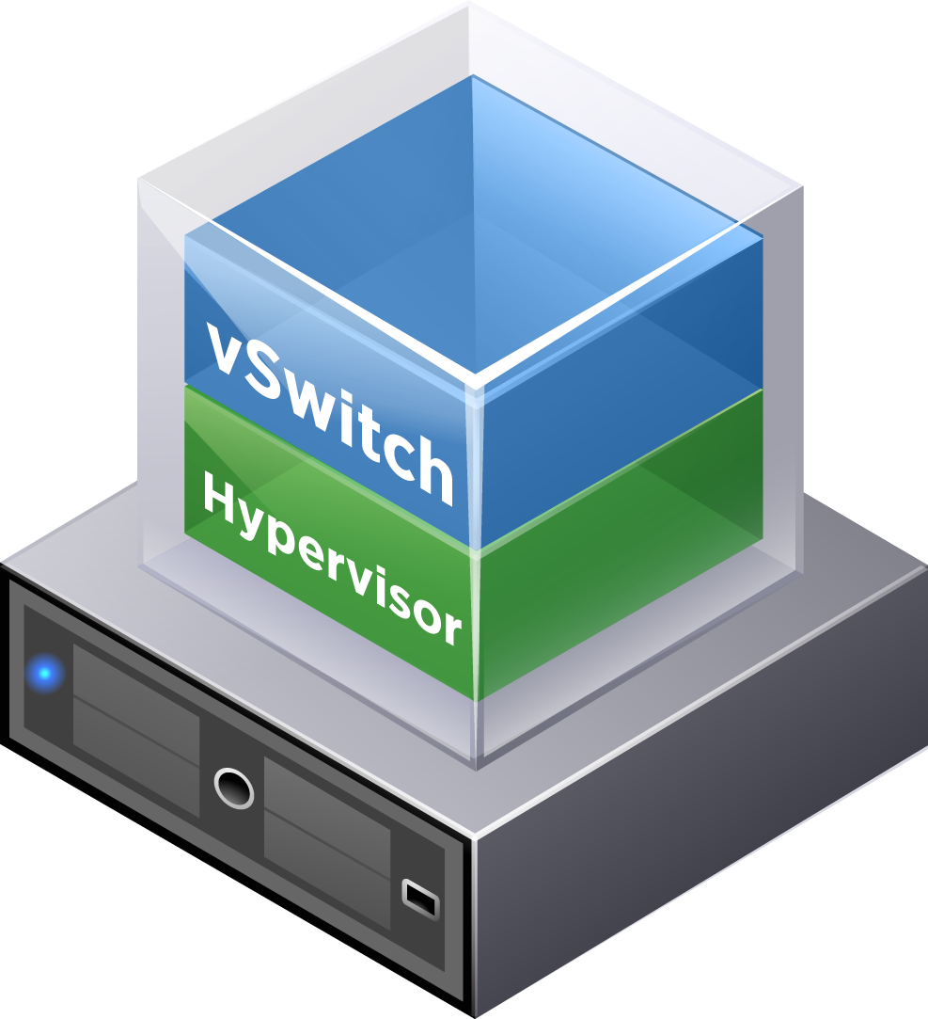
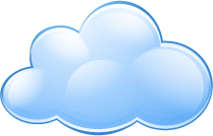
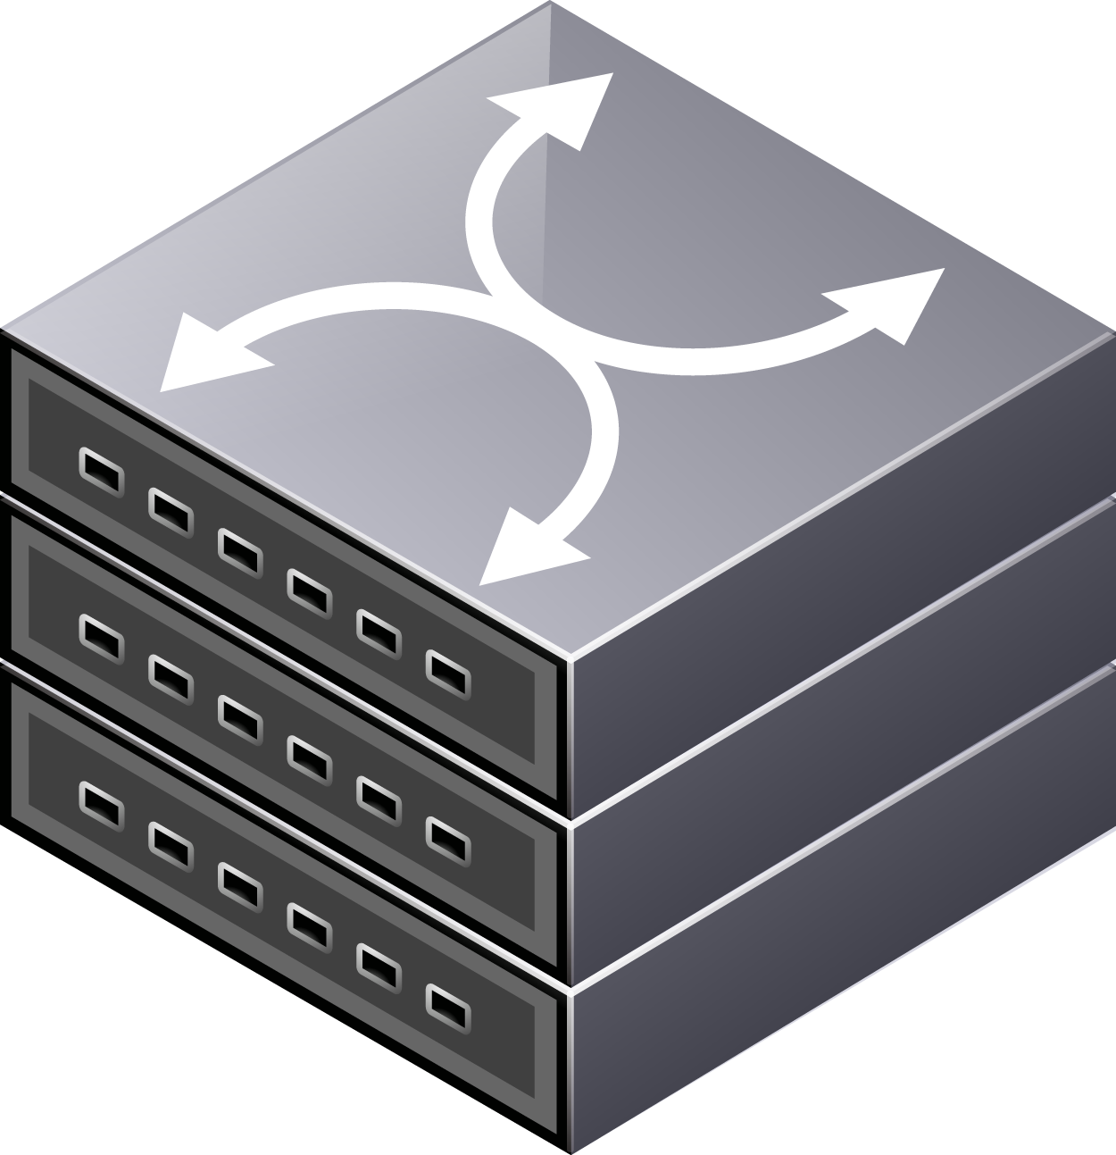
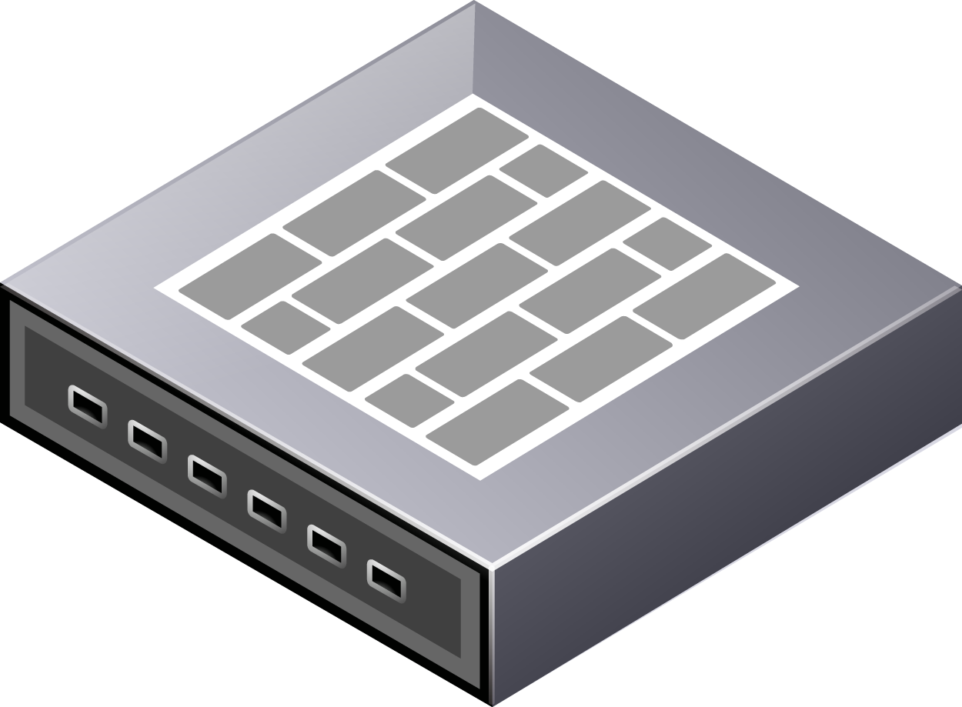
Impedance Mismatch?
Virtual Networks
Internet
Network Hypervisor
Existing Physical Network

Slide 12
RDMA Requirements for Enterprise and Cloud
Enterprise applications usually written to socket(2) based frameworks
  Need to exploit the benefits of RDMA while keeping the socket(2) based API compatibility
  R-sockets? SDP? IBM JSOR? IBM SMC-R?
How to exploit the benefits of RDMA (high bandwidth, low latency, CPU offload) in virtualized applications, without losing the benefits of compute (e.g. ESXi) and network (e.g. NSX) virtualization?

Slide 13
Thank You

