Slide 1
SRP and the scsi-mq Project
Bart Van Assche,

Slide 2
Overview
Involvement with SRP.
About storage API's.
The Linux kernel, blk-mq and scsi-mq.
SRP and the scsi-mq project.

Slide 3
Involvement with SRP
Maintaining the open source Linux SRP initiator and the SCST SRP target drivers.
Member of the Fusion-io ION team. ION is an all-flash H.A. shared storage appliance.
Flash memory provides low latency and high bandwidth.
The focus of RDMA is on low latency and high bandwidth.
In other words, RDMA is well suited for remote access to flash memory.

Slide 4
About Storage API's (1/3)
KVM = Kernel-based Virtual Machine, a hypervisor.
KVM allows guests e.g. to access resources on the host system, e.g. block storage.
KVM guests use paravirtualized drivers like virtio-blk and virtio-scsi.
In 2007 the KVM virtio-blk driver was added to the Linux kernel [Ru08].
virtio-blk provides a block device API to guests.
Over time the KVM maintainers found themselves adding more and more SCSI features to the virtio-blk driver, e.g. disk identification and whether writeback is supported.
In 2012 the virtio-scsi driver was merged in the Linux kernel.

Slide 5
About Storage API's (2/3)
Motivation for introducing the virtio-scsi driver:
The virtio-scsi HBA is the basis of an alternative storage stack for QEMU-based virtual machines (including KVM). Compared to virtio-blk it is more scalable, because it supports many LUNs on a single PCI slot), more powerful (it more easily supports pass-through of host devices to the guest) and more easily extensible (new SCSI features implemented by QEMU should not require updating the driver in the guest) [Bo12].

Slide 6
About Storage API's (3/3)
In other words ...
A storage API must provide more functionality than only reading and writing blocks.
There is a real need for the functionality present in the SCSI protocol.

Slide 7
SRP and SCSI
SRP defines a SCSI transport layer.
Enables supports for e.g. these SCSI features:
Reading and writing data blocks.
Read capacity.
Command queueing.
Multiple LUNs per SCSI host.
Inquire LUN information, e.g. volume identification, caching information and thin provisioning support (a.k.a. TRIM / UNMAP).
Atomic (vectored) write - helps to make database software faster.
VAAI (WRITE SAME, UNMAP, ATS, XCOPY).
End-to-end data integrity (a.k.a. T10-PI).
Persistent reservations a.k.a. cluster support.
Asymmetric Logical Unit Access (ALUA).
Fusion-io is actively involved in the ANSI T10 committee for standardization of new SCSI commands.

Slide 8
Linux Kernel and Storage Driver Performance
Today some storage drivers are capable of more than one million IOPS: high-end SSDs and storage over fast networks.
Some Linux kernel block drivers achieve up to 3 million IOPS.
Linux SCSI kernel drivers achieve up to 1 million IOPS.
Dilemma for high-end storage device driver developers: high performance and limited functionality (block driver) or limited performance and full functionality (SCSI driver) ?
Traditional Linux block layer triggers lock contention on multicore systems.
Multi-queue block layer (blk-mq) eliminates lock contention.
Has been merged in Linux kernel version 3.13 [Bj13].
Fusion-io has asked Christoph Hellwig to rewrite the Linux SCSI mid-layer as a multi-queue block driver (scsi-mq).

Slide 9
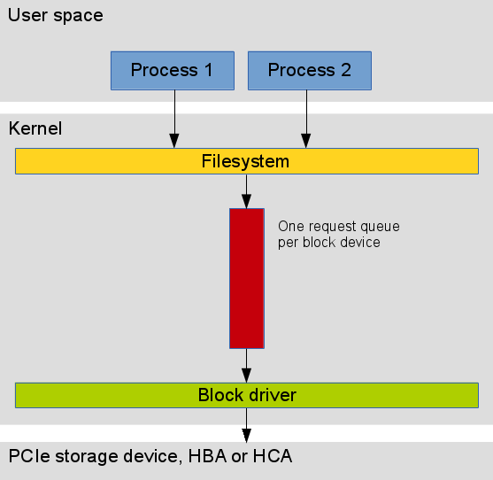
Traditional Linux Block Layer

Slide 10
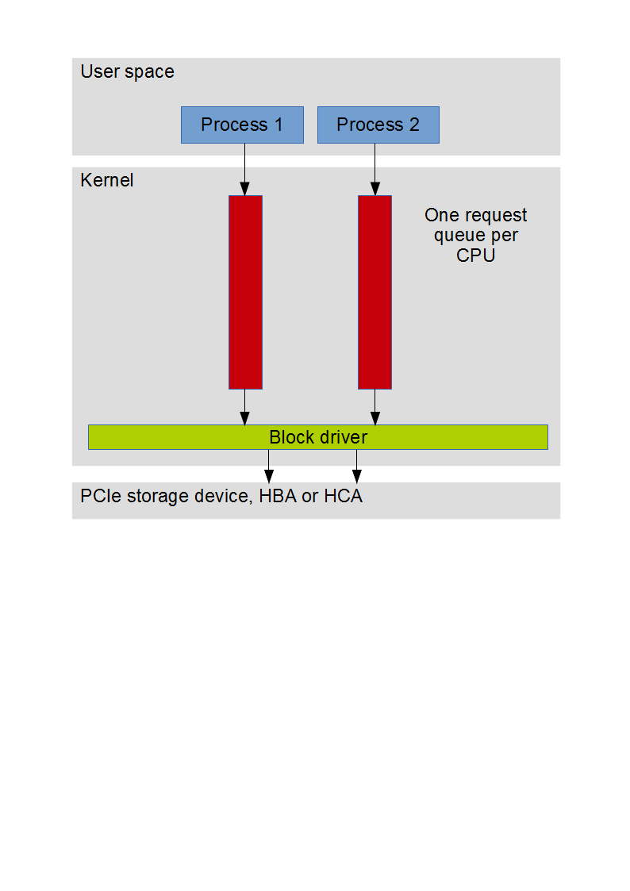
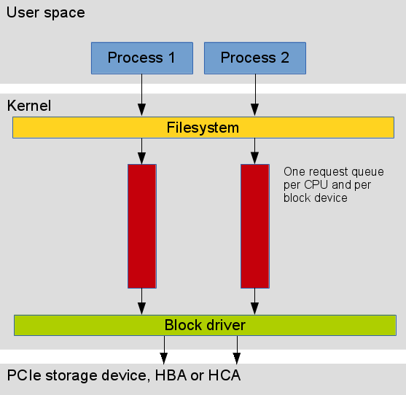
Multi-queue Block Layer

Slide 11
Advantages of the blk-mq approach
One request queue per CPU eliminates lock contention.
Certain SSD's and RDMA HCA's support multiple hardware queues and multiple MSI-X vectors.
Using multiple hardware queues reduces contention and allows to spread interrupt load over multiple CPU cores.
An example of multiple MSI-X vectors allocated for one IB port: # sed -n 's/^\([^:]*:\).*\(mlx4-ib-1-.@PCI Bus 0000:21\)/\1 \2/p' /proc/interrupts
175: mlx4-ib-1-0@PCI Bus 0000:21
176: mlx4-ib-1-1@PCI Bus 0000:21
177: mlx4-ib-1-2@PCI Bus 0000:21
178: mlx4-ib-1-3@PCI Bus 0000:21
179: mlx4-ib-1-4@PCI Bus 0000:21
180: mlx4-ib-1-5@PCI Bus 0000:21
181: mlx4-ib-1-6@PCI Bus 0000:21
182: mlx4-ib-1-7@PCI Bus 0000:21

Slide 12
Current scsi-mq Status
Traditional SCSI core is implemented as a block driver.
scsi-mq = SCSI core based on the multiqueue block layer (blk-mq).
One request queue per CPU and per LUN.
Preliminary results for multi-queue support in the SRP initiator driver:
Very significant CPU usage reduction - up to 250%.
Higher IOPS when using multiple RDMA channels.
Higher bandwidth when using multiple RDMA channels.
Latest scsi-mq patches have been posted on March 17 on the linux-scsi and linux-kernel mailing lists [Ch14].
Open issues:
Implementing multiple hardware queues in a SCSI driver is possible but is not yet integrated with the blk-mq layer.
Hardware queues are per LUN instead of per SCSI host. This means "queue full" detection is done by the SCSI layer instead of the block layer.
There is one tag pool per hardware queue so the "one hardware queue" model is a contention point on NUMA systems.

Slide 13
References
[Ru08] Rusty Russell, virtio: towards a de-facto standard for virtual I/O devices, ACM SIGOPS Operating Systems Review 42.5 (2008): 95-103.
[Bo12] Paolo Bonzini, virtio-scsi: SCSI driver for QEMU based virtual machines, Linux kernel tree, February 2012.
[Ta12] Nisha Talagala, Under the Hood of the ioMemory SDK, Fusion-io blog, April 2012.
[Bj13] Matias Bjørling, et al., Linux block IO: introducing multi-queue SSD access on multi-core systems, Proceedings of the 6th International Systems and Storage Conference. ACM, 2013.
[El14] Robert Elliott e.a., SBC-4 SPC-5 Atomic writes and reads, ANSI T10 committee, February 2014.
[Ch14] Christoph Hellwig, [WIP] scsi multiqueue, Linux SCSI mailing list, March 17, 2014.

Slide 14
Thank You

