Slide 1
NVM as a Disruptive Technology
#OFADevWorkshop

Slide 2
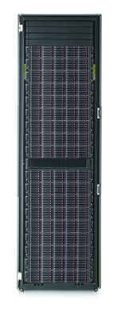
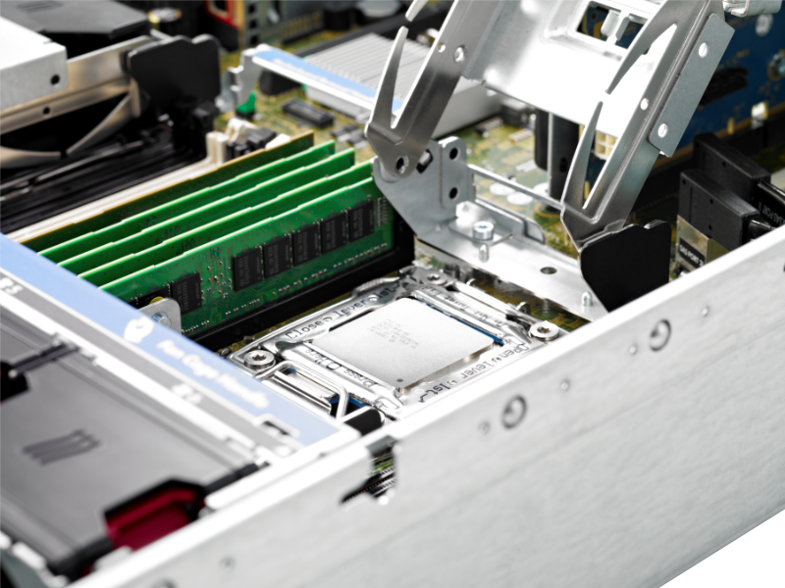
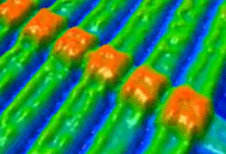
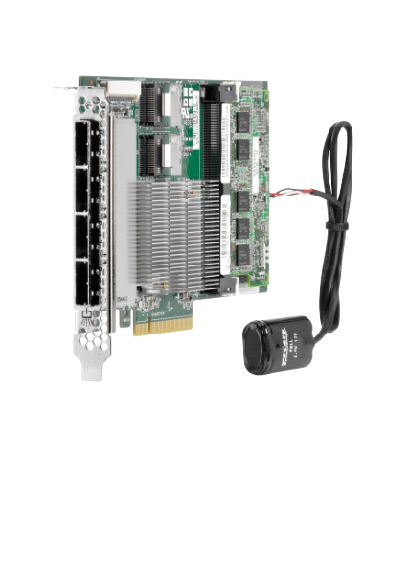
Non-Volatile Memory Vision
NVM Brings Storage
Fast Like
Memory
NVM
Durable
Like Storage
To Memory Slots
Make Data Durable Without Doing IO!

Slide 3
Next Generation Scalable NVM
Resistive RAM NVM Options
Scalable Resistive Memory Element
Family | Defining Switching Characteristics
Phase Change Memory | Energy (heat) converts material between crystalline (conductive) and amorphous (resistive) phases
Magnetic Tunnel Junction (MTJ) | Switching of magnetic resistive layer by spin-polarized electrons
Electrochemical Cells (ECM) | Formation / dissolution of “nano-bridge” by electrochemistry
Binary Oxide Filament Cells | Reversible filament formation by Oxidation-Reduction
Interfacial Switching | Oxygen vacancy drift diffusion induced barrier modulation
Wordlines
Memory
Element
Selector
Device
Bitlines
Cross Point Array in Backend Layers
~ 1000x speed-up over NAND.
From Jim Pappas, Intel, SNIA NVM Summit
Notes:
There is a fundamental technology transition approaching where NAND will be replaced by Resistive NVM. There are over a dozen competing technologies, and our work in the SNIA TWG is agnostic to which of those will succeed. Instead, we are focused on the common attribute that they share… that they are approaching a 1000X performance improvement in latency over NAND.

Slide 4
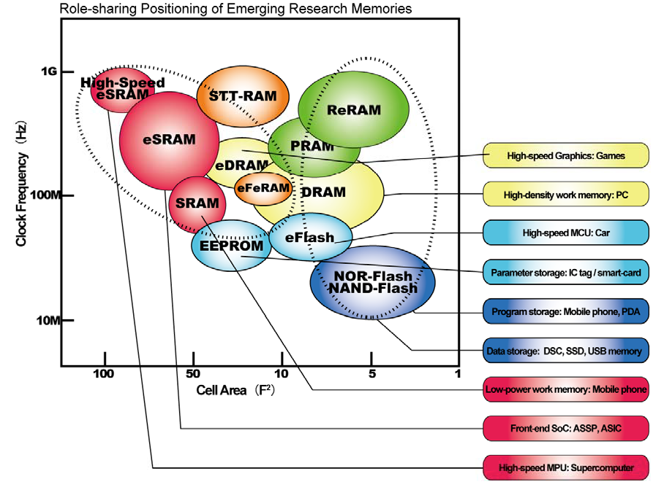
Merging Storage and Memory
From Ed Grochowski, 2014 Report on New Storage Technologies
4

Slide 5
Storage Latency is Changing
SSD Latency Profile – In the next generation, media is not the bottleneck.
From Jim Pappas, Intel, SNIA NVM Summit
Notes:
The 3 bars above show advancements that the industry has been able to make with NAND based SSDs with improvements to the NAND interface (ONFI) and the SSD bus interface (PCI Express). Everything in blue (the first 3 segments) is basic latency of the NAND SSD. If this was a HDD, then the blue segments would be about 1KM long on this screen.

Slide 6
Interconnect and Software Will Soon Dominate Latency
From Jim Pappas, Intel, SNIA NVM Summit
Notes:
For clarity, let’s expand the bottom line which now clearly identifies the new system bottlenecks as the media becomes faster. The media itself becomes “insignificant”, but the bus interface and the system storage software dominate the performance.

Slide 7
Opportunities with Next Generation NVM
NVMe & STA
SNIA
  NVM Express/SCSI Express: Optimized storage interconnect & driver
  SNIA NVM Programming TWG: Optimized system & application software
From Jim Pappas, Intel, SNIA NVM Summit
Notes:
For clarity, let’s expand the bottom line which now clearly identifies the new system bottlenecks as the media becomes faster. The media itself becomes “insignificant”, but the bus interface and the system storage software dominate the performance.

Slide 8
Application View of IO Elimination
Non-Blocking
NUMA
Software overheads are being driven to keep pace with devices
NUMA latencies up to 200 nS have historically been tolerated
Anything above 2-3 uS will probably need to context switch
Latencies below these thresholds cause disruption

Slide 9
Memory Disaggregation
Server
Shared Memory
Memory
Server
Controller
Memory Semantic Fabric
Memory
Server
Memory
Server
Increased flexibility to provision memory from a shared pool
Pass data or VM’s between servers without moving bits
Enabled at rack scale using silicon photonics

Slide 10
Application View of
Memory Properties
Durability
Applications should know which memory is persistent.
NUMA
What part of the system manages proximity of processing to memory?
How much unpredictability is tolerable?
Multi-processing
SMP boundaries implied by distance and fault domains

Slide 11
Abstractions need to account for…
Resource Diversity
Choosing the right memory resources in real time
System Scalability
Programming model accounts for wide scale
Transactions
Accelerate recoverability to memory speed

Slide 12
Thriving in Chaos
Make sure hierarchy levels earn their places
Think dual stack
Make middleware take up the slack
Mind the fault lines

Slide 13
Thank You

