Slide 1
Welcome to the 10th OFA Workshop
#OFADevWorkshop

Slide 2
Things to be sure to cover
Workshop theme: “Disruptive Technology”
h/w – the stuff going on around us
The NVW talks
The processor panel
s/w – the stuff we’re doing to ourselves (for good reason)
OFI WG
A couple of especially important blocks of talks
Exascale radio astronomy
Acting on the imperatives defined at last year’s workshop – a broader way of thinking about OFA development?

Slide 3
A short story
Last year we undertook an objective to drive the OpenFabrics Alliance forward.
Only problem was nobody really knew how to do that.
We’ve made quite a bit of progress since then.
You may see this reflected in this year’s workshop agenda.

Slide 4
From last year
At last year’s workshop, this challenge was offered:
But how to do that?
Notes:
Fall 2012 - TAC was looking at the canonical diagram, and realized that tweaking the drawing was really just re-arranging the deck chairs. What we really needed to do was figure out what kind of deck chairs the passengers wanted. This led to an emerging focus on applications in the OFA as a directional imperative
Spring 2013 - Bill Magro suggested letting s/w lead
Summer 2013 – Realization dawns – one API to rule them all is simply not workable. We need something else.

Slide 5
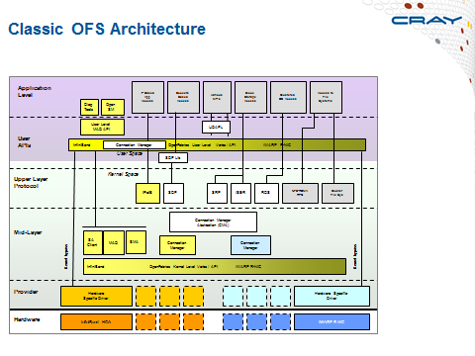
Meanwhile…
Fall 2012, the TAC had been looking to update the canonical OFA stack diagram,

Slide 6
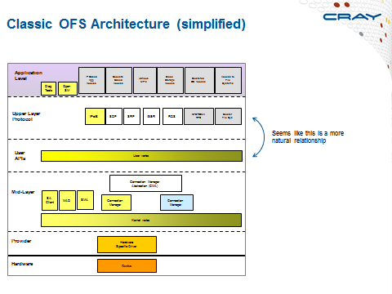
Meanwhile…
…but soon realized that tinkering with the plumbing is really just re-arranging the deck chairs.

Slide 7
Meanwhile…
What we really needed was to figure out what kind of deck chairs were needed.

Slide 8
A novel idea
The novel conclusion was to focus on applications as key drivers in developing OpenFabrics Software.
Which is what drove the agenda for last year’s workshop.

Slide 9
The OFI WG example
TAC decides to focus on applications as a key driver for OFS
2013 workshop challenge: “let the s/w lead”
Summer 2013 the OFI WG is formed with the charter to come up with interfaces that meet the needs of applications.
Notes:
Fall 2012 - TAC was looking at the canonical diagram, and realized that tweaking the drawing was really just re-arranging the deck chairs. What we really needed to do was figure out what kind of deck chairs the passengers wanted. This led to an emerging focus on applications in the OFA as a directional imperative
Spring 2013 - Bill Magro suggested letting s/w lead
Summer 2013 – Realization dawns – one API to rule them all is simply not workable. We need something else.

Slide 10
The OFI WG example
TAC decides to focus on applications as a key driver for OFS
2013 workshop challenge: “let the s/w lead”
OFI WG
But which applications???
Summer 2013 the OFI WG is formed with the charter to come up with interfaces that meet the needs of applications.
Notes:
Fall 2012 - TAC was looking at the canonical diagram, and realized that tweaking the drawing was really just re-arranging the deck chairs. What we really needed to do was figure out what kind of deck chairs the passengers wanted. This led to an emerging focus on applications in the OFA as a directional imperative
Spring 2013 - Bill Magro suggested letting s/w lead
Summer 2013 – Realization dawns – one API to rule them all is simply not workable. We need something else.

Slide 11
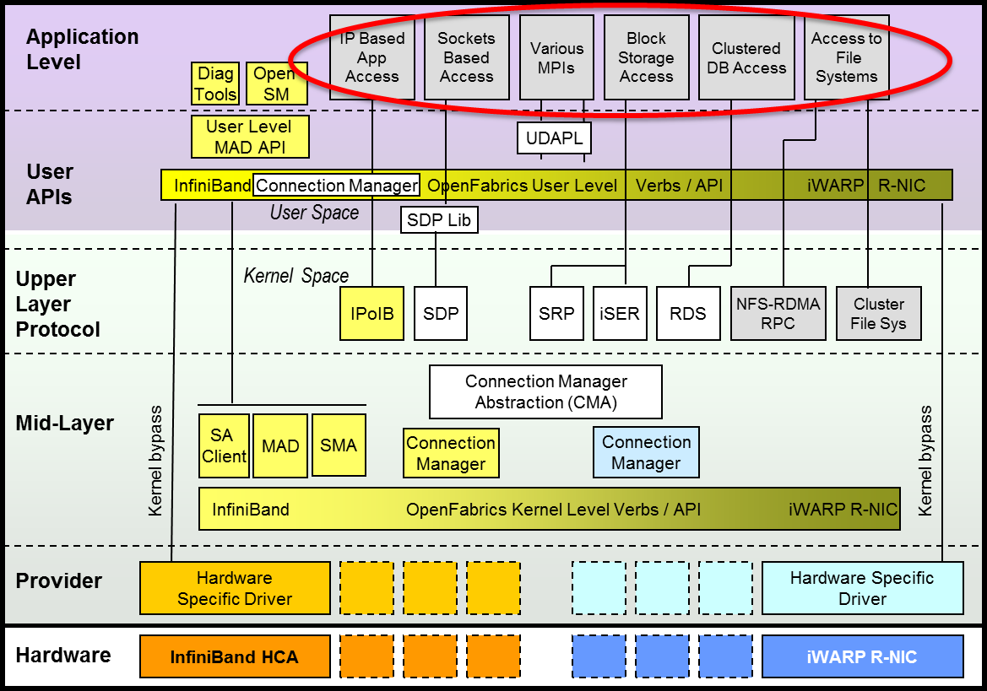
Beginning with the stack diagram
IP-based
and
Sockets-based apps
Various
MPIs
Block
Storage
Access
Clustered
DB Access
File
Systems Access

Slide 12
Grouping by common interest
IP, skts apps
Clustered
DB
File
Systems
Block
Storage
Various
MPIs
GasNet, ARMCI, etc.
Legacy apps (skts, IP)
Data Analysis
Data Storage, Data Access
Distributed Computing
Filesystems
Object storage
Block storage
Distributed storage
Storage at a distance
Skts apps
IP apps
Structured data
Unstructured data
Via msg passing
MPI applications
Via shared memory
- PGAS languages
The ways that data is organized, so value can be extracted.
How users store and access data, and collaborate through data. Sometimes over a distance.
Parallel programming models for processing data

Slide 13
A slightly different way of looking at how OFS is developed
Consumers of OFS
e.g. app developers, distros, kernel, vendors…
An Interest Group
Distributed computing
Data Storage & Access
Data Analysis
Sockets Applications
OFS Developers
Those who are deploying OFS
e.g. an Enterprise Storage team

Slide 14
Which brings us to this year’s agenda
Robust discussion of Disruptive Technologies
NVM
Processor architectures and how that impacts us as I/O providers
Many topics related to the four broad classes of applications – “interest groups”
Block storage
File I/O
Data analysis
Distributed computing, including both MPI and PGAS topics
Sockets applications support – rsockets, SMC-r
Scalability
Dr. Sterling’s keynote
Exascale Radio Astronomy sessions

Slide 15
As with last year, we will follow-up on Wednesday to see if we can draw any useful conclusions on this.
Meanwhile, enjoy the workshop!

Slide 16
Thank You

