Slide 1
Optimizing & Tuning Techniques for
Running MVAPICH2 over IB
Talk at 2nd Annual IBUG (InfiniBand User's Group) Workshop (2014)
by
Hari Subramoni
The Ohio State University
E-mail: subramon@cse.ohio-state.edu
http://www.cse.ohio-state.edu/~subramon
Dhabaleswar K. (DK) Panda
The Ohio State University
E-mail: panda@cse.ohio-state.edu
http://www.cse.ohio-state.edu/~panda

Slide 2
Presentation Outline
Overview of MVAPICH2 and MVAPICH2-X
Optimizing and Tuning Job Startup
Efficient Process Mapping Strategies
Point-to-Point Tuning and Optimizations
InfiniBand Transport Protocol Based Tuning
Tuning for Multi-rail Clusters, 3D Torus Networks and QoS Support
Collective Optimizations using Hardware-based Multicast
Optimizing and Tuning GPU Support in MVAPICH2
MVAPICH2-X for Hybrid MPI + PGAS
Enhanced Debugging System
Future Plans and Concluding Remarks

Slide 3
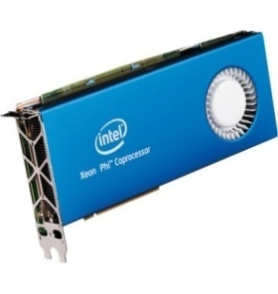
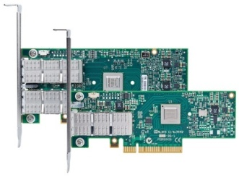
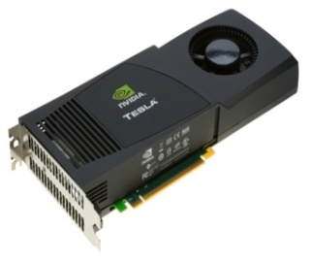
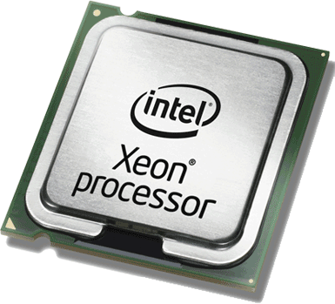
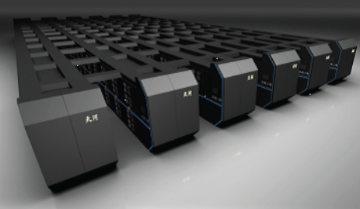

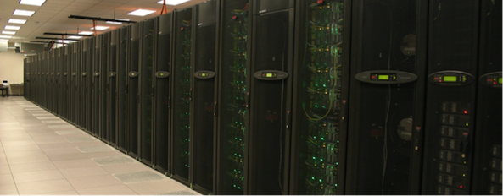
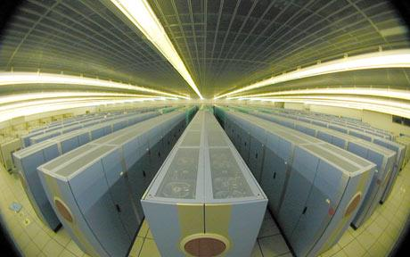
Drivers of Modern HPC Cluster Architectures
High Performance Interconnects - InfiniBand
<1usec latency, >100Gbps Bandwidth
Accelerators / Coprocessors
high compute density, high performance/watt
>1 TFlop DP on a chip
Multi-core Processors
Multi-core processors are ubiquitous
InfiniBand is very popular in HPC clusters
Accelerators/Coprocessors are becoming common in high-end systems
Pushing the envelope for Exascale computing
Tianhe – 2 (1)
Titan (2)
Stampede (6)
Tianhe – 1A (10)

Slide 4
MVAPICH2/MVAPICH2-X Software
High Performance open-source MPI Library for InfiniBand, 10Gig/iWARP, and RDMA over Converged Enhanced Ethernet (RoCE)
  MVAPICH (MPI-1), MVAPICH2 (MPI-2.2 and MPI-3.0), Available since 2002
  MVAPICH2-X (MPI + PGAS), Available since 2012
  Support for GPGPUs and MIC
  Used by more than 2,150 organizations in 72 countries
  More than 207,000 downloads from OSU site directly
  Empowering many TOP500 clusters
    7th ranked 462,462-core cluster (Stampede) at TACC
    11th ranked 74,358-core cluster (Tsubame 2.5) at Tokyo Institute of Technology
    16th ranked 96,192-core cluster (Pleiades) at NASA
    75th ranked 16,896-core cluster (Keenland) at GaTech and many others . . .
  Available with software stacks of many IB, HSE, and server vendors including Linux Distros (RedHat and SuSE)
  http://mvapich.cse.ohio-state.edu
Partner in the U.S. NSF-TACC Stampede System

Slide 5
Major Features in MVAPICH2/MVAPICH2X for Multi-Petaflop and Exaflop Systems
Scalability for million to billion processors
  Support for highly-efficient inter-node and intra-node communication (both two-sided and one-sided)
  Extremely minimum memory footprint
Scalable Job Startup
Support for Efficient Process Mapping and Multi-threading
High-performance Inter-node / Intra-node Point-to-point Communication
Support for Multiple IB Transport Protocols for Scalable Communication
Support for Multi-rail Clusters and 3D Torus Networks
QoS support for Communication and I/O
Scalable Collective Communication
Support for GPGPUs and Accelerators
Hybrid Programming (MPI + OpenMP, MPI + UPC, MPI + OpenSHMEM, …)
Enhanced Debugging System
and many more…

Slide 6
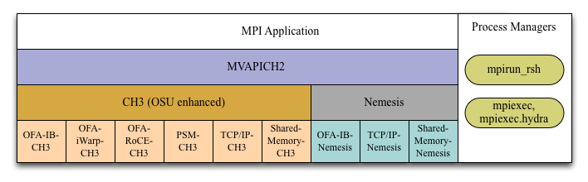
MVAPICH2 Architecture (Latest Release 2.0rc1)
All Different PCI, PCI-Ex interfaces
Major Computing Platforms: IA-32, Ivybridge, Nehalem, Westmere, Sandybridge, Opteron, Magny, ..

Slide 7
Strong Procedure for Design, Development and Release
Research is done for exploring new designs
Designs are first presented through conference/journal publications
Best performing designs are incorporated into the codebase
Rigorous Q&A procedure before making a release
  Exhaustive unit testing
  Various test procedures on diverse range of platforms and interconnects
  Performance tuning
  Applications-based evaluation
  Evaluation on large-scale systems
Even alpha and beta versions go through the above testing
Provides detailed User guides and FAQs
  http://mvapich.cse.ohio-state.edu

Slide 8
MVAPICH2 2.0RC1 and MVAPICH2-X 2.0RC1
Released on 03/24/14
Major Features and Enhancements
  Based on MPICH-3.1
  Improved performance for MPI_Put and MPI_Get operations in CH3 channel
  Enabled MPI-3 RMA support in PSM channel
  Enabled multi-rail support for UD-Hybrid channel
  Optimized architecture based tuning for blocking and non-blocking collectives
  Optimized Bcast and Reduce collectives designs
  Improved hierarchical job startup time
  Optimization for sub-array data-type processing for GPU-to-GPU communication
  Updated hwloc to version 1.8
  Enhanced build system to avoid separate builds for different networks/interfaces
    Updated compiler wrappers (example: mpicc) to avoid adding dependencies on network and other libraries
MVAPICH2-X 2.0RC1 supports hybrid MPI + PGAS (UPC and OpenSHMEM) programming models
  Based on MVAPICH2 2.0RC1 including MPI-3 features; Compliant with UPC 2.18.0 and OpenSHMEM v1.0f
  Improved intra-node performance using Shared memory and Cross Memory Attach (CMA)
  Optimized UPC collectives
Notes:
When building with shared libraries, your applications built using mpicc and friends will only link against libmpich. This means that libmpich contains the extra dependency information and your app can for example can link against a version of libmpich using the QLogic interface and then link against a version using the Gen2 interface without needing to be recompiled.

Slide 9
Presentation Outline
Overview of MVAPICH2 and MVAPICH2-X
Optimizing and Tuning Job Startup
Efficient Process Mapping Strategies
Point-to-Point Tuning and Optimizations
InfiniBand Transport Protocol Based Tuning
Tuning for Multi-rail Clusters, 3D Torus Networks and QoS Support
Collective Optimizations using Hardware-based Multicast
Optimizing and Tuning GPU Support in MVAPICH2
MVAPICH2-X for Hybrid MPI + PGAS
Enhanced Debugging System
Future Plans and Concluding Remarks

Slide 10
Job-Launchers supported by MVAPICH2
SLURM
Compatibility with external resource managers
Job-Launchers supported by MVAPICH2
TORQUE
Core Launchers
Wrappers and interfaces
mpirun_rsh
mpiexec.hydra
mpiexec
mpiexec.mpirun_rsh
- Default and preferred launcher for all interfaces
- Supports scalable hierarchical job-startup mechanism
Developed at ANL by the MPICH team
To support interfaces prescribed by the MPI standard
Hydra-like interface to mpirun_rsh

Slide 11
Tuning Job-Launch with mpirun_rsh
Job startup performance on Stampede
  MV2_HOMOGENEOUS_CLUSTER=1
  MV2_ON_DEMAND_UD_INFO_EXCHANGE=1
43% reduction in time for MPI hello
world program at 4K cores
Continually being improved
43%
Parameter | Significance | Default
MV2_MT_DEGREE | Degree of the hierarchical tree used by mpirun_rsh | 32
MV2_FASTSSH_THRESHOLD | #nodes beyond which hierarchical-ssh scheme is used | 256
MV2_NPROCS_THRESHOLD | #nodes beyond which file-based communication is used for hierarchical-ssh during start up | 8192
MV2_HOMOGENEOUS_CLUSTER | Optimizes startup for homogeneous clusters | Disabled
MV2_ON_DEMAND_UD_INFO_EXCHANGE | Optimize start-up by exchanging UD connection info on-demand | Enabled
Refer to Job Launch Tuning section of MVAPICH2 user guide for more information
http://mvapich.cse.ohio-state.edu/support/user_guide_mvapich2-2.0rc1.html#x1-950008.2

Slide 12
Presentation Outline
Overview of MVAPICH2 and MVAPICH2-X
Optimizing and Tuning Job Startup
Efficient Process Mapping Strategies
Point-to-Point Tuning and Optimizations
InfiniBand Transport Protocol Based Tuning
Tuning for Multi-rail Clusters, 3D Torus Networks and QoS Support
Collective Optimizations using Hardware-based Multicast
Optimizing and Tuning GPU Support in MVAPICH2
MVAPICH2-X for Hybrid MPI + PGAS
Enhanced Debugging System
Future Plans and Concluding Remarks

Slide 13
Process Mapping support in MVAPICH2
Process-Mapping support in MVAPICH2
(available since v1.4)
Preset Binding Policies
User-defined binding
Policy
bunch
(Default)
scatter
MPI rank-to-core binding
core
(Default)
socket
numanode
Granularity
MVAPICH2 detects processor architecture at job-launch

Slide 14
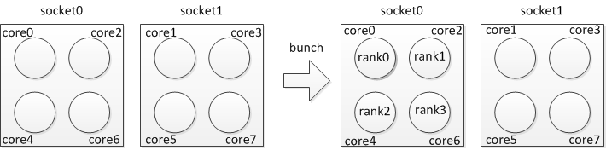
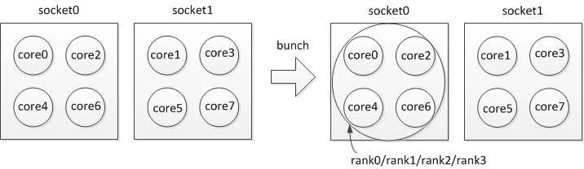
Preset Process-binding Policies – Bunch
“Core” level “Bunch” mapping (Default)
  MV2_CPU_BINDING_POLICY=bunch
“Socket/Numanode” level “Bunch” mapping
  MV2_CPU_BINDING_LEVEL=socket MV2_CPU_BINDING_POLICY=bunch
Notes:
Too much focus on hardware-loc

Slide 15
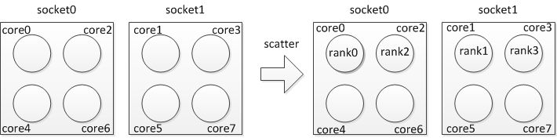
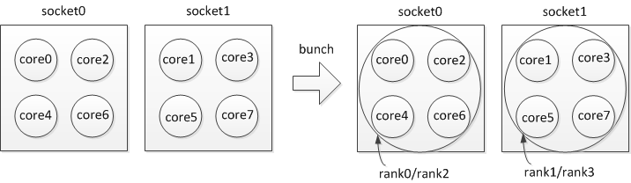
Preset Process-binding Policies – Scatter
“Core” level “Scatter” mapping
  MV2_CPU_BINDING_POLICY=scatter
“Socket/Numanode” level “Scatter” mapping
  MV2_CPU_BINDING_LEVEL=socket MV2_CPU_BINDING_POLICY=scatter
Notes:
Too much focus on hardware-loc

Slide 16
User-Defined Process Mapping
User has complete-control over process-mapping
To run 4 processes on cores 0, 1, 4, 5:
  $ mpirun_rsh -np 4 -hostfile hosts MV2_CPU_MAPPING=0:1:4:5 ./a.out
Use ‘,’ or ‘-’ to bind to a set of cores:
  $mpirun_rsh -np 64 -hostfile hosts MV2_CPU_MAPPING=0,2-4:1:5:6 ./a.out
Is process binding working as expected?
  MV2_SHOW_CPU_BINDING=1
    Display CPU binding information
    Launcher independent
    Example
      MV2_SHOW_CPU_BINDING=1 MV2_CPU_BINDING_POLICY=scatter
      -------------CPU AFFINITY-------------
      RANK:0 CPU_SET: 0
      RANK:1 CPU_SET: 8
Refer to Running with Efficient CPU (Core) Mapping section of MVAPICH2 user guide for more information
http://mvapich.cse.ohio-state.edu/support/user_guide_mvapich2-2.0rc1.html#x1-530006.5

Slide 17
Presentation Outline
Overview of MVAPICH2 and MVAPICH2-X
Optimizing and Tuning Job Startup
Efficient Process Mapping Strategies
Point-to-Point Tuning and Optimizations
  Inter-Node Tuning and Optimizations
  Intra-Node Tuning and Optimizations
InfiniBand Transport Protocol Based Tuning
Tuning for Multi-rail Clusters, 3D Torus Networks and QoS Support
Collective Optimizations using Hardware-based Multicast
Optimizing and Tuning GPU Support in MVAPICH2
MVAPICH2-X for Hybrid MPI + PGAS
Enhanced Debugging System
Future Plans and Concluding Remarks

Slide 18
Inter-node Point-to-Point Communication
Sender
Receiver
EAGER (buffered, used for small messages)
  RDMA Fast Path (Memory Semantics)
  Send/Recv (Channel Semantics)
RENDEZVOUS (un-buffered, used for large messages)
  Reduces memory requirement by MPI library
  Zero-Copy
  No remote side involvement
  Protocols
    RPUT (RDMA Write)
    RGET (RDMA Read)
    R3 (Send/Recv with Packetized Send)
send
Eager Protocol
Sender
Receiver
rndz_start
rndz_reply
data
fin
Rendezvous Protocol
Notes:
How to choose from RPUT/RGET/R3?
Depends on communication patterns and different from applications to applications

Slide 19
Inter-node Tuning and Optimizations: Eager Thresholds
Eager vs Rendezvous
Impact of Eager Threshold
Switching Eager to Rendezvous transfer
  Default: Architecture dependent on common platforms, in order to achieve both best performance and memory footprint
Threshold can be modified by users to get smooth performance across message sizes
  mpirun_rsh –np 2 –f hostfile MV2_IBA_EAGER_THRESHOLD=32K a.out
  Memory footprint can increase along with eager threshold

Slide 20
Inter-Node Tuning and Optimizations: RDMA Fast Path and RNDV Protocols
Eager: Send/Recv vs RDMA FP
Impact of RDMA FP buffers
RDMA Fast Path has advantages for smaller message range (Enabled by Default)
  Disable: mpirun_rsh –np 2 –f hostfile MV2_USE_RDMA_FASTPATH=0 a.out
Adjust the number of RDMA Fast Path buffers (benchmark window size = 64):
  mpirun_rsh –np 2 –f hostfile MV2_NUM_RDMA_BUFFER=64 a.out
Switch between Rendezvous protocols depending on applications:
  mpirun_rsh –np 2 –f hostfile MV2_RNDV_PROTOCOL=RGET a.out (Default: RPUT)

Slide 21
MVAPICH2 Two-Sided Intra-Node Tuning:
Shared memory and Kernel-based Zero-copy Support (LiMIC and CMA)
LiMIC2:
  Configure the library with ‘--with-limic2’
  mpirun_rsh –np 2 –f hostfile a.out (To disable: MV2_SMP_USE_LIMIC2=0)
CMA (Cross Memory Attach):
  Configure the library with ‘--with-cma’
  mpirun_rsh –np 2 –f hostfile a.out (To disable: MV2_SMP_USE_CMA=0)
LiMIC2 is chosen by default when library is built with both LiMIC2 and CMA
Shared-memory based design used if neither LiMIC2 and CMA is used
Refer to Running with LiMIC2 section of MVAPICH2 user guide for more information
http://mvapich.cse.ohio-state.edu/support/user_guide_mvapich2-2.0rc1.html#x1-570006.6

Slide 22
MVAPICH2 Two-Sided Intra-Node Tuning:
Shared-Memory based Runtime Parameters
Adjust eager threshold and eager buffer size:
  mpirun_rsh –np 2 –f hostfile MV2_SMP_EAGERSIZE=16K MV2_SMPI_LENGTH_QUEUE=64 a.out
  Note: Will affect the performance of small messages and memory footprint
Adjust number of buffers /buffer size for shared-memory based Rendezvous protocol:
  mpirun_rsh –np 2 –f hostfile MV2_SMP_SEND_BUFFER=32 MV2_SMP_SEND_BUFF_SIZE=8192 a.out
  Note: Will affect the performance of large messages and memory footprint

Slide 23
Presentation Outline
Overview of MVAPICH2 and MVAPICH2-X
Optimizing and Tuning Job Startup
Efficient Process Mapping Strategies
Point-to-Point Tuning and Optimizations
InfiniBand Transport Protocol Based Tuning
  eXtended Reliable Connection (XRC)
  Using UD Transport
  Hybrid (UD/RC/XRC) Transport in MVAPICH2
Tuning for Multi-rail Clusters, 3D Torus Networks and QoS Support
Collective Optimizations using Hardware-based Multicast
Optimizing and Tuning GPU Support in MVAPICH2
MVAPICH2-X for Hybrid MPI + PGAS
Enhanced Debugging System
Future Plans and Concluding Remarks

Slide 24
Using eXtended Reliable Connection (XRC) in MVAPICH2
Memory Usage
Performance with NAMD (1024 cores)
Memory usage for 32K processes with 8-cores per node can be 54 MB/process (for connections)
NAMD performance improves when there is frequent communication to many peers
Enabled by setting MV2_USE_XRC to 1 (Default: Disabled)
Requires OFED version > 1.3
  Unsupported in earlier versions (< 1.3), OFED-3.x and MLNX_OFED-2.0
  MVAPICH2 build process will automatically disable XRC if unsupported by OFED
Automatically enables SRQ and ON-DEMAND connection establishment
Refer to eXtended Reliable Connection (XRC) section of MVAPICH2 user guide for more information
http://mvapich.cse.ohio-state.edu/support/user_guide_mvapich2-2.0rc1.html#x1-990008.6

Slide 25
Using UD Transport with MVAPICH2
Memory Footprint of MVAPICH2
Performance with SMG2000
 | RC (MVAPICH2 2.0a) |  |  |  | UD (MVAPICH2 2.0a)
Number of Processes | Conn. | Buffers | Struct | Total | Buffers | Struct | Total
512 | 22.9 | 24 | 0.3 | 47.2 | 24 | 0.2 | 24.2
1024 | 29.5 | 24 | 0.6 | 54.1 | 24 | 0.4 | 24.4
2048 | 42.4 | 24 | 1.2 | 67.6 | 24 | 0.9 | 24.9
Can use UD transport by configuring MVAPICH2 with the –enable-hybrid
  Reduces QP cache trashing and memory footprint at large scale
Parameter | Significance | Default | Notes
MV2_USE_ONLY_UD | Enable only UD transport in hybrid configuration mode | Disabled | RC/XRC not used
MV2_USE_UD_ZCOPY | Enables zero-copy transfers for large messages on UD | Enabled | Always Enable when UD enabled
MV2_UD_RETRY_TIMEOUT | Time (in usec) after which an unacknowledged message will be retried | 500000 | Increase appropriately on large / congested systems
MV2_UD_RETRY_COUNT | Number of retries before job is aborted | 1000 | Increase appropriately on large / congested systems
Refer to Running with scalable UD transport section of MVAPICH2 user guide for more information
http://mvapich.cse.ohio-state.edu/support/user_guide_mvapich2-2.0rc1.html#x1-610006.10

Slide 26
Hybrid (UD/RC/XRC) Mode in MVAPICH2
Performance with HPCC Random Ring
Both UD and RC/XRC have benefits
  Hybrid for the best of both
Enabled by configuring MVAPICH2 with the –enable-hybrid
Available since MVAPICH2 1.7 as integrated interface
Parameter | Significance | Default | Notes
MV2_USE_UD_HYBRID | Enable / Disable use of UD transport in Hybrid mode | Enabled | Always Enable
MV2_HYBRID_ENABLE_THRESHOLD_SIZE | Job size in number of processes beyond which hybrid mode will be enabled | 1024 | Uses RC/XRC connection until job size < threshold
MV2_HYBRID_MAX_RC_CONN | Maximum number of RC or XRC connections created per process Limits the amount of connection memory | 64 | Prevents HCA QP cache thrashing
Refer to Running with Hybrid UD-RC/XRC section of MVAPICH2 user guide for more information
http://mvapich.cse.ohio-state.edu/support/user_guide_mvapich2-2.0rc1.html#x1-620006.11

Slide 27
Presentation Outline
Overview of MVAPICH2 and MVAPICH2-X
Optimizing and Tuning Job Startup
Efficient Process Mapping Strategies
Point-to-Point Tuning and Optimizations
InfiniBand Transport Protocol Based Tuning
Tuning for Multi-rail Clusters, 3D Torus Networks and QoS Support
Collective Optimizations using Hardware-based Multicast
Optimizing and Tuning GPU Support in MVAPICH2
MVAPICH2-X for Hybrid MPI + PGAS
Enhanced Debugging System
Future Plans and Concluding Remarks

Slide 28
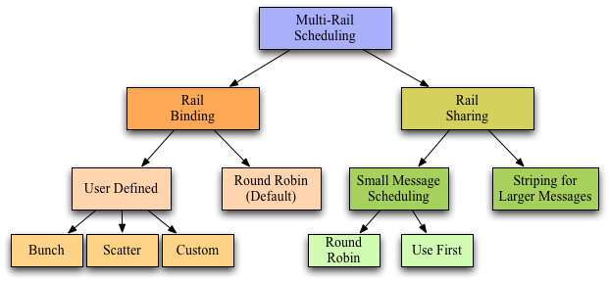
MVAPICH2 Multi-Rail Design
What is a rail?
  HCA, Port, Queue Pair
Automatically detects and uses all active HCAs in a system
  Automatically handles heterogeneity
Supports multiple rail usage policies
  Rail Sharing – Processes share all available rails
  Rail Binding – Specific processes are bound to specific rails

Slide 29
Performance Tuning on Multi-Rail Clusters
7%
98%
130%
Two 24-core Magny Cours nodes with two Mellanox ConnectX QDR adapters
Six pairs with OSU Multi-Pair bandwidth and messaging rate benchmark
Parameter | Significance | Default | Notes
MV2_IBA_HCA | Manually set the HCA to be used | Unset | To get names of HCA ibstat | grep “^CA”
MV2_DEFAULT_PORT | Select the port to use on a active multi port HCA | 0 | Set to use different port
MV2_RAIL_SHARING_LARGE_MSG_THRESHOLD | Threshold beyond which striping will take place | 16 Kbyte
MV2_RAIL_SHARING_POLICY | Choose multi-rail rail sharing / binding policy For Rail Sharing set to USE_FIRST or ROUND_ROBIN Set to FIXED_MAPPING for advanced rail binding options | Rail Binding in Round Robin mode | Advanced tuning can result in better performance
MV2_PROCESS_TO_RAIL_MAPPING | Determines how HCAs will be mapped to the rails | BUNCH | Options: SCATTER and custom list
Refer to Enhanced design for Multiple-Rail section of MVAPICH2 user guide for more information
http://mvapich.cse.ohio-state.edu/support/user_guide_mvapich2-2.0rc1.html#x1-640006.13

Slide 30
Support for 3D Torus Networks in MVAPICH2/MVAPICH2-X
Deadlocks possible with common routing algorithms in 3D Torus InfiniBand networks
  Need special routing algorithm for OpenSM
Users need to interact with OpenSM
  Use appropriate SL to prevent deadlock
MVAPICH2 supports 3D Torus Topology
  Queries OpenSM at runtime to obtain appropriate SL
Usage
  Enabled at configure time
    --enable-3dtorus-support
  MV2_NUM_SA_QUERY_RETRIES
    Control number of retries if PathRecord query fails

Slide 31
Exploiting QoS Support in MVAPICH2
IB is capable of providing network level differentiated service – QoS
Uses Service Levels (SL) and Virtual Lanes (VL) to classify traffic
Enabled at configure time using CFLAG ENABLE_QOS_SUPPORT
Check with System administrator before enabling
  Can affect performance of other jobs in system
Parameter | Significance | Default | Notes
MV2_USE_QOS | Enable / Disable use QoS | Disabled | Check with System administrator
MV2_NUM_SLS | Number of Service Levels user requested | 8 | Use to see benefits of Intra-Job QoS
MV2_DEFAULT_SERVICE_LEVEL | Indicates the default Service Level to be used by job | 0 | Set to different values for different jobs to enable Inter-Job QoS

Slide 32
Presentation Outline
Overview of MVAPICH2 and MVAPICH2-X
Optimizing and Tuning Job Startup
Efficient Process Mapping Strategies
Point-to-Point Tuning and Optimizations
InfiniBand Transport Protocol Based Tuning
Tuning for Multi-rail Clusters, 3D Torus Networks and QoS Support
Collective Optimizations using Hardware-based Multicast
Optimizing and Tuning GPU Support in MVAPICH2
MVAPICH2-X for Hybrid MPI + PGAS
Enhanced Debugging System
Future Plans and Concluding Remarks

Slide 33
Hardware Multicast-aware MPI_Bcast on TACC Stampede
85%
80%
MCAST-based designs improve latency of MPI_Bcast by up to 85%

Slide 34
Hardware Multicast-aware MPI_Scatter
57%
75%
Improves small message latency by up to 75%
Parameter | Description | Default
MV2_USE_MCAST = 1 | Enables hardware Multicast features | Disabled
--enable-mcast | Configure flag to enable | Enabled
Refer to Running Collectives with Hardware based Multicast support section of MVAPICH2 user guide
http://mvapich.cse.ohio-state.edu/support/user_guide_mvapich2-2.0rc1.html#x1-590006.8

Slide 35
Presentation Outline
Overview of MVAPICH2 and MVAPICH2-X
Optimizing and Tuning Job Startup
Efficient Process Mapping Strategies
Point-to-Point Tuning and Optimizations
InfiniBand Transport Protocol Based Tuning
Tuning for Multi-rail Clusters, 3D Torus Networks and QoS Support
Collective Optimizations using Hardware-based Multicast
Optimizing and Tuning GPU Support in MVAPICH2
  Pipelined Data Movement
  GPUDirect RDMA (GDR) with CUDA
MVAPICH2-X for Hybrid MPI + PGAS
Enhanced Debugging System
Future Plans and Concluding Remarks

Slide 36
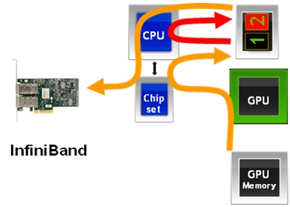
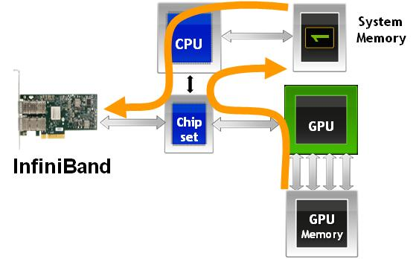

MVAPICH2-GPU: CUDA-Aware MPI
Before CUDA 4: Additional copies
  Low performance and low productivity
After CUDA 4: Host-based pipeline
  Unified Virtual Address
  Pipeline CUDA copies with IB transfers
  High performance and high productivity
After CUDA 5.5: GPUDirect-RDMA support
  GPU to GPU direct transfer
  Bypass the host memory
  Hybrid design to avoid PCI bottlenecks
CPU
Chip set
GPU
InfiniBand
GPU Memory

Slide 37
Tuning Pipelined Data Movement in MVAPICH2
Internode osu_latency large
Pipelines data movement from the GPU
Overlaps
  device-to-host CUDA copies
  inter-process data movement (network transfers or shared memory copies)
  host-to-device CUDA copies
45% improvement over naïve (Memcpy+Send)
24% improvement compared with an advanced user-level implementation (MemcpyAsync+Isend)
Better
Parameter | Significance | Default | Notes
MV2_USE_CUDA | Enable / Disable GPU designs | 0 (Disabled) | Disabled to avoid pointer checking overheads for host communication Always enable to support MPI communication from GPU Memory
MV2_CUDA_BLOCK_SIZE | Controls the pipeline blocksize | 256 KByte | Tune for your system and application Varies based on - CPU Platform, IB HCA and GPU - CUDA driver version - Communication pattern (latency/bandwidth)
Refer to Running on Clusters with NVIDIA GPU Accelerators section of MVAPICH2 user guide
http://mvapich.cse.ohio-state.edu/support/user_guide_mvapich2-2.0rc1.html#x1-810006.19

Slide 38
Performance of MVAPICH2 with GPUDirect-RDMA
GPU-GPU Internode Small Message MPI Latency
GPU-GPU Internode Small Message MPI Bandwidth
67 %
5x
5.49 usec
Parameter | Significance | Default | Notes
MV2_USE_GPUDIRECT | Enable / Disable GDR-based designs | 0 (Disabled) | Always enable
MV2_GPUDIRECT_LIMIT | Controls messages size until which GPUDirect RDMA is used | 8 KByte | Tune for your system GPU type, host architecture and CUDA version: impact pipelining overheads and P2P bandwidth bottlenecks
Based on MVAPICH2-2.0b; Intel Ivy Bridge (E5-2680 v2) node with 20 cores; NVIDIA Tesla K40c GPU,
Mellanox Connect-IB Dual-FDR HCACUDA 5.5, Mellanox OFED 2.0 with GPUDirect-RDMA Patch

Slide 39
How can I get Started with GDR Experimentation?
MVAPICH2-2.0b with GDR support can be downloaded from
https://mvapich.cse.ohio-state.edu/download/mvapich2gdr/
System software requirements
  Mellanox OFED 2.1
  NVIDIA Driver 331.20 or later
  NVIDIA CUDA Toolkit 5.5
  Plugin for GPUDirect RDMA
  (http://www.mellanox.com/page/products_dyn?product_family=116)
Has optimized designs for point-to-point communication using GDR
Work under progress for optimizing collective and one-sided communication
Contact MVAPICH help list with any questions related to the package
  mvapich-help@cse.ohio-state.edu
MVAPICH2-GDR-RC1 with additional optimizations coming soon!!

Slide 40
Presentation Outline
Overview of MVAPICH2 and MVAPICH2-X
Optimizing and Tuning Job Startup
Efficient Process Mapping Strategies
Point-to-Point Tuning and Optimizations
InfiniBand Transport Protocol Based Tuning
Tuning for Multi-rail Clusters, 3D Torus Networks and QoS Support
Collective Optimizations using Hardware-based Multicast
Optimizing and Tuning GPU Support in MVAPICH2
MVAPICH2-X for Hybrid MPI + PGAS
Enhanced Debugging System
Future Plans and Concluding Remarks

Slide 41
MVAPICH2-X for Hybrid MPI + PGAS Applications
MPI Applications, OpenSHMEM Applications, UPC Applications, Hybrid (MPI + PGAS) Applications
OpenSHMEM Calls
UPC Calls
MPI Calls
Unified MVAPICH2-X Runtime
InfiniBand, RoCE, iWARP
Unified communication runtime for MPI, UPC, OpenSHMEM available with MVAPICH2-X 1.9 onwards!
  http://mvapich.cse.ohio-state.edu
Feature Highlights
  Supports MPI(+OpenMP), OpenSHMEM, UPC, MPI(+OpenMP) + OpenSHMEM, MPI(+OpenMP) + UPC
  MPI-3 compliant, OpenSHMEM v1.0 standard compliant, UPC v1.2 standard compliant
  Scalable Inter-node and Intra-node communication – point-to-point and collectives

Slide 42
Hybrid (MPI+PGAS) Programming
Application sub-kernels can be re-written in MPI/PGAS based on communication characteristics
Benefits:
  Best of Distributed Computing Model
  Best of Shared Memory Computing Model
Exascale Roadmap*:
  “Hybrid Programming is a practical way to
  program exascale systems”
HPC Application
Kernel 1
MPI
Kernel 2
PGAS
Kernel 2
MPI
Kernel 3
MPI
Kernel N
MPI
Kernel N
PGAS
* The International Exascale Software Roadmap, Dongarra, J., Beckman, P. et al., Volume 25, Number 1, 2011, International Journal of High Performance Computer Applications, ISSN 1094-3420

Slide 43
MVAPICH2-X Runtime Parameters
MPI Parameters
  MVAPICH2-X MPI based on MVAPICH2 OFA-IB-CH3 channel
  All parameters for MVAPICH2 OFA-IB-CH3 channel are applicable
OpenSHMEM Parameters
  OOSHM_SYMMETRIC_HEAP_SIZE
    Set OpenSHMEM Symmetric Heap Size (Default: 512M)
  OOSHM_USE_SHARED_MEM
    Use shared memory for intra-node (heap memory) communication (Default: Enabled)
  OSHM_USE_CMA
    Use Cross Memory Attach (CMA) for intra-node (heap/static memory) communication (Default: Enabled)
UPC Parameters
  UPC_SHARED_HEAP_SIZE
    Set OpenSHMEM Symmetric Heap Size (Default 512M)
Hybrid Program Features
  Supports hybrid programming using MPI(+OpenMP), MPI(+OpenMP)+UPC and MPI(+OpenMP)+OpenSHMEM
  Corresponding MPI/UPC/OpenSHMEM parameters can be selected

Slide 44
Presentation Outline
Overview of MVAPICH2 and MVAPICH2-X
Optimizing and Tuning Job Startup
Efficient Process Mapping Strategies
Point-to-Point Tuning and Optimizations
InfiniBand Transport Protocol Based Tuning
Tuning for Multi-rail Clusters, 3D Torus Networks and QoS Support
Collective Optimizations using Hardware-based Multicast
Optimizing and Tuning GPU Support in MVAPICH2
MVAPICH2-X for Hybrid MPI + PGAS
Enhanced Debugging System
Future Plans and Concluding Remarks

Slide 45
Getting Help
Check the MVAPICH2 FAQ
Check the Mailing List Archives
Basic System Diagnostics
  ibv_devinfo - at least one port should be PORT_ACTIVE
  ulimit -l - should be “unlimited” on all compute nodes
  host resolution: DNS or /etc/hosts
  password-less ssh login
  run IB perf tests for all the message sizes(-a option)
    Ib_send_lat, ib_send_bw
  run system program (like hostname) and MPI hello world program
More diagnostics
  Already fixed issue: always try with latest release
  Regression: verifying with previous release
  Application issue: verify with other MPI libraries
  Launcher issue: verifying with multiple launchers (mpirun_rsh, mpiexec.hydra)
  Debug mode (Configure with --enable-g=dbg, --enable-fast=none)
  Compiler optimization issues: try with different compiler

Slide 46
Submitting Bug Report
Subscribe to mvapich-discuss and send problem report
Include as much information as possible
What information to include ???
Run-time issues
  Config flags (“mpiname –a” output)
  Exact command used to run the application
  Run-rime parameters in the environment
    What parameters are being used?
      MV2_SHOW_ENV_INFO=<1/2>
      Show values of the run time parameters
      1 ( short list), 2 (full list)
  Where is the segmentation fault?
    MV2_DEBUG_SHOW_BACKTRACE=1
    Shows backtrace with debug builds
      Use following configure flags
      --enable-g=dbg, --enable-fast=none
  Standalone reproducer program
  Information about the IB network
    OFED version
    ibv_devinfo
  Remote system access
Build and Installation issues
  MVAPICH2 version
  Compiler version
  Platform details ( OS, kernel version..etc)
  Configure flags
  Attach Config.log file
  Attach configure, make and make install step output
    ./configure {–flags} 2>&1 | tee config.out
    make 2>&1 | tee make.out
    make install 2>&1 | tee install.out

Slide 47
User Resources
MVAPIVH2 Quick Start Guide
MVAPICH2 User Guide
  Long and very detailed
  FAQ
MVAPICH2 Web-Site
  Overview and Features
  Reference performance
  Publications
Mailing List Support
  mvapich-discuss@cse.ohio-state.edu
Mailing List Archives
All above resources accessible from: http://mvapich.cse.ohio-state.edu/

Slide 48
Presentation Outline
Overview of MVAPICH2 and MVAPICH2-X
Optimizing and Tuning Job Startup
Efficient Process Mapping Strategies
Point-to-Point Tuning and Optimizations
InfiniBand Transport Protocol Based Tuning
Tuning for Multi-rail Clusters, 3D Torus Networks and QoS Support
Collective Optimizations using Hardware-based Multicast
Optimizing and Tuning GPU Support in MVAPICH2
MVAPICH2-X for Hybrid MPI + PGAS
Enhanced Debugging System
Future Plans and Concluding Remarks

Slide 49
MVAPICH2/MVPICH2-X – Plans for Exascale
Performance and Memory scalability toward 500K-1M cores
  Dynamically Connected Transport (DCT) service with Connect-IB
Enhanced Optimization for GPGPU and Coprocessor Support
  Extending the GPGPU support (GPU-Direct RDMA) with CUDA 6.0 and Beyond
  Support for Intel MIC (Knight Landing)
Taking advantage of Collective Offload framework
  Including support for non-blocking collectives (MPI 3.0)
RMA support (as in MPI 3.0)
Extended topology-aware collectives
Power-aware collectives
Support for MPI Tools Interface (as in MPI 3.0)
Checkpoint-Restart and migration support with in-memory checkpointing
Hybrid MPI+PGAS programming support with GPGPUs and Accelertors

Slide 50
Concluding Remarks
Provided an overview of MVAPICH2 and MVAPICH2-X Libraries
Presented in-depth details on configuration and runtime parameters, optimizations and their impacts
Provided an overview of debugging support
Demonstrated how MPI and PGAS users can use these optimization techniques to extract performance and scalability while using MVAPICH2 and MVAPICH2-X
MVAPICH2 has many more features not covered here
  Fault tolerance, Dynamic Process Management etc
  Please visit http://mvapich.cse.ohio-state.edu for details
More information about optimizing / tuning MVAPICH2 / MVAPICH2-X available at the 2013 MVAPICH User Group Meeting (MUG’13) website
  http://mug.mvapich.cse.ohio-state.edu

Slide 51

Pointers
Network Based Computing
Laboratory
http://nowlab.cse.ohio-state.edu
http://mvapich.cse.ohio-state.edu
panda@cse.ohio-state.edu
http://www.cse.ohio-state.edu/~panda

