Slide 1
SRP Update
Bart Van Assche,

Slide 2
Overview
Involvement With SRP
SRP Protocol Overview
Recent SRP Driver Changes
Possible Future Directions

Slide 3
Involvement with SRP
Maintainer of the open source Linux SRP initiator and the SCST SRP target drivers.
Member of the Fusion-io ION team. ION is an all-flash H.A. shared storage appliance.
Flash memory provides low latency and high bandwidth.
The focus of RDMA is on low latency and high bandwidth.
In other words, RDMA is well suited for remote access to flash memory.

Slide 4
SRP Protocol Overview
SRP = SCSI RDMA Protocol.
Defines how to perform SCSI communication over an RDMA network.
Defines how to discover InfiniBand SRP targets, how to log in, how to transfer SCSI CDB's and also how to transfer data via RDMA.
Revision 16a of the SRP protocol has been approved as an official ANSI standard in 2007.

Slide 5
SRP and SCSI
SRP defines a SCSI transport layer.
Enables supports for e.g. these SCSI features:
  Reading and writing data blocks.
  Read capacity.
  Command queueing.
  Multiple LUNs per SCSI host.
  Inquire LUN information, e.g. volume identification, caching information and thin provisioning support (a.k.a. TRIM / UNMAP).
  Atomic (vectored) write - helps to make database software faster.
  VAAI (WRITE SAME, UNMAP, ATS, XCOPY).
  End-to-end data integrity (a.k.a. T10-PI).
  Persistent reservations a.k.a. cluster support.
  Asymmetric Logical Unit Access (ALUA).
Fusion-io is actively involved in the ANSI T10 committee for standardization of new SCSI commands.

Slide 6
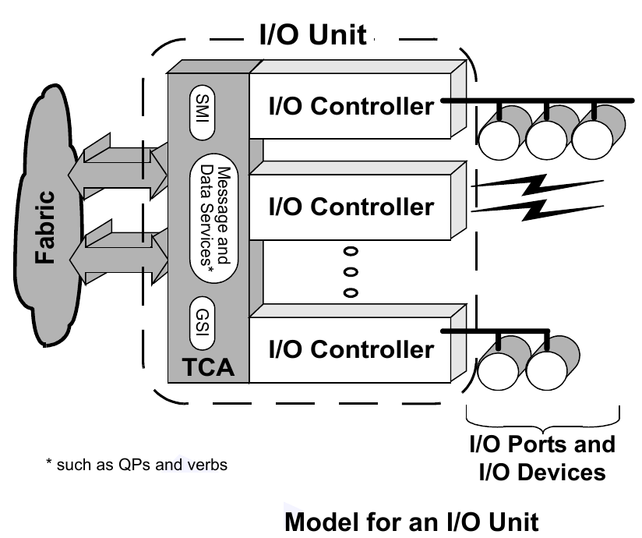
SRP Protocol - Login
IB spec defines device management.
Initiator sends device management query to subnet manager.
Subnet manager reports ports with device management capabilities.
Initiator sends I/O controller query to each port with device management capabilities.
SRP target reports I/O controllers.
Initiator sends login request to selected I/O controllers.
Initiator requests SCSI LUN report and queries capacity and identification of each LUN.
I/O starts.

Slide 7
Linux SRP Initiator Support
Kernel driver ib_srp - implements SRP protocol.
User space srptools package.
srp_daemon and ibsrpdm executables.
  Target discovery.
  Target login.
Interface between kernel and user space
  /sys/class/infiniband_srp/srp-${port}/add_target
  /sys/class/srp_remote_ports
  /sys/class/scsi_host/*/{sgid,dgid,...}
  /sys/class/scsi_device/*/{state,queue_depth,...}

Slide 8
SRP Login - Example
# cat /etc/srp_daemon.conf
a queue_size=128,max_cmd_per_lun=128
# srp_daemon -oaecd/dev/infiniband/umad1
id_ext=0002c90300fc3210,ioc_guid=0002c90300fc3210,dgid=fe800000000000000002c90300fc3211,pkey=ffff,service_id=0002c90300fc3210
id_ext=0002c90300a543b0,ioc_guid=0002c90300a543b0,dgid=fe800000000000000002c90300fc3221,pkey=ffff,service_id=0002c90300a543b0
[ … ]
# ls /sys/class/srp_remote_ports/
port-453:1 port-459:1 [ … ]
# lsscsi
[5:0:0:0] disk FUSIONIO ION LUN 3243 /dev/sdc
[5:0:0:1] disk FUSIONIO ION LUN 3243 /dev/sdd

Slide 9
Recent SRP Initiator Changes
Queue size is now configurable. Optimal performance for SSDs and hard disk RAID arrays can only be achieved with a large queue size (128 instead of the default 64).
Support for modifying the queue depth dynamically has been added.
Path loss detection time has been reduced from about 40s to about 17s. Further reduction is possible by lowering the subnet timeout on the subnet manager. This makes a significant difference in H.A. setups.
Added support for fast_io_fail_tmo and dev_loss_tmo parameters for multipath.
P_Key support has been added in srp_daemon.
Many smaller changes in the srptools package.

Slide 10
OFED and SRP Support
Fusion-io is working with Linux distribution vendors to keep SRP support up to date.
 | ib_srp | srptools
Upstream Linux kernel | 3.14.0 | 1.0.2
RHEL 6.5 | 2.6.32+ | 0.0.4
SLES 11 SP3 | 3.0.101 | 0.0.4
MLNX OFED 2.1 | 3.13.0 | 1.0.0
OFED 3.12 | 3.12.0 | 1.0.2

Slide 11
SRP Initiator and SCSI Core
Linux SRP initiator is a SCSI driver.
Linux SCSI mid-layer builds on block layer.
SRP initiator relies on SCSI core for LUN scanning, SCSI error handling, ...
Path removal triggers a call of scsi_remove_host().
Path removal during I/O works reliably since Linux kernel 3.8.
Fusion-io contributed several patches to make the Linux SCSI core and block layer handle path removal during I/O reliably.

Slide 12
Possible Future Directions
Improving Linux SCSI performance via the scsi-mq project.
Higher bandwidth by using multiple RDMA channels.
Latency reduction.
NUMA performance improvements.
FRWR support - needed e.g. for ConnectIB HCA support.
End-to-end data integrity (T10-PI) support; supported by Oracle database software. Builds on FRWR support.
Adding SR-IOV support.
Support for Ethernet networks (RoCE and/or iWARP).
  Requires to switch from IB/CM to RDMA/CM.
  Requires modification of the target discovery software (srptools). The current target discovery software is based on InfiniBand MADs.

