Slide 1
OpenStack and IB
Blake Caldwell
OFA Users Workshop
April 3, 2014

Slide 2
Background
Partitioning with P-keys
SR-IOV complexities
Configuration

Slide 3
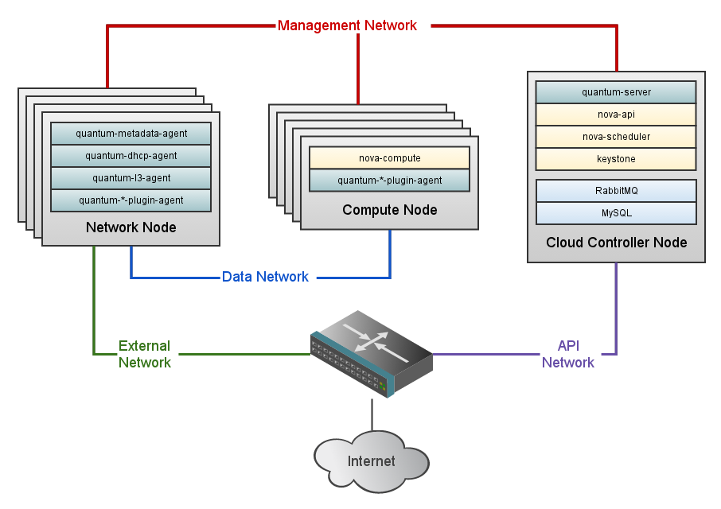
Background: OpenStack Architecture
IB
Credit: openstack.org

Slide 4
Background: SR-IOV
VM1
VM2
Hypervisor (KVM)
HCA
DMA
DMA
DMA
IOMMU
QP0
QP0
QP0
gid_idx/0
gid_idx/0
QP1
QP1
QP1
QP2
gids
QP2
QP2
PF
VF
VF

Slide 5
Background: SR-IOV
QP0 on VF is non-functional, only on PF
QP1 on VF is proxied through PF
RID tags traffic for IOMMU translation (DMA)
VF p-key and gid tables index into PF tables
Configuration of P-keys through sysfs

Slide 6
P-Keys and VFs
VF1 (00:41:00.1)
/sys/class/infiniband/mlx4_0/iov/0000:41:00.1/ports/2/pkey_idx
PF (00:41:00.0)
/sys/class/infiniband/mlx4_0/iov/ports/2/pkeys
Index | Pkey
0 | 1
1 | 0
Index | Pkey
0 | 0xffff
1 | 0xb000
2 | 0xb030
VF2 (00:41:00.2)
/sys/class/infiniband/mlx4_0/iov/0000:41:00.2/ports/2/pkey_idx
Index | Pkey_idex
0 | 2
1 | 0

Slide 7
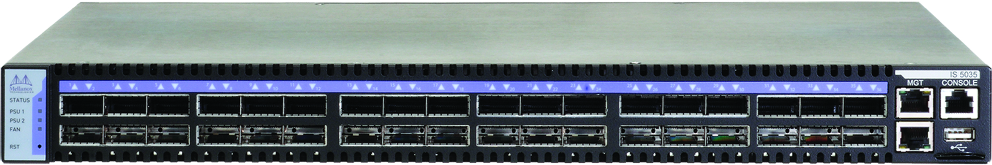
Fabric Partitioning
P-key 0x7003

Slide 8
Complexities with SR-IOV
Still have shared resources
How to administer vHCAs (tools don’t work)
Increasing functionality embedded within HCAs
Routing virtualized topologies

Slide 9
Routing with Virtualization

Slide 10
Routing with Virtualization

Slide 11
Base SR-IOV Configuration
Add SR-IOV config options in firmware
  ConnectX-2 (2.9.1200 to get bug fix for FLR)
  ConnectX-3
# mstflint -dev 82:00.0 dc
[HCA]
num_pfs = 1
total_vfs = <0-63>
sriov_en = true
Check BIOS settings
Kernel
  CONFIG_DMAR_DEFAULT_ON=y OR Intel/AMD specific kernel cmdline options
Modprobe parameters
options mlx4_core port_type_array=2,1 num_vfs=16 probe_vf=1
Options mlx4_ib sm_guid_assign=0

Slide 12
OpenSM Configuration
partitions.conf
management=0x7fff,ipoib, sl=0, defmember=full : ALL, ALL_SWITCHES=full,SELF=full;
vlan1=0x1, ipoib, sl=0, defmember=full : ALL;
vlan2=0x2, ipoib, sl=0, defmember=full : ALL;
vlan3=0x3, ipoib, sl=0, defmember=full : ALL;
opensm.conf
allow_both_pkeys TRUE

Slide 13
OpenStack Configuration
Compute node
  Select Mellanox VIF driver
  Optionally add PCI device to pci_passthrough_whitelist
Configure plugin (compute and network nodes)
  Add plugin to network node and compute node
  Define vlan range (see partitions.conf)
  vnic-type: hostdev | macvtap | virtio | bridge
Define neutron port for SR-IOV device
Launch instances with newly created nic port
$ nova boot --flavor m1.large --image rh6.5_mlnx_ofed \
--nic port-id=a43d35f3-3870-4ae1-9a9d-d2d341b693d6 sriov_instance

Slide 14
Other Features
Expose different interface types to VMs
  With kernel modules: EoIB/IPoIB/RoCE
  Paravirtualized interface (eIPoIB bridge)
QoS at VM granularity
Storage plugins (Cinder service)
  iSER plugin from Mellanox

Slide 15
  Questions?
  blakec@ornl.gov

