Slide 1
IB Monitoring
Through the Console
Jesse Martinez
Los Alamos National Laboratory
LA-UR-14-21958
April 3rd, 2013

Slide 2
Outline
Monitoring Methods
  Errors
  Performance
Use of Console
Analysis and Reporting
Future Implementations

Slide 3
Monitoring at LANL
Monitoring is done per each cluster’s fabric
  Range from 8 node to 1600 node clusters
    DDR, QDR, FDR systems
  OpenSM 3.3.6 to 3.3.16-1
Monitoring at near real time:
  Fabric Errors
  Non Optimal Links
  Performance Issues
  Bandwidth and Latency (Susan Coulter)
  Throughput

Slide 4
IBMon2
Developed by Susan Coulter
Suite of scripts designed to look for InfiniBand hardware errors as well as performance metrics
Runs off master nodes for each cluster
  Where subnet manager is located
Forwards messages to both Zenoss and Splunk
Thresholds are set to trigger fabric errors and performance issues to send to operators and system administrators

Slide 5
Error Monitoring Methods
Subnet Manager gathers counters from IB fabric continuously
Scripts written to gather this data and convert it to readable format
  Local Device: [Error == Counter] - (Remote Device)
Error counters reset every half hour
  Allows to monitor errors at near real time
  Automatically disabled during Dedicated Service Time (DST)
Errors messages recorded in syslog for each fabric

Slide 6
Performance Monitoring Methods
Scripts written to gather transmit and receive data from ports throughout fabric
  Recalculates actual data across 4 links and converts to MB
Performance counters reset every half hour
Throughput calculated based on transmit and receive data
  Converts performance counters to Average MB/s
  MB/30 minutes → ~MB/s
Can look at overall cluster or port usage every half hour

Slide 7
Counters through Console
Before: ibqueryerrors calls
  Used before to gather errors and congestion counters on the fabric and modified by scripts
OpenSM console used now to dump fabric counters via PerfMgr every half hour
  Allows counters to be gathered continuously over fabric without additional calls from our scripts
  Scripts parse dump file for information to gather error and performance counters
  Calculations done on master nodes

Slide 8
Console Output
OpenSM $ help
Supported commands and syntax:
help [<command>]
quit (not valid in local mode; use ctl-c)
loglevel [<log-level>]
permodlog
priority [<sm-priority>]
resweep [heavy|light]
reroute
sweep [on|off]
status [loop]
logflush -- flush the opensm.log file
querylid lid -- print internal information about the lid specified
portstatus [ca|switch|router]
switchbalance [verbose] [guid]
lidbalance [switchguid]
dump_conf
update_desc
version -- print the OSM version
perfmgr(pm) [enable|disable
|clear_counters|dump_counters|print_counters(pc)|print_errors(pe)
|set_rm_nodes|clear_rm_nodes|clear_inactive
|dump_redir|clear_redir
|sweep|sweep_time[seconds]]
dump_portguid [file filename] regexp1 [regexp2 [regexp3 ...]] -- Dump port GUID matching a regexp
OpenSM $

Slide 9
Monitoring through Console
Scripts search over all ports on hardware through dump file (Spine/Line cards, HCAs)
  Locate at /var/log/opensm_port_counters.log
Grep for non zero counters for errors
  SymbolErrors, PortRcv, LinkedDowned, etc.
Use source device/port to find remote device/port
  Through ibnetdiscover parse
Gathers performance metrics per port
Sends error events to syslog and Zenoss
Stores performance numbers in file (read by Splunk)

Slide 10
PerfMgr Dump File
"mu1456" 0x2c9000100d050 active TRUE port 1
Last Reset : Wed Mar 26 16:03:03 2014
Last Error Update : Wed Mar 26 16:30:03 2014
symbol_err_cnt : 0
link_err_recover : 0
link_downed : 0
rcv_err : 0
rcv_rem_phys_err : 0
rcv_switch_relay_err : 0
xmit_discards : 0
xmit_constraint_err : 0
rcv_constraint_err : 0
link_integrity_err : 0
buf_overrun_err : 0
vl15_dropped : 0
Last Data Update : Wed Mar 26 16:30:03 2014
xmit_data : 141965786566 (528.864GB)
rcv_data : 142302013218 (530.116GB)
xmit_pkts : 706078664 (673.369M)
rcv_pkts : 706229268 (673.513M)
unicast_xmit_pkts : 0 (0.000)
unicast_rcv_pkts : 0 (0.000)
multicast_xmit_pkts : 0 (0.000)
multicast_rcv_pkts : 0 (0.000)

Slide 11
Error Analysis and Reporting
Two methods for monitoring errors
  Zenoss
  Splunk
Why both?
  Preference
  Zenoss designed for real time virtualization of clusters to monitor errors
    IB grid sent to Zenoss for virtualization
    Automatically clear events
  Splunk designed for analysis and benchmarking of performance and alerts

Slide 12

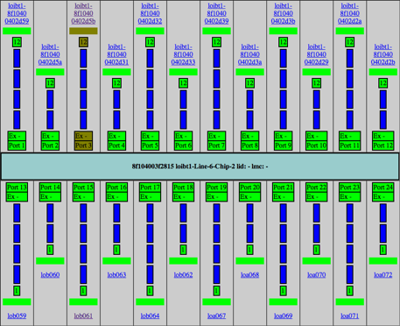
Zenoss Example

Slide 13
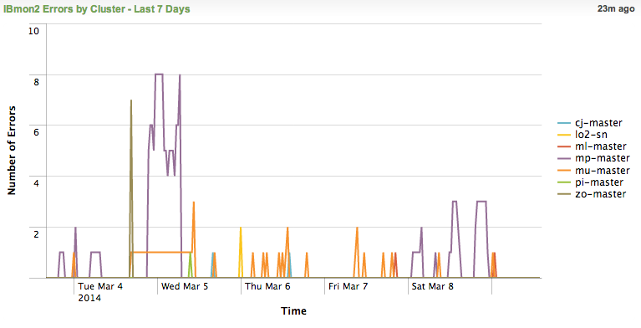
Splunk Example

Slide 14
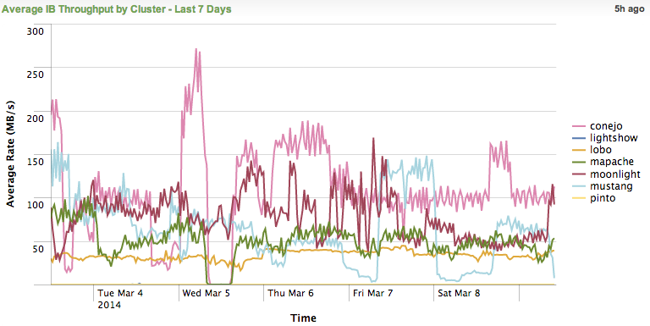
Splunk Example

Slide 15
Future Modifications
Compatible IBmon2 for InfiniBand fabrics
  Configuration Standards
    Different fabric rates
    Difference organizational implementations
Pulling additional counters to look for trends in performance and error analysis
  PortXmitWait
Robust design to handle upgrades

Slide 16
Questions?

