Slide 1
RDMA Extensions for Persistency and Consistency
Idan Burstein & Rob Davis
Mellanox Technologies

Slide 2
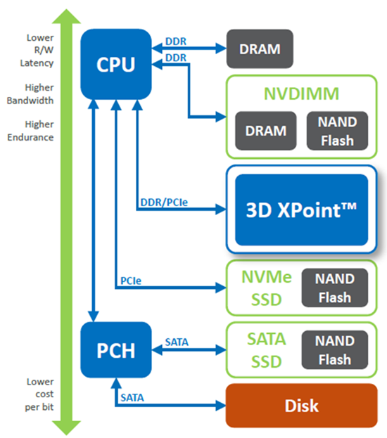
Persistent Memory (PM)
PM
Persistent Memory (PM) Benefits
  Considerably faster than NAND Flash
  Performance accessible via PCIe or DDR interfaces
  Lower cost/bit than DRAM
  Significantly denser than DRAM

Slide 3
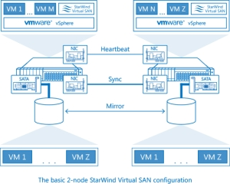
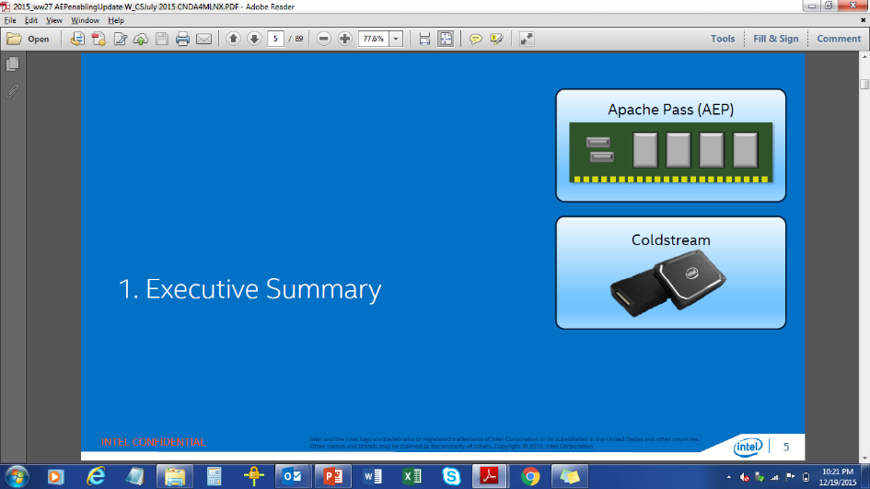
PM Needs High Performance Fabric for Storage
 | PM | NAND
Read Latency | ~100ns | ~20us
Write Latency | ~500ns | ~50us

Slide 4
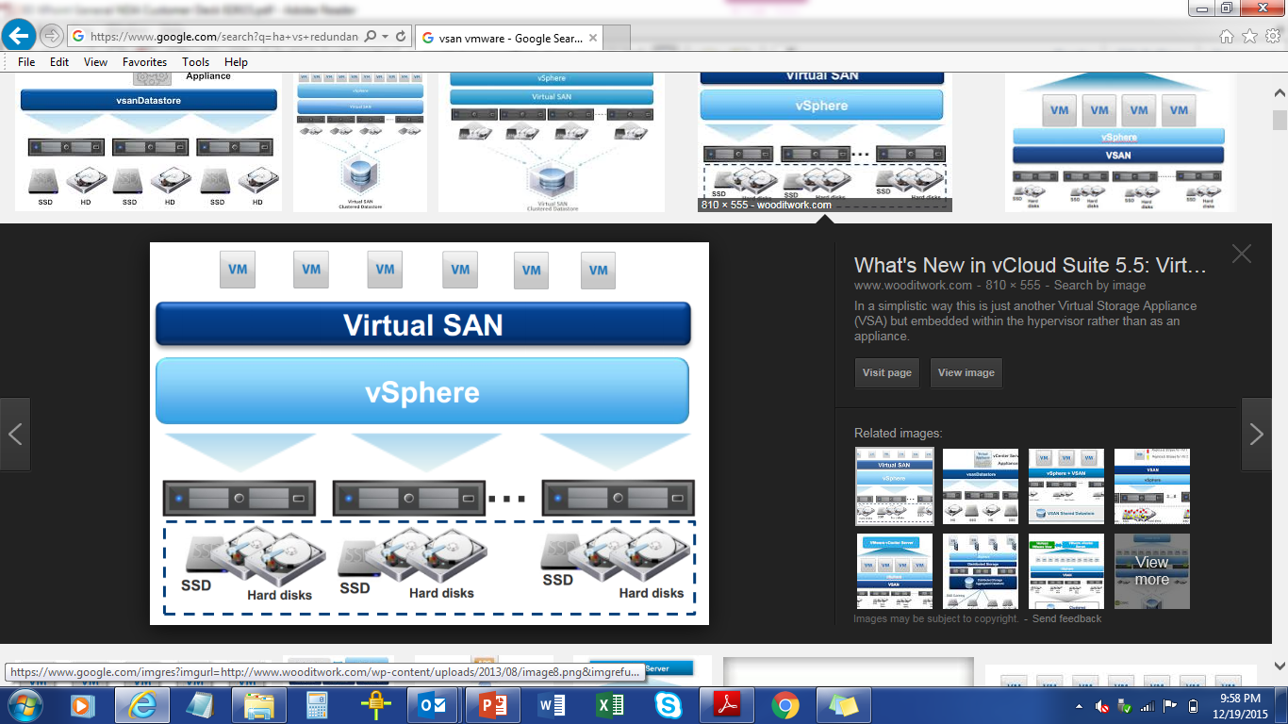
Applications Benefitting from PM
Compute Disaggregation
Scale out file/object systems
Software Defined Storage
In-Memory Database
Big Data & NoSQL workloads
Key-Value Store
Machine learning
Hyperconverged Infrastructure
Notes:
Here are a couple applications I think can take advantage of PM if we can network it with a very small performance penalty:
The first is Hyper converged infrastructure – where the storage is sale out architecture and the applications run on the same servers as the storage. Application performance is best when storage is local of course. But this is often not the case. And writes to storage need to be replicated remotely even if the storage is local.

Slide 5
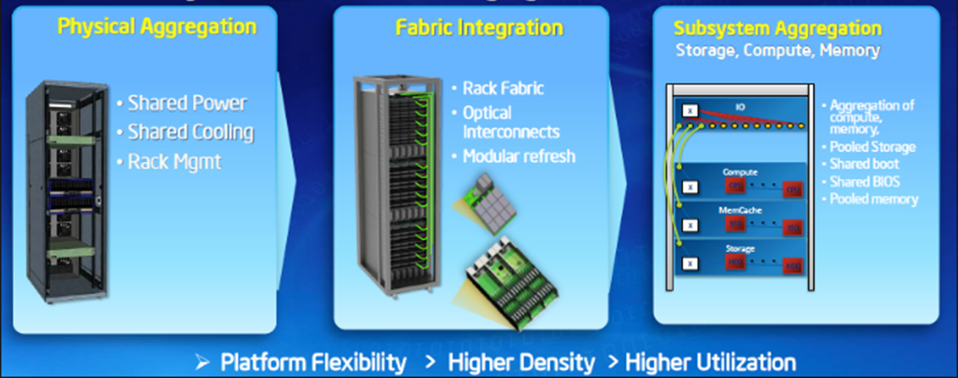
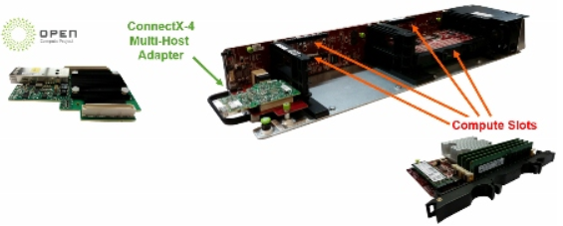

Compute Disaggregation
Network
Compute
PM Apps
Requires High Performance Network

Slide 6
How Do We Get There?
Standards Work in Progress
  SNIA NVM Programming Model TWIG
  SNIA NVM PM Remote Access for High Availability
  Other standards efforts – IBTA, others
Protocol:
  RDMA is the obvious choice
  2015 FMS demos:
    PMC(7us 4KB IO)
    HGST(2.3us)

Slide 7
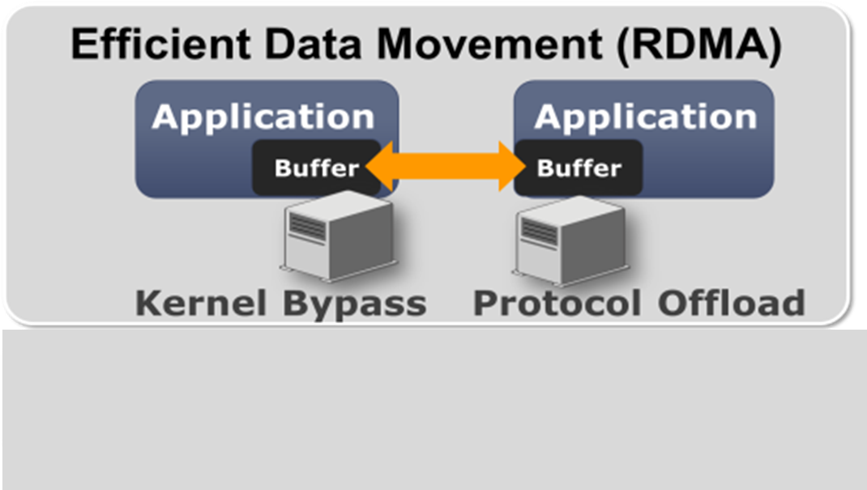
Core Requirements for Networked PM
 | PM | NAND
Read Latency | ~100ns | ~20us
Write Latency | ~500ns | ~50us
Network
PM is really fast
  Needs ultra low-latency networking
PM has very high bandwidth
  Needs ultra efficient, transport offload, high bandwidth networks
Remote accesses must not add significant latency
  PM networking requires:
    Predictability, Fairness, Zero Packet Loss
  InfiniBand/Ethernet switches and adapters must deliver all of these
Notes:
First of all why do we need to do something special to network PM?
Can’t we just use the existing storage networking technology?
The answer is yes….but if we take that approach we can not take full advantage of PM performance
Even when compared to NAND based SSD performance the difference is amazing
The industry is currently finalizing version 1 of a specialized solution for networking NAND devices called NVMf
At my company we believe we must also do a specialized industry solution to network PM

Slide 8
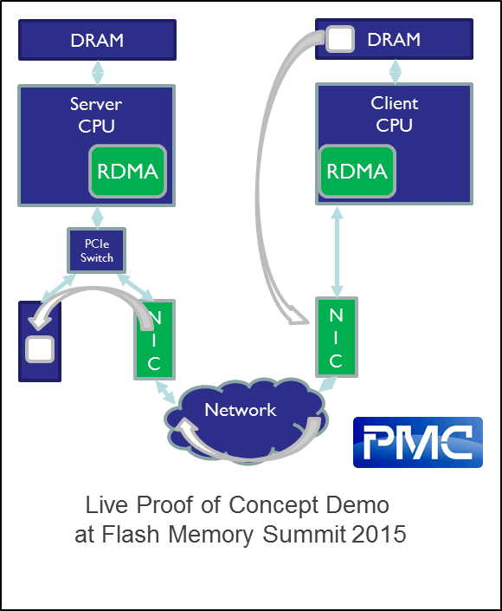
Peer-Direct NVRAM / RDMA Fabrics
Proof of Concept Platform
  Mellanox RoCE
  PMC NVRAM Card
Peer-Direct
  I/O operations bypass host CPU
7us latency 4KB IO
  Client-Server to Mem

Slide 9
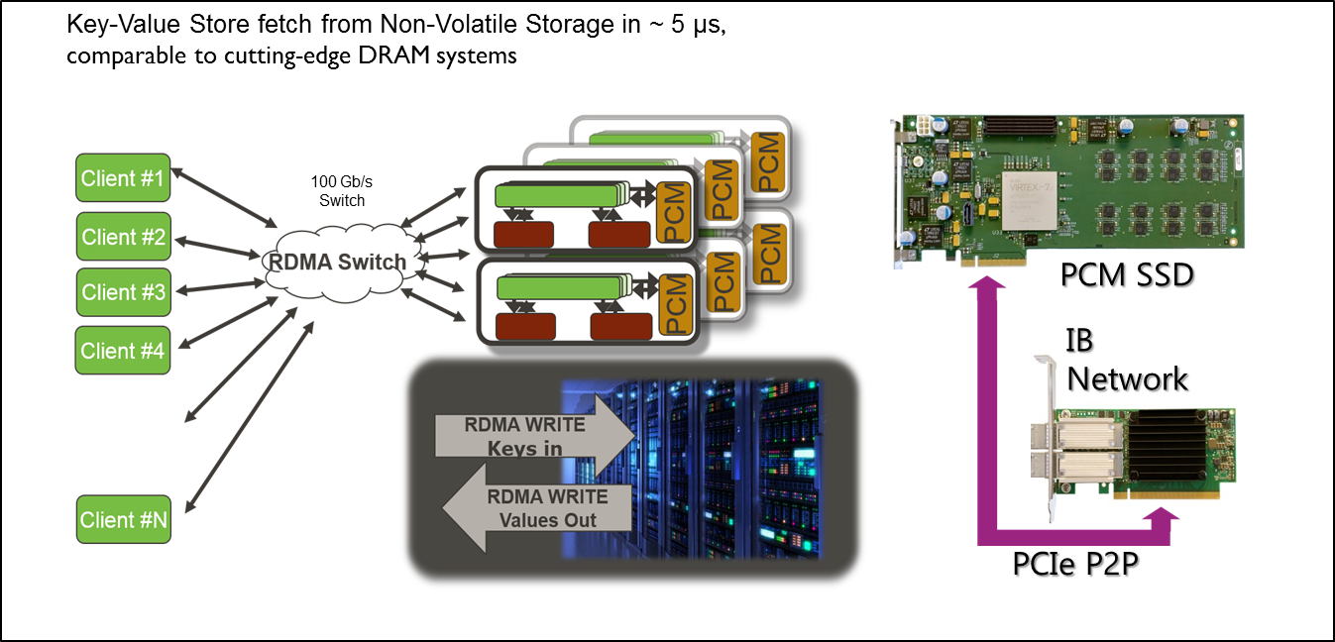
HGST PCM Remote Access Demo
HGST live demo at Flash Memory Summit
PCM based Key-Value store over 100Gb/s RDMA

Slide 10
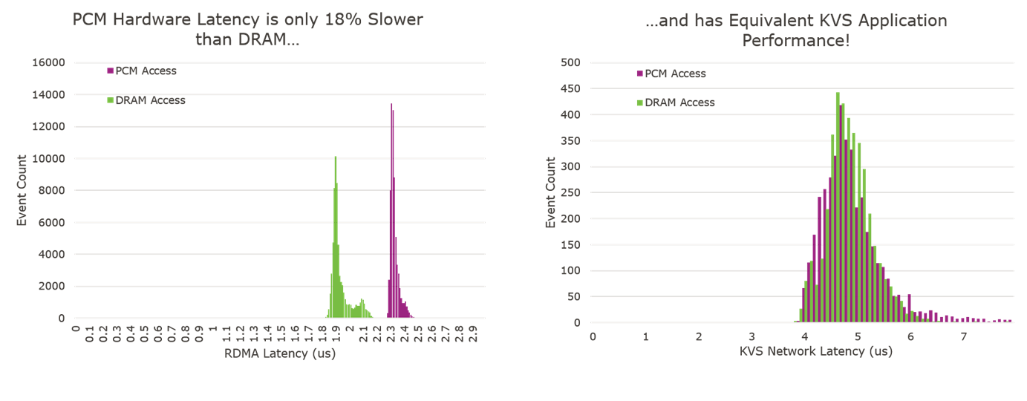
Application Level Performance
PCM is slightly slower than DRAM but …
Equivalent application level perf

Slide 11
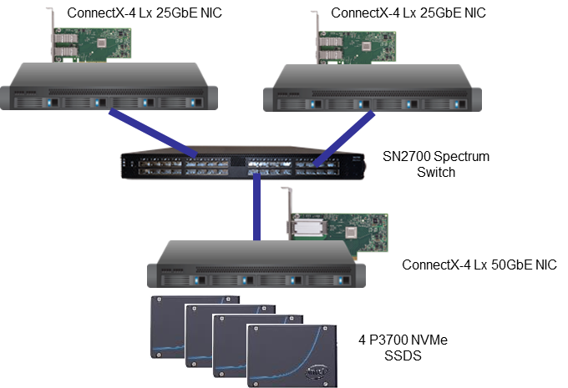
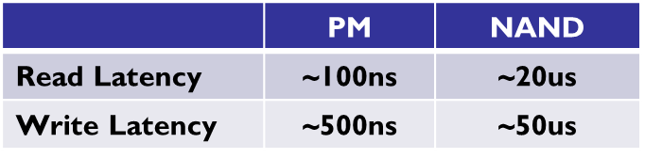
Performance with NVMf Community Driver Today
Two compute nodes
  ConnectX4-LX 25Gbps port
One storage node
  ConnectX4-LX 50Gbps port
  4 X Intel NVMe devices (P3700/750 series)
Nodes connected through switch
We see similar added fabric latency performance with Intel SPDK
Added fabric latency
~12us

Slide 12
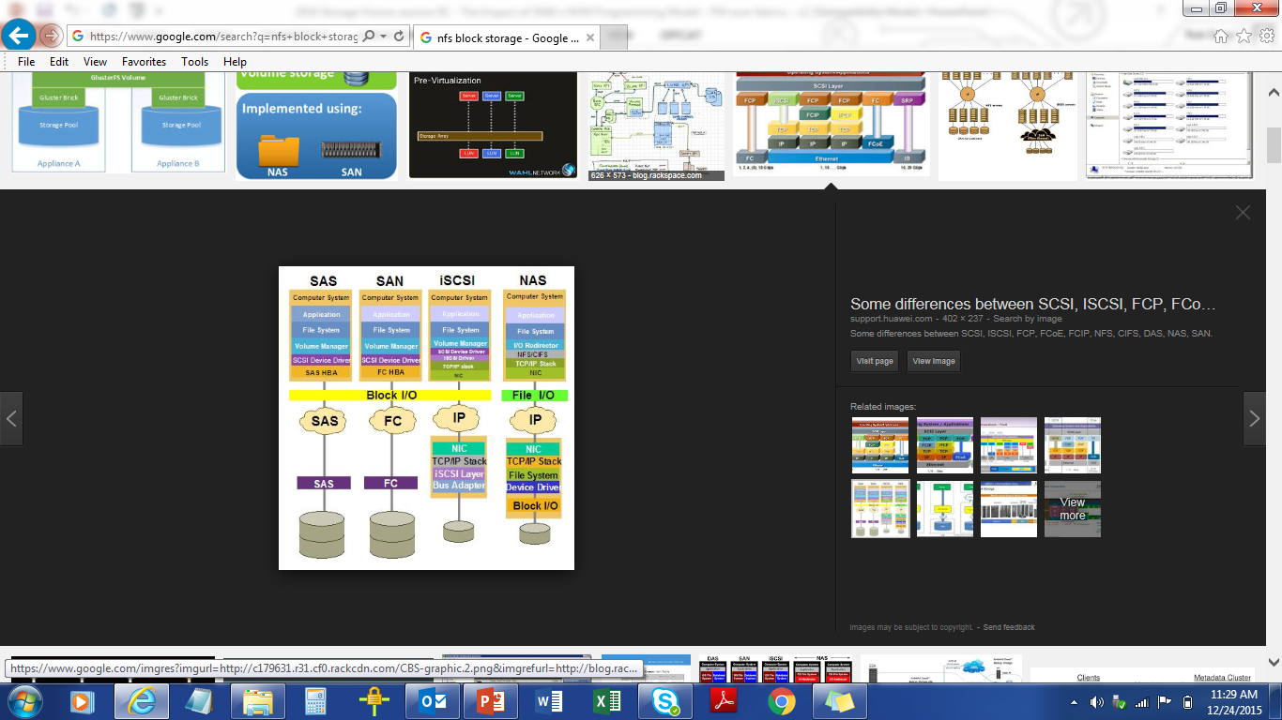
Remote PM Extensions Must be Implemented in Many Places
Data needs to be pushed to Target
Remote
Cache
Flush
Needed
NVMf
iSER
NFS o RDMA
SMB Direct

Slide 13
Software APIs for Persistent Memory
NVM Programming Model
  Describes application visible behaviors
    Guarantees, Error semantics
  Allows API’s to align with OS’s
  Exposes opportunities in networks and processors
  Accelerate the availability of software that enables NVM (Non-Volatile Memory) hardware.
Generic FS API
  PMEM Aware FS
Implementations
  Linux DAX extensions
  PMEM.IO userspace library
    Bypass the OS for persistency guarantees

Slide 14
NVM.PM.FILE Basic Semantics
MAP
  Associates memory address with a file descriptor and offset
  Specific address may be requested
SYNC
  Commit the read/write transactions to persistency
  Types
    Optimize flush
    Optimize flush and verify

Slide 15
Remote Direct Memory Access (RDMA)

Slide 16
RDMA
Transport built on simple primitives deployed for 15 years in the industry
  Queue Pair (QP) – RDMA communication end point
  Connect for establishing connection mutually
  RDMA Registration of memory region (REG_MR) for enabling virtual network access to memory
  SEND and RCV for reliable two-sided messaging
  RDMA READ and RDMA WRITE for reliable one-sided memory to memory transmission
Reliability
  Delivery
  Once
  In order

Slide 17
RDMA WRITE Semantics
RDMA Acknowledge (and Completion)
  Guarantee that Data has been successfully received and accepted for execution by the remote HCA
  Doesn’t guarantee data has reached remote host memory
Further Guarantees implemented by ULP therefore requires interrupt and add latency to the transaction
Reliability extensions are required

Slide 18
RDMA Atomics

Slide 19
SEND/RCV

Slide 20
RDMA READ

Slide 21
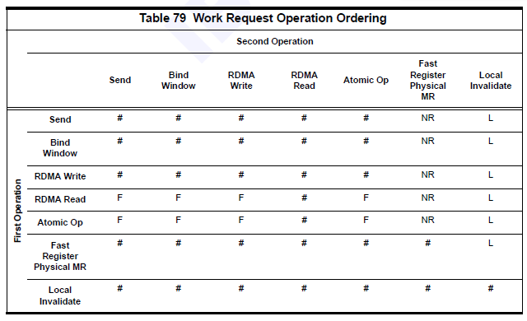
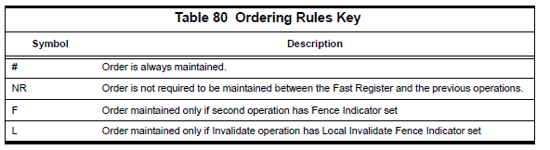
Ordering Rules

Slide 22
RDMA Storage Protocols

Slide 23
Variety of RDMA Storage Protocols
SAN: Many options
Application
SCSI
NVME
iSCSI
iSER
RDMA
SRP
RDMA(IB)
RDMA
NVMe-OF
File System
NFS
SMB Direct
RDMA
RDMA
Block Layer
Similar Exchange Model

Slide 24
Example: NVMe over Fabrics

Slide 25
NVMe-OF IO WRITE (PULL)
Host
  SEND carrying Command Capsule (CC)
  Upon RCV completion
    Free the data buffer (invalidate if needed)
Subsystem
  Upon RCV Completion
    Allocate Memory for Data
    Post RDMA READ to fetch data
  Upon READ Completion
    Post command to backing store
  Upon SSD completion
    Send NVMe-OF RC
    Free memory
  Upon SEND Completion
    Free CC and completion resources
Additional Round Trip to Fetch Data

Slide 26
NVMe-OF IO READ
Host
  Post SEND carrying Command Capsule (CC)
Subsystem
  Upon RCV Completion
    Allocate Memory for Data
    Post command to backing store
  Upon SSD completion
    Post RDMA Write to write data back to host
    Send NVMe RC
  Upon SEND Completion
    Free memory
    Free CC and completion resources
Interrupts Required for Reading

Slide 27
NVMe-OF IO WRITE In-Capsule (PUSH)
Host
  Post SEND carrying Command Capsule (CC)
  Upon RCV completion
    Free the data buffer (invalidate if needed)
Subsystem
  Upon RCV Completion
    Allocate Memory for Data
  Upon SSD completion
    Send NVMe-OF RC
    Free memory
  Upon SEND Completion
    Free CC and completion resources
Large Buffers Should be Posted in Advance
Data is being places in undeterministic location with respect to the requester

Slide 28
Summary
Storage over RDMA Model Overview
  Commands and Status
    SEND
  Data
    RDMA initiated by Storage Target
Protocol Design Considerations
  Latency of storage device is orders of magnitude higher than network latency
  Storage is usually not RDMA addressable
  Scalability of intermediate memory

Slide 29
Latency Breakdown for Accessing Storage
Traditional storage latency are ~10usec added latency
  Round trip time (RTT)
  Interrupt overheads
  Memory management and processing
  Operating system call
RDMA latency may go down to 0.7 usec

Slide 30
Latency Breakdown for Accessing Storage
Persistent Memory Non-Volatile memory technologies are reducing the latency to <1usec
Spending time on RTT and interrupts becomes unacceptable and unnessacary
  Memory mapped for DMA is not a staging buffer, it is the storage media
PMEM storage should be exposed directly to RDMA access to meet its performance goals

Slide 31
Remote Access to Persistent Memory
Exchange Model

Slide 32
Proposal – RDMA READ Directly From PMEM
Utilized the RDMA capabilities to directly with storage
RPC Model
DMA Model

Slide 33
Proposal – RDMA Write Directly to PMEM
Utilized the RDMA capabilities to directly communicate with storage
RPC Model
DMA Model
Resolves the latency, memory scalability and processing overhead while communicating with PMEM

Slide 34
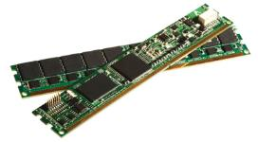
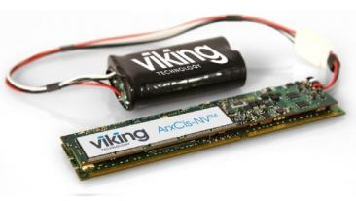
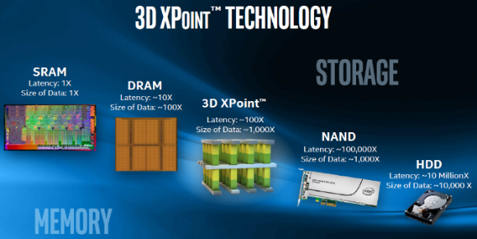
DMA Model is Mostly Relevant When…
Storage Access Time becomes comparable to Network Roundtrip Time
Storage Device can be Memory Mapped Directly as RDMA WRITE Target Buffer
Main challenge:
  RDMA WRITE/Atomics reliability guarantees

Slide 35
RDMA Extensions for Persistency and Consistency

Slide 36
RDMA Extensions for Memory Persistency and Consistency
RDMA FLUSH Extension
  New RDMA operation
  Higher Performance and Standard
  Straightforward Evolutionary fit to RDMA Transport
Target guarantees
  Consistency
  Persistency

Slide 37
RDMA FLUSH Operation System Implication
System level implication may be:
  Caching efficiency
  Persistent memory bandwidth / durability
  Performance implications for the flush operation
The new reliability semantics design should consider these implications during the design of the protocol
These implications are the base for our requirement

Slide 38
Baseline Requirement
Enable FLUSH the data selectively to persistency
FLUSH the data only once consistently
Responder should be capable of provisioning which memory regions could execute FLUSH and are targeted to PMEM
Enable amortization of the FLUSH operation over multiple WRITE
  Utilize RDMA ordering rules for ordering guarantees
Figure: Flush is a new transport operation

Slide 39
Use Case: RDMA to PMEM for High Availability

Slide 40
Use Case: RDMA to PMEM for High Availability
MAP
  Memory address for the file
  Memory address + Registration of the replication
SYNC
  Write all the “dirty” pages to remote replication
  FLUSH the writes to persistency
UNMAP
  Invalidate the registered pages for replication

Slide 41
Conclusions
Persistent memory performance and functionality brings a paradigm shift to storage technology
Effective remote access to such media will require revision of the current RDMA storage protocols
IBTA extends the transport capabilities of RDMA to support placement guarantees to align these into a single efficient standard
  Join us to IBTA if you want to contribute
  Help us driving the standards in other groups (PCIe, JDEC, NVMe, etc.)

Slide 42
Thanks!
idanb@mellanox.com
robd@Mellanox.com

