Slide 1
OFA 2020 INTEROP TESTING DIRECTION
Doug Ledford, Vice-Chair
January 9, 2020

Slide 2
OFILP - The old program
Original Interop program, dating back to the early 2000s:
Narrowly focused on supporting a small hardware vendor community
InfiniBand, RoCE, iWARP
Forced vendors into a rigid schedule (2x “interop events” 2x “debug events” per year)
Required on-site presence for debug events
Focused on a certification program – ‘logo program’
Original purpose of the logo was to demonstrate that the newly emerging InfiniBand Architecture was viable
Tightly coupled with OFED
Original purpose was to validate the only available software stack (OFED) with available hardware
Long story short, it was the right program for its time, but no longer meets the needs of either the industry, or the Alliance
A small, and shrinking, client base bore the fixed costs of a relatively expensive program

Slide 3
A better idea?
At the 2019 Workshop, a ‘re-imagined’ Interop program was proposed:
Meets the needs of a much broader client base
Still includes the traditional hardware vendors, but also caters to:
Distros, Linux Kernel community, network s/w developers, application/middleware developers …
Eliminate rigid calendar; greatly improved flexibility in program execution
Based on an ‘on-demand’ philosophy
Retains the original logo program, if it is desired, but it is no longer the center of the universe, as it was previously
Integrates popular Distributions
vs the former program, that was driven by OFED releases
Open-ended support for multiple network interfaces
Verbs is still supported, as are emerging APIs such as libfabric and others
Hardware and software infrastructure no longer tied exclusively to a particular API (or style of API)

Slide 4
What we want the Interop program to be able to do
Able to test any OS platform
SuSE, Red Hat, Debian, Ubuntu, etc. (ok, so really any Linux platform)
Able to test a specific OS platform with additional software
OFED, MOFED, beta packages on top of the released OS platform code, upstream -rc releases, upstream final releases
Able to test user supplied software on any OS platform with or without OS updates
Able to test across all of the different fabric types
Able to test across multiple different vendor’s hardware
Broadcom RoCE to Mellanox RoCE for example
Able to automatically select machines to run tests on and install all necessary software for the test
Able to give the option of automated testing or manual testing once the machines are installed
Able to manually schedule all or a portion of the cluster for user checkout

Slide 5
Enabling a broader clientele
Upstream: Automatic, continuous testing of upstream software (kernel, rdma-core, others)
Creation and incubation of an open source community that contributes tests that can be run in an automated fashion in the cluster
OS Distros: On demand testing for OS distros (Red Hat, SuSE, OFED, etc.)
Geared more towards OS testing rather than hardware testing
Logo program, if desired
Hardware Vendors: On demand testing for hardware vendors
Similar to the defunct interop program
Logo program, if desired
ULPs, Middleware, Applications: On demand testing of specific software (OpenMPI, AMQP, OpenStack, others)
On demand platform for development (Apache? MySQL?)

Slide 6
To meet those goals: 3 major services
Pre-release Integration Testing to Support Upstream Development
Objective: Identify problems in the upstream software introduced during development
Provides maintainers a state of the tree check as development progresses and changes are merged
vs attempting to ascertain that information once all merges have been completed
Primarily targeted at supporting upstream maintainers
vendors derive some benefit too
On-Demand Testing Service to Support Everybody
Objective: Provide when needed when needed by client, not when scheduled twice a year
Driven by recipes on an OFA controlled server including:
an IWG-designed test plan
Additional upstream designed test plans
Vendor contributed test plans
Client gets to choose which tests to run and all results are logged for analysis
A logo program is an option, if the client community wants it
Manual Machine Checkout and Use
Objective: Cover all testing and development needs not already covered
Primarily targeted at supporting early testing needs and development needs

Slide 7
To meet those goals: 1 cluster
Supported by a partitionable hardware cluster
Supports a variety of network types
Easily extensible to add new network types
Controlled access from the Internet
VPN account required to access cluster
Account on cluster required to access functions of cluster controller
Lab machine
Lab machine
InfiniBand Fabric
RoCE Fabric
Lab machine
Internet
VPN
Firewall
Cluster Controller
Lab machine
Lab machine
Control Network
iWARP Fabric
OPA Fabric
Lab machine

Slide 8
How does it all work
The beaker lab controller is responsible for powering on and off each lab machine, and for controlling the dhcp boot parameters for each lab machine. By using this, it can install whatever software is requested simply by setting up the proper PXE boot image in dhcp and then powering on the machine (which will be set to PXE boot)
The beaker lab controller will pull tests from the beaker test repo to run on newly installed machines (automated test mode), or it can leave the machines ready for ssh login (manual use mode).
The End User can use either the web interface or the command line interface (CLI) to initiate either an automated test run or a manual use run. If an automated test run is initiated, it will run until it completes or times out, and the user is email the results of the run. If something goes wrong during the run, the user can investigate the issue by remotely logging into the test machines up until the test timeout occurs, and then only the logs will still be available.
The CKI runner watches upstream source trees and when new commits are added to a source tree, it triggers a preplanned automated test run depending on which tree triggered the run.
Lab machine
Beaker test repo
Lab machine
End User
Beaker Web Interface
Lab machine
Beaker lab controller
RDMA Networks
Beaker CLI
Lab machine
CKI Runner
Lab machine
Control Network
Lab machine

Slide 9
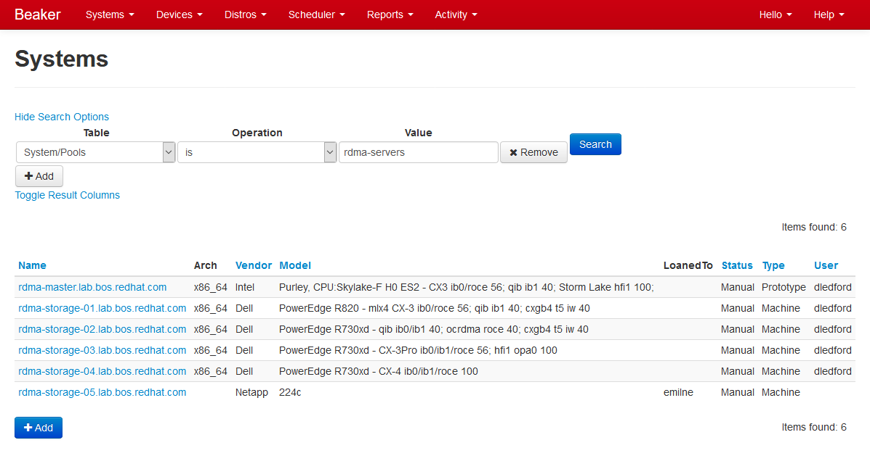
Beaker Web Interface – System Search

Slide 10
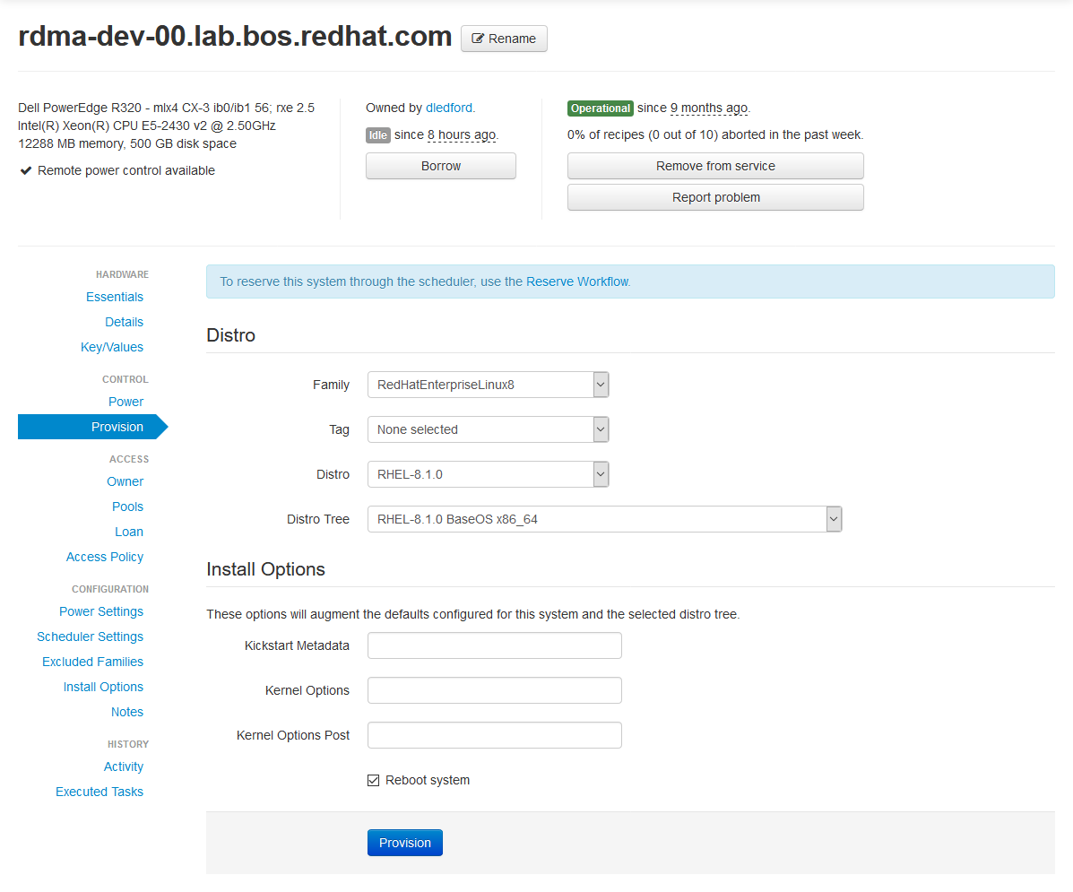
Beaker Web Interface – Provisioning

Slide 11
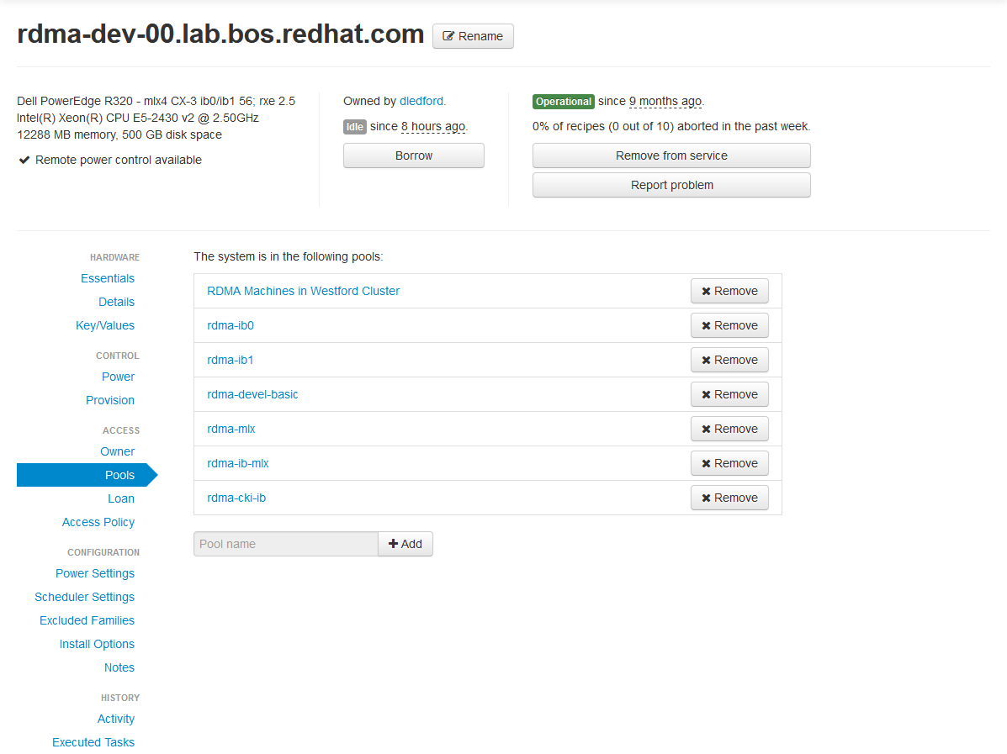
Beaker Web Interface – Pools

Slide 12
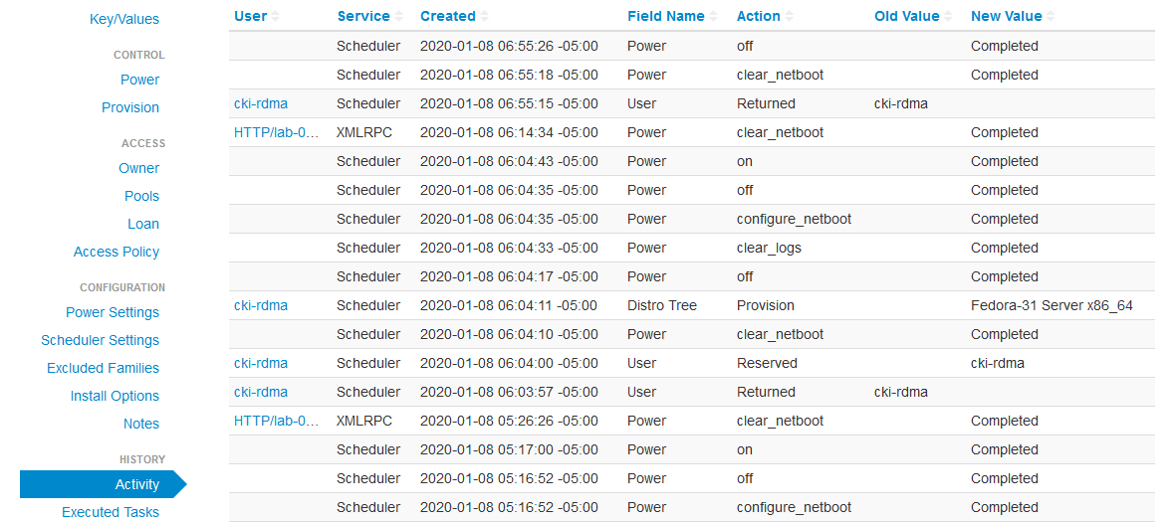
Beaker Web Interface – Activity

Slide 13
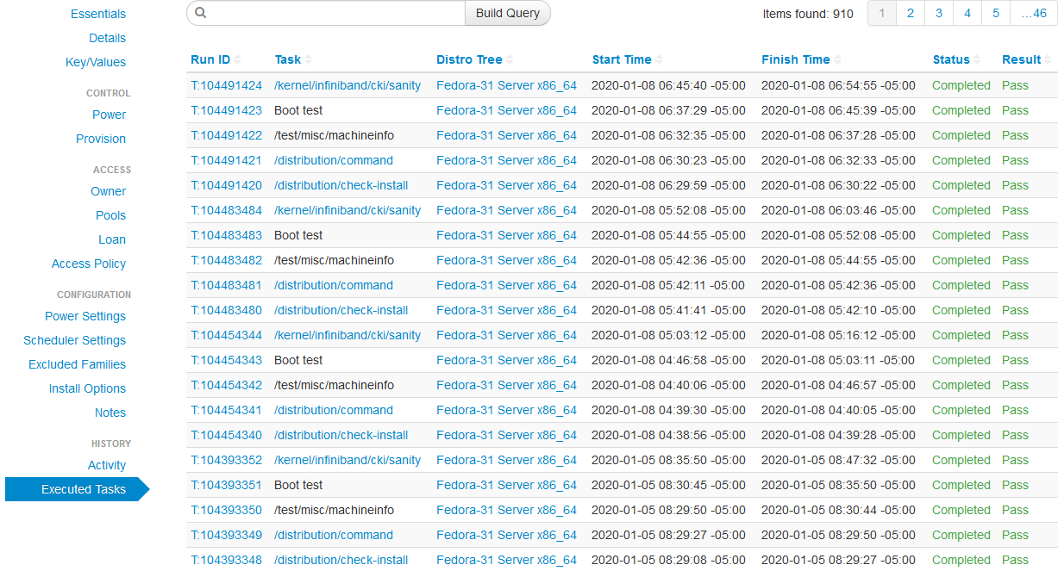
Beaker Web Interface – Executed Tasks

Slide 14
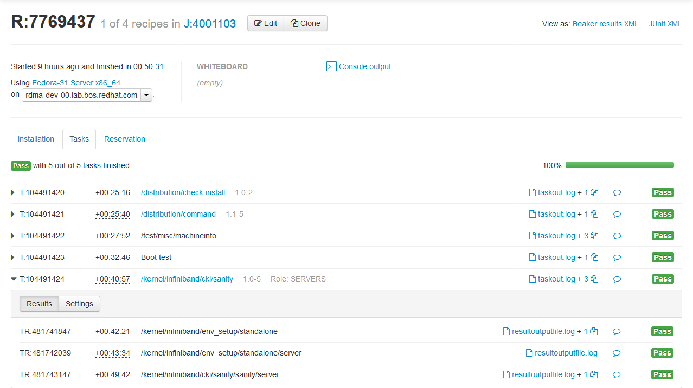
Beaker Web Interface – Job Log

Slide 15
Boneyard
One shouldn’t look too closely beyond these limits….

Slide 16
Where the proposed solution comes from
Red Hat is in the process of open sourcing its entire CKI (Continuous Kernel Integration) Testing framework (https://gitlab.com/cki-project)
Red Hat long ago open sourced their Beaker lab management software (https://beaker-project.org/)
Red Hat is in the process of open sourcing the various tests they’ve used with beaker for years (https://github.com/CKI-project/tests-beaker)
The combination of these three projects, plus a little glue infrastructure, creates essentially a replica of what we use inside Red Hat, but outside our firewall. It also just happens to be highly suited to what we want to enable

