Slide 1
OFA Fabric Software Development Platform FSDP
Proposal
March, 2020

Slide 2
To close the proposal
Slide 21 – FSDP H/W Infrastructure - Doug to fill in hardware details
including existing UNH-IOL inventory
Slide 23 – System Administration - Doug to describe some options for system admin
Slide 24 – Program Administration – Jim to add initial thoughts
Slide 25 – Governance Model – Doug w/ Tatyana to clean up the diagram
Slide 26 – Siting Options – Jim to clean up, add Ken’s options to the list
Slide 28 – Funding Model
Do we want to add a “limited” testing member, e.g. pay by use?
What to do about kernel maintainers?
Slide 29 – Costs – Doug and Jim to collaborate on their respective sections

Slide 3
Executive summary
We propose that the OFA create the OFA Fabric Software Development Platform – OFA FSDP
Comprises a hardware platform and accompanying software infrastructure
Designed to provide its target clientele with easy access to a modern cluster incorporating high performance network technologies to be used in the development, testing, and validation of software associated with client access to fabric services
Intended to operate primarily ‘lights out’
Sited at a commercial vendor site
Includes a range of “memberships” in the program
Promoter members are “full” FSDP members
Supported by normal OFA membership dues
Seen as a vehicle for driving OFA membership and stature in the community

Slide 4
Table of Contents
Motivation and Objectives
Background
Program Overview - Fabric Software Development Platform (FSDP) program
Fabric Software Development Platform – Hardware and Software Infrastructure
Program and Cluster Administration
Governance – FSDP Working Group
Siting Options
Membership, Costs, Funding Model

Slide 5
Why an fsdp program
The simple answer - It is a core component of the OFA’s mission:
“The mission of the OpenFabrics Alliance (OFA) is to accelerate the development and adoption of advanced fabrics for the benefit of the advanced networks ecosystem.”
The OFA Fabric Software Development Platform, like the OFILP before it, is a key element in driving the adoption of advanced fabrics

Slide 6
question
Can we design a program that delivers greater value than the OFILP at lower cost?
While serving the needs of:
Alliance members
The open community
Vendors
OEMs
In short, a program that delivers on the OFA’s mission

Slide 7
Target clients – a broader audience
Linux Kernel Maintainers
Hardware vendors*
Distros**
ISVs, Application, Middleware developers
Network Services Consumers
…
Broadly, anybody engaged in:
Developing networking software
Consuming networking services
*served by original OFILP (OpenFabrics Logo Program)
**served by the “on-demand” testing program at NMC

Slide 8
Serving our proposed target clients
Linux Upstream Maintainers
Automatic, continuous testing of upstream software (kernel, rdma-core …)
Centralized testing of multiple hardware vendors’ products
Relieve maintainers of the burden of tracking the efficacy of hardware from multiple vendors
Incubation of an open source community that contributes tests that can be run on the cluster
Hardware Vendors
Private, on demand access to a multi-vendor cluster for testing/validation of new hardware, software, firmware
Logo program, if desired
OS Distros: On demand testing for distros (Red Hat, SuSE, OFED, etc.)
Private, on demand access to a multi-vendor cluster for e.g. release testing
Logo program, if desired
ISVs, Applications, Middleware
On demand testing of specific software (OpenMPI, AMQP, OpenStack, others)
Software development (Apache? MySQL?)

Slide 9
serving our clients
1.
Support the upstream kernel release cycle
2.
Provide ‘On-demand’ access to all stakeholders
to a multi-vendor, multifabric testbed
3.
Continue the Logo Program if desired, but based on Linux distributions

Slide 10
Two major usages, one possibility
Pre-release Integration Testing
Objective: Identify problems in the upstream kernel introduced in the merge window
Provide kernel maintainers a broad-based view of the state of device testing
vs forcing maintainers to gather that information from each individual vendor
Primarily targeted at supporting kernel maintainers
vendors derive some benefit too
On-Demand Development and Testing Capability for Distros, Vendors and Others
Objective: Provide a hardware and software platform for use by clients ‘on-demand’
A Possible Third Objective – A Certification Program (‘Logo Testing’)
Objective: An industry recognized, independent certification program allowing clients (e.g. primarily vendors and distros) to claim “compliance” to a given set of tests

Slide 11
An instructive look in the rearview mirror
The original OpenFabrics Interoperability Logo Program was:
Designed to validate interoperability between vendors, and with the OFED stack
Narrowly focused on a small hardware vendor community
Centered around a certification program – ‘Logo Program’
Forced participants into a rigid program schedule
Paid for by the subscribers, who were charged a fixed base fee + an incremental fee based on number of devices tested
Over time …
OFED’s components were replaced by a community-supported open source RDMA subsystem
RDMA users and vendors expressed strong preference to test against standard Distros and upstream kernels
Industry consolidation reduced the number of hardware devices
Long Story Short – it was the right program for its time, but that time has passed

Slide 12
A better idea?
At the 2019 Workshop, a ‘re-imagined’ Interop program was proposed:
Targeted at a much broader audience
Much more responsive to the needs of the broader networking community
Still includes the traditional hardware vendors, but adds:
Distros, Linux Kernel community, network software developers and others as stakeholders
Greatly improved flexibility for clients of the program, highly responsive to their needs
Based on an ‘on-demand’ philosophy
Retains the original logo program, if it is desired, but no longer the center of the universe
Integrates popular Distributions
vs the former program, that was driven by OFED

Slide 13
What it is
The program is built around a ‘lights out’ cluster maintained and supported by the OFA
The cluster has potentially three major usages
Pre-release integration testing
On-demand testing
A logo program
Other use cases are likely to emerge as the industry becomes aware of the capability being offered
This section describes these three usages
The next section describes the hardware and software infrastructure

Slide 14
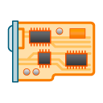
Usage: pre-release integration testing
Objective: Support the Linux kernel community through an integration testing program
Synchronized to, and automatically triggered by, the kernel release cycle
A local daemon patrols for changes in the upstream kernel
Driven by an OFA-defined test plan
Interactive test and debug cycle
Results reported thru standard open source mechanisms
test plan
start
kernel rc4
mailing list
Benefits:
Provides the Linux open source community with ‘one stop shopping’
Frees the vendors from duplicating tests being run by every other vendor
Think of it as collaborative debugging

Slide 15
Usage: ON-demand program
Cluster is made available to the client (e.g. h/w vendor, a distro…) for its exclusive use for a defined duration
Private debug, design validation, testing …
Cost for use of the cluster depends on the FSDP membership level – see the section on “Membership”
During that interval, the cluster is dedicated for the sole use of that client
Use of the cluster is not necessarily driven by the OFA-defined test plan
test plan
vendor under test
On-Demand Testing
results
Results are returned to the client
distribution under test

Slide 16
Usage: logo program
Two possible types of Logos: Vendor Logo & Distro Logo
Logo tests are run ‘on-demand’, driven by OFA’s test plan
Test plan is executed selectively
Run against a defined (“certified”) hardware configuration
Run against a specific distribution(s)
Logo is awarded to Vendor or Distro
Certification includes:
Test environment
list of tests executed
pass/fail results
test plan
vendor under test
Logo Testing
LOGO
“Our new hardware is certified to work with RHEL x.x, SLES y.y”
or
“Our distribution is supported by the following hardware”
distribution under test

Slide 17
Fabric software development platform
A partitionable hardware cluster
Lab machine
Multi-vendor
Multi-network types (e.g. IB, RoCE, iWARP …)
Easily extensible to add new network types
Controlled access from the Internet
VPN account required to access cluster
Account on cluster required to access functions of cluster controller
Provisioned with existing OFA-owned hardware
Currently stored at UNH-IOL
Lab machine
InfiniBand Fabric
RoCE Fabric
Lab machine
Internet
VPN
Firewall
Cluster Controller
Lab machine
Lab machine
Control Network
iWARP Fabric
OPA Fabric
Lab machine

Slide 18
FsdP software infrastructure
The cluster is automatically configured and run by the Beaker Lab Controller according to specifications for a particular client or usage
Lab machine
Automated System Configuration
Beaker powers on and off each lab machine as needed
Controls the dhcp boot parameters for each lab machine
Installs software as requested
by setting up the proper PXE boot image in dhcp and then powering on the machine (which will be set to PXE boot)
Test Operation
Once the system is configured, the Beaker Lab Controller:
Pulls tests from the beaker test repo (automatic mode), or
Leaves the machines ready for ssh login (manual use mode).
Beaker test repo
Lab machine
End User
Beaker Web Interface
Lab machine
Beaker lab controller
RDMA Networks
Beaker CLI
Lab machine
CKI Runner
Lab machine
Control Network
Lab machine

Slide 19
FSDP software infrastructure
Integration Testing – Continuous Kernel Integration Runner serves as the “client”
Lab machine
Beaker test repo
Lab machine
End User
Beaker Web Interface
CKI Runner watches upstream source trees
tIt Triggers a preplanned automated test run depending on which tree triggered the run.
On request by the CKI Runner, the Beaker Lab Controller configures the system for Integration Testing
Lab machine
Beaker lab controller
RDMA Networks
Beaker CLI
Lab machine
CKI Runner
Lab machine
Control Network
Lab machine

Slide 20
FSDP software infrastructure
On-Demand (end user) Testing
Lab machine
End user uses the web interface or the command line interface (CLI) to initiate either an automated test run or a manual use run.
If an automated test run is initiated, it will run until it completes or times out, results emailed to the client
If something goes wrong during the run, the user can remotely logon the test machines up until the test timeout occurs, and then only the logs will still be available.
Beaker test repo
Lab machine
End User
Beaker Web Interface
Lab machine
Beaker lab controller
RDMA Networks
Beaker CLI
Lab machine
CKI Runner
Lab machine
Control Network
Lab machine

Slide 21
fSDP hardware Infrastructure
Inventory of existing OFA-owned hardware currently stored at UNH-IOL
Proposed cluster hardware
Doug to fill in

Slide 22
Fsdp software infrastructure
Based on the following open source (or soon to be) tools developed by Red Hat
CKI (Continuous Kernel Integration) Testing framework
https://gitlab.com/cki-project
Beaker lab management software
https://beaker-project.org/
Various tests used by Red Hat with Beaker for years
https://github.com/CKI-project/tests-beaker

Slide 23
System Administration
Describe the proposal, and options, for administering the system
Redhat initial volunteer
Find a “permanent” volunteer
Hire Ken Strandberg to work under the auspices of the IWG
Others?
Doug to fill in

Slide 24
Program administraton
What is our proposal for administering the program (not the system)?
Who handles requests to participate? Who ensures that those requests turn into actual user accounts and ‘billing’?
Who allocates time on the cluster and resolves conflicts?
Jim to take an initial crack at this

Slide 25
FSDP Governance Model
Open to participation by all
Voting rights by membership level
OFA FSDP WG
FSDP WG oversees the cluster usage and testing activities via a Test Plan, different subsets of tests can be used for kernel/distro/member testing
test plan(s)
Kernel
testing
Distro testing
Member
testing
Cadence
Linux kernel testing starting with RC1
Distro testing is ‘on demand’
Logo testing in ‘on demand’
FSDP usage is ‘on demand’
Debug
Debug
Debug
Logo
Doug w/ Tatyana to clean up the drawing

Slide 26
Siting Options
Prepare and distribute a “Testing Services Discussion Document - JimR
Targeted 3 locations listed below, emailed Document to VTM and NMC 2/11. UNH-IOL intentionally held. No response from VTM as of 2/17, ping. Schedule NMC call week of 2/17
UNH-IOL
Decide when to read-in UNH-IOL on “Testing Services” leading to a quote
Current inventory AR: Doug, target ETA?
VTM Beaverton
Discuss “Testing Services” leading to a quote
NMC
As of 2/17 current contract still has not been responded to, ping
Discuss “Testing Services” leading to a quote
Jim to polish this, in terms of the options being explored

Slide 27
Membership model
Membership level | OFA Rights | IWG Rights | FSDP Rights
OFA Promoter | Full rights as defined by Bylaws | -right to serve as FSDP WG Chair - right to vote in FSDP WG | Unlimited access, Highest priority in the queue
Statutory member
Membership level | OFA Rights | IWG Rights | FSDP Rights
Voting FSDP Member | n/a | - right to vote in FSDP WG | Unlimited access, 2nd priority
Non-voting FSDP Member | n/a | - none | Unlimited access, 3rd priority
Limited FSDP Member | n/a | - none | Access subject to availability
Individual Member | n/a | - none | Free access, as available
FSDP member
‘statutory members’ are defined in the Bylaws by law
‘FSDP membership classes’ are defined by a Board-defined membership policy
A Voting FSDP Member may serve as FSDP WG Co-chair, but not as sole chair, unless there is no OFA Promoter in that role
Access to the cluster is limited to those in one of the above membership classes

Slide 28
Funding model
Must be a member of the OFA to use the test cluster, whether as an unlimited testing membership level or pay-as-you-go
Cluster is supported by OFA Membership dues
Propose 3 levels of Membership:
Promoter Member (statutory): senior rights including unlimited testing
Voting FSDP Member: Right to vote in FSDP WG but not to chair; unlimited testing
Non-Voting FSDP Member: No right to vote in the FSDP WG, unlimited testing
Limited Member: access to the cluster on a “per-use” basis ??
Individual Member: Limited to bona fide individuals with a demonstrated need to use the cluster
FSDP WG is treated as a “Works of Authorship” working group
Decisions are made via voting mechanisms
Anyone may attend meetings, but voting is limited to FSDP members (including OFA Promoters)
Opens:
what about kernel maintainers?

Slide 29
Costs
Start up costs
Operational costs
Facility rental
Support staff
Jim and Doug to collaborate

Slide 30
NMC Distro Testing
Need arose for distro vendors to test their OFED stack for pre-release with a 3rd party entity
Contract formed with New Mexico Consortium (NMC) and OFA to provide testing ground for vendors to submit their pre-release distro and test against hardware
NMC had hardware that was not utilized 9 months out of the year and kept relatively up to date
Initially started off with NMC providing no cost support for testing
Intent was to provide charging once the program was fully solidified
Distro test framework based on UNH-IOL interop testing
Tested distro against various RDMA hardware (IB, OPA, RoCE, iWARP), both for functionality and usability
Reported results back to vendor
Provided follow up and retesting as issues were found
SUSE was the only vendor so far utilizing the program
LANL staff were the ones performing the testing on behalf of NMC
Additional contract/support may be need to be addressed if moving forward with NMC and LANL

Slide 31
OFILP- openfabrics interop logo program
The original Interop program, dating to the 2000s
Long story short …
Was tightly coupled with, and driven by, OFED
Did vendor devices interoperate with OFED?
Did vendor devices interoperate with each other?
Narrowly focused on a small hardware vendor community
InfiniBand, RoCE, iWARP
Centered around a certification program – ‘logo program’
Forced vendors into a rigid schedule
(2x “interop events” 2x “debug events” per year)

Slide 32
OFILP mechanics
Subscribers paid a fixed base fee, + an incremental fee based on number of devices tested
Program operated on a cost recovery basis, with the OFA serving as the financial backstop
Cost per device was based on a forecast of the aggregate number of devices to be tested (all vendors)
Like clockwork
(until it’s not)
spring
Debug
LOGO
The annual cycle included two debug events, and two logo events, all bundled together and covered by the single subscription fee
Fees for each vendor were calculated based on the number of devices to be tested at the beginning of each year
An ‘all or nothing’ program
annual
cycle
LOGO
Debug
fall

Slide 33
Stakeholders
Direct Stakeholders
Kernel maintainers
Hardware vendors
Distros
Indirect Stakeholders
OpenFabrics Alliance
OEMs (rely on the IHVs to test hardware)
Upstream Linux RDMA community
OFA Alliance Members who have a stake in the success of the OFA

Slide 34
stakeholder wish lists
Kernel Maintainers, Linux Open Source Community
Improve the fidelity of kernel pre-release testing
Focus on integration testing late in the kernel release cycle (when vendor driver updates have been integrated)
Ensure that existing drivers interop correctly with a pre-release kernel
Provide visibility to upstream maintainers into what’s been tested by vendors
Hardware Vendors
Reduce testing costs;
Test new hardware and/or software interoperability with other vendors and/or multiple distros
An independent certification program driven by an industry-defined test plan (for those who want it)
test upstream drivers
Distros
Support for testing release candidates against a stable, current, multi-vendor hardware base
Test backported drivers – ensure that features that work in the upstream version did not get broken in the Distro
The opportunity to evaluate vendor backported drivers before inclusion in a GA release
May value a certification program

Slide 35
Upstream kernel pre-release testing
Why?
Ensures that existing drivers interop correctly with a pre-release kernel
Provides visibility to upstream maintainers into what’s been tested by vendors
Creates a fuller picture of device testing during the kernel pre-release process
How?
Provide a known test plan to be used during the kernel pre-release process
Support integration testing late in the kernel release cycle (when all vendors driver updates have been integrated)
Provide results to the upstream linux-rdma mailing list for faster response times
ed note: either beef up this slide and add a corresponding version for the h/w vendors, or ditch this slide and rely on the previous slide to get the message across.

Slide 36
interoperability means:
Historically, the ‘distro’ was OFED + CentOS
app
app
OFED
OFED
1
2
h/w vendor 1
h/w vendor 2
cable b
cable c
Devices interoperate with their peers
“Horizontal interoperability”
Devices interoperate with the s/w stack
“Vertical Interoperability”
sw x
sw y

Slide 37
a streamlined virtuous cycle
start
kernel pre-release testing
validated h/w & drivers
high quality distributions
end

Slide 38
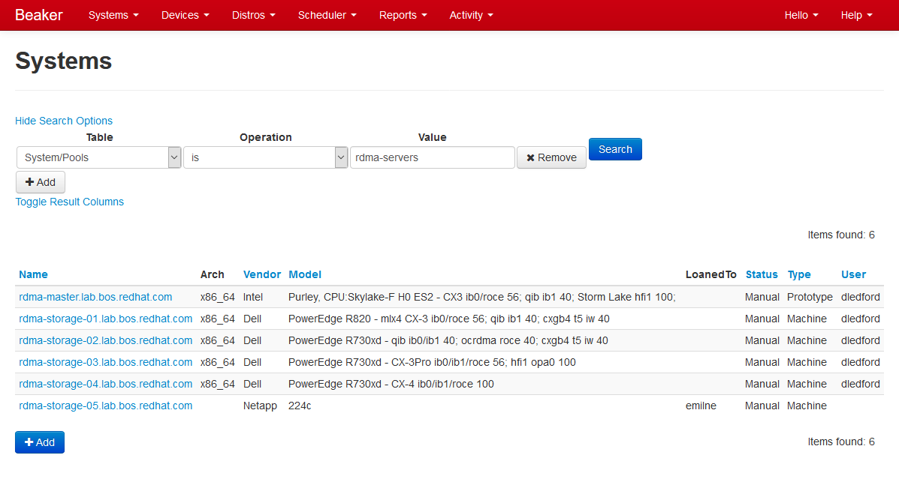
Beaker Web Interface – System Search

Slide 39
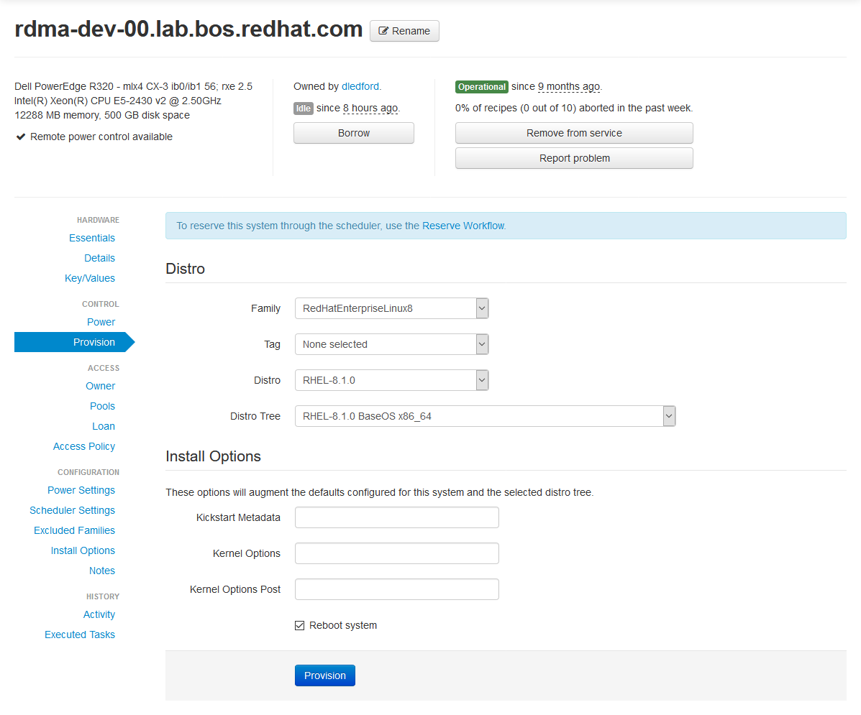
Beaker Web Interface – Provisioning

Slide 40
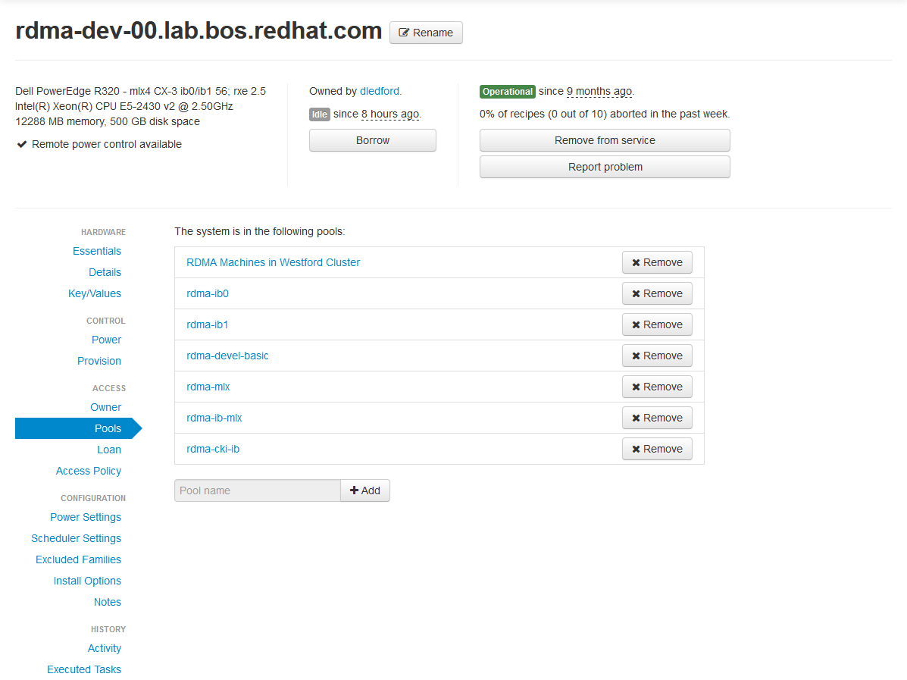
Beaker Web Interface – Pools

Slide 41
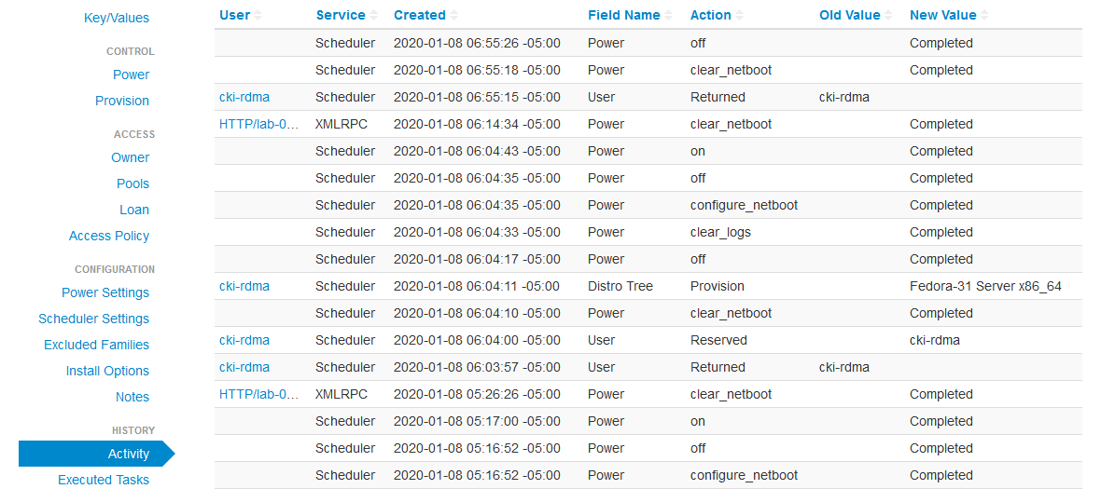
Beaker Web Interface – Activity

Slide 42
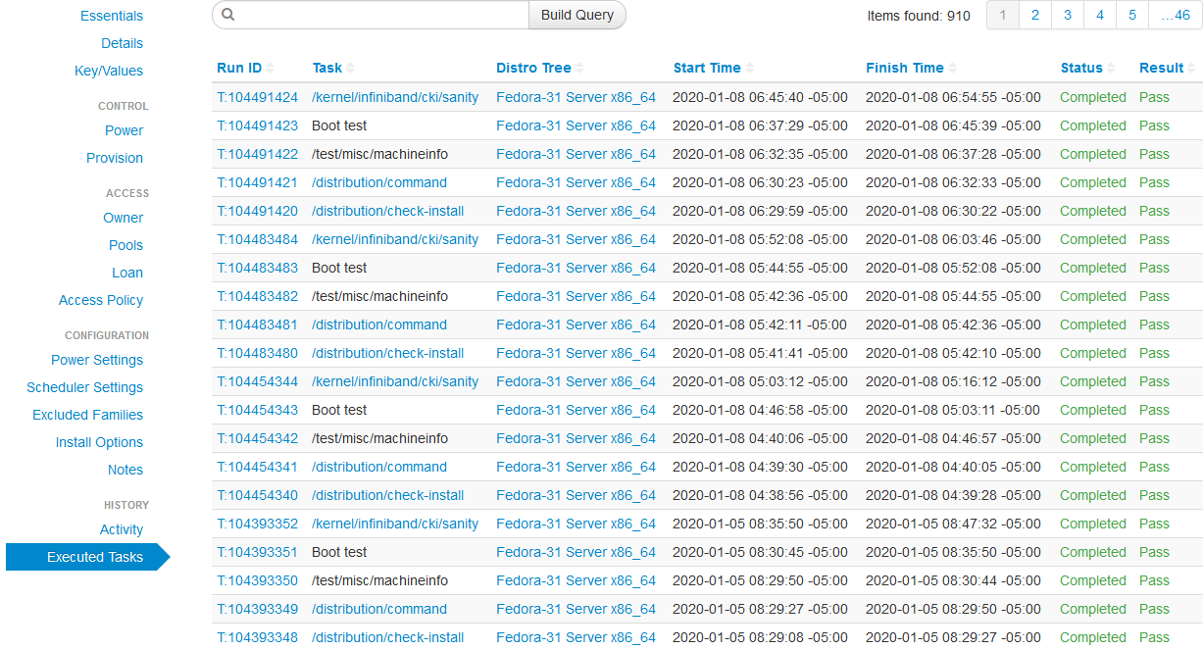
Beaker Web Interface – Executed Tasks

Slide 43
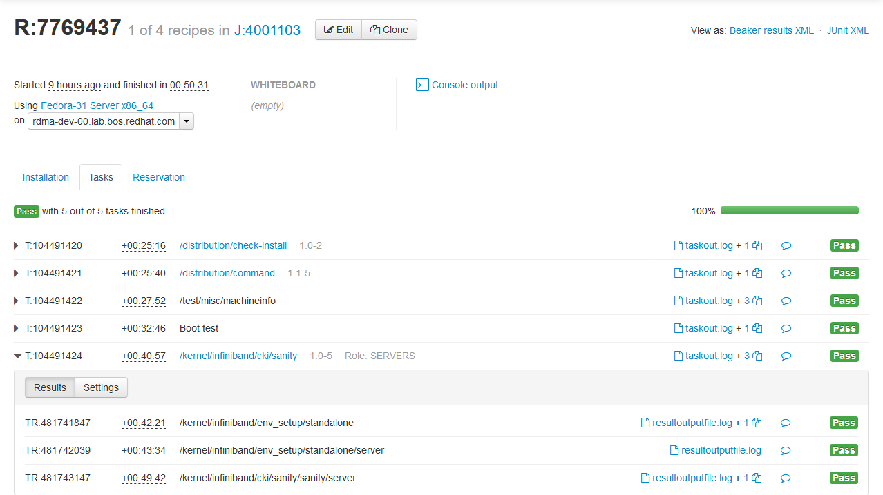
Beaker Web Interface – Job Log

Slide 44
Program objectives – high level
Driven by, and capable of testing, standard, commercially available, OS platforms
SuSE, Red Hat, Debian, Ubuntu, etc.
Capable of testing specialized OS platforms (with additional software)
OFED, MOFED, beta packages on top of the released OS platform code, upstream -rc releases, upstream final releases
Able to test user supplied software on any OS platform with or without OS updates
Adaptable to multiple different fabrics (see following slides on Scope)
Capable of testing interoperability across vendor hardware
Broadcom RoCE to Mellanox RoCE for example
Runs mostly in lights out mode
Able to automatically select machines to run tests on and install all necessary software for the test
Able to give the option of automated testing or manual testing once the machines are installed
Able to manually schedule all or a portion of the cluster for user checkout

