Slide 1
OFA Logo Program Developments
#OFADevWorkshop
Presented by Bob Noseworthy, Technical Sherpa
University of New Hampshire’s InterOperability Laboratory (UNH-IOL)

Slide 2
Outline
Evolution and Benefits of the OFA Logo Program
Overview
Recent updates
Using the OFA Logo List
Feedback needed:
Continued evolution
Virtualization, NVMe, IPv6, Increased Distro involvement
Additional ULPs of Interest
Next challenges

Slide 3
UNH-IOL / OFA
UNH-IOL:
Host of the OpenFabrics Interoperability Logo Group
>25 Years providing Interop/Conformance Test
2013: 12th Recipient of the IEEE-SA Corporate Award
Your Speaker: Bob Noseworthy
Technical Sherpa / Chief Engineer
18 Years in Ethernet conformance test
(10Mbps-100Gbps)
Expertise in IEEE 802.3, 802.1
Oversaw IOL’s brief iWARP Consortium

Slide 4
Today’s OFA Logo Program

Slide 5
OpenFabrics Interop Logo Group
OpenFabrics Interoperability Logo Group (OFILG)
Purpose: Validate OFED functionality, test ULPs and verify interoperability in a heterogeneous environment
Current Members:
Chelsio, DDN, Emulex, IBM, Intel, Mellanox and NetApp
Validating IB, RoCE and iWARP
Current Upper Layer Protocols Tested
Fabric Init, IPoIB, Link Init, NFSoRDMA, Open MPI, RDMA Utilities, RSockets, SM failover, SRP, uDAPL (& optional iSER and RDS)
OFA Logo Test Plan defined by OFA-IWG
driven by OFA member contribution

Slide 6
OFILG (2)
OFA Cluster hosted at UNH-IOL
Servers: iWARP 12 hosts, InfiniBand 18 hosts, RoCE 15 hosts
InfiniBand HW : 12 HCAs, 4 switches, 5 SRP targets, 1 gateway
iWARP HW: 9 RNICs, 1 switch
RoCE HW: 6 RCA, 1 switch
OFED versions Tested
1.5.x, 3.5.x, 3.12
PXE Boot environment available
Centos 6.x
Past Distros: RHEL 5.x and 6.x, SLES 11, Ubuntu 10.04 and 12.04
OFED 1.4.x, 1.5.x, 3.5.x, 3.12
Highly scripted test environment
January 2014 Logo Event Tests executed – approximately 8,049

Slide 7
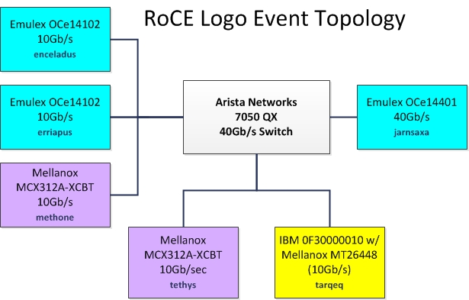
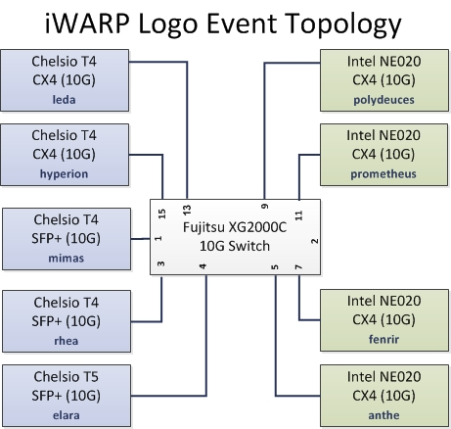
OFILG – Recent test topologies

Slide 8
OFA Logo Program (1/3)
iol.unh.edu/ofilp
P&P doc (Policy & Procedures)
What can be on the Logo List?

Slide 9
OFA Logo Program (2/3)
What can be on the Logo List? Additions of v1.16/v1.17 in bold
InfiniBand HCA
Ethernet R-NIC
RoCE Adapter (RCA)
InfiniBand Switch with Subnet Manager
InfiniBand Switch with no Subnet Manager
Ethernet Switches
Ethernet DCB & Fabric Switches
SRP Target/Server over InfiniBand
iSER Target/Server (over InfiniBand or iWARP or RoCE)
NFS-RDMA Client/Server (over InfiniBand or iWARP or RoCE)
Gateways (InfiniBand-to-Ethernet, InfiniBand-to-FibreChannel)

Slide 10
OFA Logo Program (3/3)
What can be on the Logo List? Additions of v1.16/v1.17 in bold
Server Systems using InfiniBand HCA and running OFA software
Server Systems using InfiniBand HCA and running non-OFA software
such as for Sun Solaris, Apple Mac, HPUX, IBM AIX and other operating systems
Server Systems using Ethernet R-NIC and running OFA software
Server Systems using Ethernet R-NIC and running non-OFA software
such as for Sun Solaris, Apple Mac, HPUX, IBM AIX and other operating systems
Server Systems using RoCE Adapters and running OFA software
Server Systems using RoCE Adapters and running non-OFA software
such as for Sun Solaris, Apple Mac, HPUX, IBM AIX and other operating systems

Slide 11
Recent additions - RoCE
First RCAs added May 2013
End stations tested
RCA providers
System providers
Anticipate return of iSER targets and additional system provider participation this year
Bridges / Ethernet Fabrics
More on this in upcoming slides

Slide 12
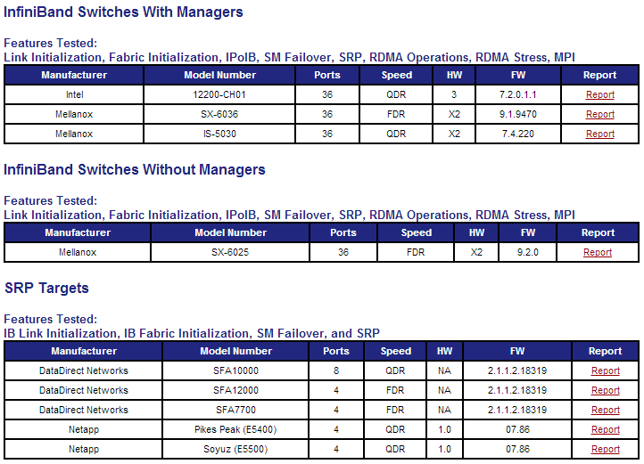
The OFA Logo List (iol.unh.edu/ofilglist)
Example
from
2014 list:

Slide 13
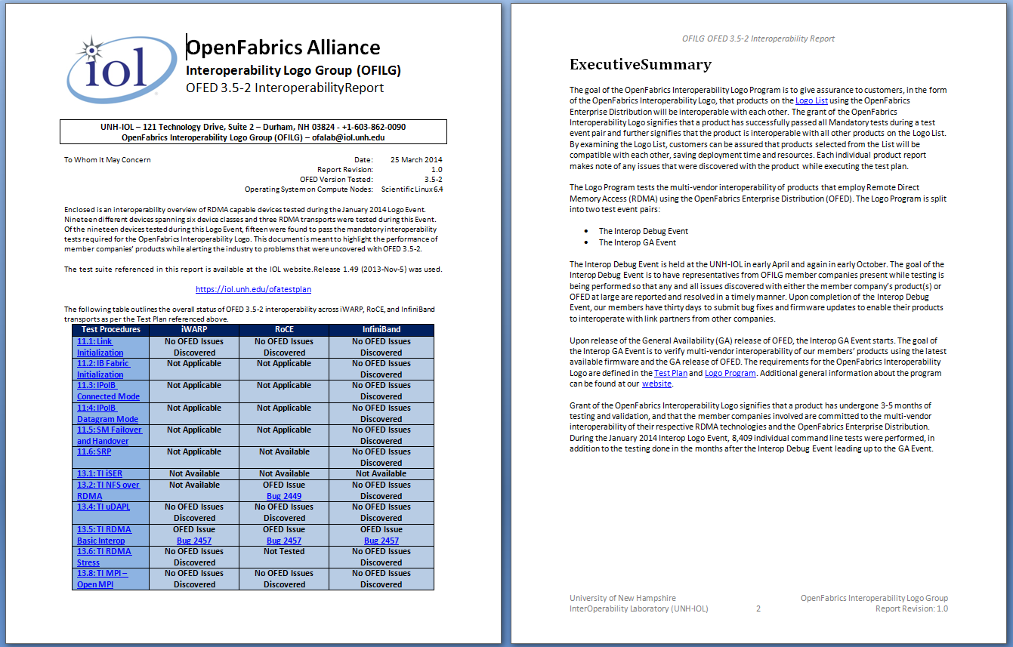
OFA Logo List Reports
http://iol.unh.edu/ofilglist
Most recent Logo List includes summary report of all testing

Slide 14
Using the OFA Logo List
How do you use it?
Do you also use the IBTA Integrator’s List?
For Cables?
For Equipment (HCAs, Switches)?
Is the product you are evaluating on the list?
What limits your usage?
Validation Depth?
Validation Breadth?
More ULPs covered, different Distros validated
Participating Vendors/Product variety?

Slide 15
Tomorrow’s OFA Logo Program?

Slide 16
Logo Program Next Steps
Input needed
Set priorities
End User Stories / Needs
Any OFA Member may participate in the OFA’s Interoperability Working Group (OFA-IWG):
e.g:
End Users;
Application Developers;
Purchasers and Evaluators;
share your needs and desires with the OFA-IWG
Only OFILG Members can receive logos for their products
The following slides are my speculation and are NOT active work within the OFA-IWG, if you support some of the ideas, please get involved !!!

Slide 17
RoCE Bridge Testing
Ethernet Bridges tested
None formally, yet play a critical role in CE
Emulex provided an Arista Networks 40GbE switch for current RoCE testing
Put the “Fabric” in Ethernet Fabric validation
Ethernet Fabrics are real
Congestion Avoidance (Data Center Bridging)
Well-beyond Multiple Spanning Tree
Proprietary examples: Qfabric, MLAG, FabricPath
Standards-based: IETF TRILL, IEEE SPB

Slide 18
Virtualization
Support for hardware pass-thru for RDMA
Which Hypervisor solutions?
Must be OFILG member driven
Which OSes within the VM
Again: OFILG member driven
Virtualization providers encouraged to directly participate in OFILG

Slide 19
Distro/OS provider Involvement
Today using Scientific Linux, or Centos
Distro/OSes tested in previous Interop events:
Canonical’s Ubuntu
Microsoft (WinOfed)
RedHat
SUSE
Distro/OS providers encouraged to directly participate in OFILG
Distro/OS choice is at the direction of OFILG and OFA-IWG members
(as is the entirety of the OFA Logo Test Plan)

Slide 20
Speed
IB at FDR / EDR
Ethernet at 40 / 100 Gbps
4x10Gbps or 10x10Gbps
Soon 4x25Gbps
Testing at Higher Speeds / lower latencies critical for validation of some ULPs
Requires
PCIe gen3 / gen4
Continuously challenging OFA test-cluster resources
Credit to AMD, HP, Intel for their contributions to the cluster over the years to support ever faster technologies.

Slide 21
Speed begets Performance
Should OFA Logo Program expand to include Performance requirements?
Discussed at length during formation process
Currently Logo Program validates functionality and interoperability, but does not restrict based on performance
The Market is currently left to make that determination
Should a “minimum bar” be set for some of the validation
e.g: A fixed number or some percentage below a moving average of performance numbers from past events

Slide 22
NVMe
Further pushing the envelop of speed
UNH-IOL NVMe Consortium
Working in concert with the NVM Express Organization
Integrator’s List
https://www.iol.unh.edu/services/testing/NVMe/integratorslist.php
Validation of storage protocols / solutions at NVMe speeds
eg: EMC XtremeIO, Fusion-IO, DDN Storage Fusion Xcelerator (SFX) solutions, etc.

Slide 23
IPv6
UNH-IOL IPv6 Consortium / IPv6 Forum
IPv6 Ready Logo List
https://www.iol.unh.edu/services/testing/ipv6/logoholders.php
USGv6 Certification
https://www.iol.unh.edu/services/testing/ipv6/usgv6tested.php
Not done today:
Validation of IPv6 connectivity in an RDMA OFED environment
IPoIB
IPoCE
iWARP-o-v6 ?

Slide 24
Still more growth options
Scalability
Today, only functional testing is done (homogeneously and heterogeneously)
Improved Fail-Over validation
HCA to HCA Failover / RCA-to-RCA Failover
requested via OFA RDMA Programming & System Admin Classes
Additional ULPs
Lustre
Or…?
Contribute your ideas to the OFA-IWG discussion

Slide 25
Interop vs Conformance
OFILG focus:
Interoperability validation of OFED and ULPs with underlying RDMA transports
Conformance validation is currently not required to participate in the logo testing.

Slide 26
Interop v Conformance (2)
 | Interop | Conformance | Logo / I.L./Cert. | Notes
IB | OFA | IBTA | OFA Logo, IBTA I.L.
iWARP | OFA | None | OFA Logo | Past UNH-IOL Conformance test
RoCE | OFA | None | OFA Logo | Future IBTA I.L. ?
DCB | UNH-IOL | UNH-IOL | None | OFA Logo:Add subset?
TRILL | UNH-IOL | UNH-IOL | None | OFA Logo:Add subset?
SPB | UNH-IOL | UNH-IOL | None
IPv6 | UNH-IOL | UNH-IOL | IPv6 Ready / USGv6 | OFA Logo:Add subset?
NVMe | UNH-IOL | UNH-IOL | UNH-IOL I.L. | OFA Logo:Add subset?
PCIe | UNH-IOL | PCI-SIG/ UNH | PCI-SIG Workshops
40/100GE | UNH-IOL | UNH-IOL | None
Cables (IB) | None | IBTA | IBTA I.L.
Cables (10-100GE) | UNH-IOL | UNH-IOL | None

Slide 27
Next Steps: Much to discuss
Far more to consider than this brief presentation and discussion can touch on
Continue the discussion with the:
Open Fabrics Interoperability Working Group
(OFA-IWG)
Survey
https://docs.google.com/forms/d/1qwGuWe4rsFvYM6nyJVwa4q12_bWDiLlfRFi3p0EGV_w/viewform
Same link as above: http://tinyurl.com/2014OFADev

Slide 28
How to get involved…
OFA Interoperability Working Group (IWG)
Every other Tuesday, 1pm ET
Tuesday, April 08, 2014, 10:00 AM US Pacific Time 916-356-2663, 8-356-2663, Bridge: 1, Passcode: 7004471
Join the OFA-IWG Mailing List
https://www.openfabrics.org/index.php/working-groups/wg-mail-subscription.html?view=form
Links:
OFA Interop Program Overview:
https://www.openfabrics.org/index.php/ofedofaw.html
https://www.openfabrics.org/images/docs/LinkedDocs/UNH_IOL_OFA_11-11_MR_FINAL.pdf
OFA Logo List: http://iol.unh.edu/ofilglist
OFA Logo Program: http://iol.unh.edu/ofilp
OFA Test Plan: http://iol.unh.edu/ofatestplan

Slide 29
Thank You
Contact:
Bob Noseworthy (ren@iol.unh.edu)
UNH-IOL OFA Group (ofalab@iol.unh.edu)

Slide 30
And in other news: Training
Next OFA Training courses @ UNH-IOL
May 19-20th: Writing Application Programs for RDMA using OFA Software
https://www.openfabrics.org/index.php/resources/training/training-offerings.html
May 21-22rd : Infiniband Fabric Administration
https://www.openfabrics.org/index.php/resources/training/infiniband-fabric-administration.html
On-site training can also be arranged
please contact Rupert Dance at rsdance@soft-forge.com

